Slide 1
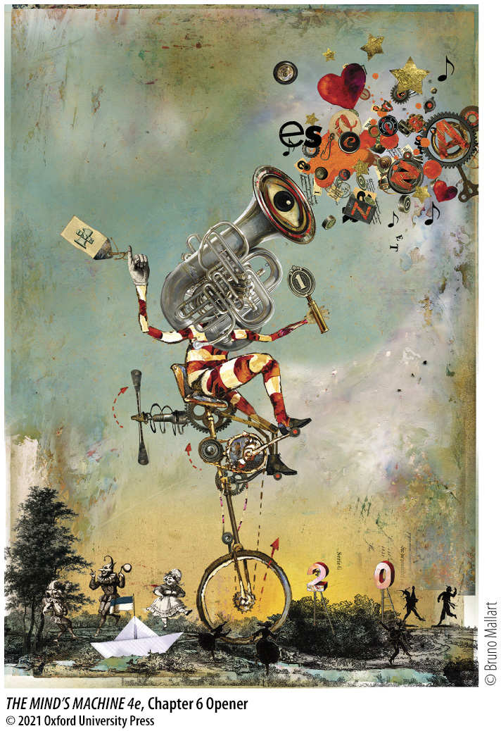
Chapter 6 Opener
Notes:
Chapter 6 Opener

Slide 2
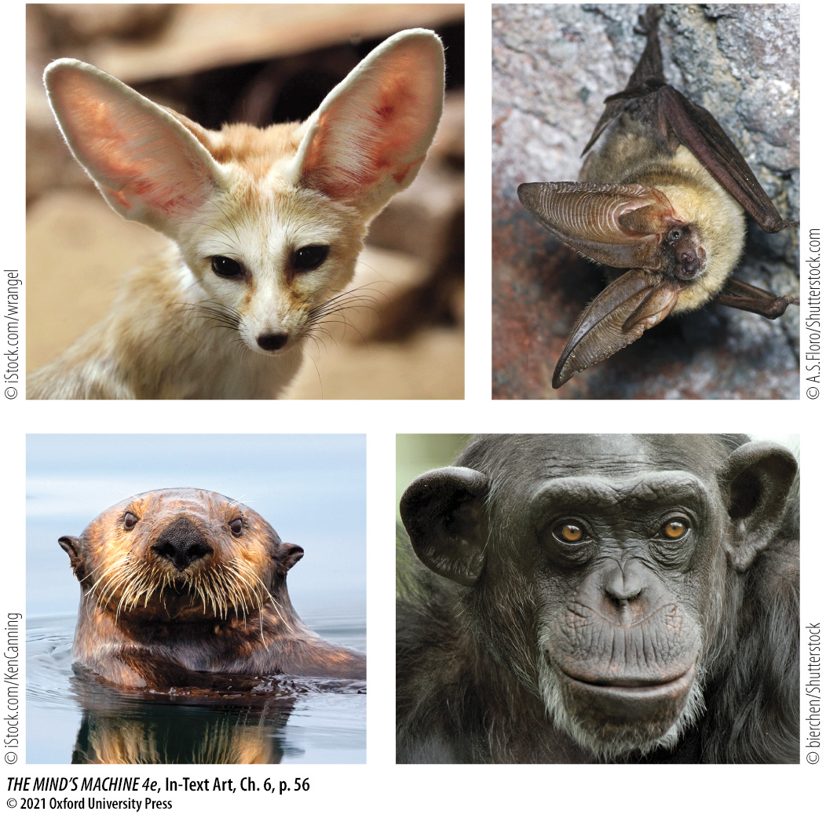
In-Text Art, Ch. 6, p. 56
Notes:
The Ears Have it
The external ears, or pinnae, of mammals come in a variety of shapes, each adapted to a particular ecological niche. Many mammals can move their ears to direct them toward a particular sound. In such cases, the brain must account for the position of the ear to judge where a particular sound came from. (Fennec fox [top left]; whispering bat [top right]; chimpanzee [bottom left]; sea otter [bottom right].)

Slide 3
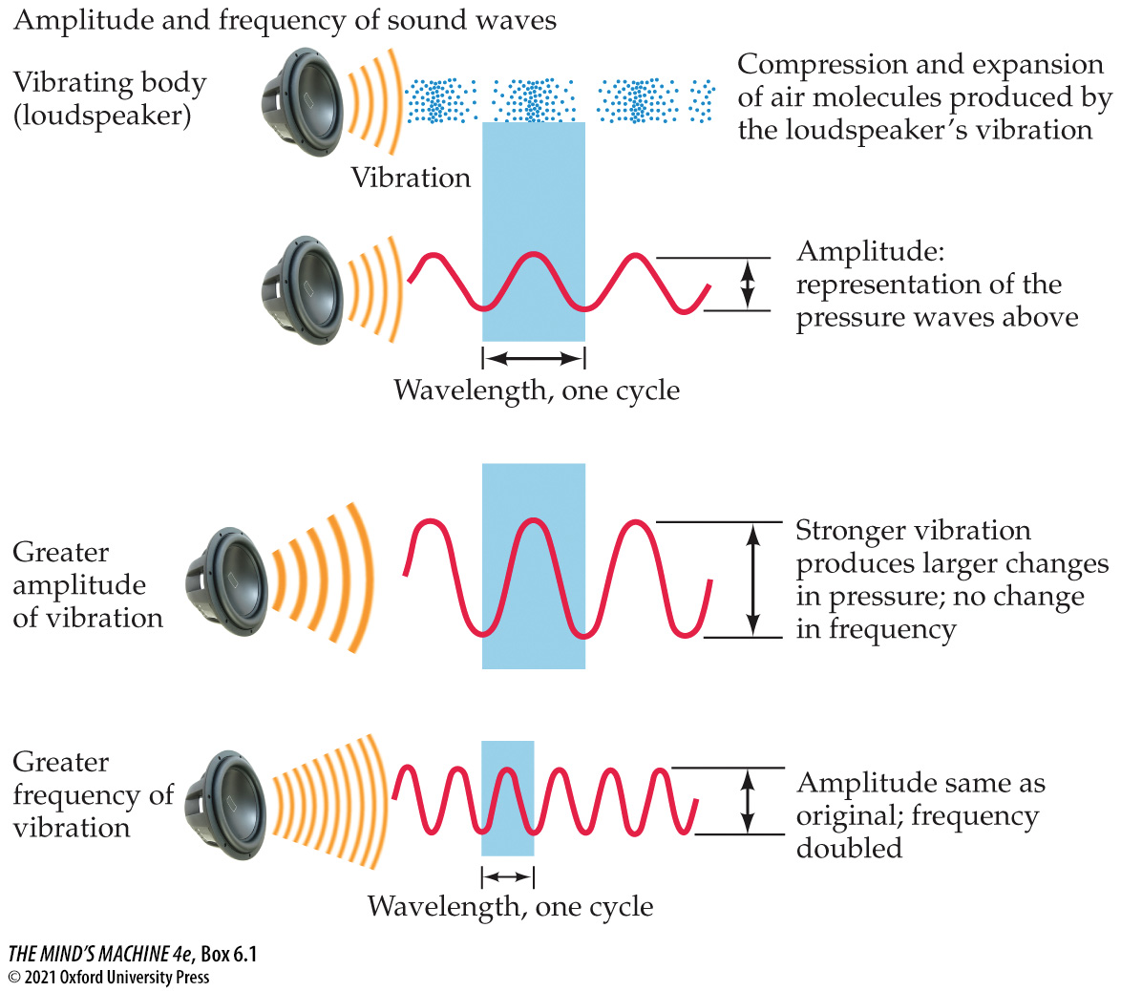
BOX 6.1 The Basics of Sound
Notes:
BOX 6.1 The Basics of Sound

Slide 4
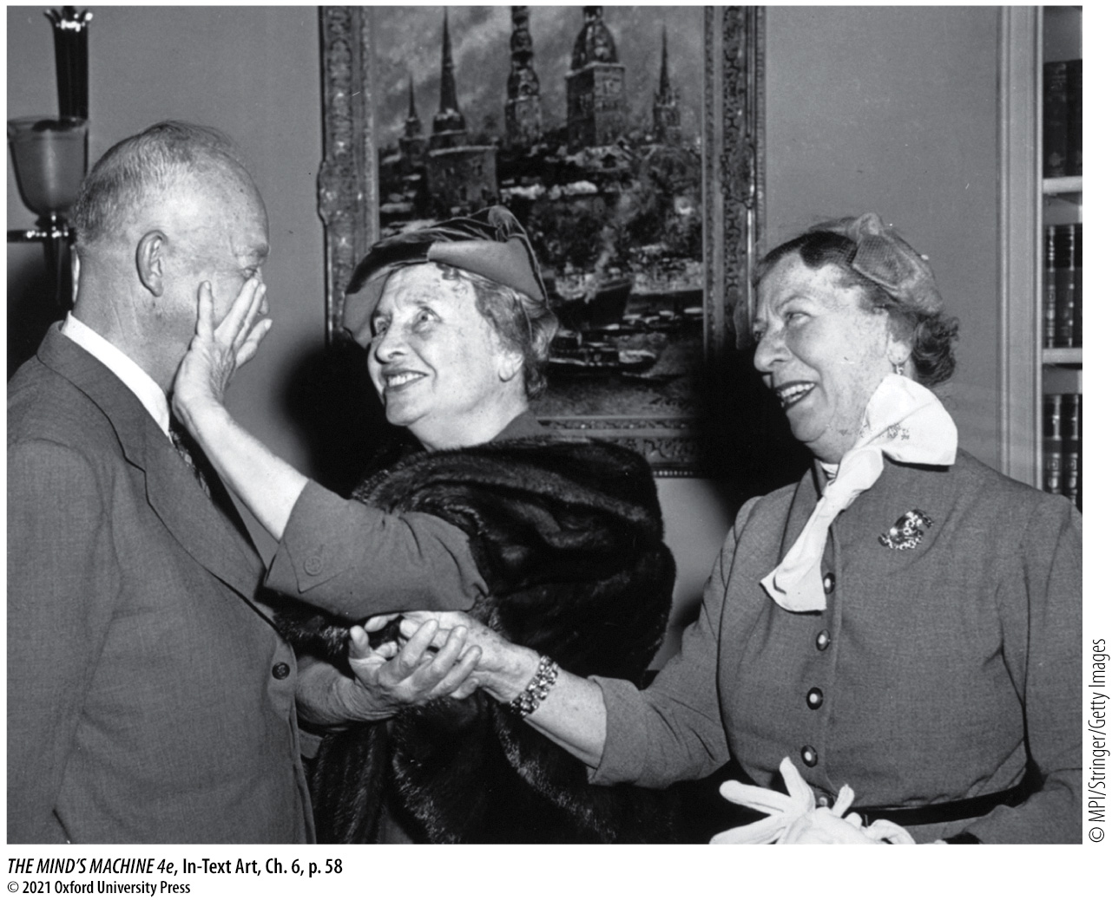
In-Text Art, Ch. 6, p. 58
Notes:
A Touching Moment
Helen Keller, who was both blind and deaf, said, “Blindness deprives you of contact with things; deafness deprives you of contact with people”—a poignant reminder of the importance of speech for our social lives. Here, Keller (center, accompanied by her aide and interpreter, Polly Thompson) communicates with U.S. President Dwight Eisenhower by feeling Eisenhower’s face as he speaks and makes facial expressions. Rather than living in sensory and social isolation, Keller honed her intact senses to such a degree that she was able to become a noted teacher and writer.

Slide 5
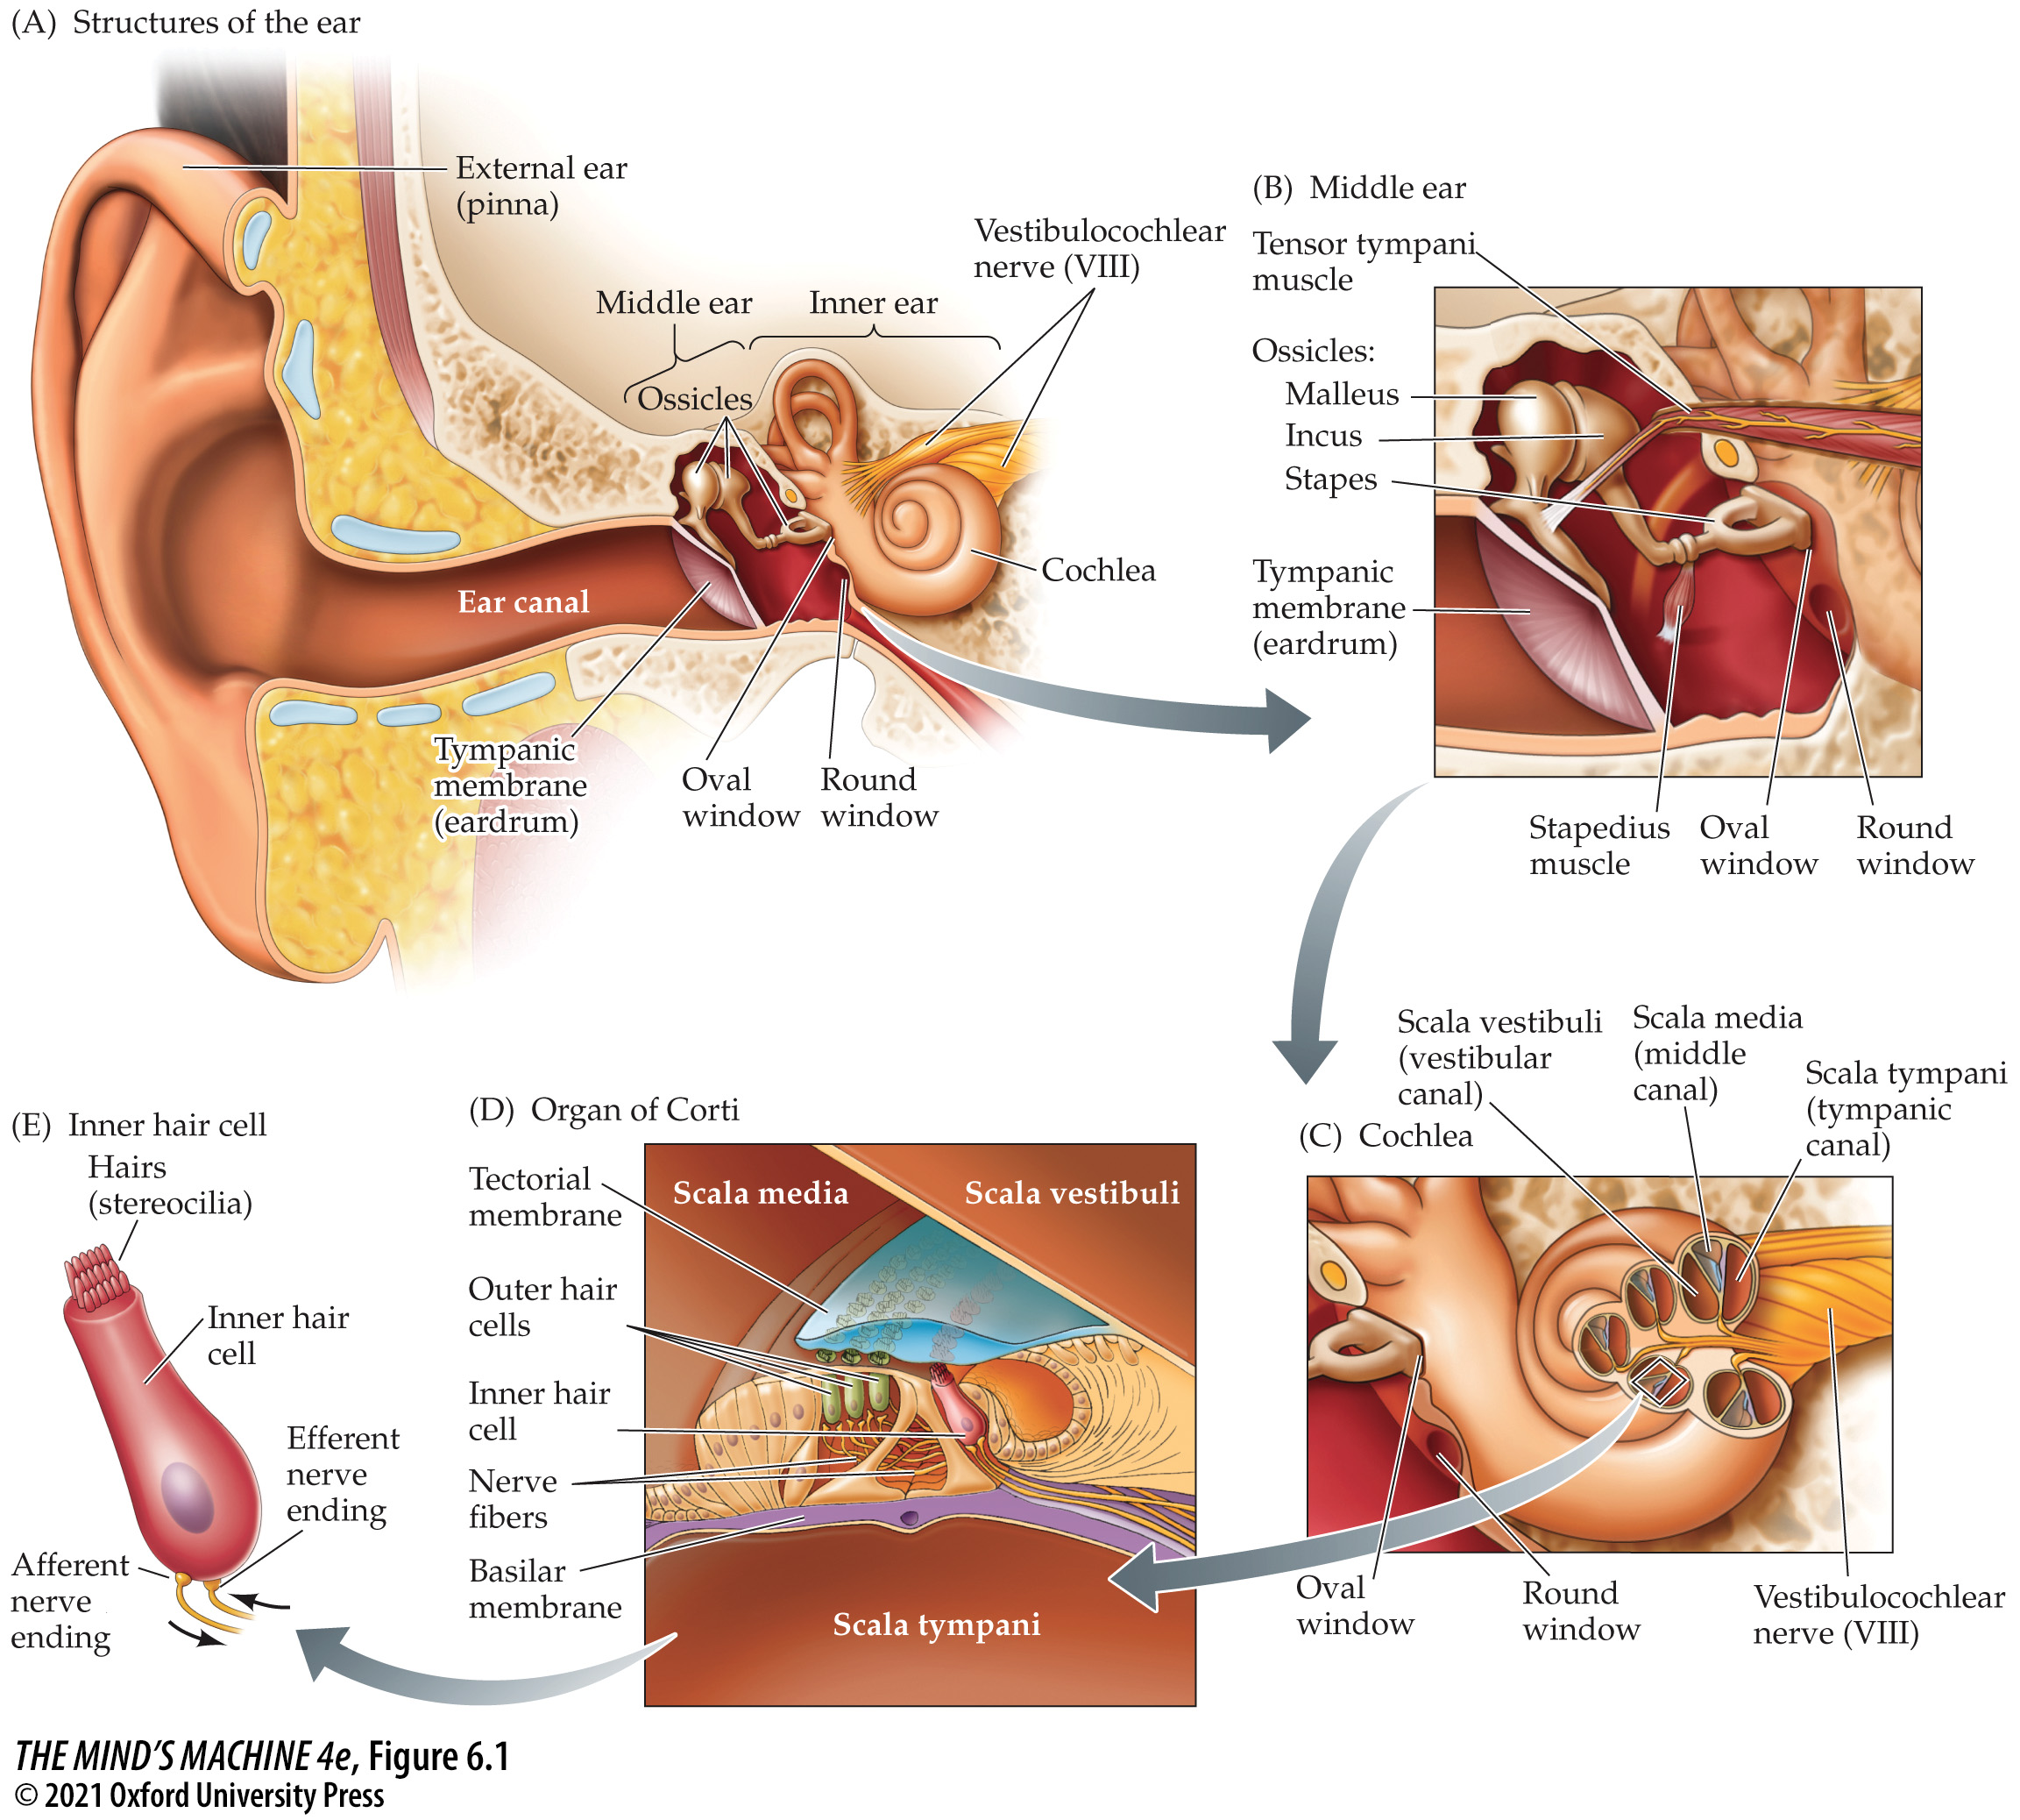
FIGURE 6.1 External and Internal Structures of the Human Ear
Notes:
FIGURE 6.1 External and Internal Structures of the Human Ear

Slide 6
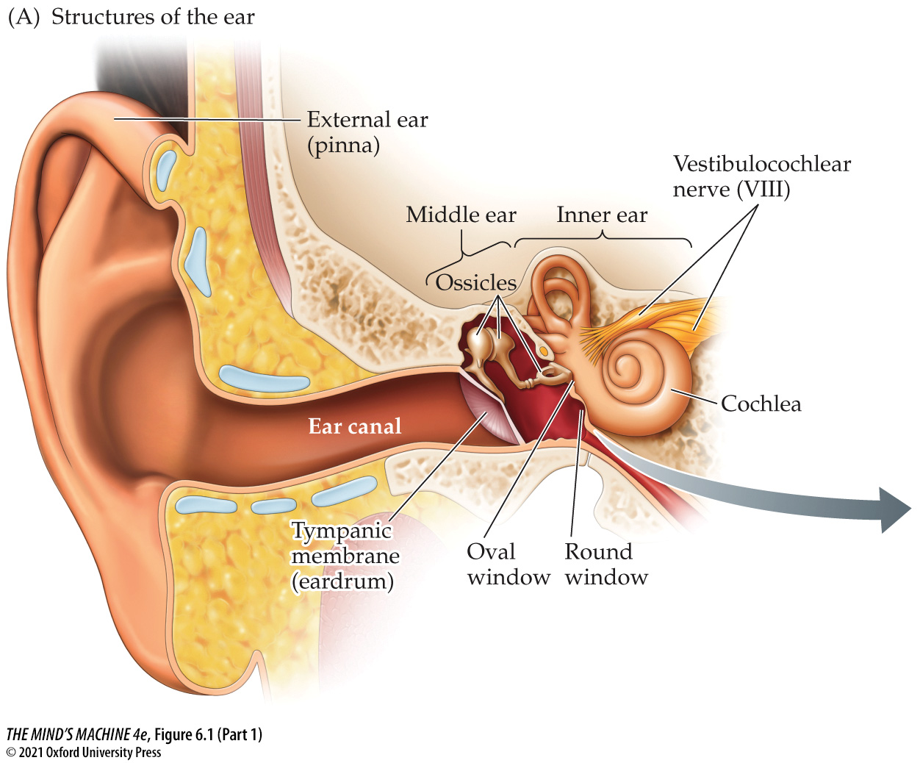
FIGURE 6.1 External and Internal Structures of the Human Ear (Part 1)
Notes:
FIGURE 6.1 External and Internal Structures of the Human Ear

Slide 7
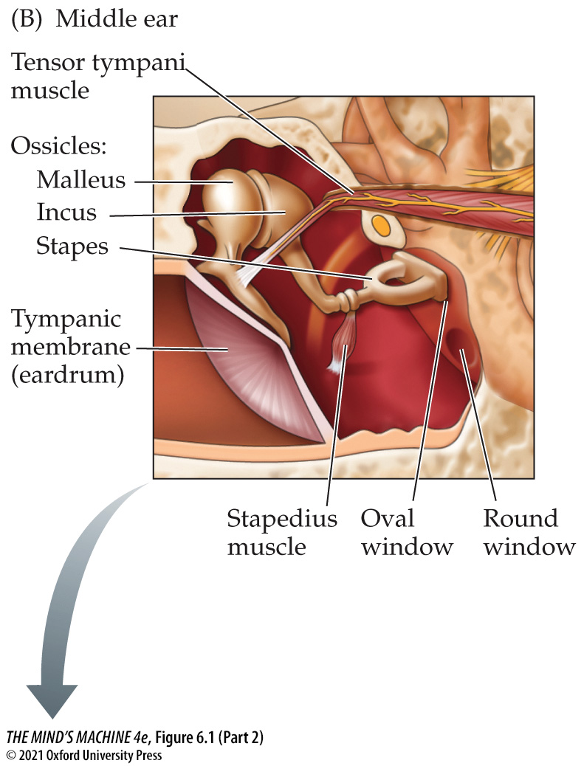
FIGURE 6.1 External and Internal Structures of the Human Ear (Part 2)
Notes:
FIGURE 6.1 External and Internal Structures of the Human Ear

Slide 8
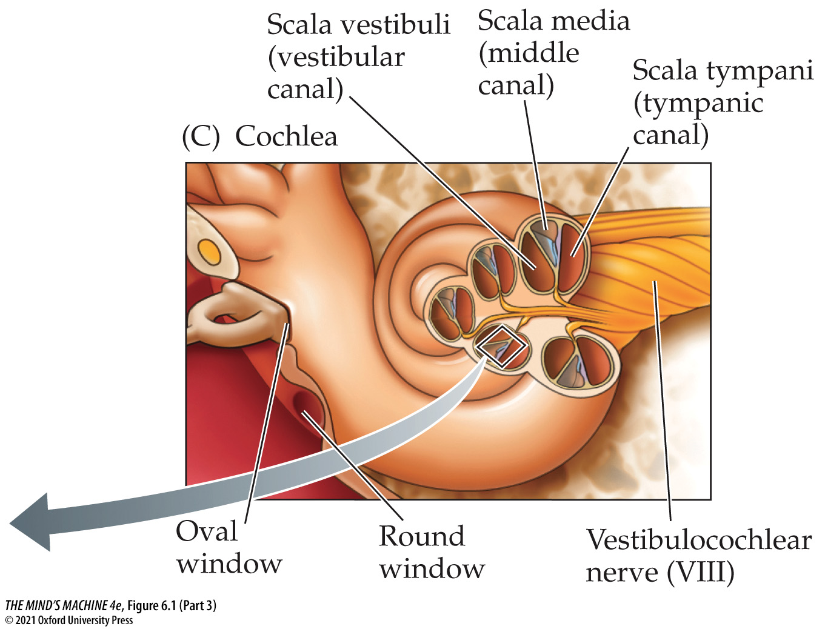
FIGURE 6.1 External and Internal Structures of the Human Ear (Part 3)
Notes:
FIGURE 6.1 External and Internal Structures of the Human Ear

Slide 9
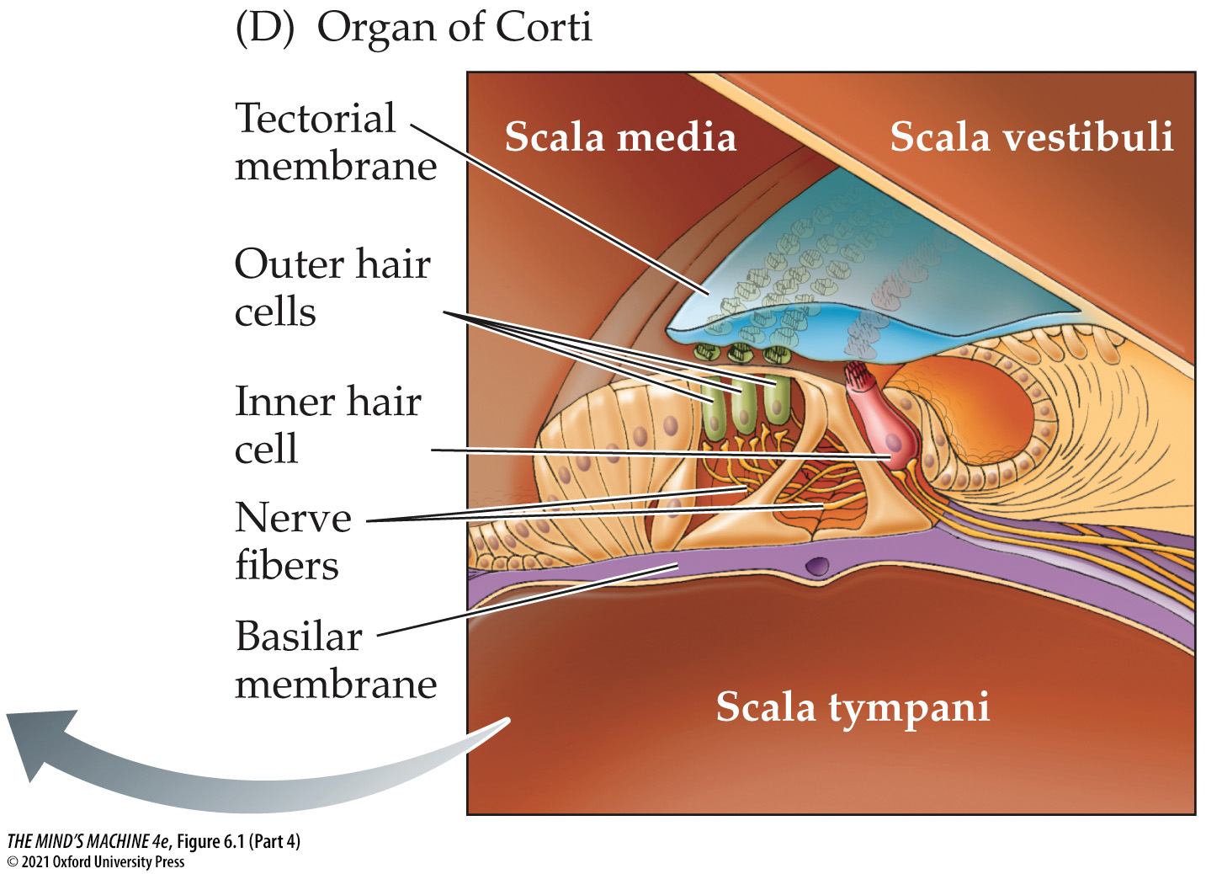
FIGURE 6.1 External and Internal Structures of the Human Ear (Part 4)
Notes:
FIGURE 6.1 External and Internal Structures of the Human Ear

Slide 10
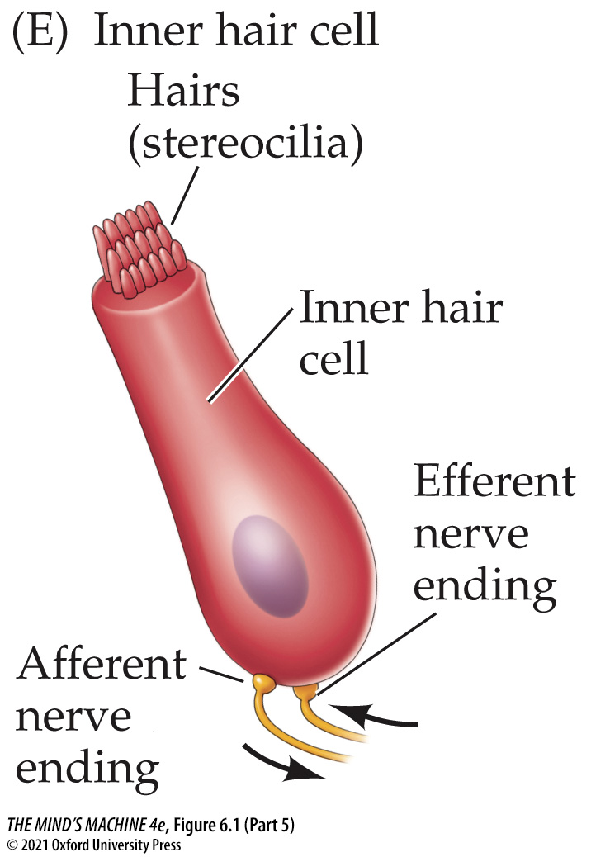
FIGURE 6.1 External and Internal Structures of the Human Ear (Part 5)
Notes:
FIGURE 6.1 External and Internal Structures of the Human Ear

Slide 11
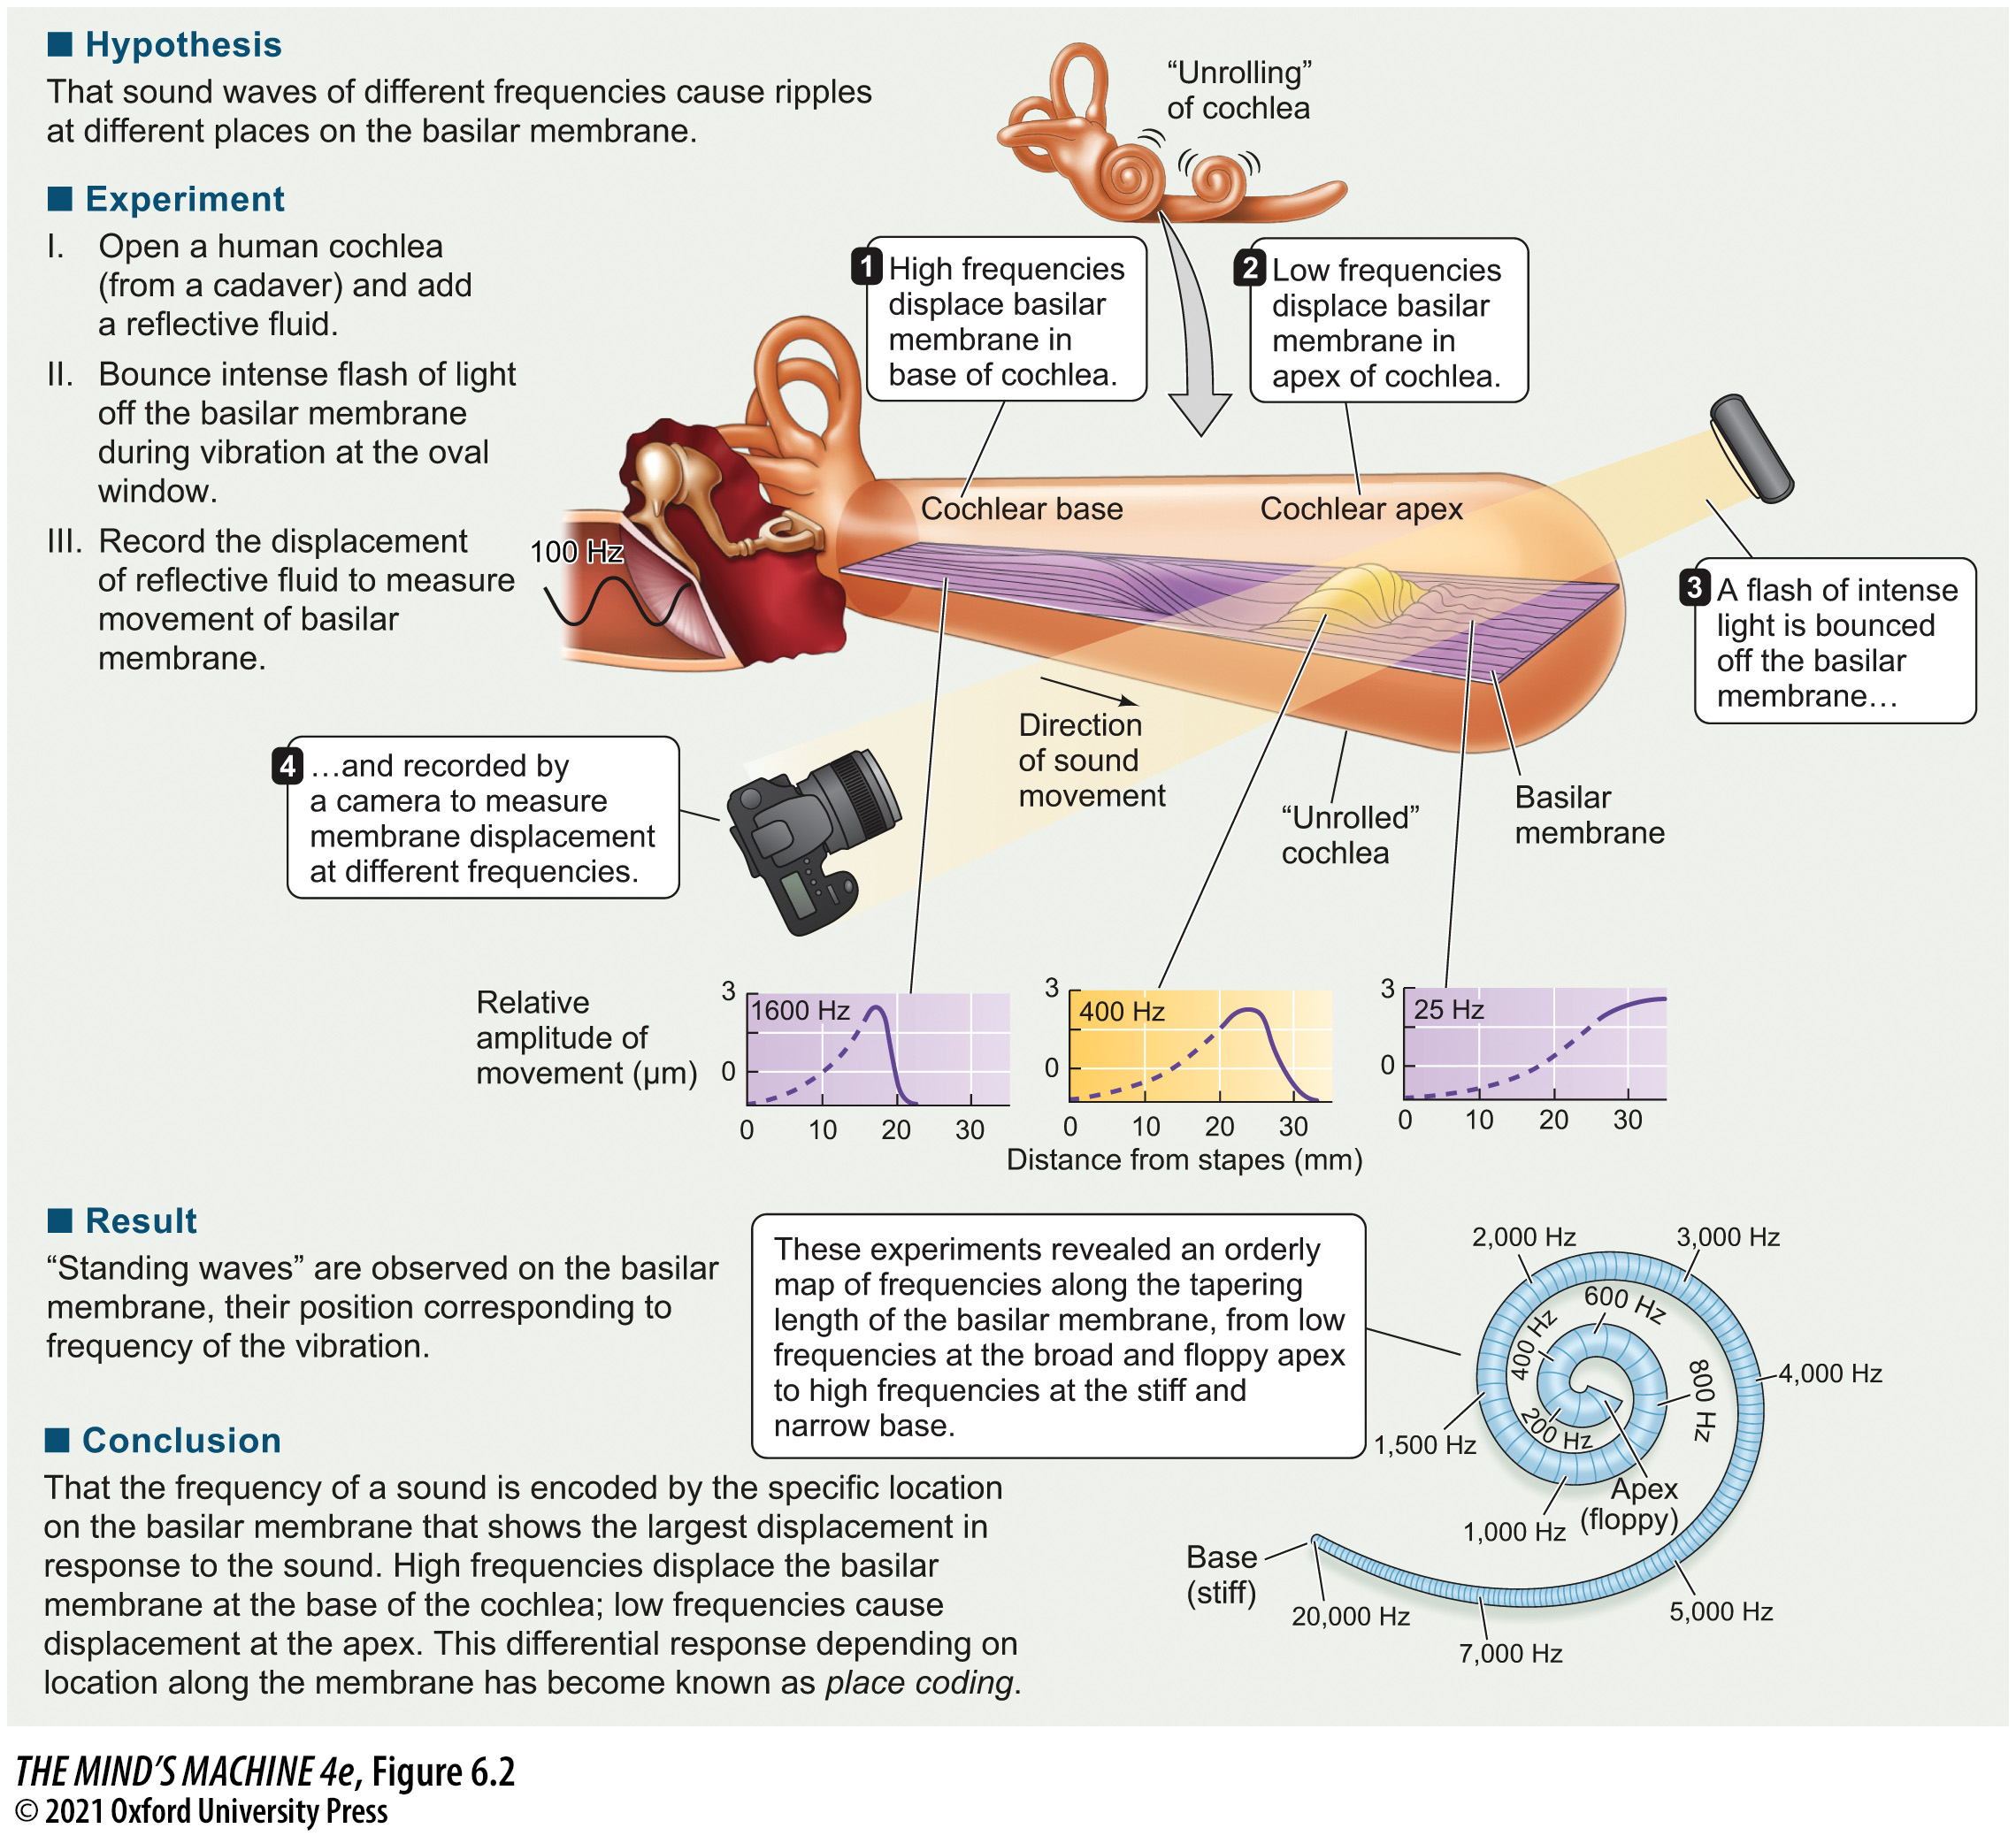
FIGURE 6.2 Deformation of the Basilar Membrane Encodes Sound Frequencies (1)
Notes:
FIGURE 6.2 Deformation of the Basilar Membrane Encodes Sound Frequencies

Slide 12
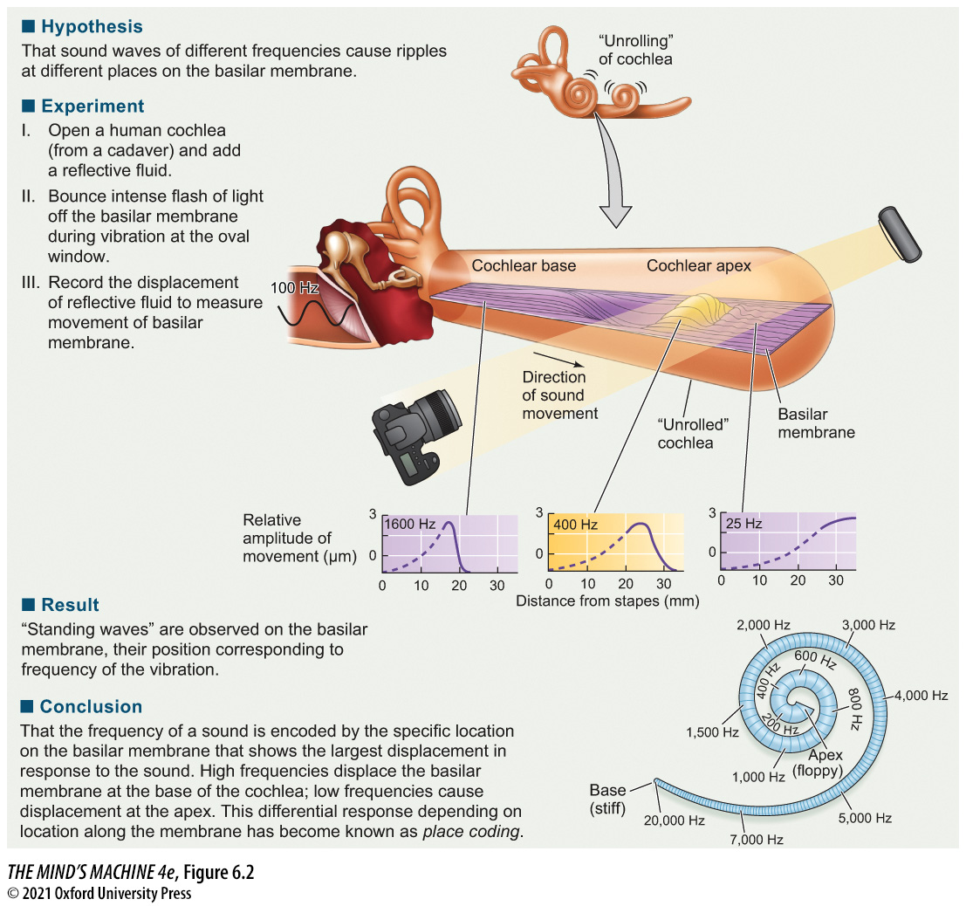
FIGURE 6.2 Deformation of the Basilar Membrane Encodes Sound Frequencies (2)
Notes:
FIGURE 6.2 Deformation of the Basilar Membrane Encodes Sound Frequencies

Slide 13
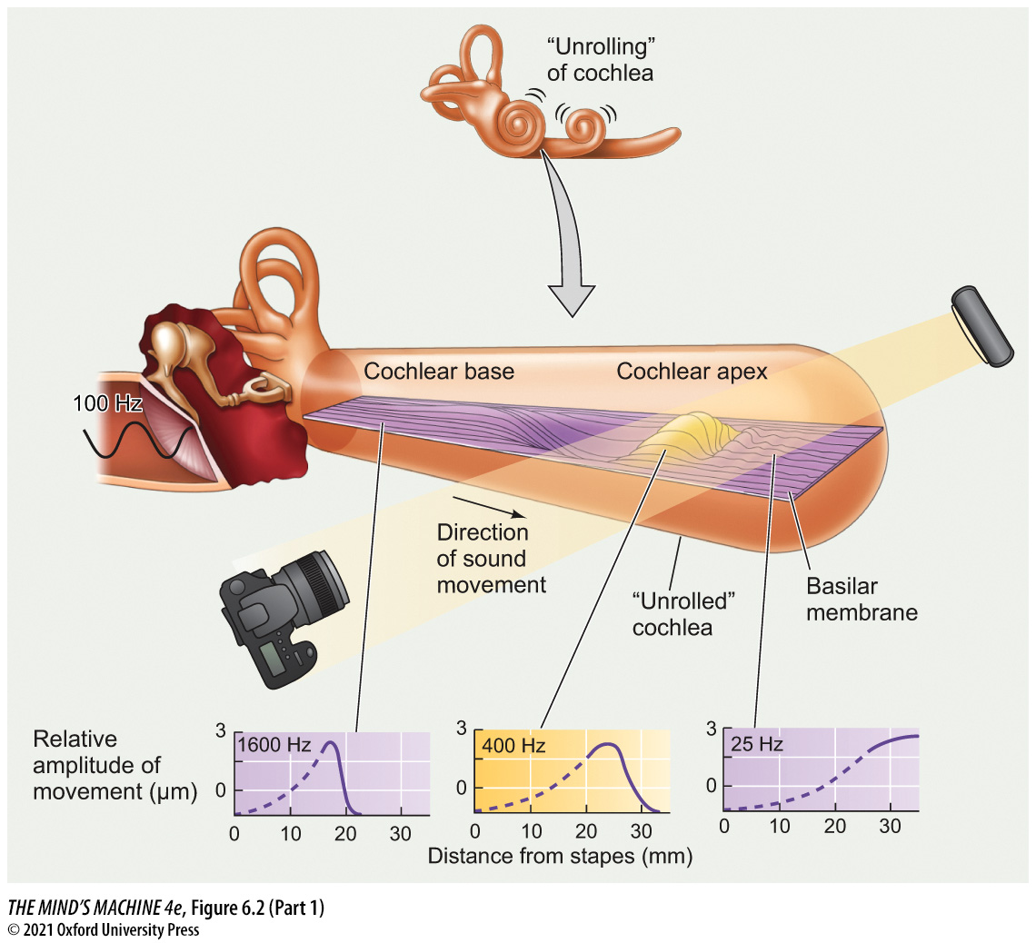
FIGURE 6.2 Deformation of the Basilar Membrane Encodes Sound Frequencies (Part 1)
Notes:
FIGURE 6.2 Deformation of the Basilar Membrane Encodes Sound Frequencies

Slide 14
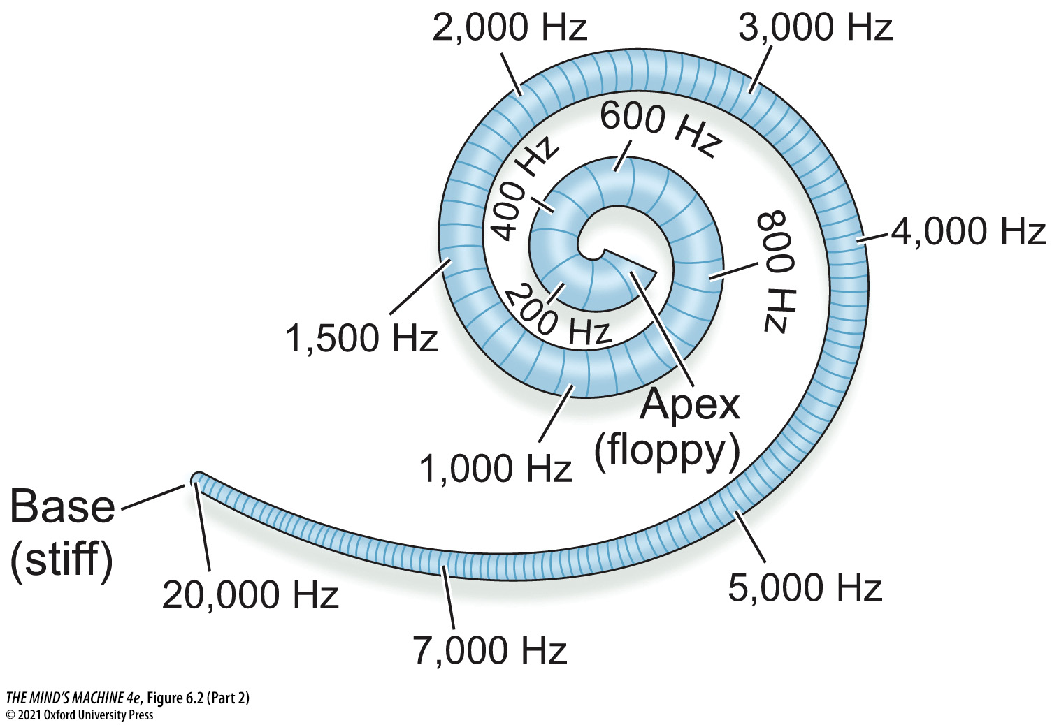
FIGURE 6.2 Deformation of the Basilar Membrane Encodes Sound Frequencies (Part 2)
Notes:
FIGURE 6.2 Deformation of the Basilar Membrane Encodes Sound Frequencies

Slide 15
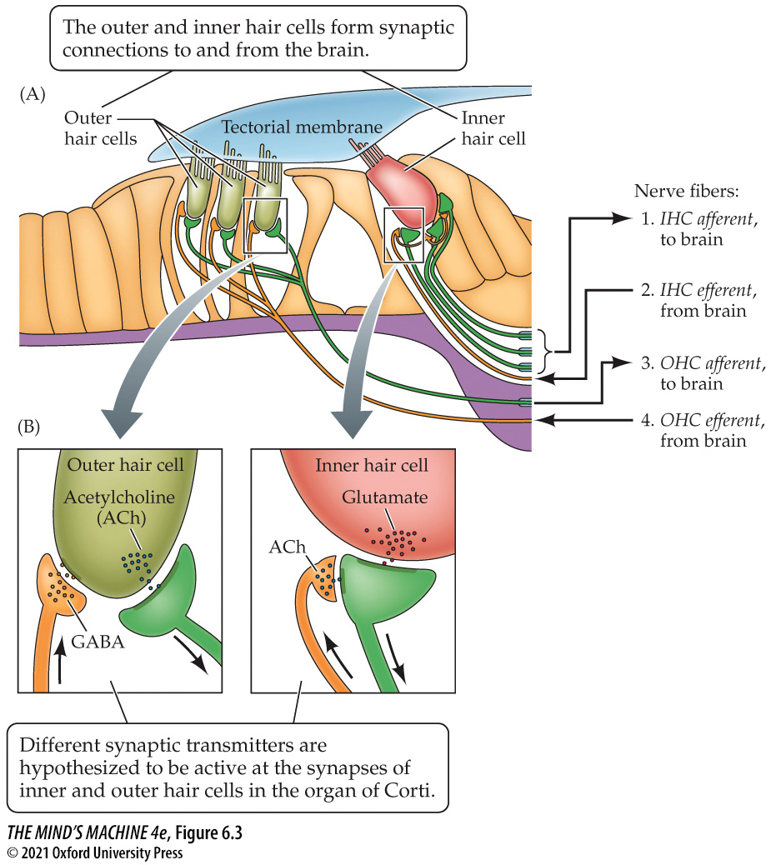
FIGURE 6.3 Auditory Nerve Fibers and Synapses in the Organ of Corti (1)
Notes:
FIGURE 6.3 Auditory Nerve Fibers and Synapses in the Organ of Corti

Slide 16
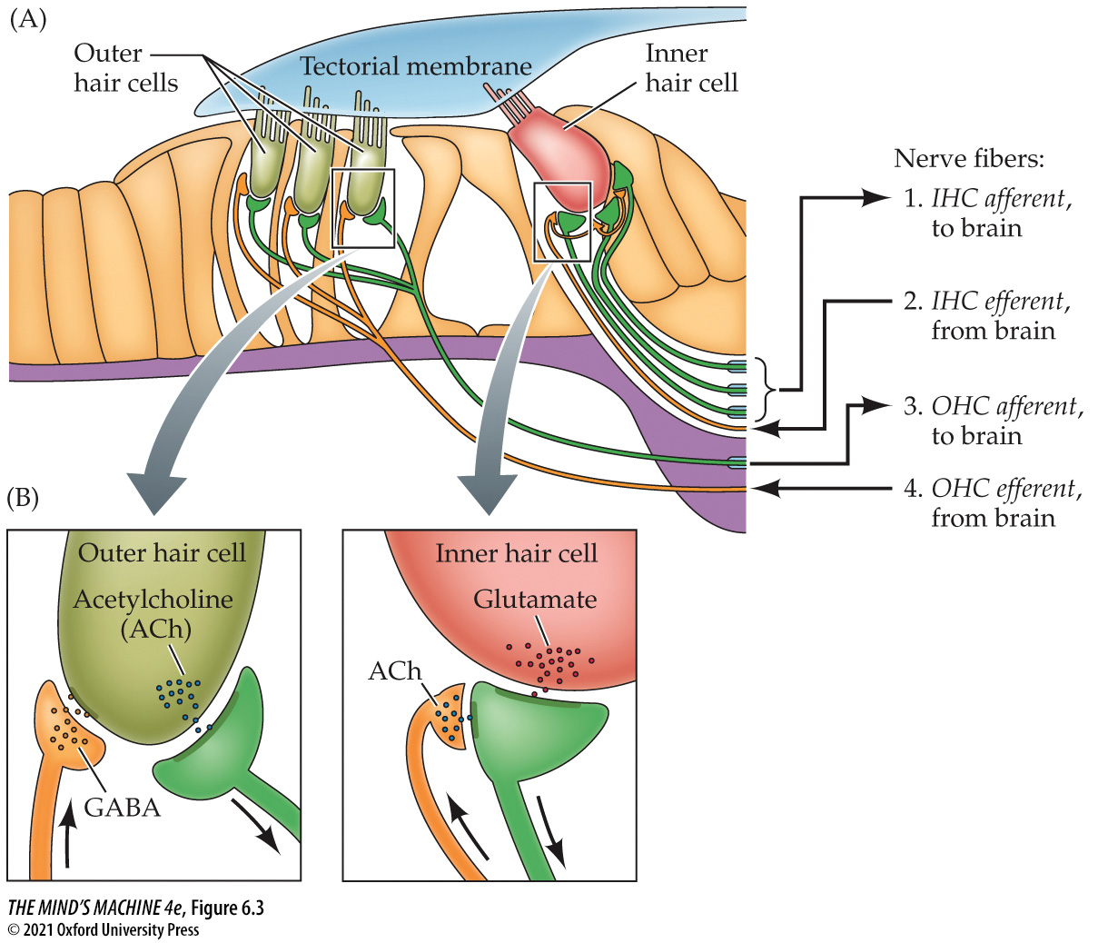
FIGURE 6.3 Auditory Nerve Fibers and Synapses in the Organ of Corti (2)
Notes:
FIGURE 6.3 Auditory Nerve Fibers and Synapses in the Organ of Corti

Slide 17
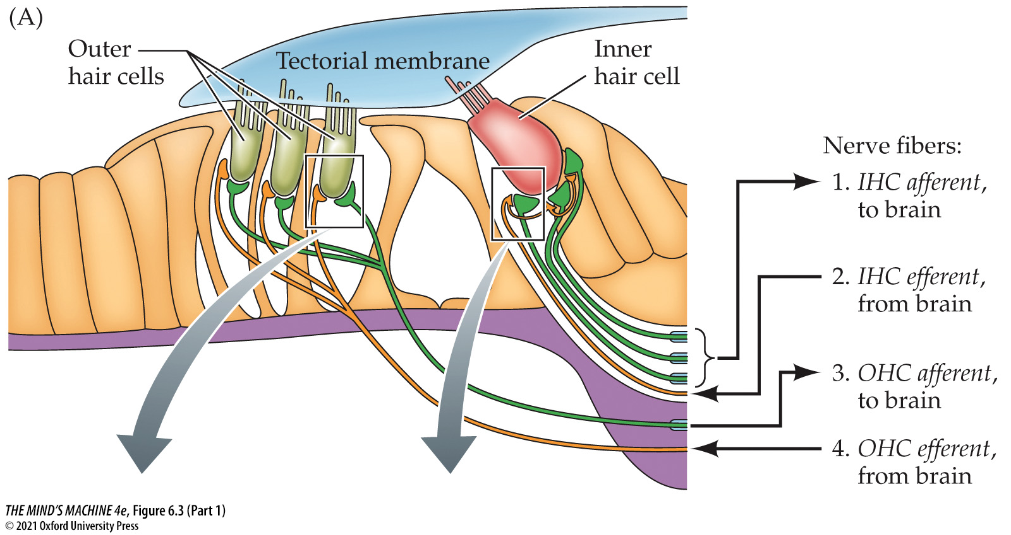
FIGURE 6.3 Auditory Nerve Fibers and Synapses in the Organ of Corti (Part 1)
Notes:
FIGURE 6.3 Auditory Nerve Fibers and Synapses in the Organ of Corti

Slide 18
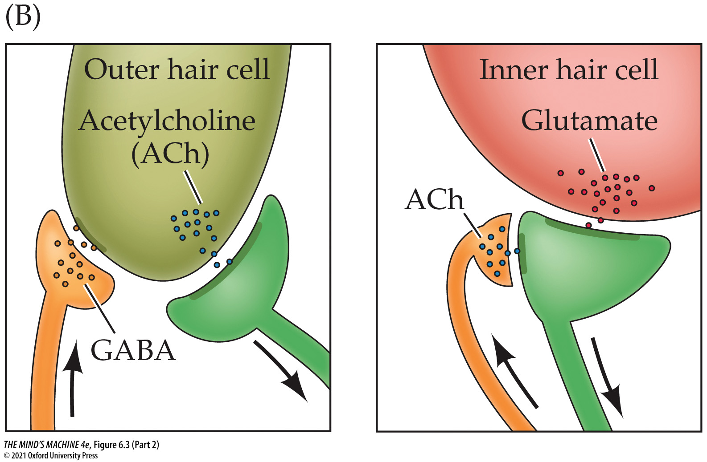
FIGURE 6.3 Auditory Nerve Fibers and Synapses in the Organ of Corti (Part 2)
Notes:
FIGURE 6.3 Auditory Nerve Fibers and Synapses in the Organ of Corti

Slide 19
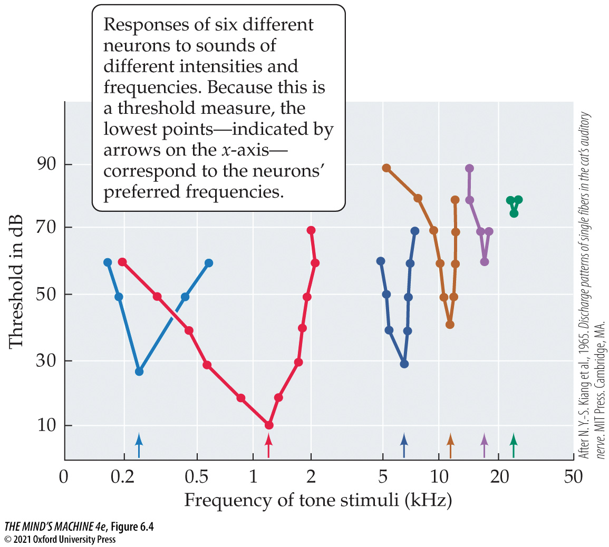
FIGURE 6.4 Tuning Curves of Auditory Nerve Cells (1)
Notes:
FIGURE 6.4 Tuning Curves of Auditory Nerve Cells (After N. Y.-S. Kiang et al., 1965. Discharge patterns of single fibers in the cat’s auditory nerve. MIT Press. Cambridge, MA.)

Slide 20
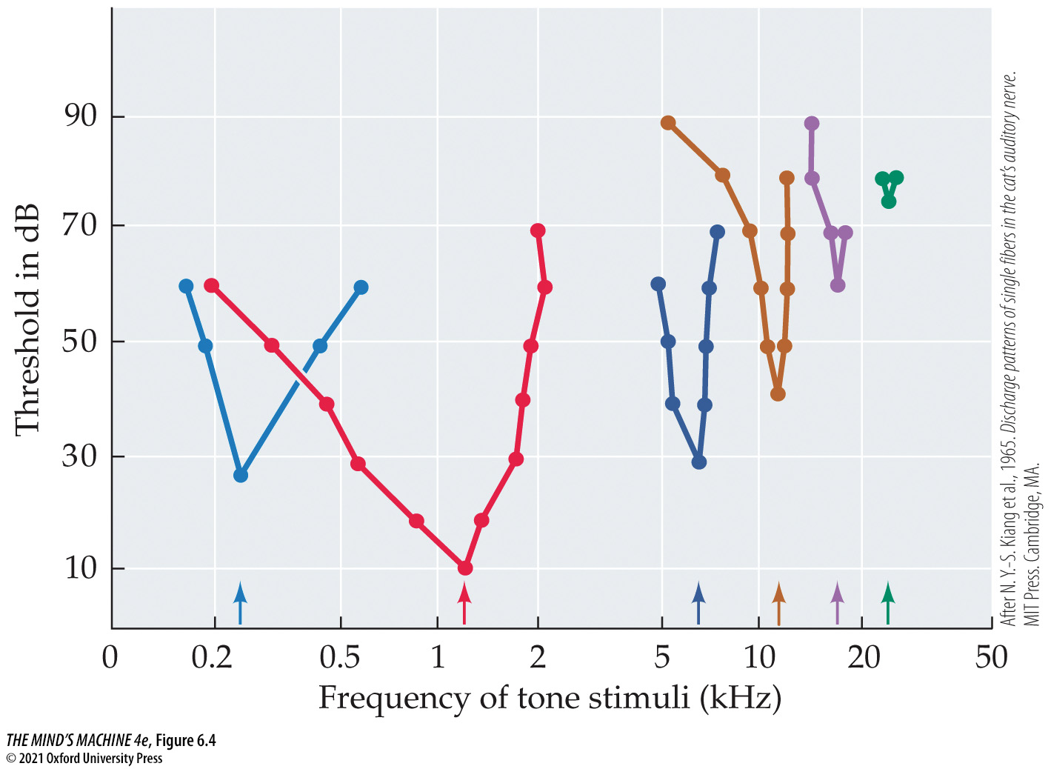
FIGURE 6.4 Tuning Curves of Auditory Nerve Cells (2)
Notes:
FIGURE 6.4 Tuning Curves of Auditory Nerve Cells (After N. Y.-S. Kiang et al., 1965. Discharge patterns of single fibers in the cat’s auditory nerve. MIT Press. Cambridge, MA.)

Slide 21
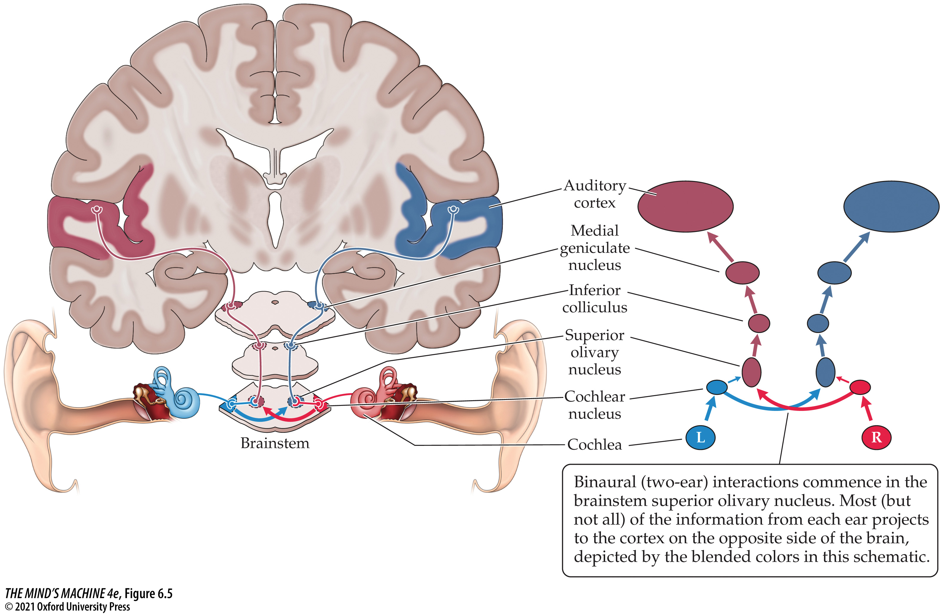
FIGURE 6.5 Auditory Pathways of the Human Brain (1)
Notes:
FIGURE 6.5 Auditory Pathways of the Human Brain

Slide 22
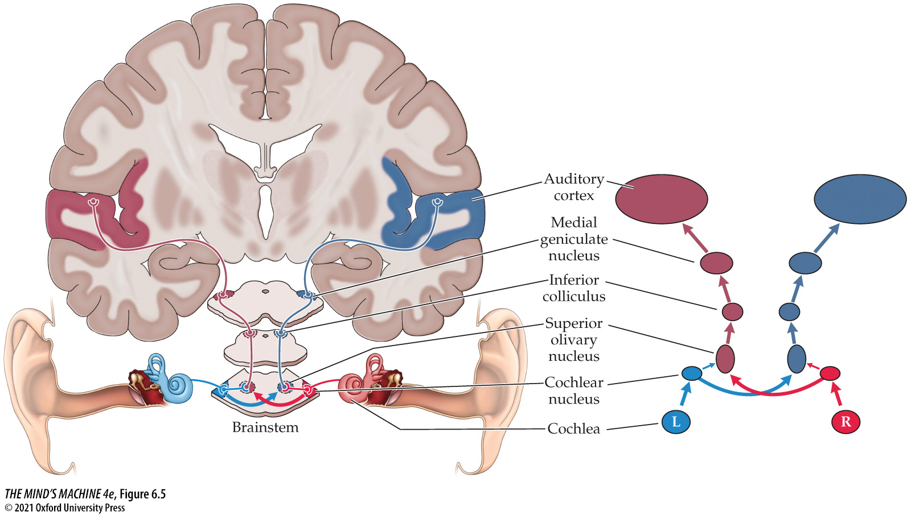
FIGURE 6.5 Auditory Pathways of the Human Brain (2)
Notes:
FIGURE 6.5 Auditory Pathways of the Human Brain

Slide 23
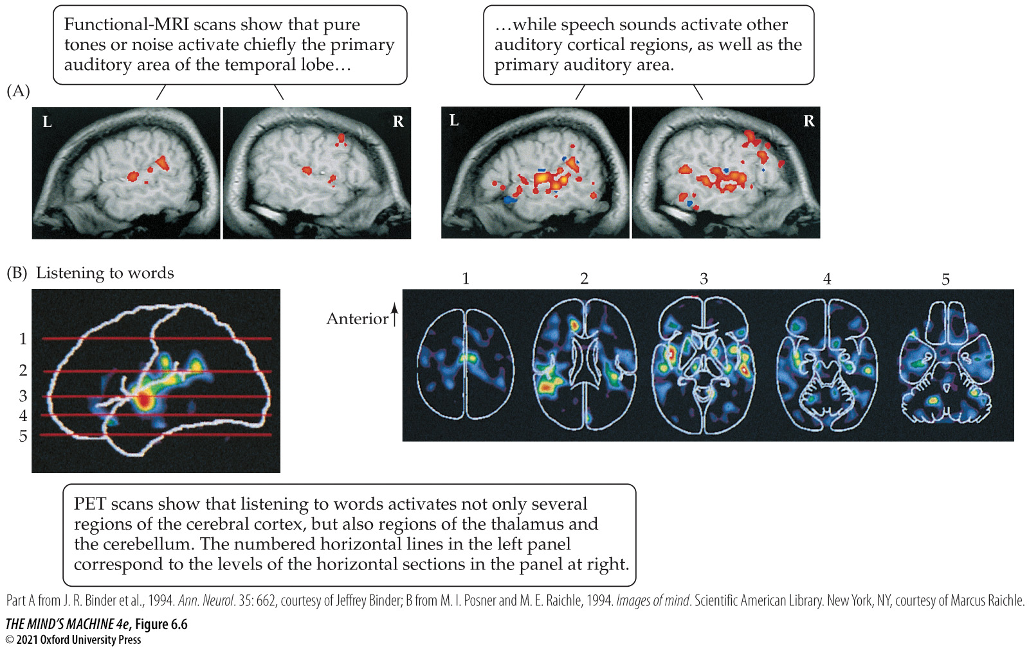
FIGURE 6.6 Responses of the Human Auditory Cortex to Random Sounds versus Speech (1)
Notes:
FIGURE 6.6 Responses of the Human Auditory Cortex to Random Sounds versus Speech

Slide 24
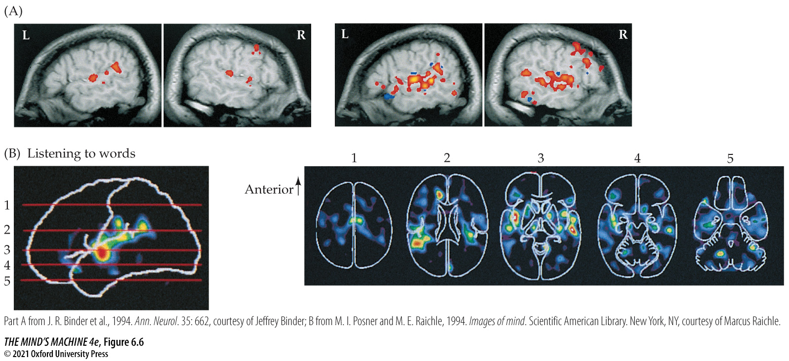
FIGURE 6.6 Responses of the Human Auditory Cortex to Random Sounds versus Speech (2)
Notes:
FIGURE 6.6 Responses of the Human Auditory Cortex to Random Sounds versus Speech

Slide 25
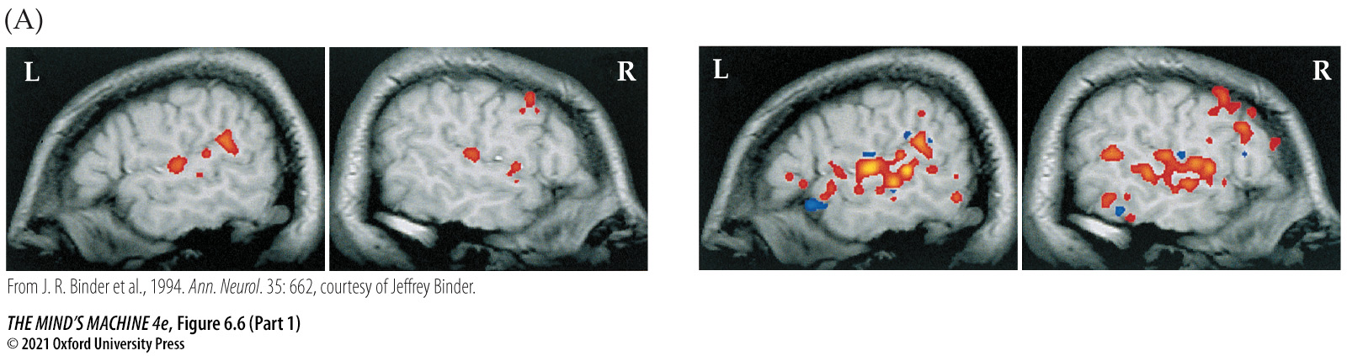
FIGURE 6.6 Responses of the Human Auditory Cortex to Random Sounds versus Speech (Part 1)
Notes:
FIGURE 6.6 Responses of the Human Auditory Cortex to Random Sounds versus Speech

Slide 26
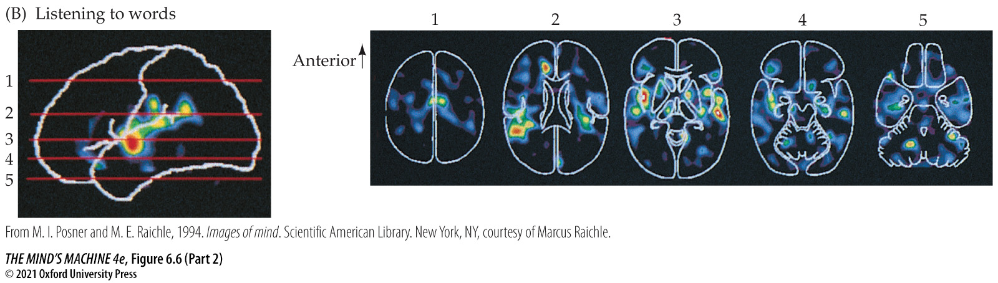
FIGURE 6.6 Responses of the Human Auditory Cortex to Random Sounds versus Speech (Part 2)
Notes:
FIGURE 6.6 Responses of the Human Auditory Cortex to Random Sounds versus Speech

Slide 27
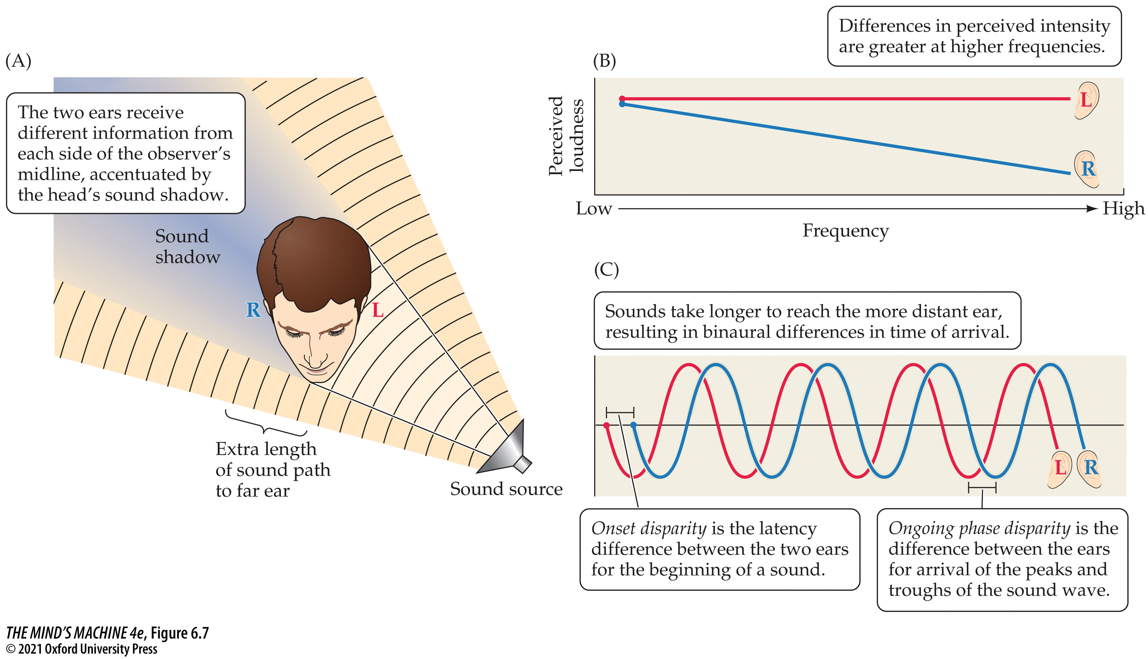
FIGURE 6.7 Cues for Binaural Hearing (1)
Notes:
FIGURE 6.7 Cues for Binaural Hearing

Slide 28
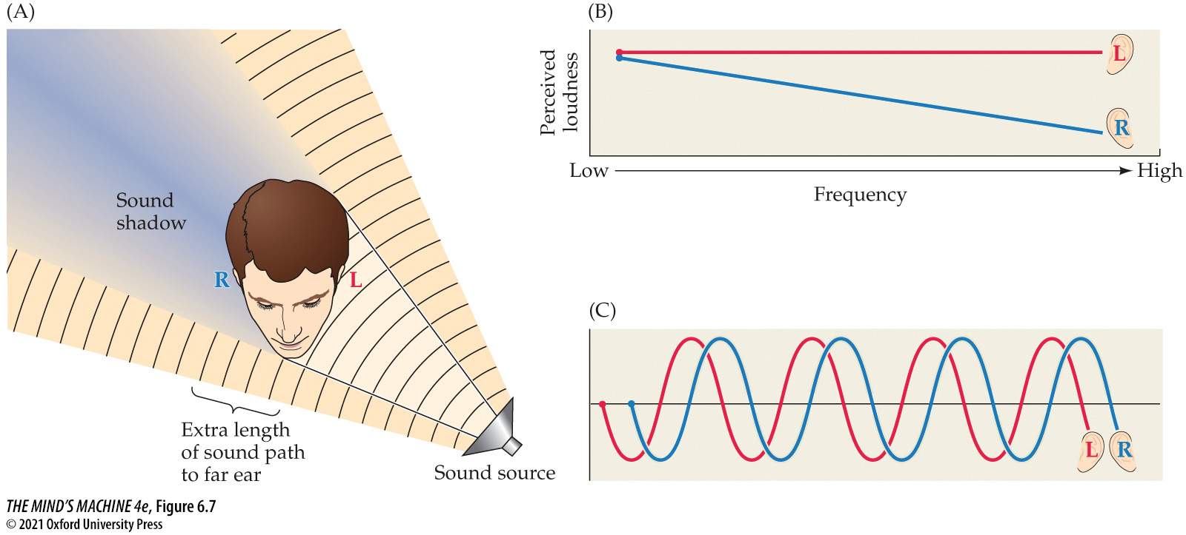
FIGURE 6.7 Cues for Binaural Hearing (2)
Notes:
FIGURE 6.7 Cues for Binaural Hearing

Slide 29
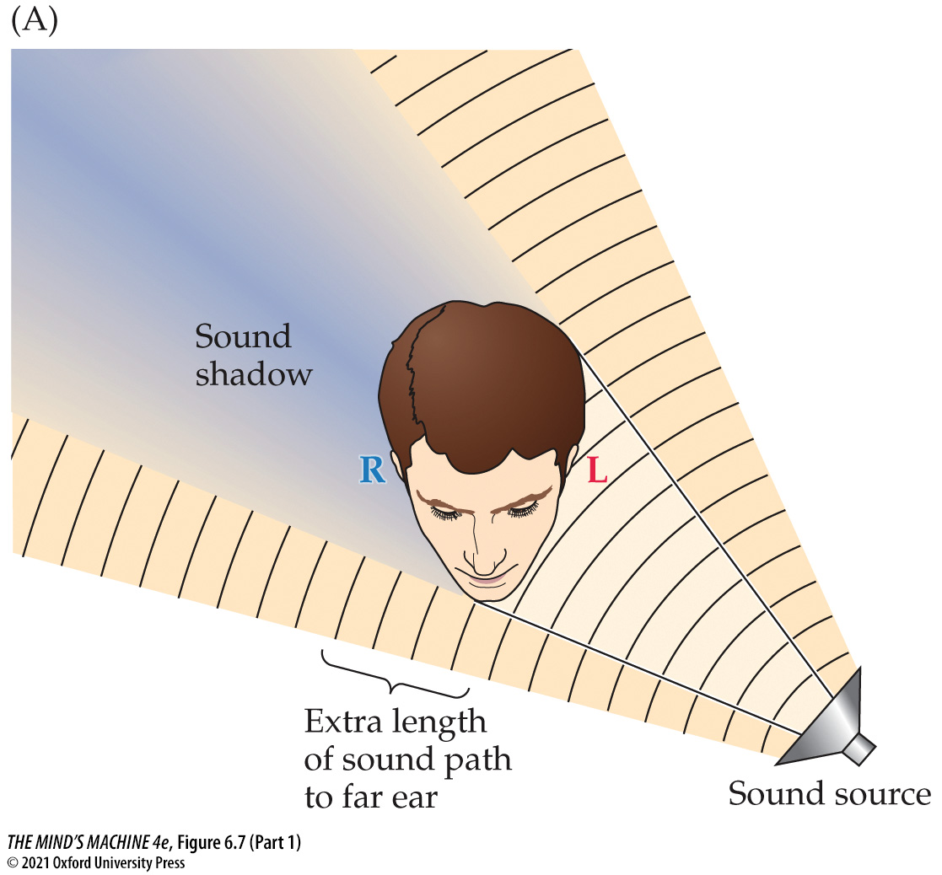
FIGURE 6.7 Cues for Binaural Hearing (Part 1)
Notes:
FIGURE 6.7 Cues for Binaural Hearing

Slide 30
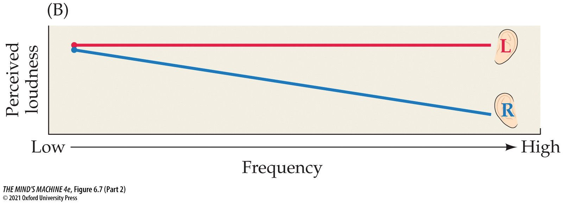
FIGURE 6.7 Cues for Binaural Hearing (Part 2)
Notes:
FIGURE 6.7 Cues for Binaural Hearing

Slide 31
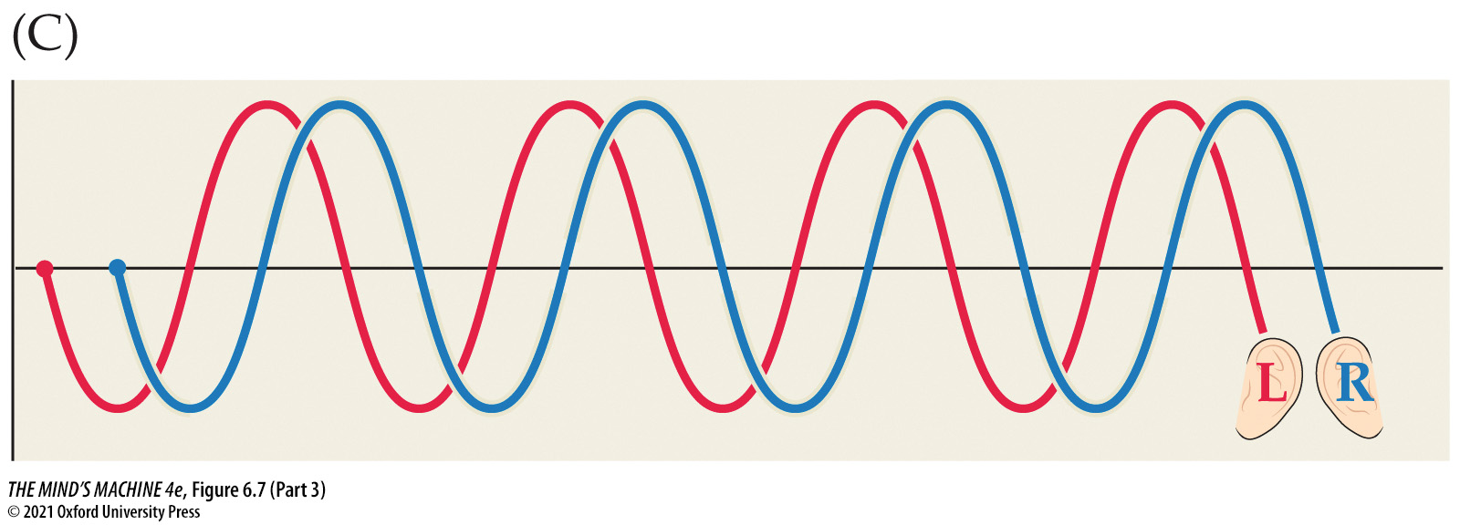
FIGURE 6.7 Cues for Binaural Hearing (Part 3)
Notes:
FIGURE 6.7 Cues for Binaural Hearing

Slide 32
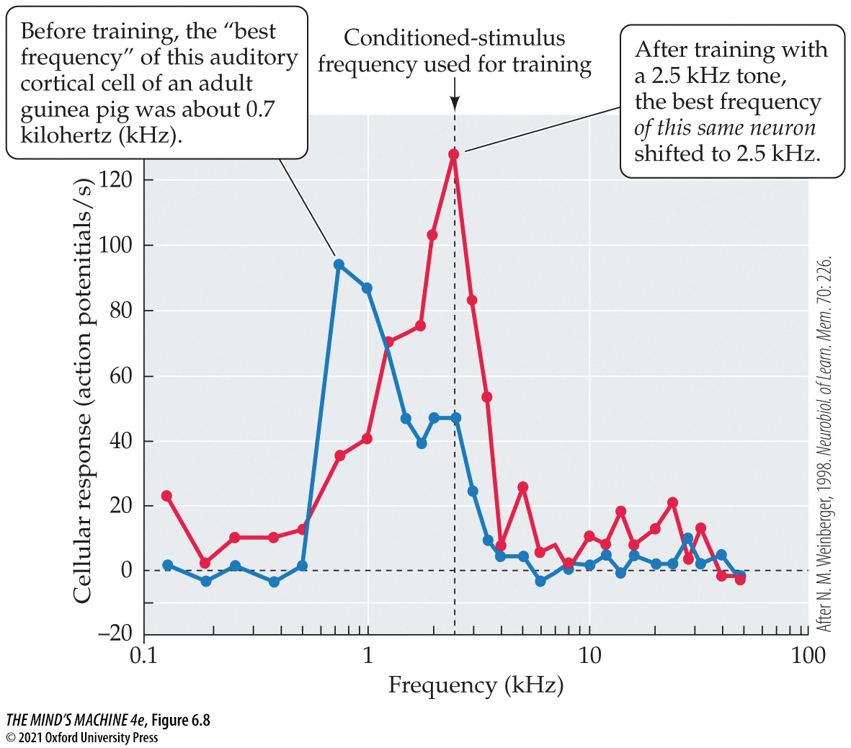
FIGURE 6.8 Long-Term Retention of a Trained Shift in the Tuning of an Auditory Receptive Field (1)
Notes:
FIGURE 6.8 Long-Term Retention of a Trained Shift in the Tuning of an Auditory Receptive Field (After N. M. Weinberger, 1998. Neurobiol. of Learn. Mem. 70: 226.)

Slide 33
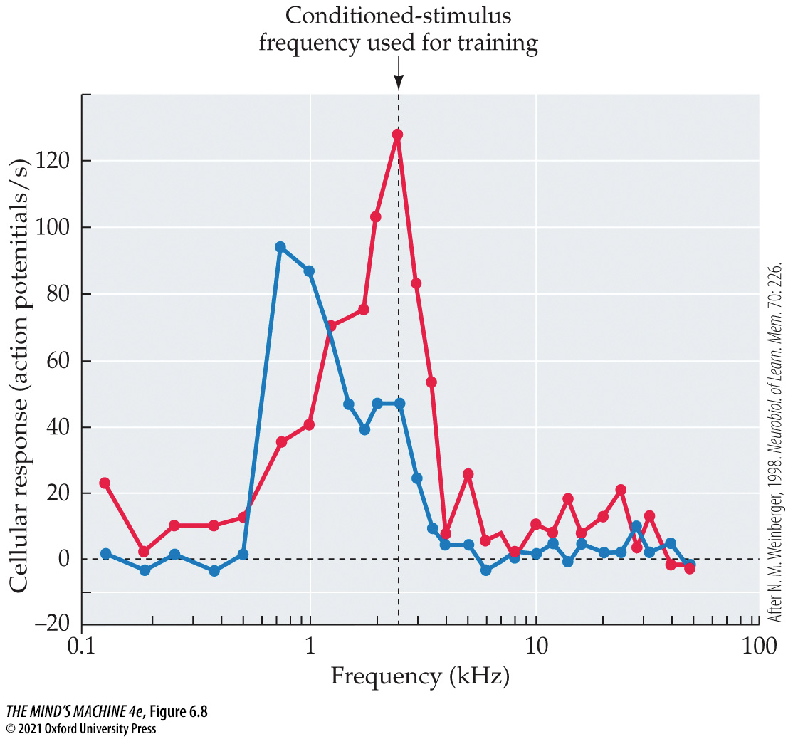
FIGURE 6.8 Long-Term Retention of a Trained Shift in the Tuning of an Auditory Receptive Field (2)
Notes:
FIGURE 6.8 Long-Term Retention of a Trained Shift in the Tuning of an Auditory Receptive Field (After N. M. Weinberger, 1998. Neurobiol. of Learn. Mem. 70: 226.)

Slide 34
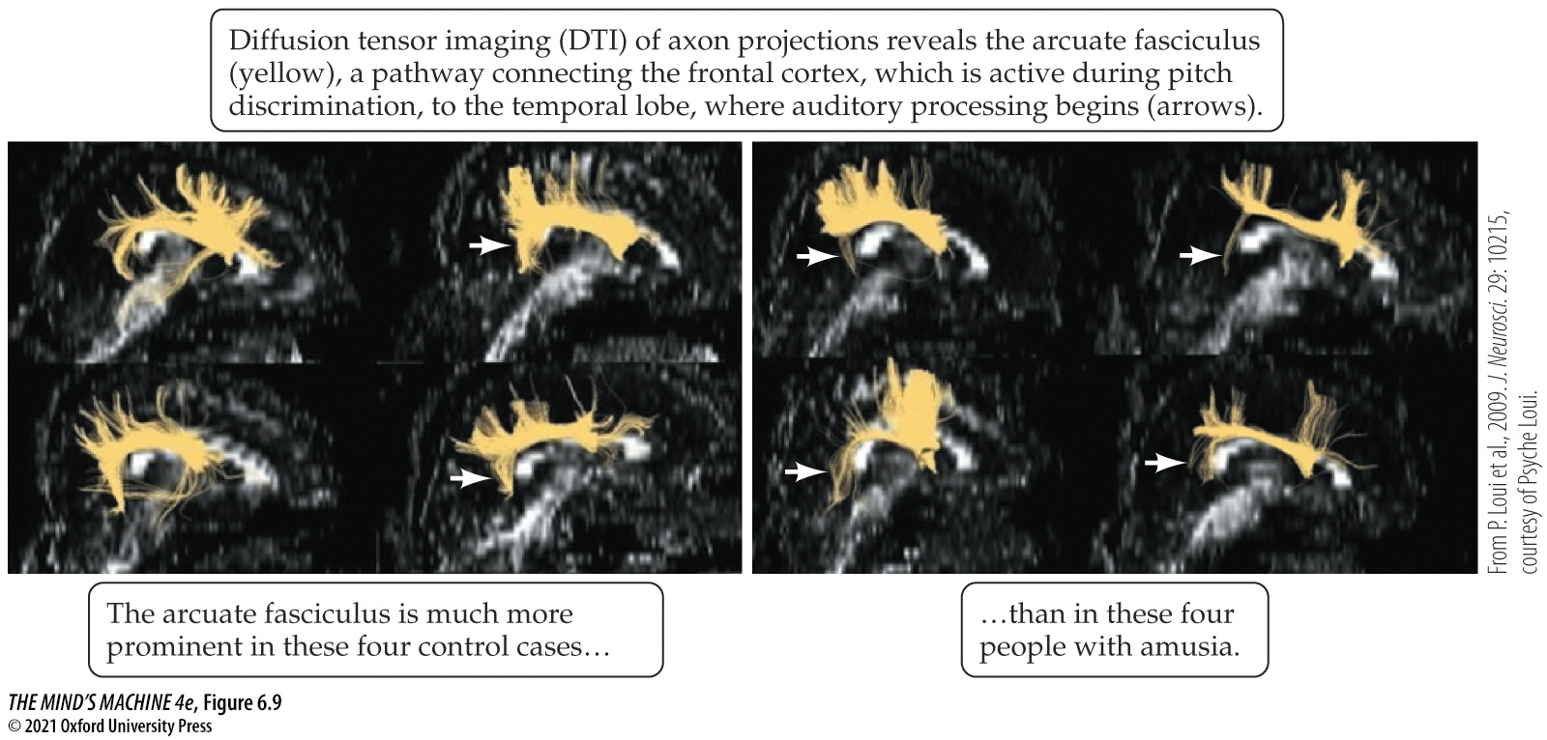
FIGURE 6.9 Brain Connections in People with Amusia (1)
Notes:
FIGURE 6.9 Brain Connections in People with Amusia

Slide 35
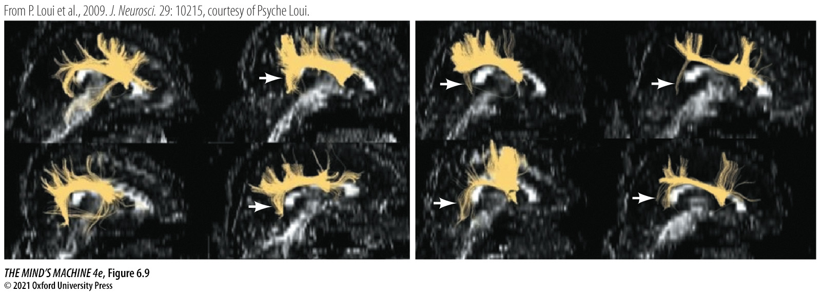
FIGURE 6.9 Brain Connections in People with Amusia (2)
Notes:
FIGURE 6.9 Brain Connections in People with Amusia

Slide 36
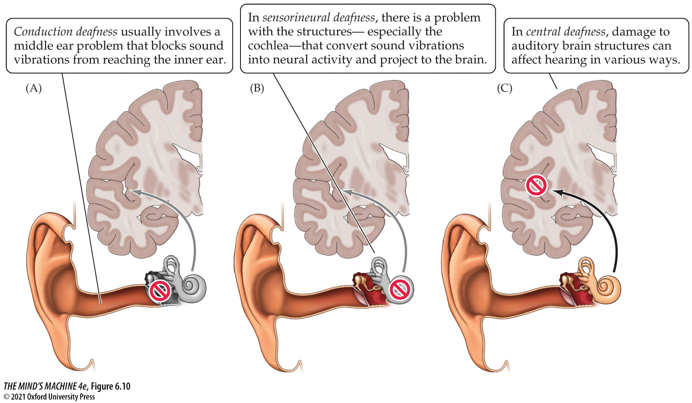
FIGURE 6.10 Types of Hearing Loss (1)
Notes:
FIGURE 6.10 Types of Hearing Loss

Slide 37
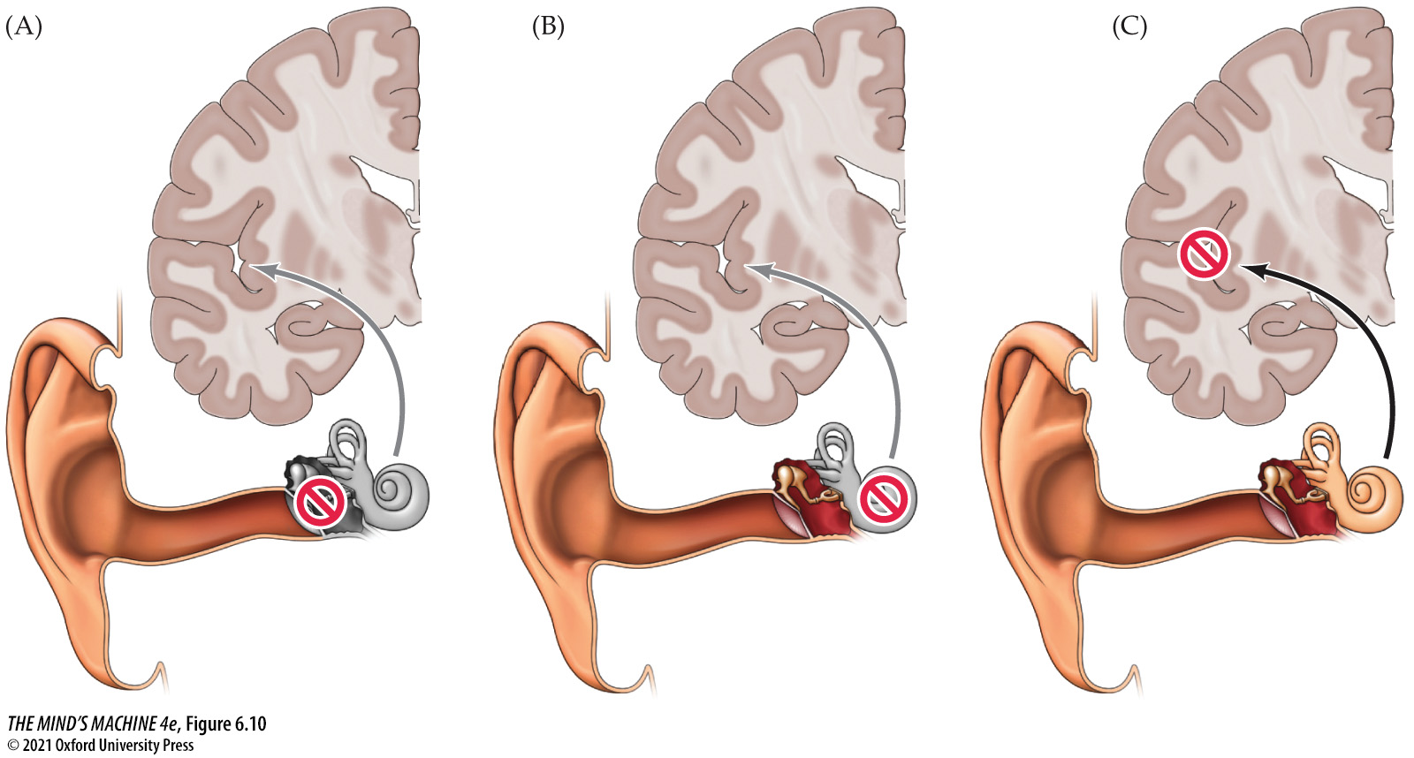
FIGURE 6.10 Types of Hearing Loss (2)
Notes:
FIGURE 6.10 Types of Hearing Loss

Slide 38
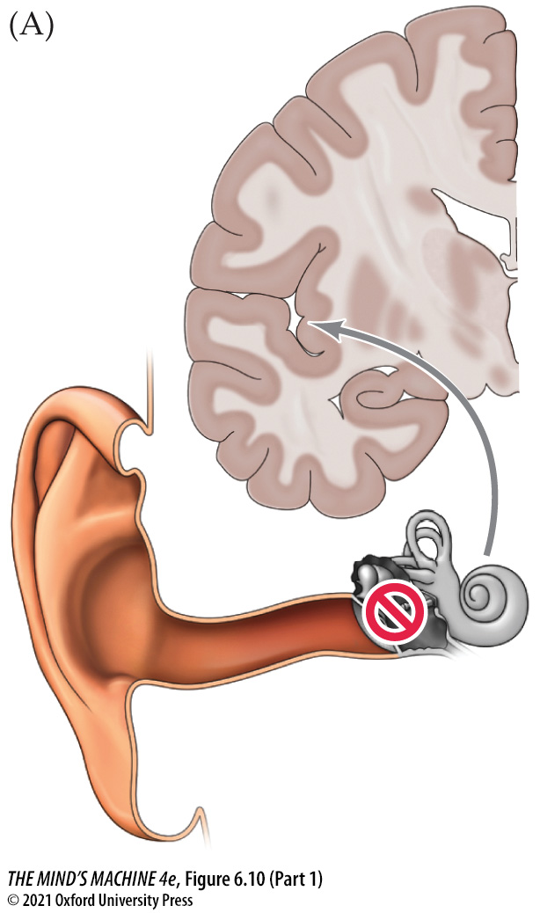
FIGURE 6.10 Types of Hearing Loss (Part 1)
Notes:
FIGURE 6.10 Types of Hearing Loss

Slide 39
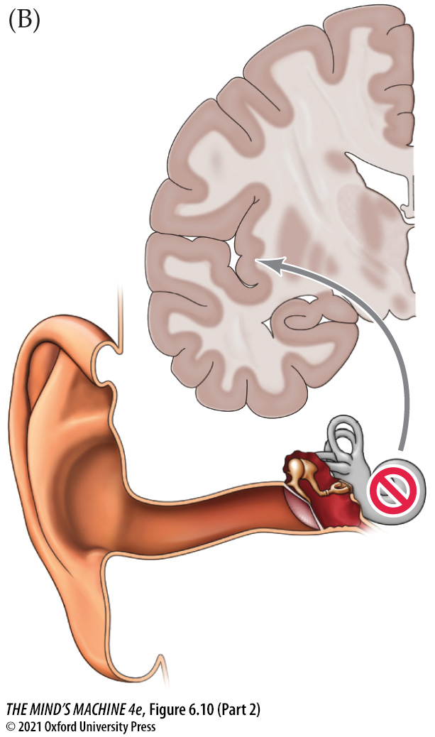
FIGURE 6.10 Types of Hearing Loss (Part 2)
Notes:
FIGURE 6.10 Types of Hearing Loss

Slide 40
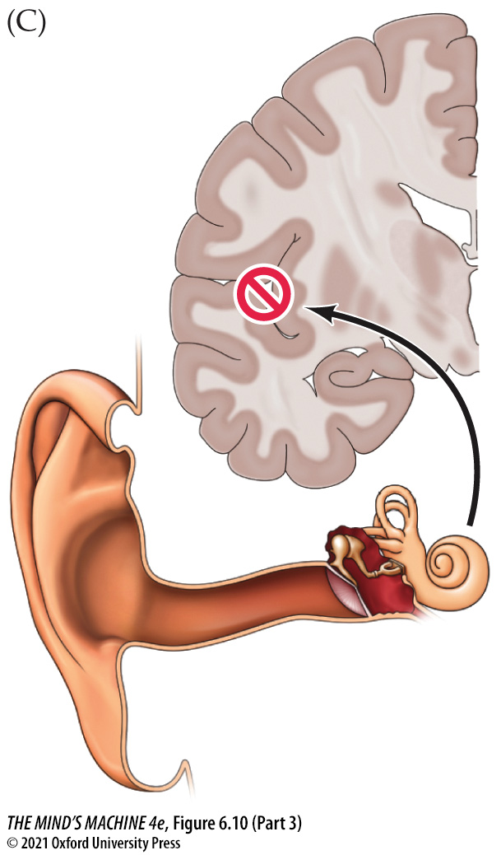
FIGURE 6.10 Types of Hearing Loss (Part 3)
Notes:
FIGURE 6.10 Types of Hearing Loss

Slide 41
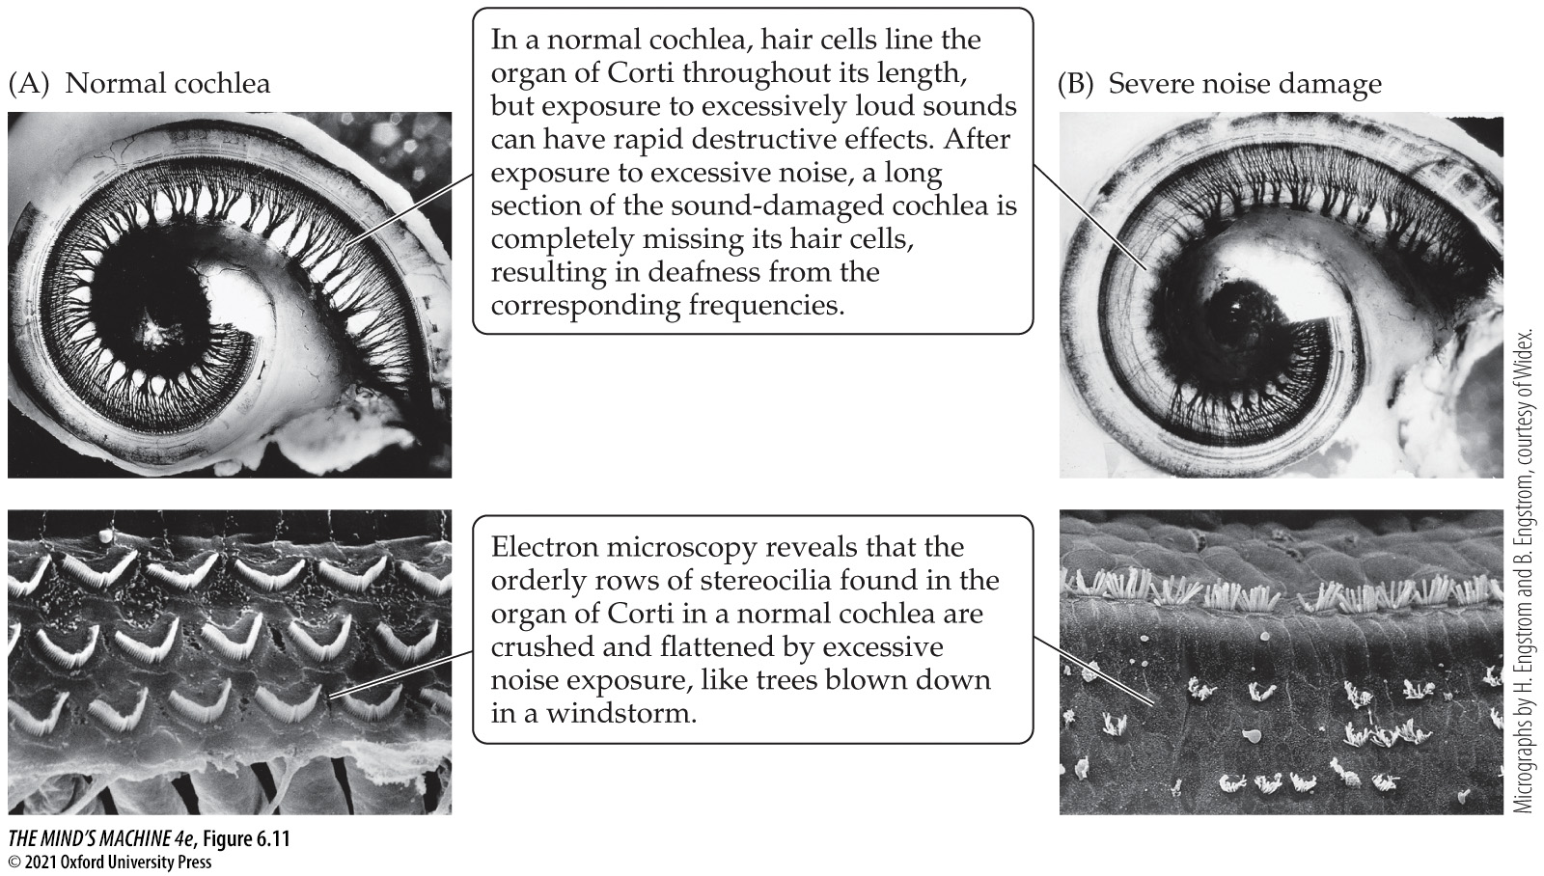
FIGURE 6.11 The Destructive Effects of Loud Noise (1)
Notes:
FIGURE 6.11 The Destructive Effects of Loud Noise

Slide 42
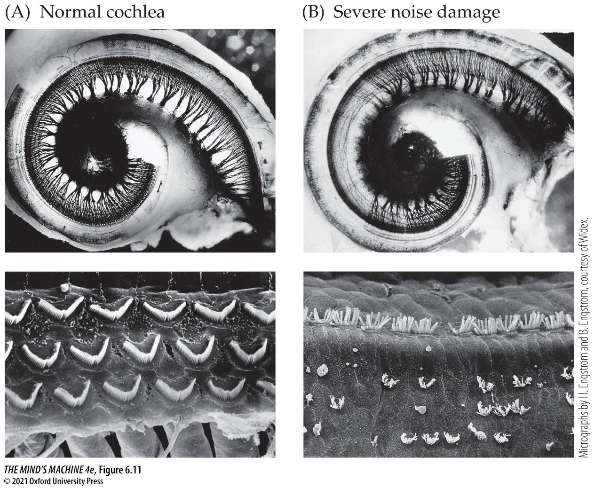
FIGURE 6.11 The Destructive Effects of Loud Noise (2)
Notes:
FIGURE 6.11 The Destructive Effects of Loud Noise

Slide 43
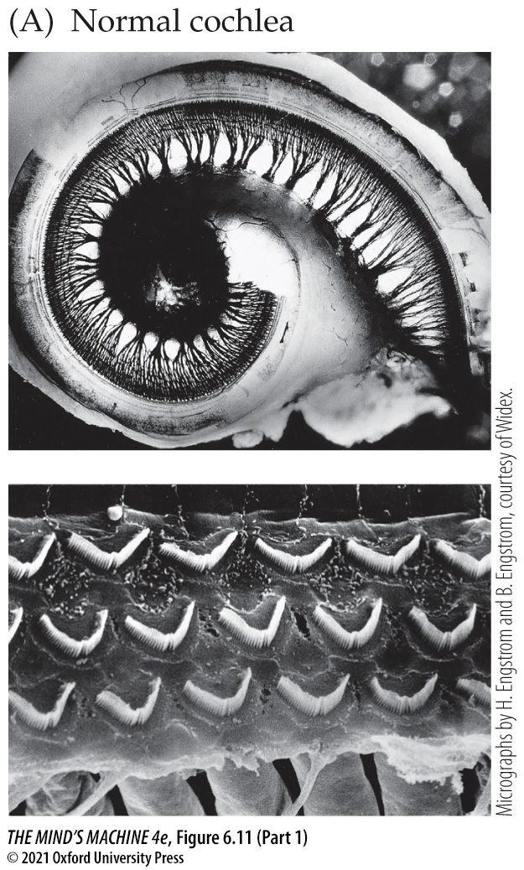
FIGURE 6.11 The Destructive Effects of Loud Noise (Part 1)
Notes:
FIGURE 6.11 The Destructive Effects of Loud Noise

Slide 44
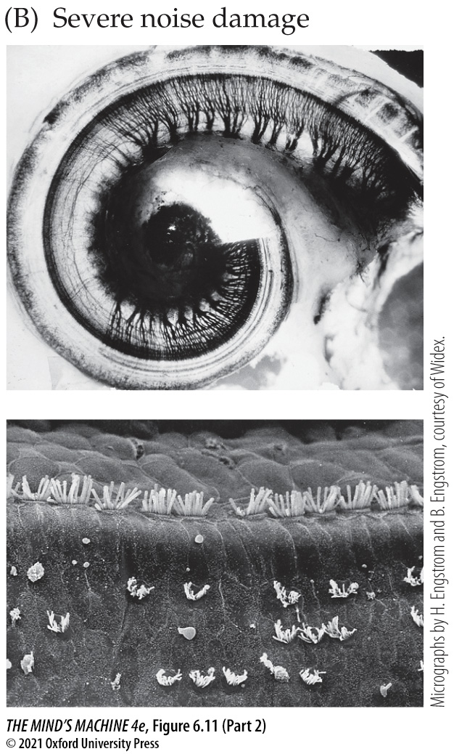
FIGURE 6.11 The Destructive Effects of Loud Noise (Part 2)
Notes:
FIGURE 6.11 The Destructive Effects of Loud Noise

Slide 45
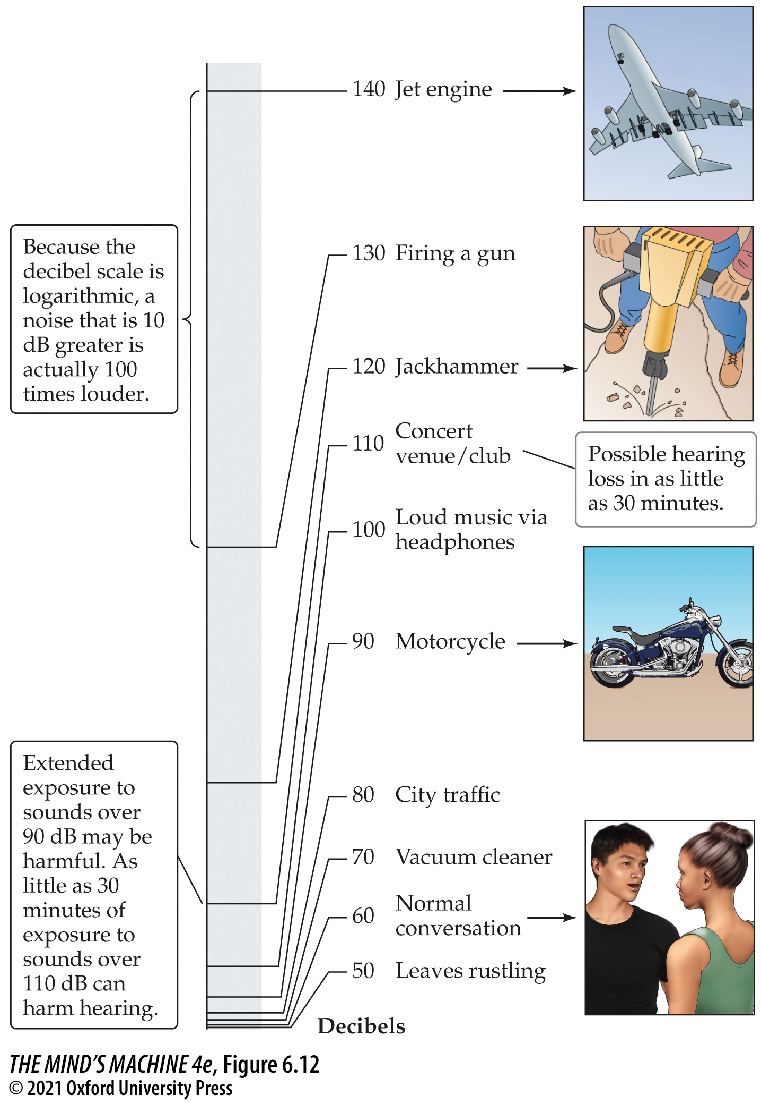
FIGURE 6.12 How Loud Is Too Loud? (1)
Notes:
FIGURE 6.12 How Loud Is Too Loud?

Slide 46
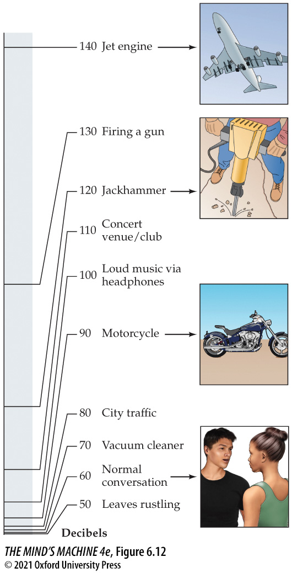
FIGURE 6.12 How Loud Is Too Loud? (2)
Notes:
FIGURE 6.12 How Loud Is Too Loud?

Slide 47
FIGURE 6.13 Cochlear Implants Provide Hearing in Some Deaf People
We are sorry, but portions of this figure are not available in this PowerPoint slide set produced as a free instructor’s resource to accompany the text. Springer-Nature’s fee for the additional use of part of this figure is prohibitive, and considering Oxford University Press’ ongoing commitment to make all educational resources affordable for students, we have chosen not to include the image in this slide set.
Notes:
FIGURE 6.13 Cochlear Implants Provide Hearing in Some Deaf People

Slide 48
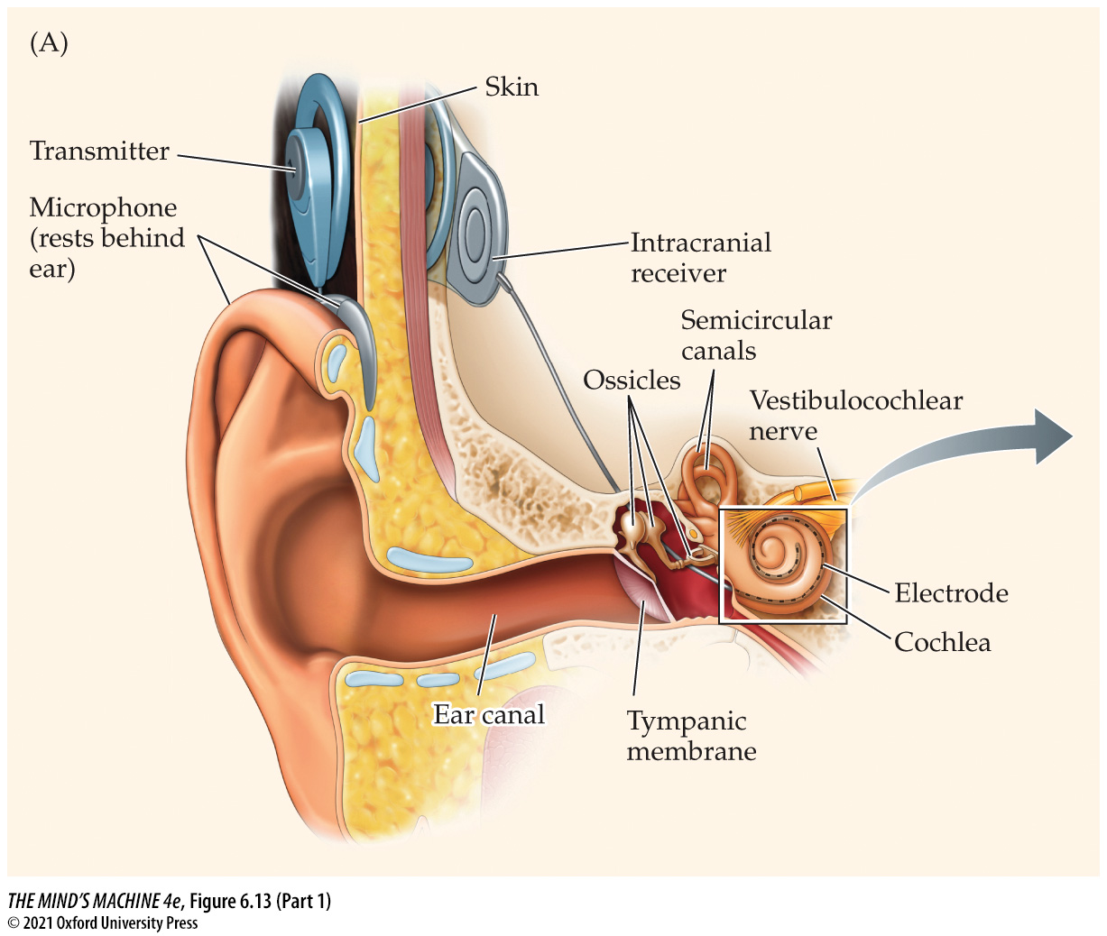
FIGURE 6.13 Cochlear Implants Provide Hearing in Some Deaf People (Part 1)
Notes:
FIGURE 6.13 Cochlear Implants Provide Hearing in Some Deaf People

Slide 49
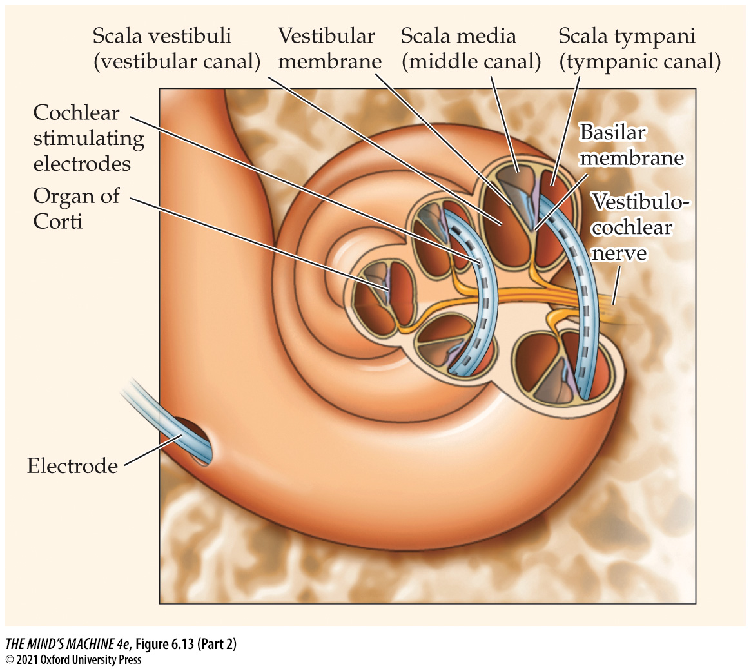
FIGURE 6.13 Cochlear Implants Provide Hearing in Some Deaf People (Part 2)
Notes:
FIGURE 6.13 Cochlear Implants Provide Hearing in Some Deaf People

Slide 50
FIGURE 6.13 Cochlear Implants Provide Hearing in Some Deaf People (Part 3)
We are sorry, but this figure is not available in this PowerPoint slide set produced as a free instructor’s resource to accompany the text. Springer-Nature’s fee for the additional use of part of this figure is prohibitive, and considering Oxford University Press’ ongoing commitment to make all educational resources affordable for students, we have chosen not to include the image in this slide set.
Notes:
FIGURE 6.13 Cochlear Implants Provide Hearing in Some Deaf People

Slide 51
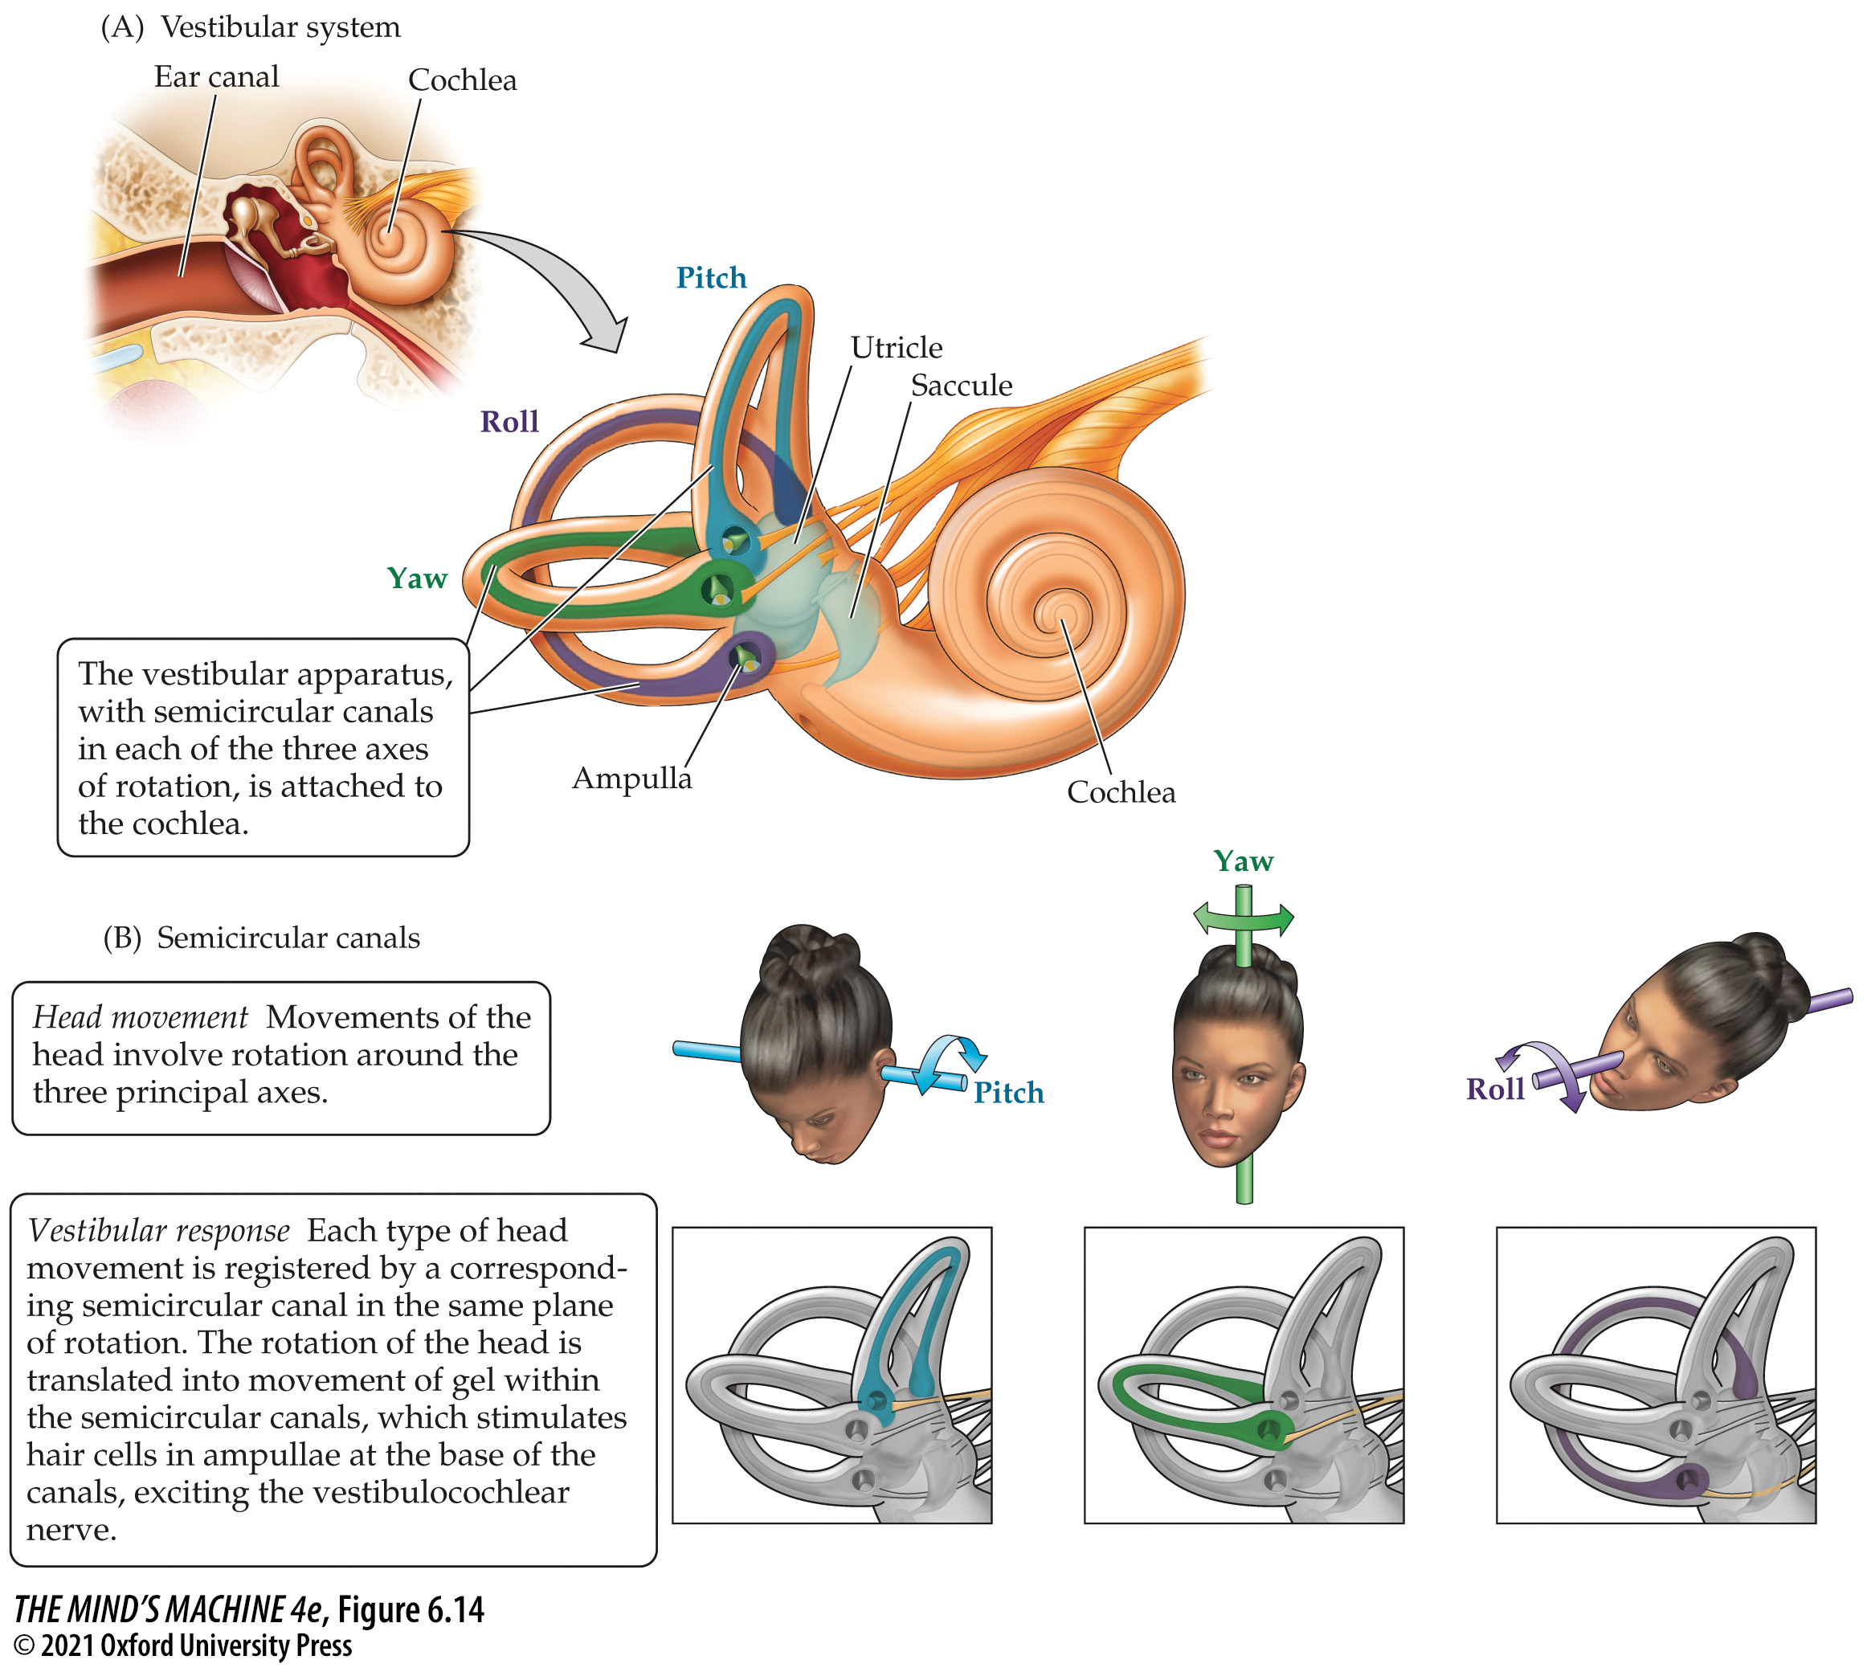
FIGURE 6.14 Structures of the Vestibular System (1)
Notes:
FIGURE 6.14 Structures of the Vestibular System

Slide 52
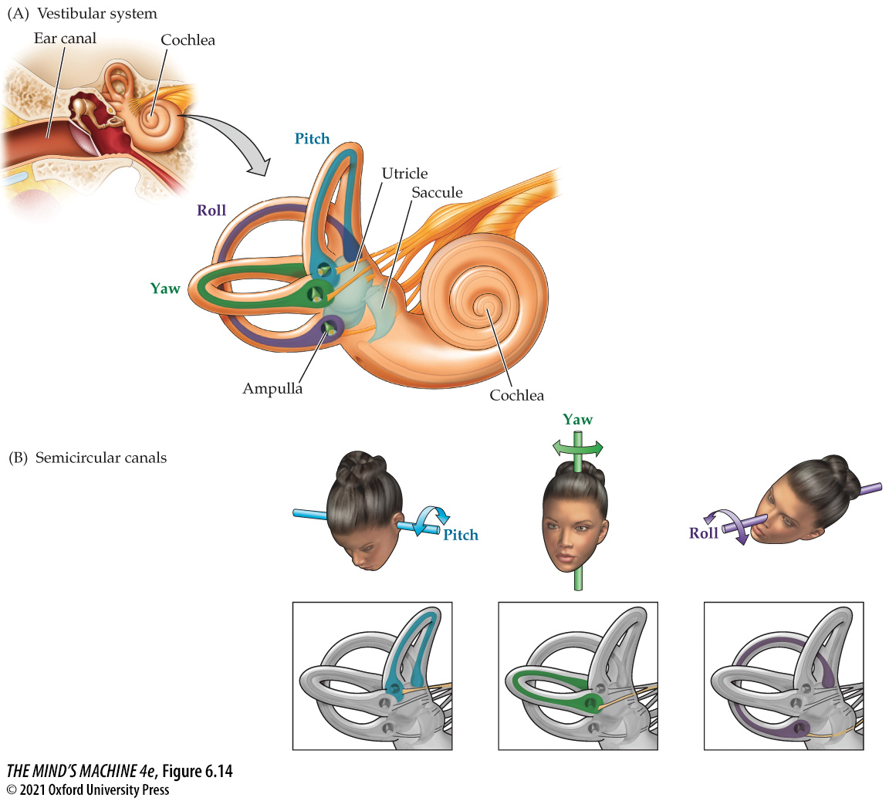
FIGURE 6.14 Structures of the Vestibular System (2)
Notes:
FIGURE 6.14 Structures of the Vestibular System

Slide 53

FIGURE 6.14 Structures of the Vestibular System (Part 1)
Notes:
FIGURE 6.14 Structures of the Vestibular System

Slide 54

FIGURE 6.14 Structures of the Vestibular System (Part 2)
Notes:
FIGURE 6.14 Structures of the Vestibular System

Slide 55

FIGURE 6.14 Structures of the Vestibular System (Part 3)
Notes:
FIGURE 6.14 Structures of the Vestibular System

Slide 56

FIGURE 6.15 A Cross Section of the Tongue
Notes:
FIGURE 6.15 A Cross Section of the Tongue

Slide 57

FIGURE 6.16 Taste Buds and Taste Receptor Cells (1)
Notes:
FIGURE 6.16 Taste Buds and Taste Receptor Cells (Part A after S. K. McLaughlin et al., 1994. Physiol. Behav. 56: 1157; C after L. M. Bartoshuk in D. Chadwick et al., 1993. The Molecular Basis of Smell and Taste Transduction. Wiley. New York and J. Chandrashekar et al., 2006. Nature 444: 288.)

Slide 58

FIGURE 6.16 Taste Buds and Taste Receptor Cells (2)
Notes:
FIGURE 6.16 Taste Buds and Taste Receptor Cells (Part A after S. K. McLaughlin et al., 1994. Physiol. Behav. 56: 1157; C after L. M. Bartoshuk in D. Chadwick et al., 1993. The Molecular Basis of Smell and Taste Transduction. Wiley. New York and J. Chandrashekar et al., 2006. Nature 444: 288.)

Slide 59

FIGURE 6.16 Taste Buds and Taste Receptor Cells (Part 1)
Notes:
FIGURE 6.16 Taste Buds and Taste Receptor Cells (Part A after S. K. McLaughlin et al., 1994. Physiol. Behav. 56: 1157; C after L. M. Bartoshuk in D. Chadwick et al., 1993. The Molecular Basis of Smell and Taste Transduction. Wiley. New York and J. Chandrashekar et al., 2006. Nature 444: 288.)

Slide 60

FIGURE 6.16 Taste Buds and Taste Receptor Cells (Part 2)
Notes:
FIGURE 6.16 Taste Buds and Taste Receptor Cells (Part A after S. K. McLaughlin et al., 1994. Physiol. Behav. 56: 1157; C after L. M. Bartoshuk in D. Chadwick et al., 1993. The Molecular Basis of Smell and Taste Transduction. Wiley. New York and J. Chandrashekar et al., 2006. Nature 444: 288.)

Slide 61

FIGURE 6.16 Taste Buds and Taste Receptor Cells (Part 3)
Notes:
FIGURE 6.16 Taste Buds and Taste Receptor Cells (Part A after S. K. McLaughlin et al., 1994. Physiol. Behav. 56: 1157; C after L. M. Bartoshuk in D. Chadwick et al., 1993. The Molecular Basis of Smell and Taste Transduction. Wiley. New York and J. Chandrashekar et al., 2006. Nature 444: 288.)

Slide 62

FIGURE 6.17 Body Tissues Expressing Taste Receptors (1)
Notes:
FIGURE 6.17 Body Tissues Expressing Taste Receptors

Slide 63

FIGURE 6.17 Body Tissues Expressing Taste Receptors (2)
Notes:
FIGURE 6.17 Body Tissues Expressing Taste Receptors

Slide 64

FIGURE 6.18 It’s All a Matter of Taste Buds (1)
Notes:
FIGURE 6.18 It’s All a Matter of Taste Buds

Slide 65

FIGURE 6.18 It’s All a Matter of Taste Buds (2)
Notes:
FIGURE 6.18 It’s All a Matter of Taste Buds

Slide 66

FIGURE 6.18 It’s All a Matter of Taste Buds (Part 1)
Notes:
FIGURE 6.18 It’s All a Matter of Taste Buds

Slide 67

FIGURE 6.18 It’s All a Matter of Taste Buds (Part 2)
Notes:
FIGURE 6.18 It’s All a Matter of Taste Buds

Slide 68

FIGURE 6.19 Anatomy and Main Pathways of the Human Gustatory System (1)
Notes:
FIGURE 6.19 Anatomy and Main Pathways of the Human Gustatory System

Slide 69

FIGURE 6.19 Anatomy and Main Pathways of the Human Gustatory System (2)
Notes:
FIGURE 6.19 Anatomy and Main Pathways of the Human Gustatory System

Slide 70

FIGURE 6.20 The Human Olfactory System (1)
Notes:
FIGURE 6.20 The Human Olfactory System

Slide 71

FIGURE 6.20 The Human Olfactory System (2)
Notes:
FIGURE 6.20 The Human Olfactory System

Slide 72

FIGURE 6.20 The Human Olfactory System (Part 1)
Notes:
FIGURE 6.20 The Human Olfactory System

Slide 73

FIGURE 6.20 The Human Olfactory System (Part 2)
Notes:
FIGURE 6.20 The Human Olfactory System

Slide 74

FIGURE 6.21 Different Kinds of Olfactory Receptor Molecules on the Olfactory Epithelium (1)
Notes:
FIGURE 6.21 Different Kinds of Olfactory Receptor Molecules on the Olfactory Epithelium (Part A after R. Vassar et al., 1993. Cell 74: 309.)

Slide 75

FIGURE 6.21 Different Kinds of Olfactory Receptor Molecules on the Olfactory Epithelium (2)
Notes:
FIGURE 6.21 Different Kinds of Olfactory Receptor Molecules on the Olfactory Epithelium (Part A after R. Vassar et al., 1993. Cell 74: 309.)

Slide 76

FIGURE 6.21 Different Kinds of Olfactory Receptor Molecules on the Olfactory Epithelium (Part 1)
Notes:
FIGURE 6.21 Different Kinds of Olfactory Receptor Molecules on the Olfactory Epithelium (Part A after R. Vassar et al., 1993. Cell 74: 309.)

Slide 77

FIGURE 6.21 Different Kinds of Olfactory Receptor Molecules on the Olfactory Epithelium (Part 2)
Notes:
FIGURE 6.21 Different Kinds of Olfactory Receptor Molecules on the Olfactory Epithelium (Part A after R. Vassar et al., 1993. Cell 74: 309.)

Slide 78

FIGURE 6.22 Components of the Brain’s Olfactory System
Notes:
FIGURE 6.22 Components of the Brain’s Olfactory System

Slide 79

FIGURE 6.23 The Vomeronasal System
Notes:
FIGURE 6.23 The Vomeronasal System

