Slide 1
VERTEBRATE LIFE
by F. Harvey Pough, William E. Bemis, Betty Mcguire and Christine M. Janis

Slide 2
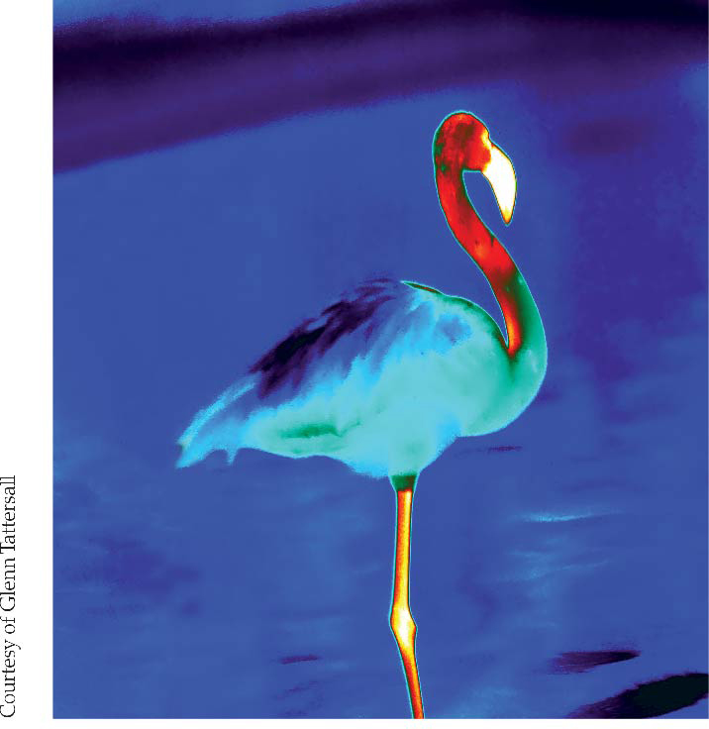
1

Slide 3
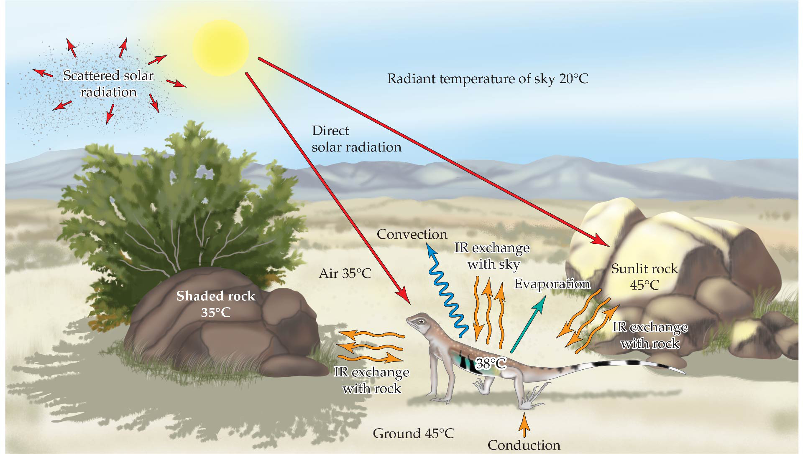
Figure 14.1 Pathways of energy exchange.
Notes:
Figure 14.1 Pathways of energy exchange. A terrestrial organism exchanges energy with its environment via several pathways. These are illustrated here in simplified form by a lizard resting on the floor of a desert arroyo. Arrowheads indicate the direction of energy flow. Small adjustments of posture or position can change the magnitude and even the direction of energy exchange in the various pathways, giving the lizard considerable control over its body temperature. IR = infrared radiation. (After F.H. Pough et al. 2016. Herpetology, 4th ed. Oxford University Press/Sinauer: Sunderland, MA.)

Slide 4
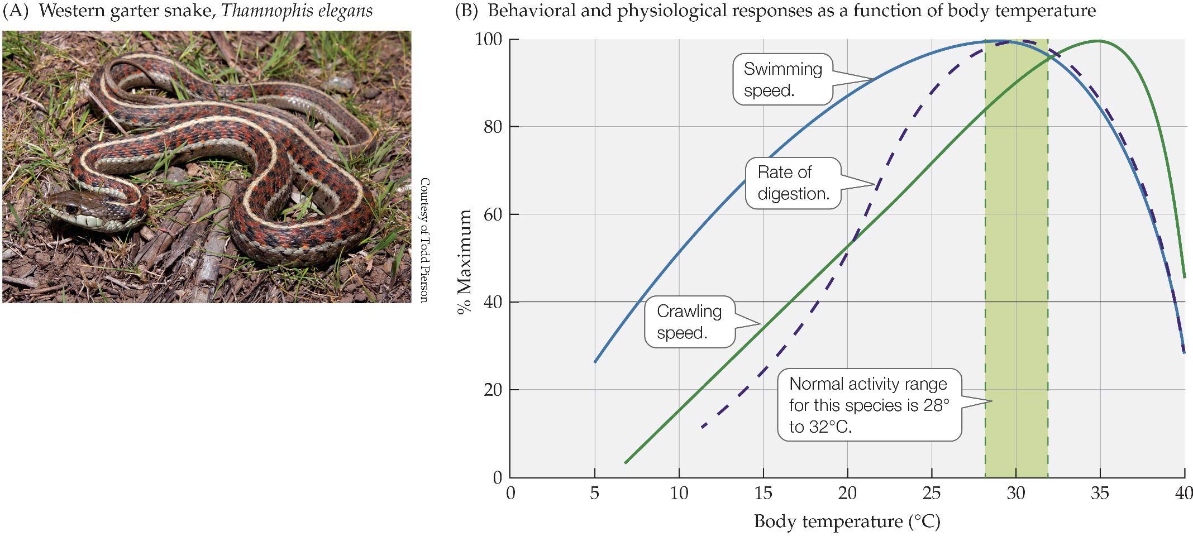
Figure 14.2 Effect of temperature on performance.
Notes:
Figure 14.2 Effect of temperature on performance. An ectotherm’s ability to engage in its normal behaviors and physiological processes is temperature-sensitive. Crawling and swimming speeds and speed of digestion by western garter
snakes all reach their maximum within or close to the species’ activity temperature range. The vertical axis shows the percentage of maximum performance achieved at each temperature. Within the snake’s activity range (shaded area), performance level is at least 85% of maximum for all these activities. (B after R.D. Stevenson et al. 1985. Physiol Biochem Zool 565: 48–57. © 1985 The University of Chicago Press.)

Slide 5
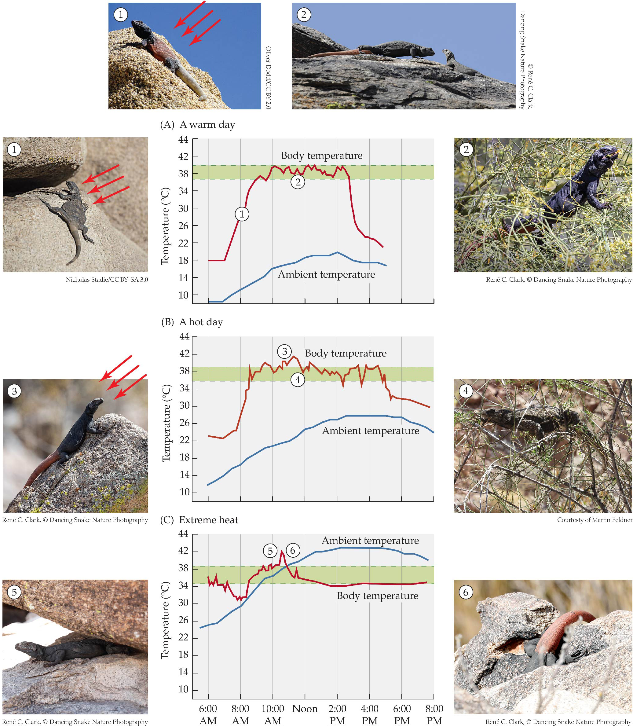
Figure 14.3 Behavioral thermoregulation by a desert lizard.
Notes:
Figure 14.3 Behavioral thermoregulation by a desert lizard. Chuckwallas (genus Sauromalus) are large, diurnal, herbivorous lizards that inhabit deserts in the southwestern United States and northern Mexico. While they are active, chuckwallas maintain their body temperatures between 36° and 40°C; this thermoregulation is based on changes in posture and selection of microclimates. (A) When they are warming in the morning (①), lizards maximize solar heat absorption by orienting with their backs perpendicular to the rays of the sun and flattening the body to increase the area being heated. When they have reached their activity temperature range they engage in social behavior, feeding, and moving (②). (B) To reduce heating while remaining active, a lizard can (③) face into the sun with its body parallel to the sun’s rays so that the sun shines only on the lizard’s head and shoulders or (④) climb into a bush where the wind speed and convective cooling are greater than at ground level. (C) When it is extremely hot, a lizard can (⑤) seek shade under an overhanging rock or (⑥) return to the deep crevice where it spent the night. (Graphs after T.J. Case.1976.
J Herpetol 10: 85–95. Published by Society for the Study of Amphibians and Reptiles.)

Slide 6
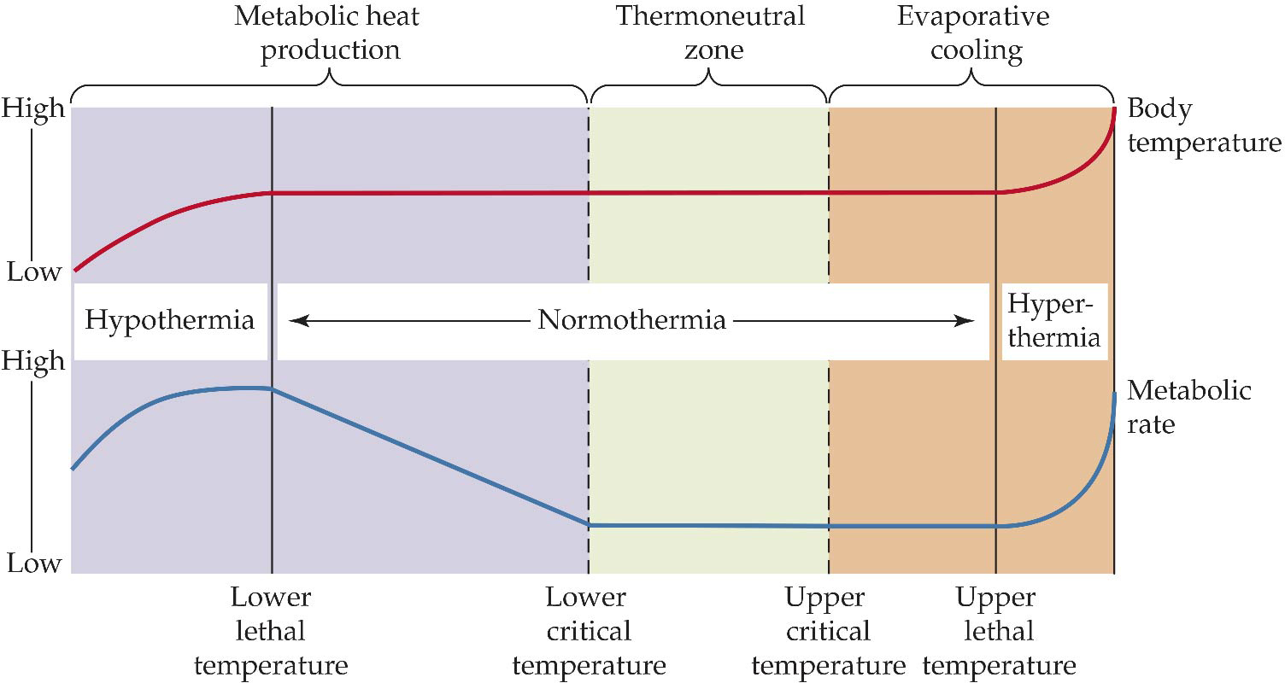
Figure 14.4 Endotherms maintain stable body temperatures over a range of environmental temperatures.
Notes:
Figure 14.4 Endotherms maintain stable body temperatures over a range of environmental temperatures. Within the thermoneutral zone, changing insulation allows a bird or mammal to maintain a stable body temperature. Below the lower critical temperature metabolic heat production must increase. Below the lower lethal temperature, body temperature falls (hypothermia), reducing metabolic heat production, and death follows. Above the upper critical temperature, evaporative cooling maintains normothermy. Above the upper lethal temperature, evaporative cooling is no longer sufficient; body temperature rises (hyperthermia), metabolic heat production increases, and an explosive rise in body temperature leads to death.

Slide 7
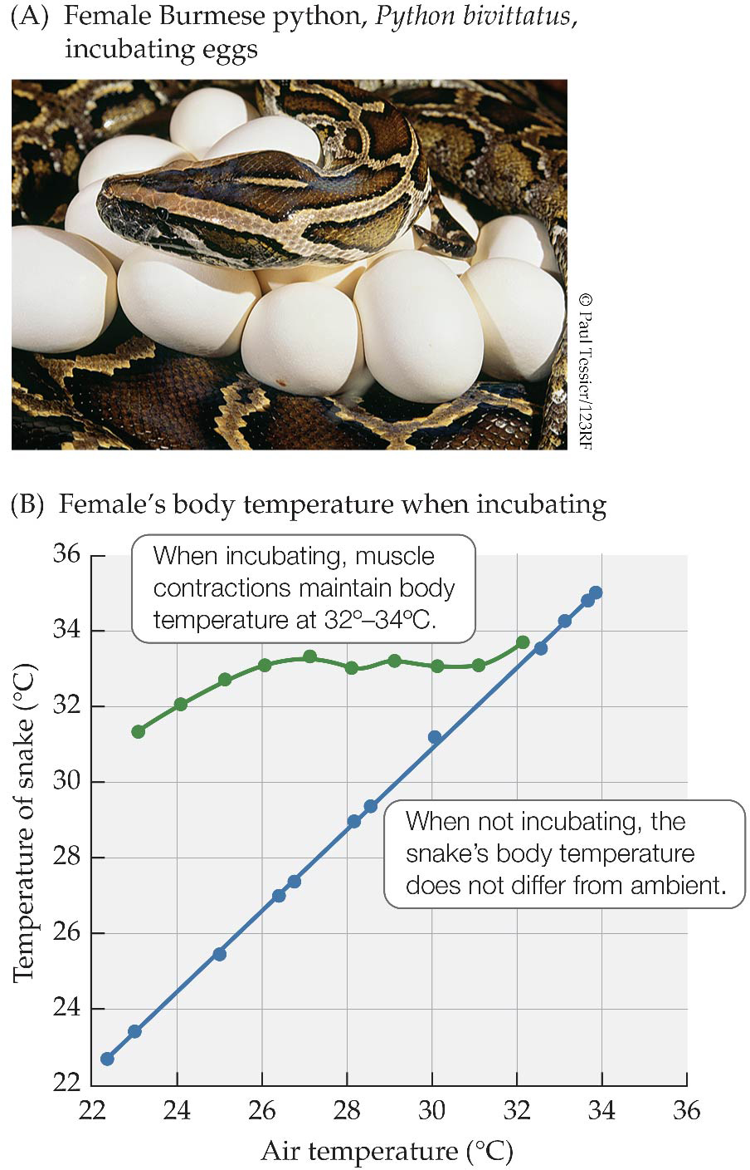
Figure 14.5 Some female pythons can produce metabolic heat to warm their eggs.
Notes:
Figure 14.5 Some female pythons can produce metabolic heat to warm their eggs. When a female Burmese python is incubating, muscular contractions allow her to maintain the temperature of her body (and of her eggs) between 32º and 34ºC. When the python is not incubating, her body temperature does not differ from the ambient temperature. (B from L.H.S. Van Mierop and S. Barnard. 1978. Copeia 1978: 615–621. Courtesy of American Society of Ichthyologists and Herpetologists [ASIH].)

Slide 8
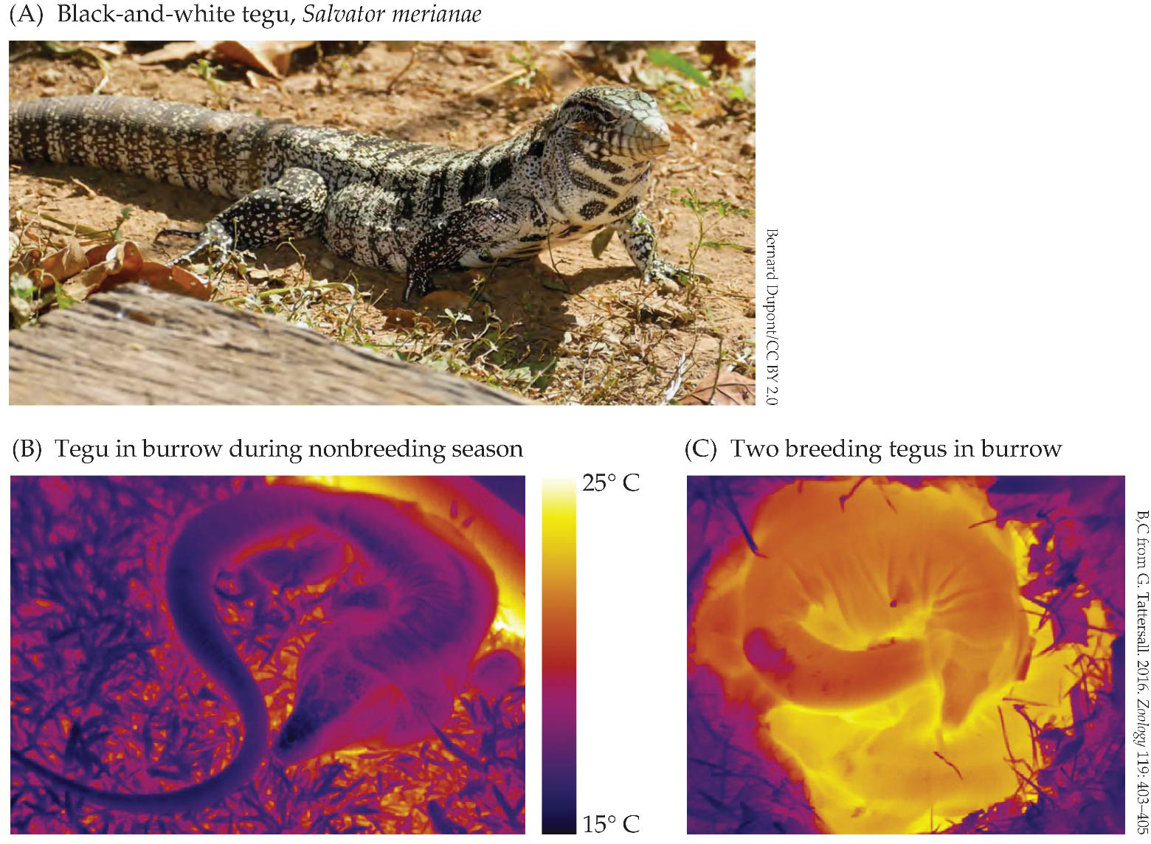
Figure 14.6 Tegu lizards can be endothermal during the breeding season.
Notes:
Figure 14.6 Tegu lizards can be endothermal during the breeding season. (A) Black-and-white tegus are large, carnivorous lizards from South America that prey on small mammals and birds as well as frogs, snakes, and smaller lizards. (B) When a tegu is in its burrow during the nonbreeding season, its surface temperature falls to the temperature of the burrow. (C) During the breeding season, tegus can maintain body temperatures as much as 10ºC higher than the burrow temperature. (There are two lizards in this image, one warmer than the other.)

Slide 9
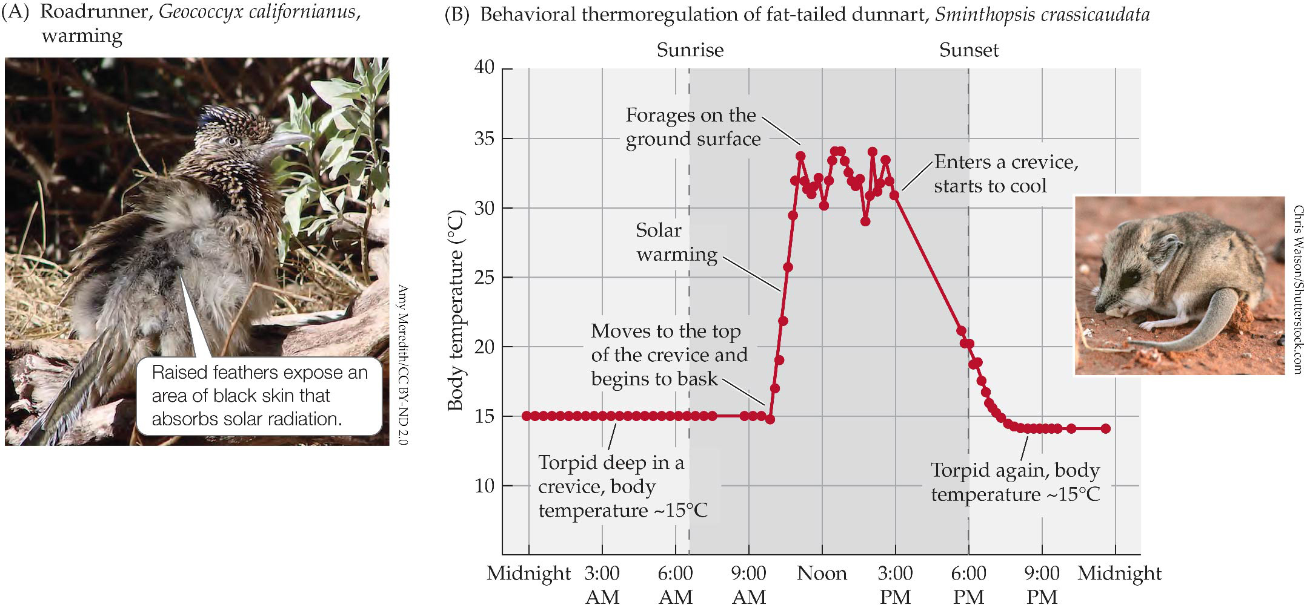
Figure 14.7 Solar heating.
Notes:
Figure 14.7 Solar heating. (A) Facing away from the sun, this roadrunner has drooped its wings and lifted the feathers on its back to expose an area of black skin that absorbs solar radiation. (B) Around 9 am on the day shown here, a dunnart, its body temperature still near 15°C, climbs to the top of the crevice and basks in the sun; in 2 hours its body temperatures has reached 30°–35°C and it begins to forage. Its body temperature rises and falls as it moves between sun and shade. About 3 pm, the dunnart returns to a crevice and its body temperature cools to 15°C for the night. (B from L. Warnecke et al. 2008. Naturwissenschaften 95: 73–78.)

Slide 10
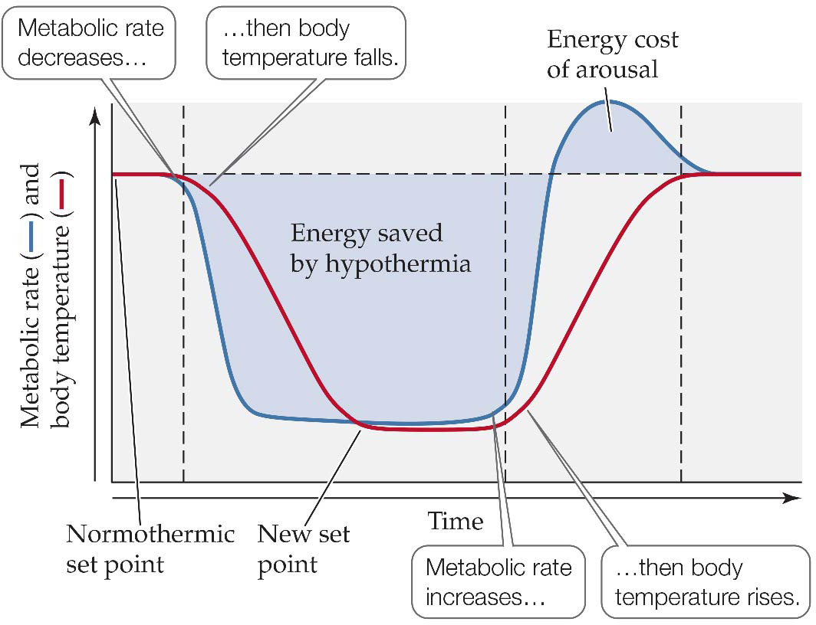
Figure 14.8 Changes in body temperature and metabolic rate during rest-phase torpor.
Notes:
Figure 14.8 Changes in body temperature and metabolic rate during rest-phase torpor. As an animal enters restphase torpor, a decrease in metabolic rate precedes a fall in body temperature to a new set point. On rewarming, an increase in metabolism precedes the return to normothermia. The metabolic rate during arousal briefly overshoots the resting rate, but the energy cost of arousal is less than the energy saved by the period of torpor.

Slide 11
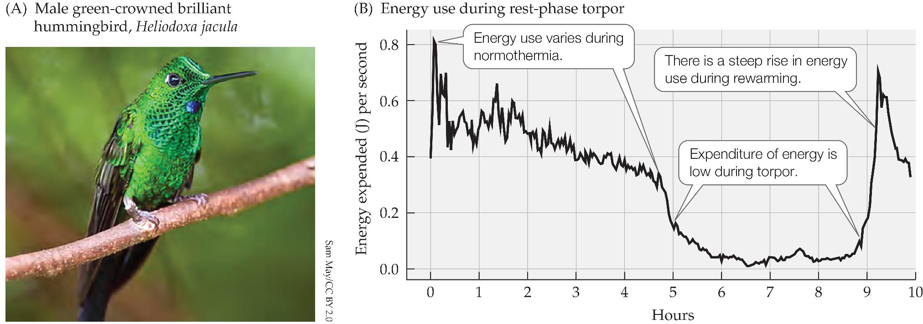
Figure 14.9 Hummingbirds can become torpid at night.
Notes:
Figure 14.9 Hummingbirds can become torpid at night. (A) Some hummingbirds, such as Heliodoxa jacula, enter rest-phase torpor. (B) In the experiment shown here, the bird was active for the first 4.7 hours after being placed in the metabolism chamber, and its temperature was in the normothermal range. Energy expenditure decreased gradually and fell abruptly when the bird entered torpor. The energy used during torpor was only 21% of the cost of remaining normothermal, and in this experiment torpor reduced the energy expenditure during the night by 55%. (B, data from A. Shankar et. al. 2020. J Avian Biol 2020: e02305.)

Slide 12
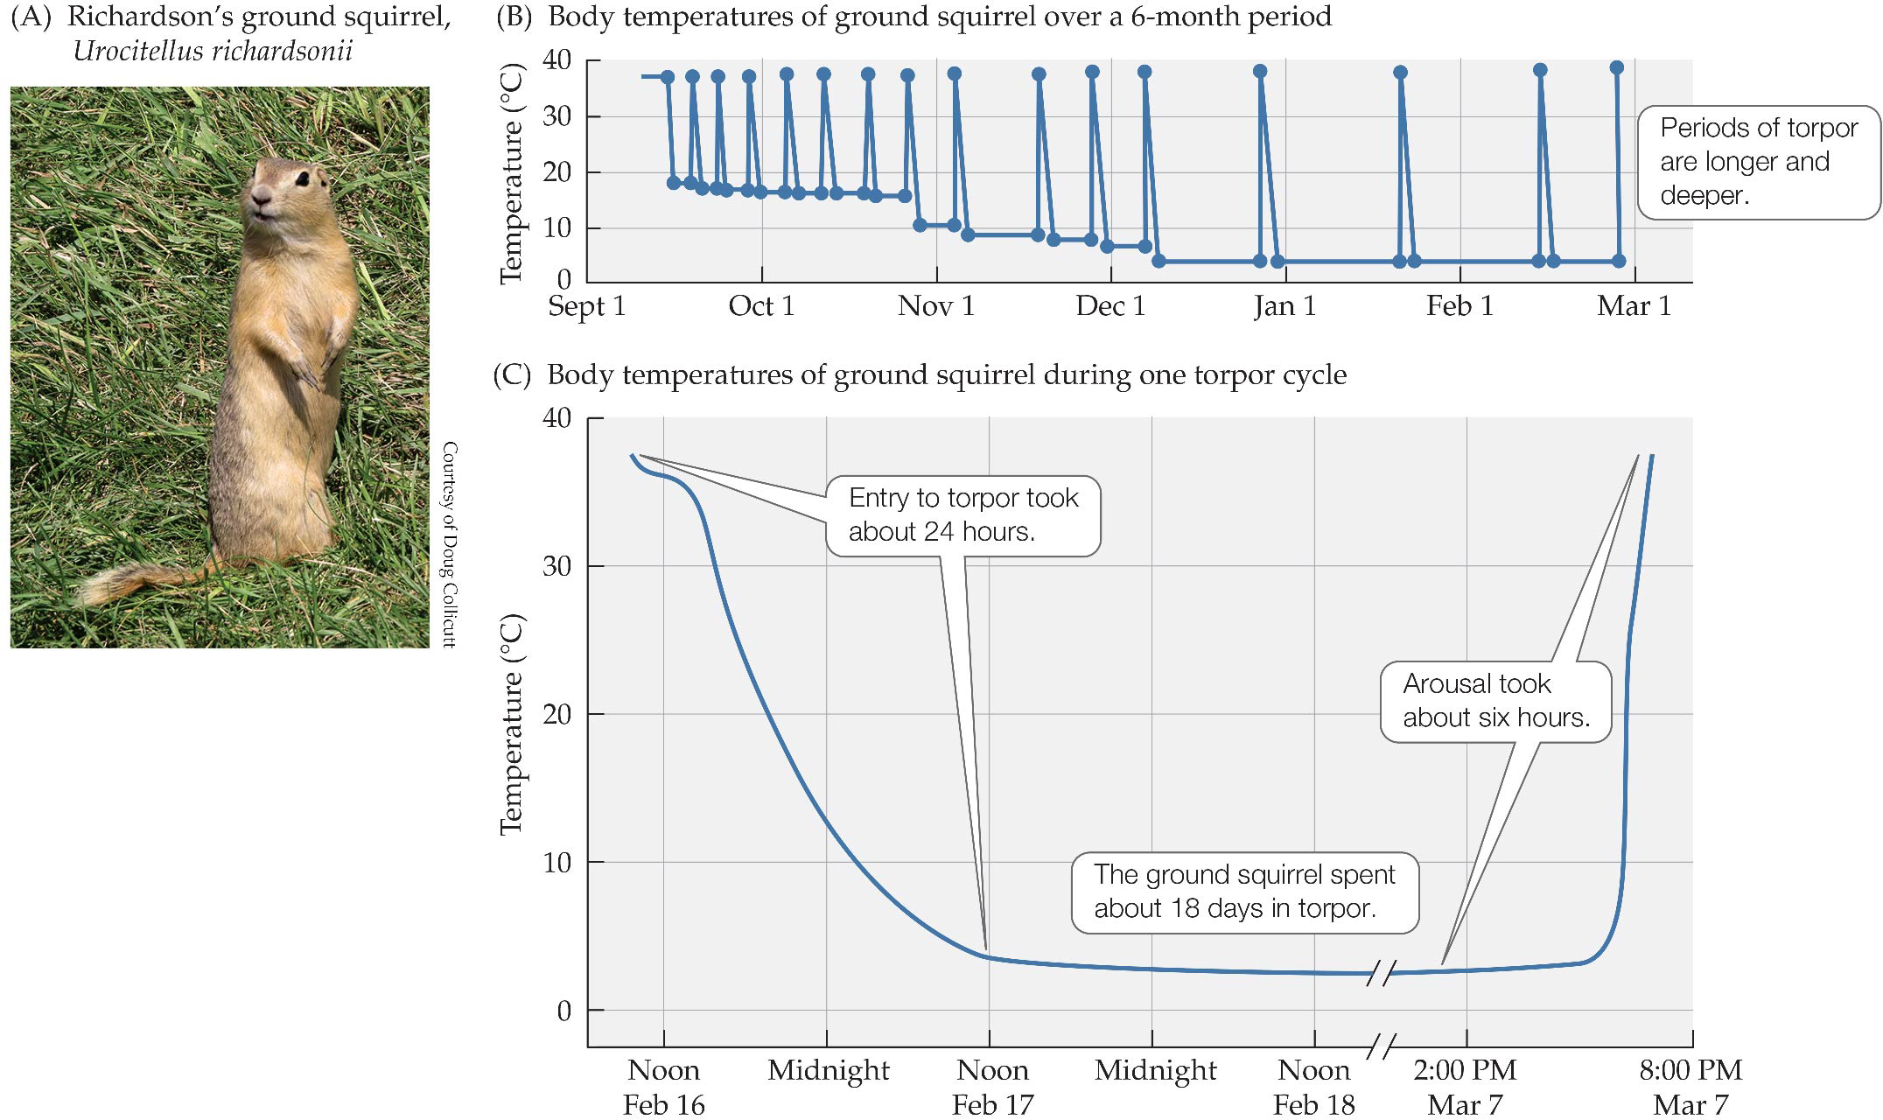
Figure 14.10 Hibernation by Richardson’s ground squirrel.
Notes:
Figure 14.10 Hibernation by Richardson’s ground squirrel. (A) Adult Richardson’s ground squirrel. (B) This squirrel entered hibernation in September, when the temperature in the burrow was about 13°C. As winter progressed and the burrow’s temperature fell, the intervals between arousals lengthened and the squirrel’s body temperature decreased. In late February, the periods of torpor became shorter, and the squirrel emerged from hibernation in early March. (C) A single torpor cycle. Entry into the cycle began shortly after noon on February 16 and lasted until late afternoon on March 7. In the final 3 hours of the cycle, the squirrel warmed from 3°C to 37°C. (B,C, from L.C.H. Wang and J.W. Hudson 1978. Strategies in Cold, pp. 109–145. Academic Press, with permission from Elsevier.)

Slide 13
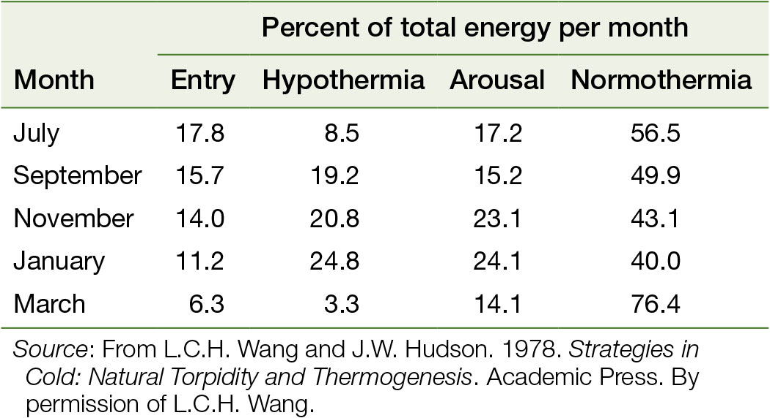
Table 14.1 Energy use during hibernation of a Richardson’s ground squirrel.
Notes:
Table 14.1 Energy use during hibernation of a Richardson’s ground squirrel.

Slide 14
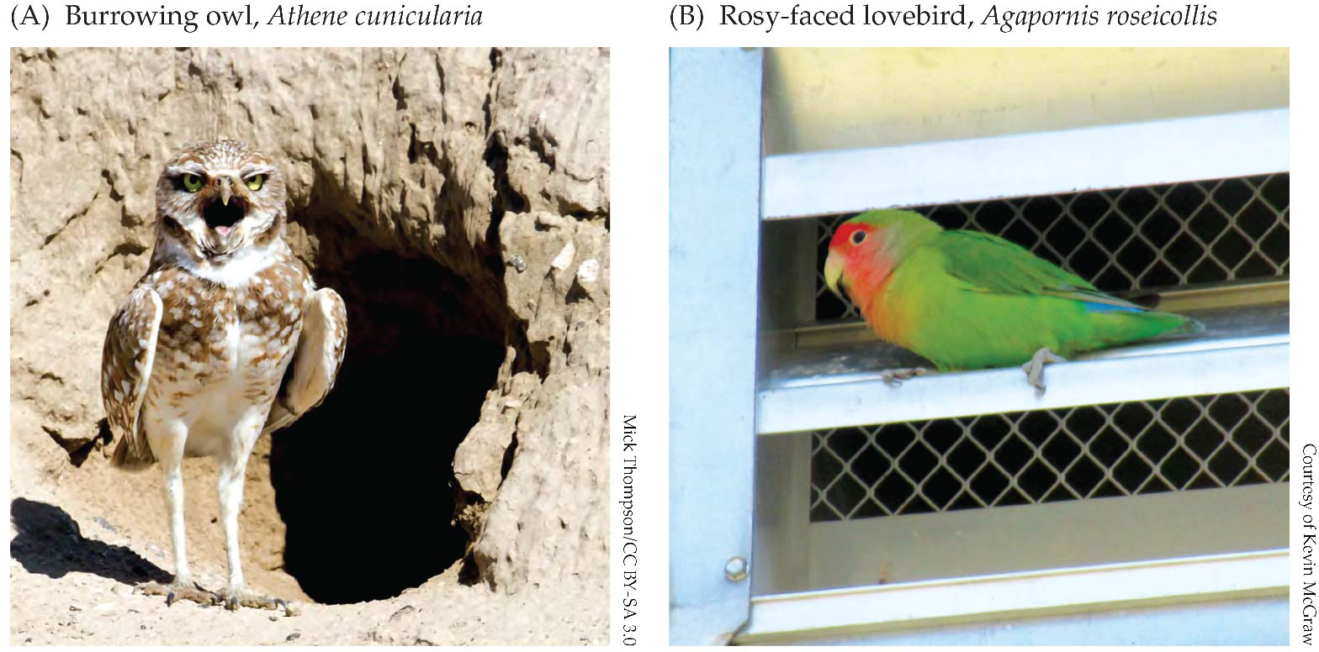
Figure 14.11 Desert birds can escape extreme heat.
Notes:
Figure 14.11 Desert birds can escape extreme heat. (A) Burrowing owls are one of several bird species that shelter from the heat in burrows constructed by rodents or desert tortoises. (B) A rosy-faced lovebird in Phoenix has found a vent exhausting cooled air from an air-conditioned building.

Slide 15
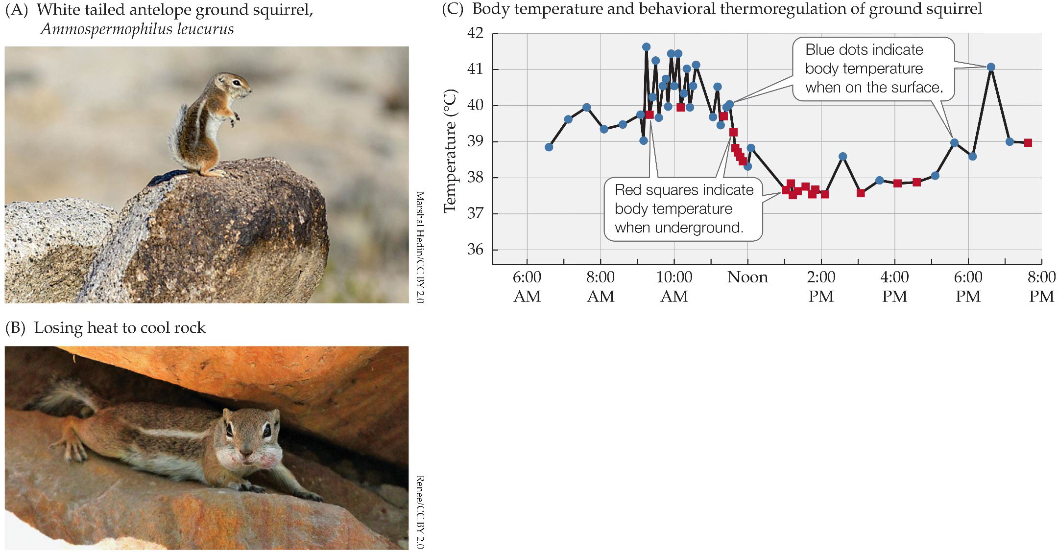
Figure 14.12 Short-term cycles of activity and body temperature.
Notes:
Figure 14.12 Short-term cycles of activity and body temperature. (A) White-tailed antelope ground squirrels are diurnal, even during the summer when ambient temperatures exceed the species’ upper lethal temperature. (B) Early in the day, a squirrel can dump heat by pressing its lightly furred belly against a shaded rock that is still cool from the night. (C) Later in the day, it must seek its burrow to find a cool substrate. (C after M.A. Chappell and G.A. Bartholomew. 1981. Physiol Zool 54: 215–223.)

Slide 16
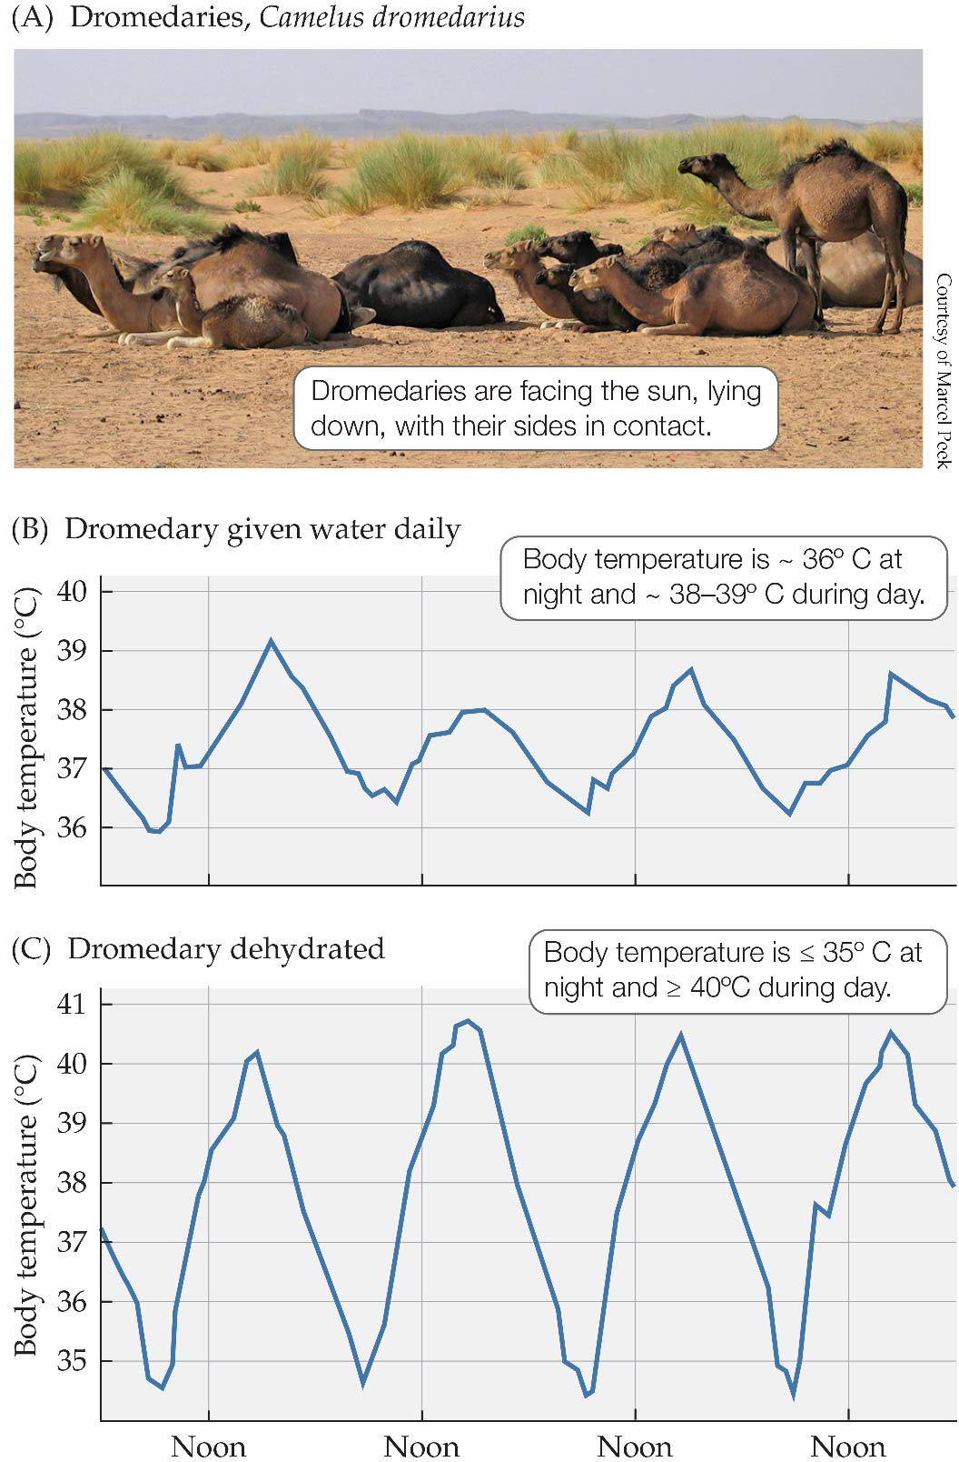
Figure 14.13 Daily cycles of body temperature of dromedaries.
Notes:
Figure 14.13 Daily cycles of body temperature of dromedaries. (A) In the heat of the day, dromedaries face into the sun so that solar radiation falls on their well-insulated necks, shoulders, and backs and press together so solar energy does not strike their sides. Their lightly insulated bellies and legs are in contact with sand that is still cool from the previous night. (B) When a dromedary has daily access to water, its body temperature cools to about 36ºC at night and rises to 38–39ºC during the day. (C) When the dromedary is dehydrated, its body temperature falls below 35ºC at night and rises above 40ºC during the day. (B,C after K. Schmidt-Nielsen et al. 1956. Am J Physiol 188: 103–112.)

Slide 17
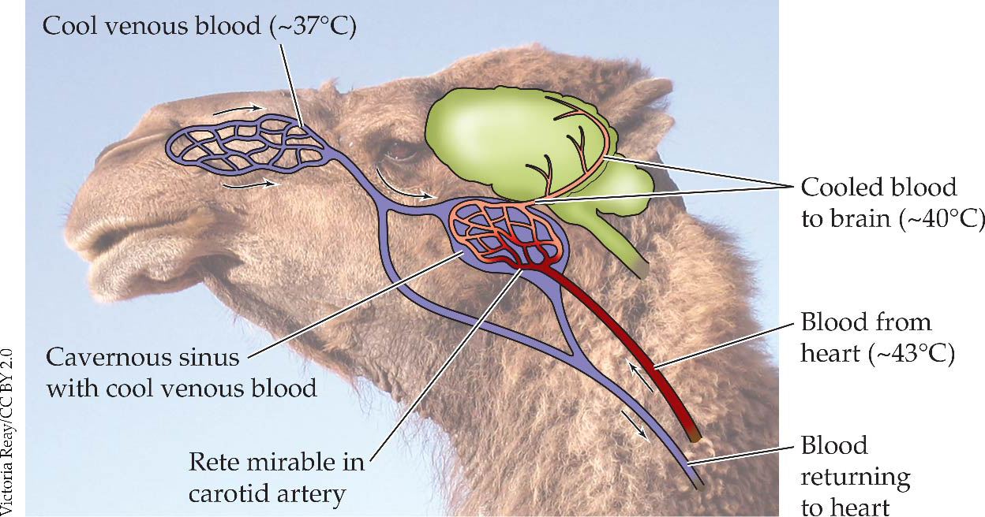
Figure 14.14 Countercurrent heat-exchange cools blood going to a dromedary’s brain.
Notes:
Figure 14.14 Countercurrent heat-exchange cools blood going to a dromedary’s brain. Venous blood is cooled by evaporation in the nasal passages. When this blood enters the cavernous sinus, it has a temperature of about 37ºC. Blood flowing to the brain via the internal carotid arteries has a temperature of about 43ºC when it enters the vessels of a rete mirabile in the cavernous sinus. Here it is surrounded by the cool venous blood. This countercurrent mechanism
cools the blood to approximately 40ºC by the time it reaches the brain.

Slide 18
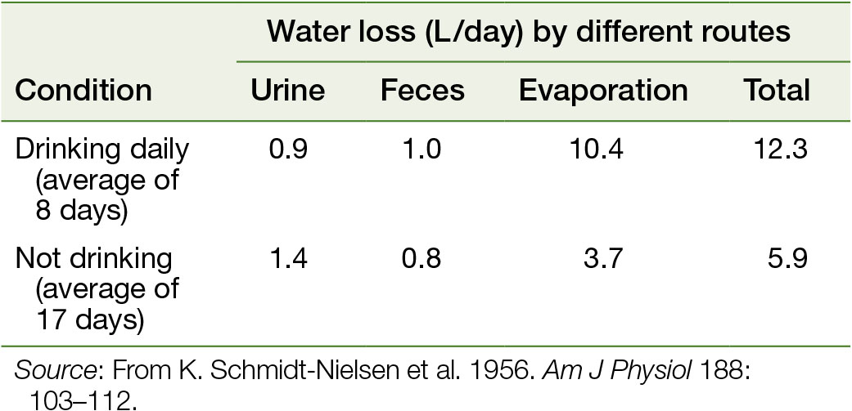
Table 14.2 Daily water loss of a 250-kg dromedary
Notes:
Table 14.2 Daily water loss of a 250-kg dromedary

Slide 19
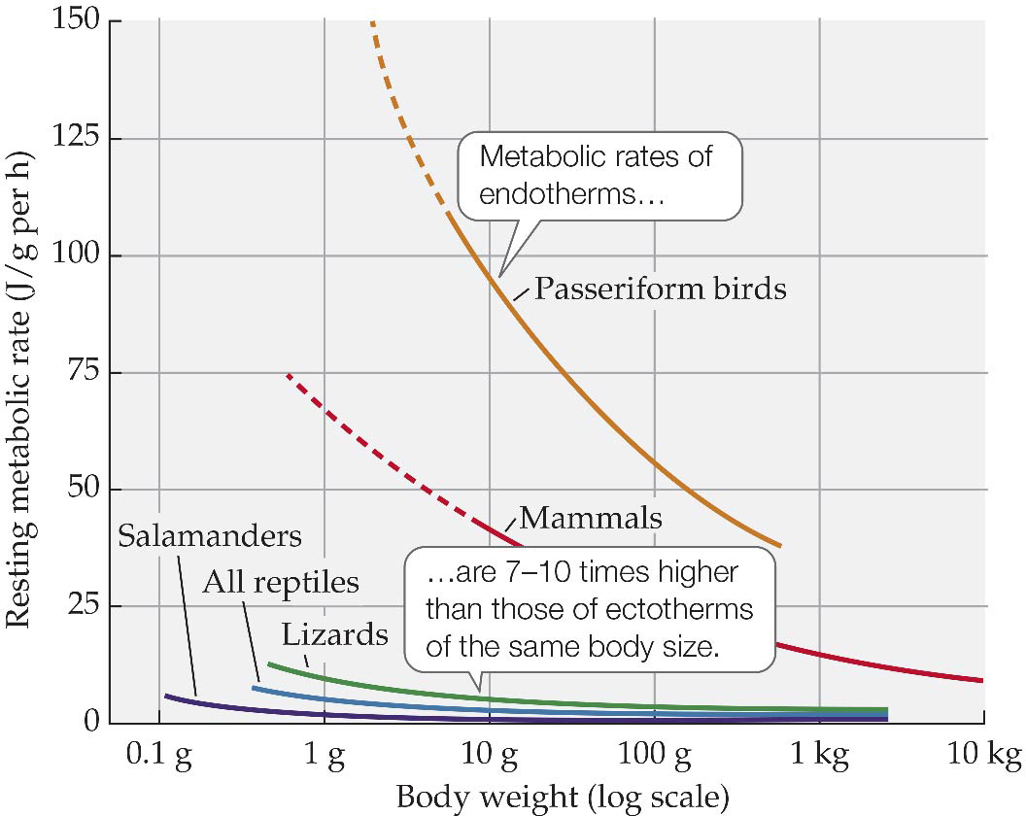
Figure 14.15 Weight-specific energy use by endotherms and ectotherms.
Notes:
Figure 14.15 Weight-specific energy use by endotherms and ectotherms. Resting metabolic rates of ectothermal and endothermal tetrapods are shown as a function of body size. Metabolic rates of endotherms are 7–10 times higher than those of ectotherms of the same body size. Because weight-specific energy requirements increase at small body sizes, and because rates for ectotherms are substantially lower than those for endotherms, ectotherms can be smaller than endotherms. Dashed portions of the lines for passeriform (perching) birds and mammals show hypothetical extensions into body sizes below the minimum for adults of most species. (After F.H. Pough 1980. Am Natur 115: 92–112.)

Slide 20
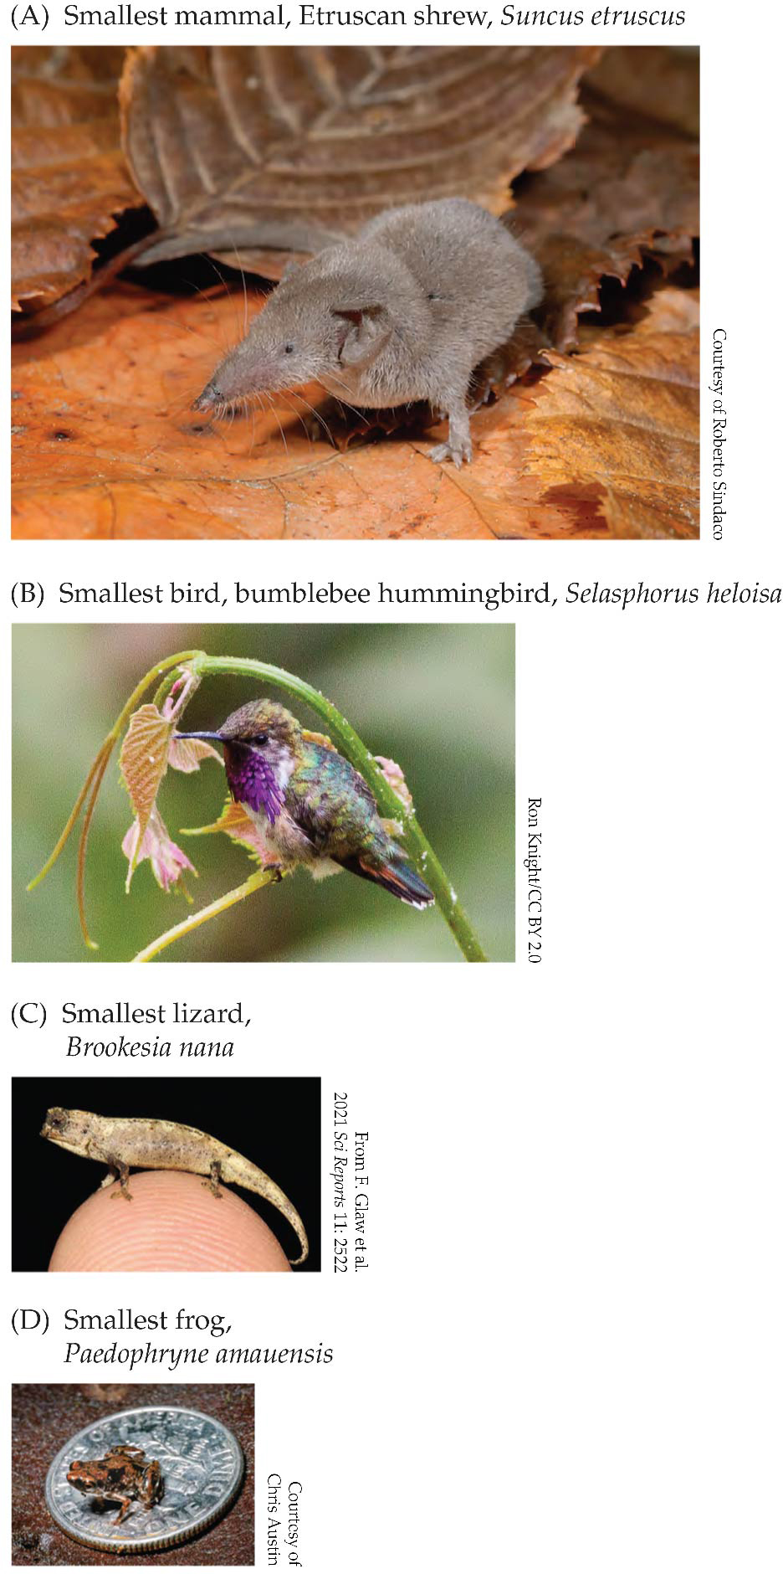
Figure 14.16 The smallest species of tetrapod endotherms are enormous compared to the smallest ectotherms.
Notes:
Figure 14.16 The smallest species of tetrapod endotherms are enormous compared to the smallest ectotherms. The smallest mammal, the Etruscan shrew from southern Europe and northern Africa (A) and the smallest bird, the bumblebee hummingbird of Mexico (B), both weigh about 2 g. The smallest lizard, a chameleon from Madagascar (C), weighs 0.2 g. The smallest frog, Paedophryne amauensis from Papua New Guinea (D), weighs about 0.1 g.

Slide 21
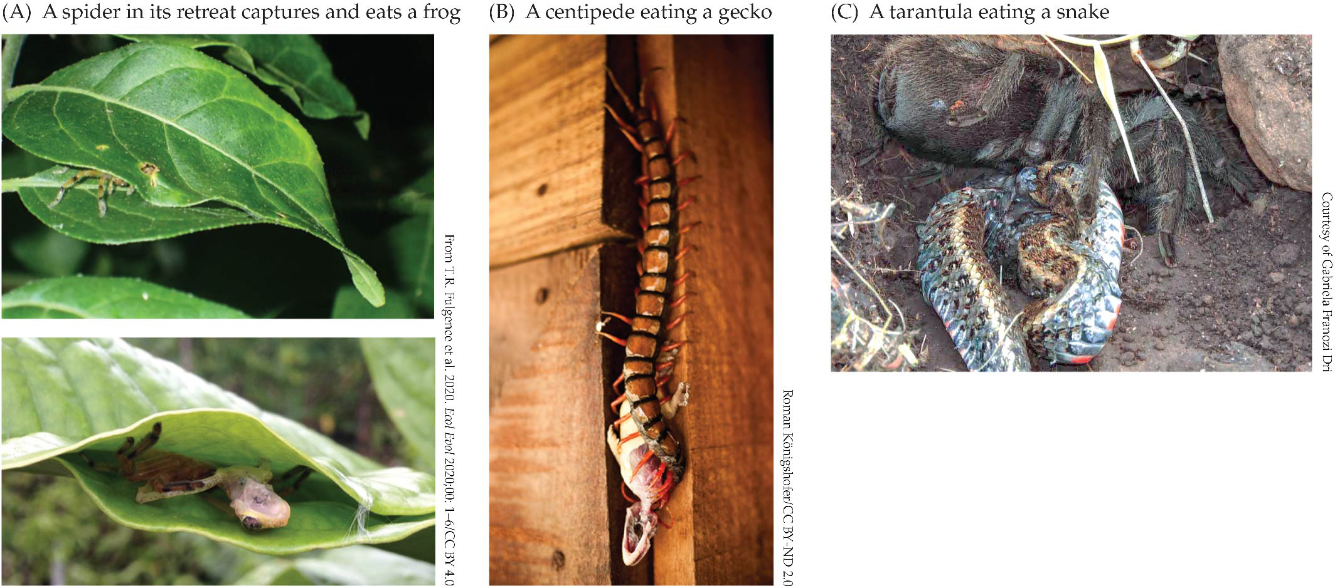
Figure 14.17 Spiders and centipedes prey on small vertebrates.
Notes:
Figure 14.17 Spiders and centipedes prey on small vertebrates. (A) This Madagascan spider creates traps for frogs by weaving two leaves together. The spider hides at the back of the enclosure and seizes frogs when they enter the retreat. (B,C) Arthro-pods such as centipedes and spiders can attack and kill small species of lizards and snakes.

Slide 22
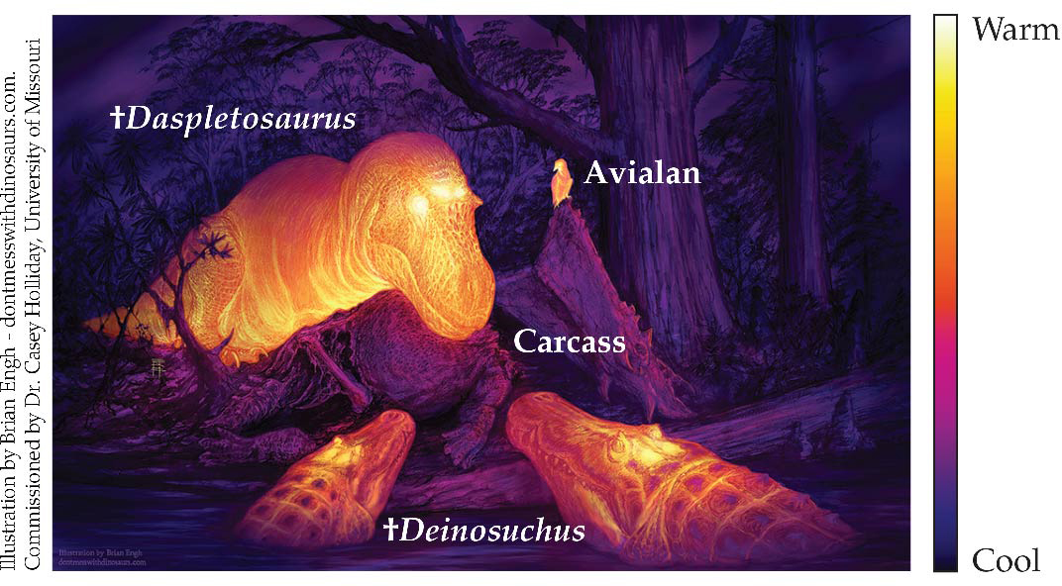
Figure 14.18 Thermal windows in the skull?
Notes:
Figure 14.18 Thermal windows in the skull? The frontoparietal fossa (depression) of archosaurs, unlike the fenestrae in the skull, is not associated with jaw muscles. Instead, it contains a dense array of blood vessels that may have provided a cooling system for the brain. This reconstruction of a scene from the Late Cretaceous shows a thermographic view of a theropod (Daspletosaurus) and two crocodylians (Deinosuchus) facing off at the carcass of a ceratopsian (horned dinosaur) while an avialian (basal bird) watches. The frontoparietal fossae of the theropod and the crocodylians are bright yellow, indicating that they are radiating heat.

Slide 23
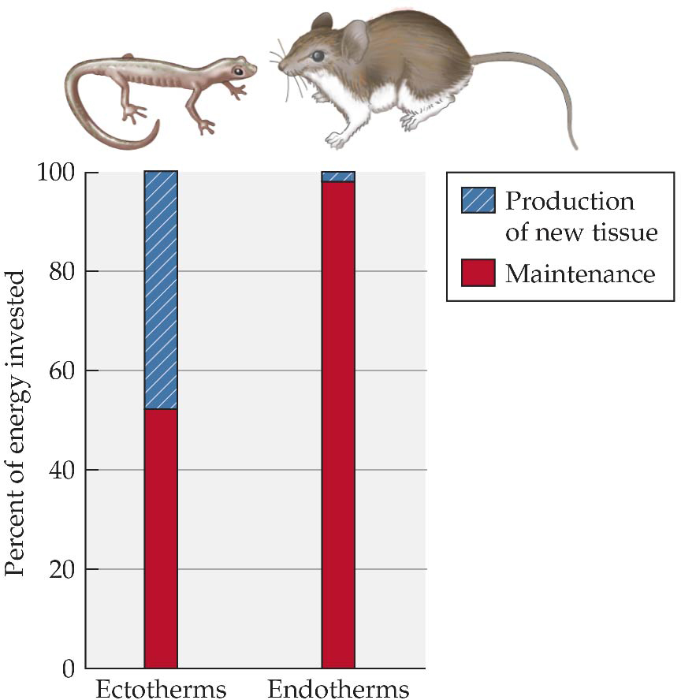
Figure 14.19 Efficiency of biomass production.
Notes:
Figure 14.19 Efficiency of biomass production. On average, ectotherms convert 25 times more of the food they consume to growth and reproduction than endotherms. (Data from F.H. Pough 1980. Am Natur 115: 92–112.)

