Slide 1
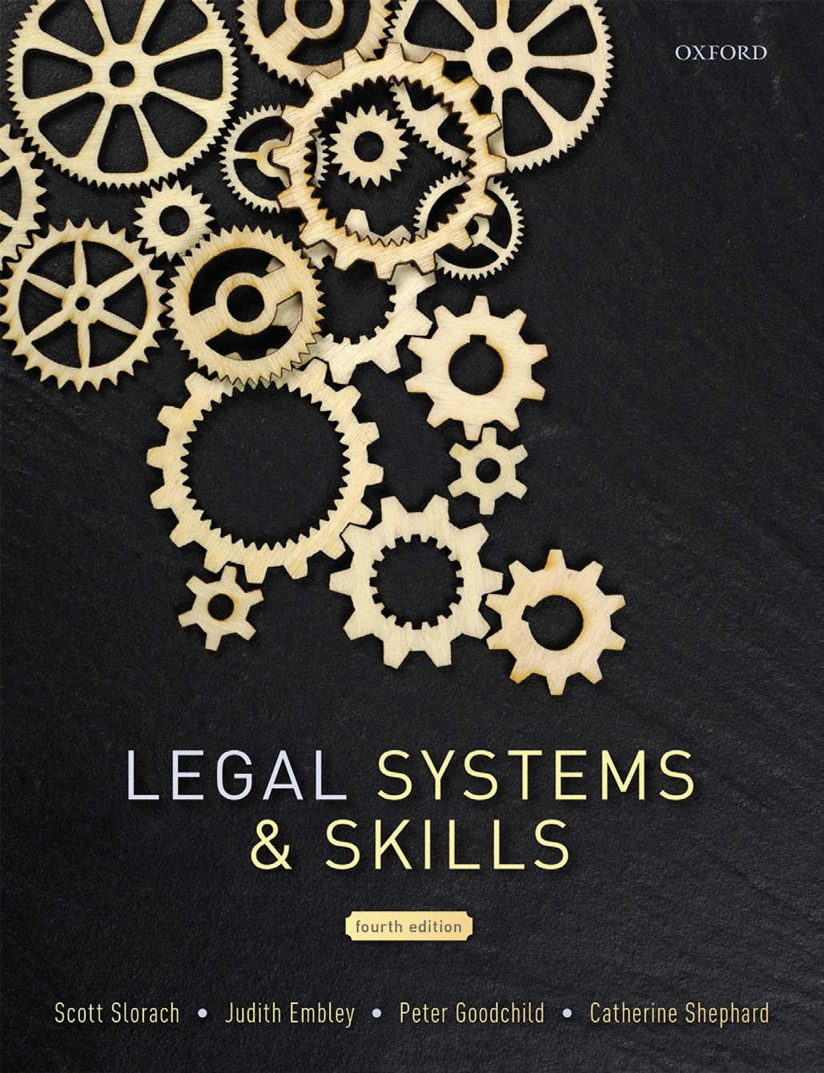
Legal Systems & Skills
by Scott Slorach, Judith Embley, Peter Goodchild and Catherine Shephard

Slide 2
Part 3
Employability and Commercial Awareness
Chapter 15
Making yourself more employable

Slide 3
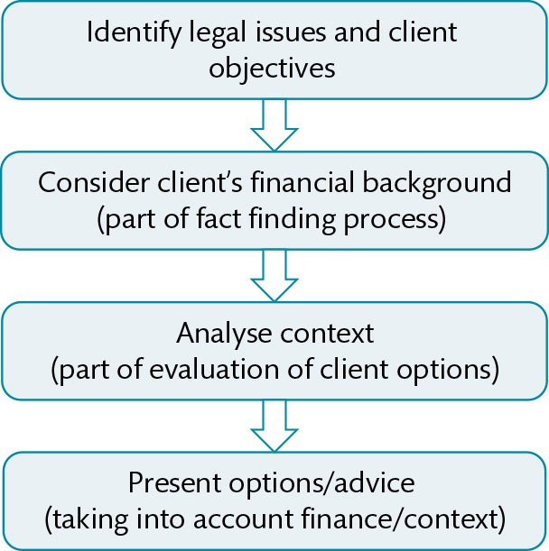
Figure 15.1 Commercial awareness steps

Slide 4
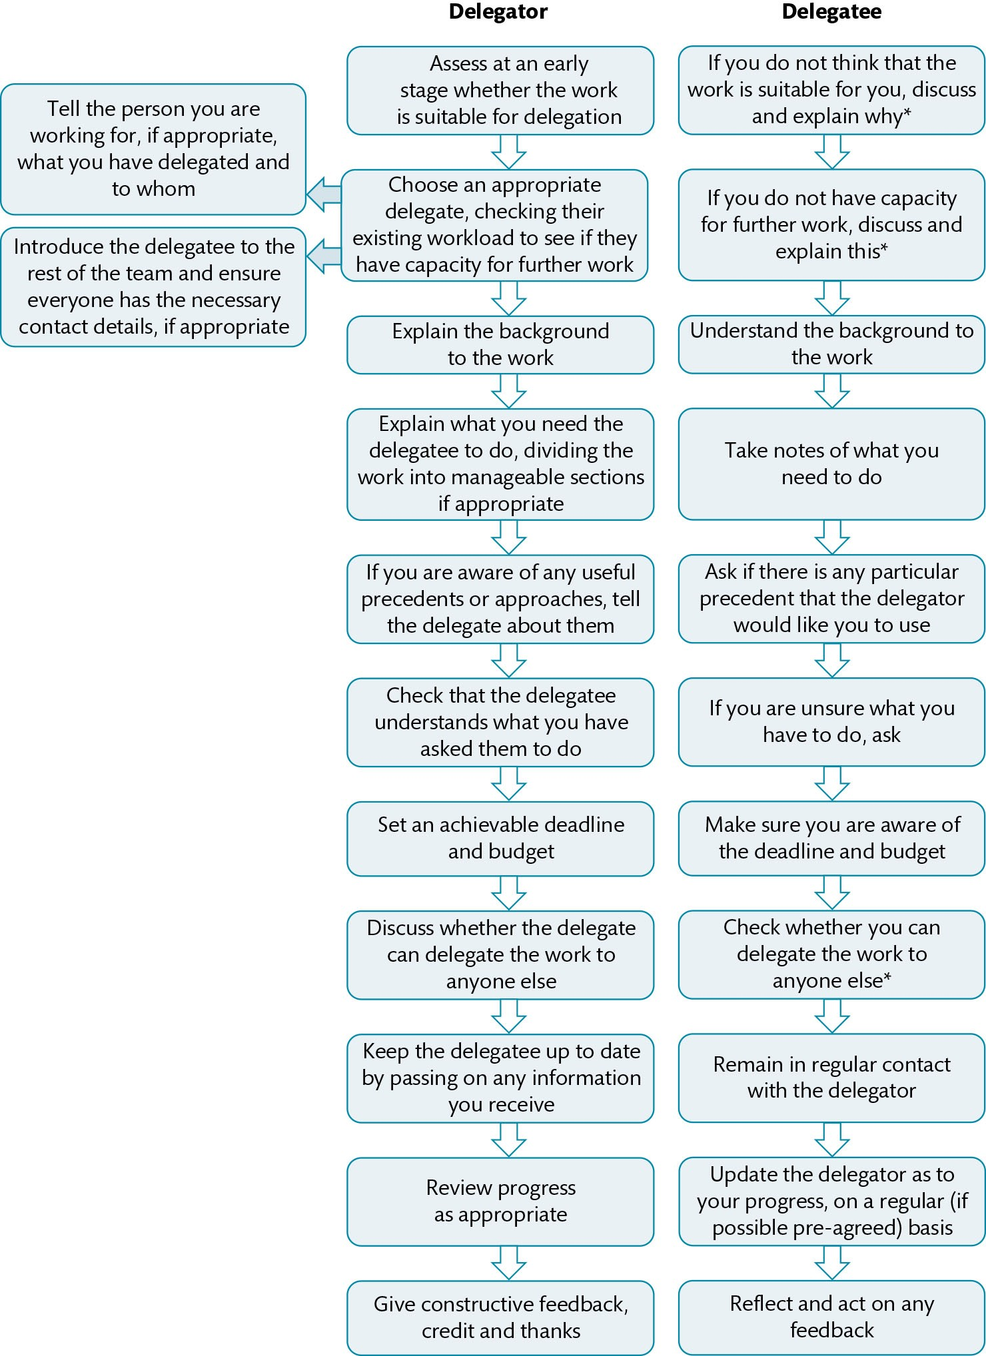
Figure 15.2 Delegation flowchart

