Slide 1
1
Issues and Trends in Professional Communication

Slide 2
Communicating for Change in the New Economy
Communication: A transactional and relational process involving the meaningful exchange of information
Top skills for entry-level hires
Collaboration/teamwork skills
Communication skills
Problem-solving skills
Analytical capabilities
Resiliency
Notes:
Soft skill: A social, interpersonal, self-management, or language skill that complements a person’s technical skills
Hard skill: A technical skill (know-how and abilities) that a person requires for a specific job
Good communication skills makes good business sense. Strong communication skills benefits employees and the companies they work for. HR specialists and business leaders increasingly look for new hires that have good communication skills.
Effective communication nurtures collaborative and creative workplaces; builds credibility, accountability, and relationships; increases efficiency, workflow, and productivity; enhances problem-solving and decision-making, and creates wealth.

Slide 3
The Knowledge Economy
Technologies make knowledge and information more accessible
Workers need to find, evaluate, process, and communicate information
Insight economy
Data-driven approach to business
Competitive intelligence used to make decisions
Shared workspaces and intranets allow employees to share insider information
Notes:
Canada’s economy no longer based on raw materials and manufacturing; it is now knowledge-based. Information is a valuable commodity.
Workers are expected to find and evaluate information and then process and communicate that information effectively.
Practice of collecting, analyzing, and comparing large data sets, and identifying patterns in them to better understand consumer preferences, forecast trends, and attune strategies, products, and services, is increasingly common in businesses large and small.
73% of surveyed businesses reported gaining value from the data and artificial intelligence (AI) projects they launched in marketing, customer-relationship management, data sharing, human resources and hiring, and security enhancement.
Companies also rely on competitive intelligence—the practice of deriving data insight from external sources to gain a competitive advantage by utilizing information about a competitor’s products, services, and customers to make business decisions.
Example: The Toronto Raptors front office has drawn insights from big data since 2016, when it partnered with IBM to use its AI-based Watson technology to make the strategic draft
picks that helped it clinch the 2019 NBA championship.

Slide 4
The Risk Society
Risk = potential for loss
Manufactured risks
Piracy
Cyberwarfare
Identity theft
Data breach
Risk communication
Crucial for addressing concerns and developing protocols to manage risk
Notes:
Unprecedented modernization and globalization have brought not only unprecedented progress but also unprecedented risk. Recognizing this, sociologists Anthony Giddens and Ulrich Beck have called our modern society a “risk society.”
Manufactured risks can be catastrophic—lost/compromised data impact commerce and credibility; legal costs and settlements impact bottom line
Piracy: unauthorized reproduction and distribution of copyrighted material, including video games, software, music, and films
Cyberwarfare: form of information warfare, usually politically motivated sabotage/hacking
Identity theft: act of acquiring and collecting an individual’s personal information for criminal purposes
Managing risk is essential for the active risk-taking that allows a dynamic economy to continue. Preventive measures and regulation are part of this stabilizing effort, as are the specialized protocols of crisis and risk communication.

Slide 5
Sustainability and Corporate Social Responsibility
Corporate Social Responsibility (CSR)
human rights
labour standards
environmental protections
anti-corruption
Notes:
Corporations now have great power and influence; 42 of the 100 largest economies in the world are companies, not countries.
Corporate Social Responsibility (CSR): A company’s voluntary contributions to sustainable development through the support of non-profit organizations and/or the creation of socially conscious corporate policies.
CSR movement was born in the 1990s amid concerns over environmental catastrophes (such as the sinking of the Exxon Valdez), the first sustainability reports from forward-looking companies such as Ben & Jerry’s, and the emergence of the anti-globalization movement.
The United Nations Global Compact (UNGC) asks companies to embrace, support, and enact core values related to human rights, labour standards, environmental protections, and anti-corruption.
CRS reporting is increasingly important. It strengthens reputation, links with stakeholders, stakeholder value, investor appeal, and financial performance
Sustainable development: Economic development that maintains natural resources for future generations and recognizes the relationship between economic, social, and environmental issues

Slide 6
Business on a Global Scale
Globalized economy due to new technologies and outsourcing
Companies compete and operate across international markets
Increased foreign investment in Canada and Canadian companies
Skills in intercultural communication are crucial
Notes:
The globalized business structure provides new opportunities as well as challenges for Canadian workers and their organizations.
Canadian products must compete in international markets
brands we may think of as 100 per cent Canadian may in fact be produced, in whole or in part, in other countries
Example: Canadian aerospace and transportation giant Bombardier has facilities in 28 countries.
The need to explore new and emerging markets, negotiate, buy and sell overseas, market products, and enter into joint ventures is anchored in effective communication with people from around the world; without this communication, none of these functions could be accomplished.
The ability to communicate across cultural differences, time zones, and language barriers—and to exercise intercultural sensitivity by respecting differences in customs, lifestyles, religions, and business etiquette—is crucial to business success in this new global economy.

Slide 7
More Diverse Employee Base
Gender
Race
Ethnicity
Age
Sexual orientation
Religious belief
Physical abilities
Embracing diversity = greater productivity and competitive advantage
Notes:
Diversity: Differences among people with respect to gender, race, ethnicity, age, sexual orientation, religious belief, and physical ability, which are to be acknowledged, valued, and celebrated in today’s workplaces.
Canada’s diverse, multi-generational workforce is not simply the outcome of Canada’s success in attracting talented immigrants or in cultivating social responsibility through fair and equitable employment policies; it is a matter of good economic sense, as companies capitalize on talents, expertise, creativity, and strengths across diverse groups to obtain greater productivity and competitive advantage.
A company’s human capital, or the individuals that make up an organization, either fuel or curb its success and are arguably its greatest asset.
RBC Financial Group refers to this practice as “the diversity advantage” and cites it as a defining business trend in the twenty-first century.
The demographic makeup of most workplaces and the interactions brought about by a worldwide economy makes promoting diversity an important component of management.

Slide 8
Growing Millennial and Gen Z Workforce
Millennials + Gen Z = 64% of Canada’s workforce by 2020
Prefer to work from home
Like gig economy
Work preferences
financial rewards and benefits
flexible work hours
work–life balance
ongoing learning, coaching, and real-time feedback
fulfillment—be themselves and develop strengths
being kept in the loop—access to information
Notes:
Millennials: born between 1981 and 1996; 1/3 of Canada’s population
Gen Z: born in 1997 or after
Gig economy: a labour market characterized by a high number of freelance and contract jobs
Millennials are also known for their willingness to work in teams, communicate openly with managers, embrace new communication technologies, and change jobs frequently, in fact twice as often as previous generations, in order to achieve career goals.
70 per cent of millennials prefer to work from home, making telecommuting, mobile offices, online collaboration tools, and cloud software more than just passing trends.
If this new generation of employees has a personality, it could be summed up as the Pew Research Center has described it: confident, connected, and open to change.

Slide 9
Team Work Environments
21st century business is conducted by teams
Collaboration helps drive growth and innovation
IT enables remote, virtual teamwork
Teamwork requires good communication and interpersonal skills
Training helps teams boost performance, manage conflict, and communicate openly
Notes:
Creativity demands different work modes and types of technology
“People need to work alone, in pairs and in different size groups throughout a creative process, and they need a range of devices that are mobile and integrated into the physical workplace.”
Collaboration through cross-functional teams, in which individuals with different areas of expertise come together to share information for a common goal, makes the most of a workforce’s creative potential by increasing individual involvement in decision-making and project development.
Cross-functional teams: individuals with different areas of expertise come together to share information for a common goal

Slide 10
Disruptive Technologies
Disruptive technologies displace established competitors, make some obsolete
Examples: laptops, e-mail, texting, smartphones, WhatsApp, cloud computing, and wearables
New industrial revolution (Industry 4.0): automation, data exchange, machine learning
Notes:
Disruptive Technologies: innovative, transformative products and services that create new opportunities and move up the market to replace established competitors
Technological breakthroughs have brought us closer to a fully digitized society, complete with smart home security systems, “smart factories”, cyber-physical system integration and blockchain record-keeping technology.
Many technologies that are now essential communication tools are disruptive technologies: laptops; e-mail; tablets; smartphones; Bluetooth technology; instant messaging (IM); text messaging; voicemail; proprietary Voice over Internet Protocol services (VoIP) such as Skype; podcasts; mobile apps such as WhatsApp; space-defying video conferencing and web conferencing; presentation software such as PowerPoint and Keynote; interactive software that can change the sequence of information; blogs; wikis; augmented and virtual reality; cloud computing; smart and virtual assistants; and wearable computer components.
These technologies allow us to communicate farther, faster, and around the clock—to the point where we are always using one technology or another.
As political theorist Michael Sandel has noted, “developments in information technology are enabling companies to squeeze out all the inefficiencies and friction from their markets and business operations.”

Slide 11
Digital Connectivity
Extensive impact on business communication, relationships, marketing, productivity
Social networking sites
Web 3.0
Mobile apps for business: B2B and B2C
Notes:
Many business leaders believe Web 3.0 will transform business (sales, marketing, product development) with its unprecedented ability to connect and communicate with customers; real-time analytics; data capture from online activities. Companies that have embraced it include Dell (community of 1 million users to test products and give feedback) and Amazon (uses AI to give customer recommendations based on browsing history).
Business-to-business (B2B) apps are used to support an organization’s internal business processes such as customer-relationship management, warehouse management, and salesforce automation.
Business-to-consumer (B2C) apps fulfill different needs: content-oriented apps, such as Twitter and IM+, answer the need for information, communication, entertainment, and socialization; marketing-oriented apps promote brands and target them to young, digitally native demographics
Service-oriented apps allow users to perform tasks such as banking, shopping, or consulting schedules; productivity apps include note-taking apps, business-planning apps, file-synching apps, and virtual assistant apps.

Slide 12
New Economies
Attention economy
Attention = the new currency, always at a premium
Measured in views, tags, likes, followers
Distraction economy
Drawing consumers’ attention from one source to another
Share (peer) economy
Access to resources, not ownership—sharing, renting, swapping, gifting, lending, bartering
Notes:
Internet and social media have made information glut and overload a central fact of daily experience.
Surging volumes of content bring endless choices about what to view, read, listen to, and know.
Though capital, labour, information, and knowledge are plentiful, attention is scarce, and businesses must compete and manage information strategically to attract it.
For businesses and their stakeholders, getting attention quickly and memorably and forging connections and affinities online matters more now than it has ever before.
Share economy app-based services such as Airbnb (accommodation), Lyft (ride sharing), and TaskRabbit (micro jobs) have disrupted previously regulated taxi, car-rental, and hotel industries.
Because share economies place a monetary value on access to assets, they enable people who control that access to become part-time entrepreneurs.

Slide 13
Indigenous Economic Empowerment
Indigenous entrepreneurship emphasizes collectiveness, community development, Indigenous knowledge
Broad range of sectors include eco-tourism, solar power, fashion, food and beverage
Territorial acknowledgements from non-Indigenous businesses—important cultural protocols, show respect and help build relationships
Notes:
Indigenomics: describes the effort of indigenous peoples to build their future and improve their communities and quality of life through equity, ownership, the environment, environmental planning and procurement.
Territorial acknowledgement: statement that recognizes the traditional territory of Indigenous peoples who inhabit, or once inhabited, the land on which a meeting, conference, course, community event, occurs
Territorial acknowledgements must be specific to the area and the Indigenous people(s) who call or called that area home. Some go further, mentioning obligations to Indigenous communities and treaties, recognizing Indigenous title to traditional territories.

Slide 14
Professionalism and Employee Engagement
Professionalism: demonstrating the competence and/or skill expected from a professional
Employee engagement: employees’ genuine enthusiasm for and commitment to their work and organization

Slide 15
Why Professionalism Is Important
Acting professionally
put clients first
maintain confidentiality
use knowledge for honest, legal, and ethical purposes
Developing a shared work identity
educational background
professional training
experiences and expertise
membership in professional associations
shared work cultures
shared problem solving and customer relations
Creates benefits for individuals and organizations
higher status and authority
reduces conflicts, errors
improves workflow, work environment, customer relations
Notes:
Professionalism is embedded in every aspect of the workplace, including its systems, structures, rules, and procedures. It is prioritized in an organization’s policies, mission statement, codes of conduct, training manuals, and communication standards because it is considered desirable, appealing, and rewarding.
Example: 2014–2015 the Chartered Professional Accountants of Canada raised awareness of its new professional designation by promoting its brand with the tagline “Need a PRO?”
A commitment to professionalism increases the chance that your behaviour, interactions, communications, and achievements will be viewed positively.
Professionalism is good for business because it enhances a company’s efficiency, productivity, competitiveness, and reputation.

Slide 16
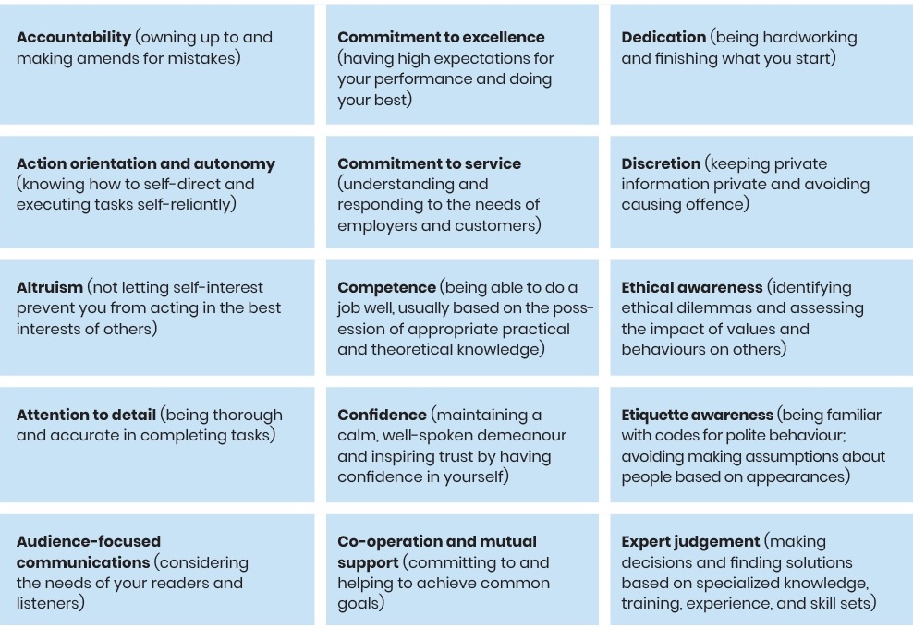
Qualities, Characteristics, and Expectations
Notes:
Figure 1.1 lists the skills and personal qualities required for professionalism or “good corporate citizenship”; continued on following slide

Slide 17
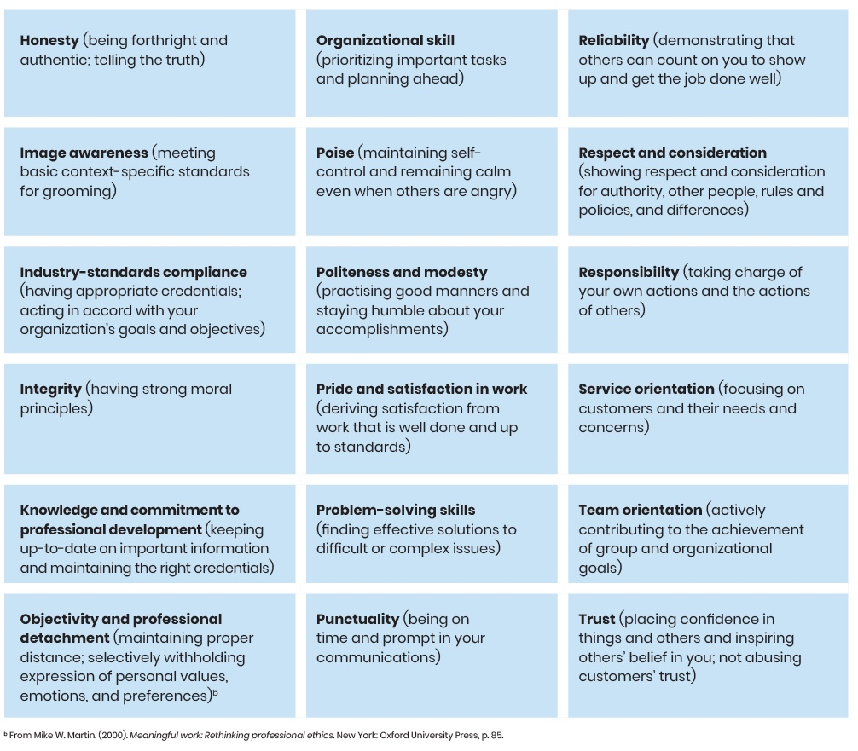
Notes:
Figure 1.1 (cont’d) lists the qualities most organizations expect of employees who are good “corporate citizens”

Slide 18
Qualities, Characteristics, and Expectations (cont’d)
Most organizations expect employees to be good “corporate citizens”
“Authentic organizations” foster creative, innovative environments to boost engagement
Increased employee engagement boosts company performance and revenues
Notes:
Authentic organizations: Organizations that encourage employees to be their best selves by valuing and nurturing their perspectives and differences in attitudes. They take this approach to counter negative interpretations of the “good corporate citizen” expectation.
Examples:
IT company Cisco Systems Canada has set up a reverse-mentoring program that gives new recruits the opportunity to share tips with corporate leaders and motivates the new employees by making them feel they can make a difference.
The Aboriginal Peoples Television Network Inc. (APTN), one of the Globe and Mail’s Top 100 Employers, formed a committee to foster long-term employee engagement through a collaborative approach.

Slide 19
Professional Boundaries and Behaviours
Personal boundaries
The emotional, physical, and mental limits individuals establish to protect themselves from harm and to set their thoughts and feelings apart from those of other people
Professional boundaries
The emotional, physical, and mental limits that define what employees should and should not do and how they should be treated in the workplace
Notes:
Relationships are defined by the boundaries we set to map out what is acceptable behaviour and what is off-limits in particular contexts.
Boundaries create transparency and help build strong, respectful relationships.
Professional boundaries help employees work safely, comfortably, and productively.
They help each member of an organization know where they stand, what is expected of them, and what they can rightfully say “yes” and “no” to.
Recognizing and respecting boundaries helps people work together more effectively, and it helps build an environment of transparency in which there is less chance of stress, blame, or bullying.

Slide 20
Professional Boundaries and Behaviours (cont’d)
Be aware of how professional boundaries relate to communication
organizational rules and reg’s (positive/negative sanctions)
Set professional boundaries
read job description and employment manual
Crossing professional boundaries can have negative results
causes confusion, conflict, embarrassment, loss of respect and reputation
norms (obligations that must be met)
cognition (ways of thinking)
individualized self-regulation (self-control, pride in performance)
reflect on personal values
talk to supervisors and superiors
observe workplace culture and how others interact
shifts attention off-task and away from a customer’s needs
lowers morale
disrupts co-worker relationships
Notes:
Defining and establishing professional boundaries begins with recognizing the limits of your personal boundaries. It also requires you to understand the guidelines your organization has set to regulate how you will behave toward others and how others will behave toward you.
To start, you should be able to answer the following questions:
• What is your role according to your job description?
• What are your duties and responsibilities?
• Who do you support and report to?
• Who assigns your work and sets your priorities?
• Who evaluates your work and provides feedback?
Unprofessional behaviour is often the result of loose boundaries or a lack of respect for established boundaries. It includes:
• gossiping about colleagues
• bullying and intimidating colleagues
• using cliques to ostracize certain colleagues
• using profane language
• ignoring messages or responding to colleagues in an inappropriate way
• sabotaging a colleague’s efforts
• blaming a colleague unfairly for your mistake
• not acknowledging a colleague’s presence or contribution
Example: Former Toronto mayor Rob Ford learned first-hand the negative repercussions of violating boundaries in the workplace when, in 2013, he knocked over and caused injury to Toronto City Councillor Pam McConnell in the city council’s chambers—their shared place of work. Toronto citizens and media criticized Ford’s behaviour, and widespread media reports of the incident did little to improve Ford’s already sagging reputation.
General rules of thumb: check your emotional baggage at the door; stay principled, committed, and respectful; and be the best employee you can be.

Slide 21
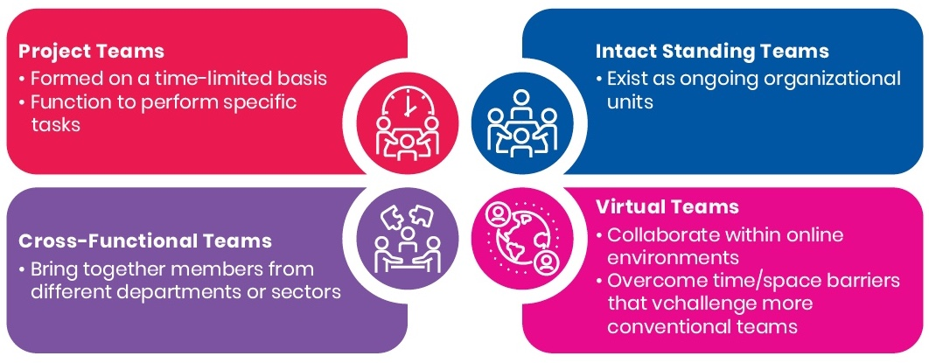
Teamwork
Notes:
Figure 1.2 Types of Teams
Team: A group whose members have complementary skills and work toward a common mission or goal
Team orientation is a sought-after skill
Teams are the foundation of organizational life
Teams help organizations perform crucial functions, including meeting work needs, realizing specific outcomes, and sustaining a competitive advantage.
Teams are essential because of their capacities in
• accomplishing projects too large or too complex to be completed by individuals
• forming bonds and a sense of community
• proposing and evaluating solutions to organizational problems
• facilitating innovation

Slide 22
Characteristics of High-Performing Teams
Trust
Commitment
SMART goals
Open communication
Accountability
Problem-solving orientation
Defined responsibilities
Ground rules
Decision-making model
Notes:
High-performance teams establish a record of working well together and succeeding according to these objectives.
The experience of working on such a team can be exhilarating and empowering for its members; however, optimal experience and success depends on adhering to specific principles and boundaries.
Team performance = degree to which team meets objectives for time, quality, and cost

Slide 23
Team Decision-Making Models
Team leader is central to group success
Models for decision-making:
Unilateral
Input
Delegation
Consensus
Majority
Notes:
The team leader plays a central role in group performance. The team leader can help build cognitive trust among team members and enhance the team’s shared sense of collective efficacy.
Cognitive trust: In a team setting, individuals’ beliefs in the reliability and dependability of fellow team members
Collective efficacy: In a team setting, the group’s belief in the ability of the team to organize and execute activities that will enable them to achieve their goal(s)
Several models, with differing team-leader roles, are open to teams for guiding the decision-making process:
• unilateral decision-making by the team leader, who then informs other members of the decision (often preferred in time-sensitive situations)
• decision-making by the team leader with input from team members based on their expertise
• decision-making through delegation to team members
• decision-making through a consensus model with input from all members
• decision-making through a majority-rules mode
Quality decisions involve a process where group members engage in open communication, respect each other’s input, and actively support any decision that is made.
There must be a sound and logical rationale for every decision, based on reliable information that has been shared with all team members and, when appropriate, input from outside stakeholders affected by the decision.

Slide 24
Stages in Team Development
Notes:
Figure 1.4 The Four Stages in Team Development
Teams need to evolve and pass through these four stages of behavioural development before they can perform at the highest level.

Slide 25
Managing Team Conflict
Rely on co-operative approaches
Re-think conflict
Recognize success for one is success for all
Look for areas of agreement
Listen carefully
Combine good ideas
Avoid competing
Develop a sense of team identity and trust
Don’t engage power struggles
Increase team member input
Notes:
Conflicts in teams are common. The way team members respond to and manage conflict can affect a team’s overall performance. These tips are helpful for avoiding/managing conflict.

Slide 26
Virtual Teams
Use technology to overcome differences in location, time, outlook to achieve common goals
Communication between members must be
Frequent
Predictable
Timely
Clear
Team members must all have access to the same software and be trained to use that technology.
Notes:
virtual communication has become increasingly common—business meetings, group tasks, work teams
growth of offshoring (a company practice of subcontracting of a business unit to a different company in a different country), flexible work arrangements, and rapid advances in technology makes it necessary
Communication in virtual teams is different than face-to-face communication and comes with unique advantages, namely saving time and money, but also challenges. Geographically dispersed team members may be less able to use informal communication approaches and pick up on non-verbal cues.
They may not have the benefit of contextual information that is typically shared among team members.
Misunderstandings may be more common.

Slide 27
Tools for Online Collaboration
Communication and Videoconferencing
Skype, Zoom, Flowdock, Slack, GoToMeeting, Microsoft Teams
Documentation Tools
Google Docs
File-sharing tools
OneDrive, DropBox, Google Drive
Task and project management tools
Asana, Zoho, LiquidPlanner, Teamwork Projects

Slide 28
Ethics and Legal Responsibilities of Business Communication, cont’d
Business ethics: The socially accepted moral principles and rules of business conduct
Company code of ethics
Upholds important company values
Sensitizes managers and staff to how to behave
Ethical policies, procedures and training
Provide guidance during crises or times of change
Strengthen brand image and company reputation
May provide legal benefits
Notes:
Business ethics = “do the right thing” with regard to stakeholders (employees, customers, investors, and the public) and the administration of products and services.
2017 Corporate Communication International Practices & Trends Study Final Report—trust, integrity and candour ranked number one among critical issues in corporate communication.
Most public- and private-sector firms across Canada have instituted a code or policies to deal with matters such as conflicts of interest, external and customer relations, the handling of company assets, relationships with competitors, and employee workplace issues.
Create marketplace advantage, enhance employee performance, promote a strong public image, prevent legal challenges, avoid huge sums in legal fees, and provide incentive for leniency in legal proceedings.

Slide 29
Ethical Lapses and Why They Happen
Safety-in-numbers
Head-in-the-sand
Between-a-rock-and-a hard-place
It’s-no-big-deal
Entitlement
Team-player
Notes:
The safety-in-numbers rationalization: the belief that such behaviour is excusable or guaranteed immunity.
The head-in-the-sand rationalization: the belief that remaining silent about wrongdoing will make it go away, or fear that taking action to correct it will be seen as “rocking the boat.”
The between-a-rock-and-a-hard-place rationalization: the belief that a positive or favourable outcome justifies any means said to be necessary, even if they are unethical.
The it’s-no-big-deal rationalization: an attempt to excuse wrongdoing as unimportant
and minimize its consequences.
The entitlement rationalization: self-deception based on the argument that one is entitled to break the rules and be free from consequences
The team-player rationalization: the reluctance to expose or confront colleagues about their wrongdoing out of fear that it will harm professional relationships and career advancement (also known as the yes-man syndrome).

Slide 30
Tips for Ethical Communication
Tell the truth
Accept responsibility
Don’t suppress or de-emphasize important information
Offer value for money
Be timely
Consider obligations
Show respect
Avoid libel
Distinguish between fact and opinion
Use layout to highlight, not hide, information
Be careful online
Know what you can / cannot disclose
Don’t plagiarize
Avoid language that evades responsibility
Notes:
Libel is printed and recorded defamation and is characterized by false, malicious, or derogatory remarks—remarks that arouse hatred, contempt, or ridicule toward the individuals to whom they are applied. Common law protects every person against libel.

Slide 31
Privacy in the Workplace
Privacy is “the claim of individuals, groups, or institutions to determine for themselves when, how, and to what extent information about them is communicated to others.” —Alan Westin, legal scholar
Government of Canada privacy laws
The Privacy Act
The Personal Information Protection and Electronic Documents Act (PIPEDA)
Notes:
In Canada, the Privacy Act explains how federally regulated public bodies can collect, use, and disclose individuals’ personal information. The Personal Information Protection and Electronic Documents Act (PIPEDA) applies to commercial transactions in the private sector and organizations that are federally regulated. According to PIPEDA, “personal information” includes a person’s:
• name, age, ID numbers such as a Social Insurance Number (SIN), income, ethnic origin
• bank account number, credit records, loan records, transaction histories, tax returns
• medical records, employee personnel files, and even voiceprints and fingerprints

Slide 32
Privacy in the Workplace (cont’d)
Criteria for corporate privacy agreements
1. Provide accountability
2. Identify reason for collecting information
3. Gain valid consent
4. Collect only necessary information
5. Use information for intended purpose only
6. Maintain accuracy of information
7. Provide safeguards
8. Inform individuals of use of information
9. Give individuals access to their information
10. Develop straightforward procedures for complaints
Notes:
The central role of technology in business means that concerns about privacy and data security have never been greater.
Despite companies’ efforts to safeguard personal information, privacy breaches are still common.
Examples:
• In 2019, the Desjardins Group, the largest association of credit unions in North America, suffered a massive data breach when a disgruntled employee leaked the personal data of 2.9 million members, including their social insurance numbers, their addresses, and details of their banking habits.
• In 2018, Loblaws drew complaints from customers who applied for gift cards in the wake of the bread-price-fixing scandal and felt they were asked for too much personal information.
• In 2017, hackers gained access to Equifax systems through a security vulnerability the credit monitoring company had known about for months. The result was a data breach affecting 143 million people around the world, including 19,000 Canadians whose personal information had been transferred to a third party in the United States without their knowledge. The Privacy Commissioner of Canada criticized Equifax Canada for falling short of its privacy obligations to Canadians on several accounts: retaining information too long and having poor security safeguards and consent procedures.
• The Ontario Court of Appeal case of Jones v. Tsige began with a love affair and ended in 2012 with a landmark decision that created a new remedy for privacy invasion. The defendant, Winnie Tsige, was in a common-law relationship with the ex-husband of the plaintiff, Sandra Jones. Both women worked for the Bank of Montreal (BMO), but they had never met. Tsige was involved in a financial dispute with her partner and was determined to find out if he was making support payments to Jones. She used her office computer to access Jones’s personal accounts 174 times over a four-year period. She admitted to her actions when confronted by BMO and received a one-week unpaid suspension. Jones made a claim for invasion of privacy and damages, but the motions judge held that no right to privacy existed under the Canadian Charter of Rights and Freedoms. This decision was overturned when the courts recognized the tort of “intrusion upon seclusion.” This refinement to privacy law involves three elements: intentional or reckless conduct, intrusion on privacy, and the perception by a reasonable person that this action would cause distress or humiliation.
To combat problems of this kind, PIPEDA and the Privacy Act set down rules for the management of personal information. PIPEDA’s privacy principles form the cornerstone of most corporate privacy agreements and state that organizations must meet the ten criteria listed above.

Slide 33
Privacy in the Workplace (cont’d)
Know and follow privacy legislation when dealing with personal info.
Obtain consent to collect, use, and disclose customers’ personal info.
Prevent unwarranted intrusion, release, or misuse of personal info.
Understand how much privacy you are giving up in exchange for user privileges.
Adjust privacy settings on all business devices, use up-to-date anti-virus software, and use firewalls.
When using smart speakers, be mindful of their full listening capabilities.
Notes:
Canada’s 2015 Digital Privacy Act requires organizations to notify affected individuals when a privacy breach has occurred and poses significant harm.
Because governments and businesses collect such a wide array of information, compliance with PIPEDA has implications for communications practices at every level.
Adopting new protocols is a step in the right direction, and problems can be minimized or avoided altogether with a few simple safeguards, such as those listed above.
Fair employers have clear policies that tell their employees exactly what personal information can be collected and how it will be used.
Employees should be well advised of web, e-mail, and social media policies, random surveillance, and any monitoring of their Internet use.

