Slide 1
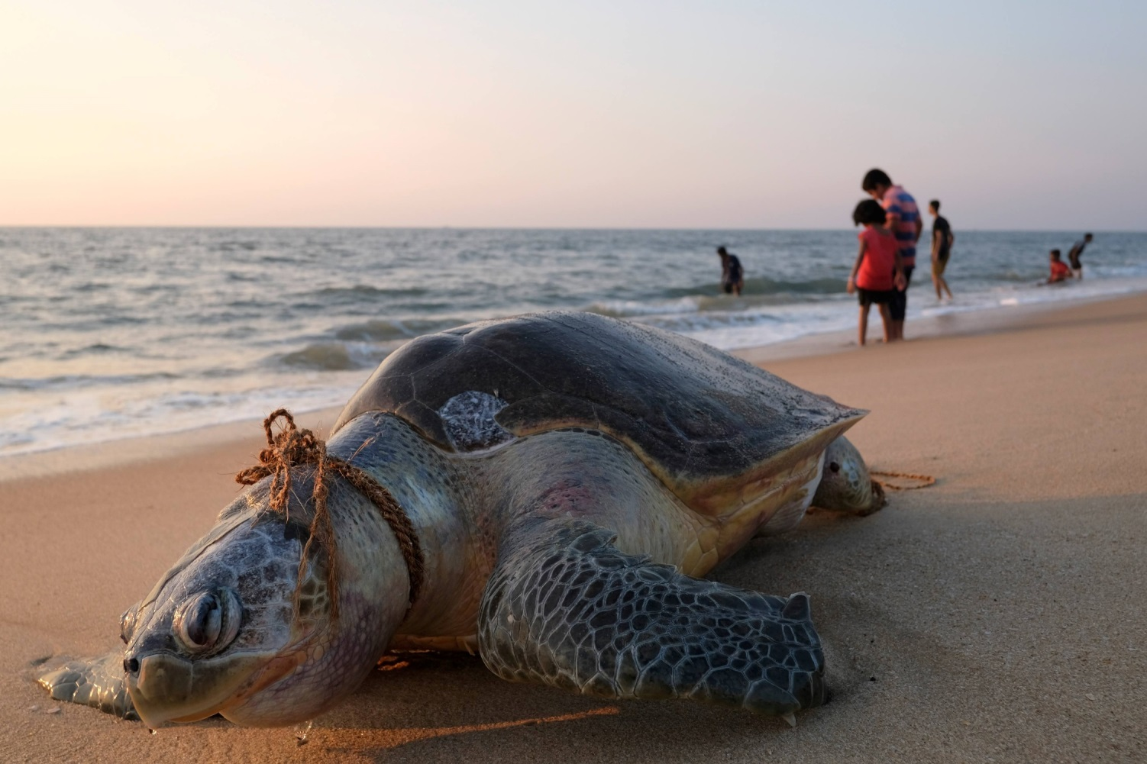
Chapter 13
Global Political Ecology
Notes:
1

Slide 2
Chapter 13
Global Political Ecology
An Ecological State of the World
Global Carrying Capacity
Global Climate Change: The Looming Macro-Challenge

Slide 3
Chapter 13 Learning Objectives
12.1 Explain different perspectives on global environmental issues and the ways they shape thinking about environmental problems and possible solutions
11.2 Discuss the impact of human activity on the natural environment
12.3 Identify the factors that point to the urgency for a global policy response to climate change

Slide 4
An Ecological State of the World 1 of 10
Neotraditionalists
a) humans are causing serious, even irreversible, damage to the environment
b) environmental damage increase cause human
c) deeply rooted in systems thinking

Slide 5
An Ecological State of the World 2 of 10
Modernists
a) More optimistic views of the global environment and its future
b) Ecology movement for alarmism by promoting “green guilt
c) technological innovation to solve most biosphere problems

Slide 6
An Ecological State of the World 3 of 10
Carrying capacity; the maximum capacity of an ecosystem to sustain organisms
Precautionary principle; the concept that preventative remedial action is warranted in situations where consequences are high

Slide 7
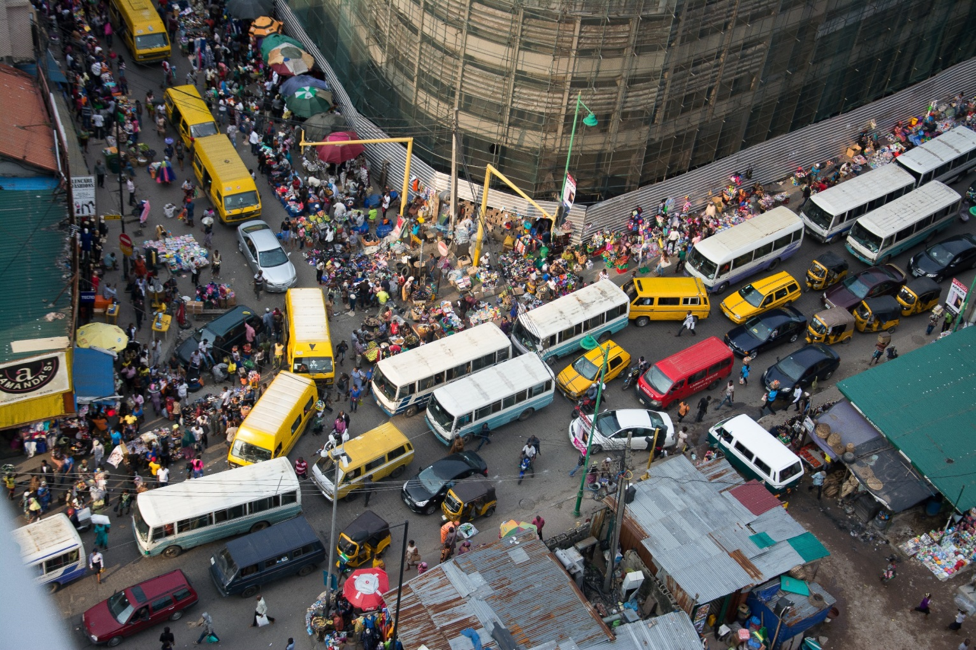
An Ecological State of the World 4 of 10
The Challenge of Sustainable Development

Slide 8
An Ecological State of the World 5 of 10
The Challenge of Sustainable Development
Sustainable Development
How to achieve sustainable Development
World Commission on Environment and Development
Gro Harlem Brundtland of Norway
Notes:
Sustainable Development: Development that meets the needs of the present without compromising the ability of future generations to meet their own needs

Slide 9
An Ecological State of the World 6 of 10
The Challenge of Sustainable Development
Rise in population
Society’s ecological footprint
North/South divide on sustainable development
Divide on responsibility to solve the ecological problem
1 billion Global North over 6 billion Global South

Slide 10
An Ecological State of the World 7 of 10
The Challenge of Sustainable Development
Technological progress increase consumption, waste and pollution
U.S. 20 time more oil consumption than India
Surge of cars in India and China increase (CO2)
China world’s largest emitter of CO2 since 2007

Slide 11
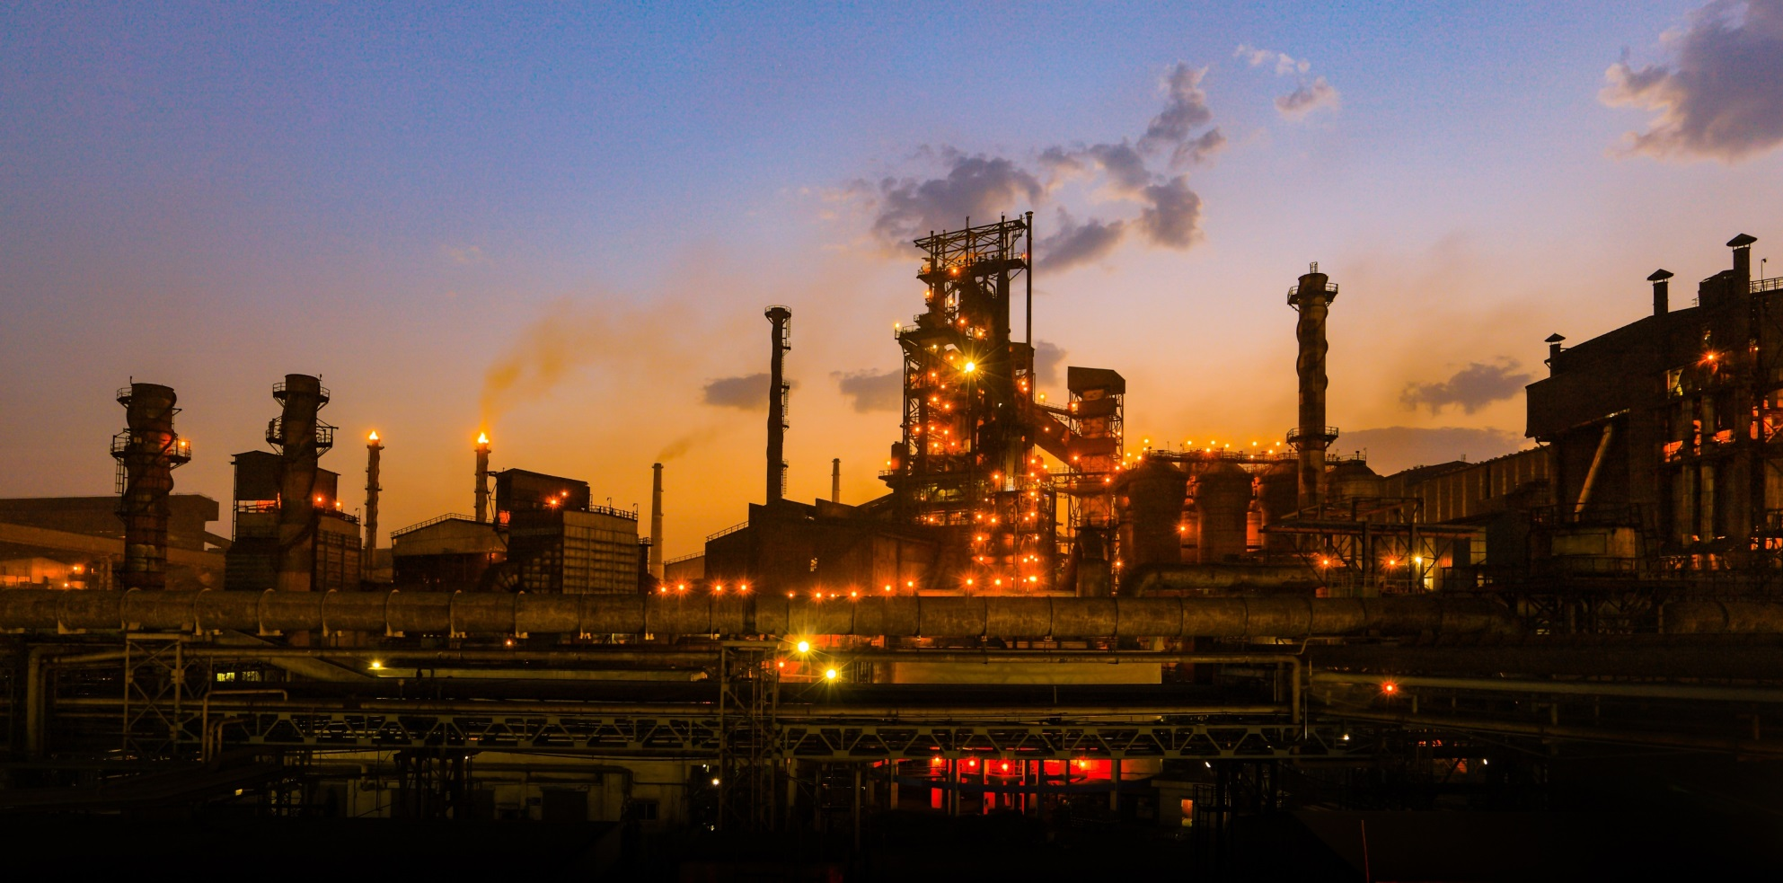
An Ecological State of the World 8 of 10
The Challenge of Sustainable Development

Slide 12
An Ecological State of the World 9 of 10
The Challenge of Sustainable Development
How do we achieve sustainable development?
Advance socioeconomic development
a) How do we safeguard future generations?
b) Can the Global South follow the same model of development as the North?

Slide 13
An Ecological State of the World 10 of 10
Historical Context: Earth Summits and the Politics of Sustainable Development
The 1992 UN (UNCED)
Agenda 21
The Convention on Biological Diversity
UN Framework Convention on Climate Change (UNFCCC)

Slide 14
Global Carrying Capacity 1 of 1
Human Population Pressures
April 2017 population passed the 7.5 billion
Population was 1 billion in 1804
High fertility rates
Fewer deaths

Slide 15
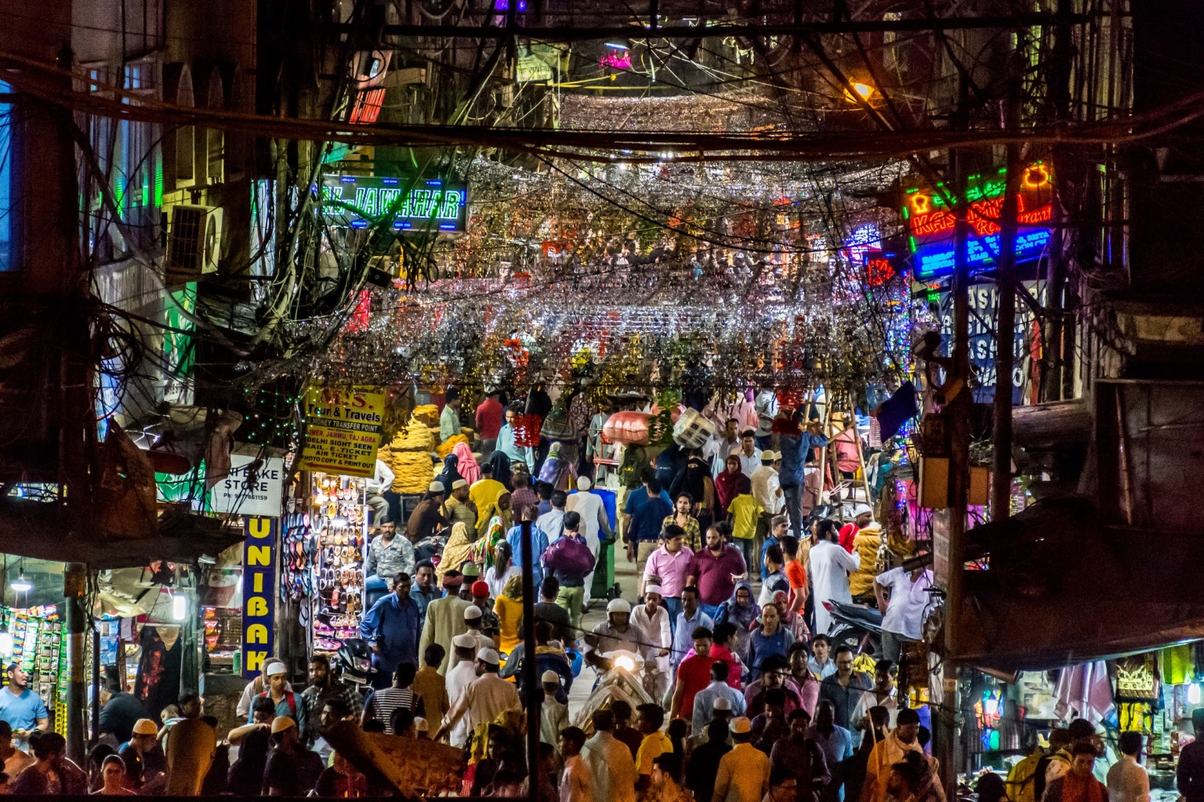
Global Carrying Capacity 2 of 2
Human Population Pressures

Slide 16
Global Carrying Capacity 3 of 7
Human Population Pressures
Finite resources and ability to absorb waste
Approaches to Reducing the Birthrate
a) Social approaches
b) Educational approaches

Slide 17
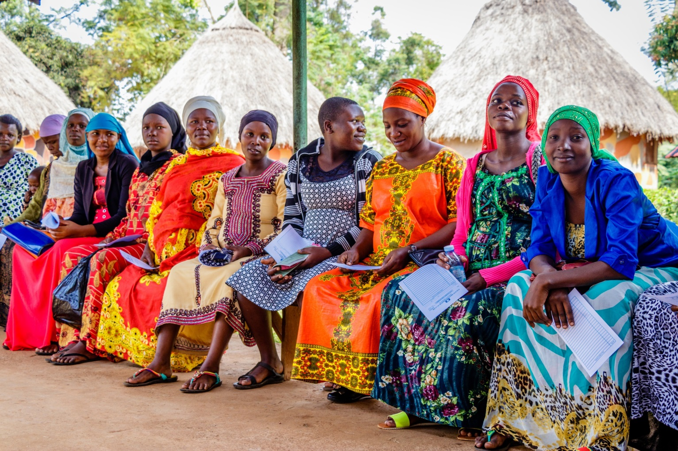
Global Carrying Capacity 4 of 7
Human Population Pressures
Notes:
During the early 1960s, the contraceptive prevalence rate (the percentage of couples practicing contraception) in the Global South was only 9 percent. Now it is about 60 percent. This contraceptive prevalence rate falls off drastically, however, in the least developed countries in the Global South, where the rate is only 40 percent.

Slide 18
Global Carrying Capacity 5 of 7
Assessing Global Environmental Quality
The degree of ecological stress
Enormous physical changes to the Earth
Dramatically change the ecosystems
Anthropocene age: The current geological age
Notes:
Land use change is the growing urbanization of the global population
Many of today’s concerns about air quality around the world

Slide 19
Global Carrying Capacity 6 of 7
Assessing Global Environmental Quality
Marine safety and pollution
a) Pollution from runoff
b) Spillage from shipping
c) ocean waste dumping
d) offshore mining
e) offshore oil and gas drilling
Notes:
Land use change is the growing urbanization of the global population
Many of today’s concerns about air quality around the world

Slide 20
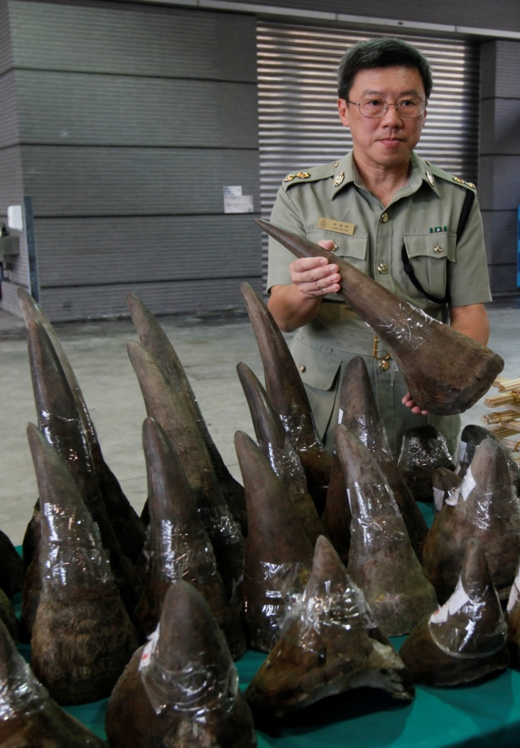
Global Carrying Capacity 7 of 7
Assessing Global Environmental Quality
Efforts to protect biodiversity
Convention on International Trade in Endangered Species of Wild Fauna and Flora (CITES)
Notes:
The demand for ivory remains high in some global markets, especially in Asia, and eliminating that element of the problem continues to pose difficulties. Many conservationists continue to view the situation as a “tragedy for elephants…when we are seeing such a dramatic increase in the slaughter of elephants for ivory

Slide 21
Global Climate Change: The Looming Macro-Challenge 1 of
Global Climate Change: What We Know
leading global environmental concern
Very little scientific controversy on this topic
Intergovernmental Panel on Climate Change
The greenhouse effects
Global emissions of greenhouse gases have risen significantly

Slide 22
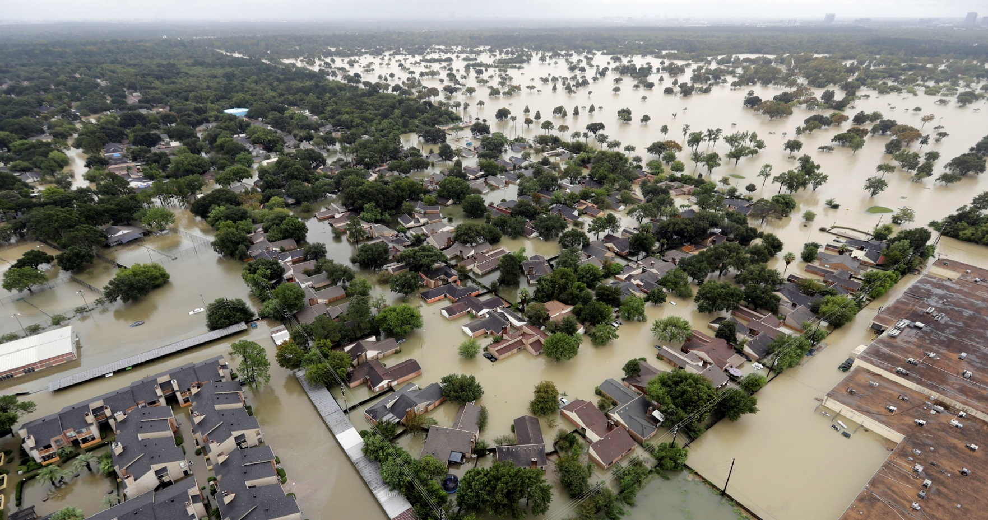
Global Climate Change: The Looming Macro-Challenge 2 of
Global Climate Change: What We Know
Notes:
One recent study published in Science shows that climate change has produced a change in the annual timing of river flooding in Europe. A change in flood timing can also have a cascading effect on river ecosystems, and on salmon spawning, agricultural production, and hydroelectric power generation

Slide 23
Global Climate Change: The Looming Macro-Challenge 3 of
Global Climate Change: Policy Challenges
The need for short term and long-term policy
Ecological consequences of climate change
Economic consequences of climate change
Necessary economic and lifestyle changes

Slide 24
Global Climate Change: The Looming Macro-Challenge 4 of
Global Climate Change: Policy Challenges
Environmental Impacts of Global Climate Change
Neotraditionalists predict dire consequences from global climate change.
World’s average temperature could rise several more degrees Celsius by the year 2100 (IPCC)

Slide 25
Global Climate Change: The Looming Macro-Challenge 5 of
Global Climate Change: Policy Challenges
Economic Impacts of Global Climate Change
Cost of adaptation widely varied
The Costs of Taking Action on Global Climate Change

Slide 26
Global Climate Change: The Looming Macro-Challenge 6 of
The Global Response to Climate Change
World Climate Conference (WCC, 1990)
The United Nations Framework Convention on Climate Change (UNFCCC, 1992)

Slide 27
Global Climate Change: The Looming Macro-Challenge of
The Global Response to Climate Change
The Kyoto Protocol (1997)
Global South call for 12% cut GHG emissions up to 15% by 2012
b) Global North wanted the Global South to commit to upper limits on future emissions, but the South rejected this idea

Slide 28
Global Climate Change: The Looming Macro-Challenge 6 of
The Global Response to Climate Change
The Paris COP meeting in 2015
Average temperature to well below 2 °C above pre-industrial levels
Efforts to limit the temperature increase to 1.5 °C above pre-industrial levels

Slide 29
Chapter 13 Review off Learning Objectives
12.1 Explain different perspectives on global environmental issues and the ways they shape thinking about environmental problems and possible solutions
11.2 Discuss the impact of human activity on the natural environment
12.3 Identify the factors that point to the urgency for a global policy response to climate change

