Slide 1
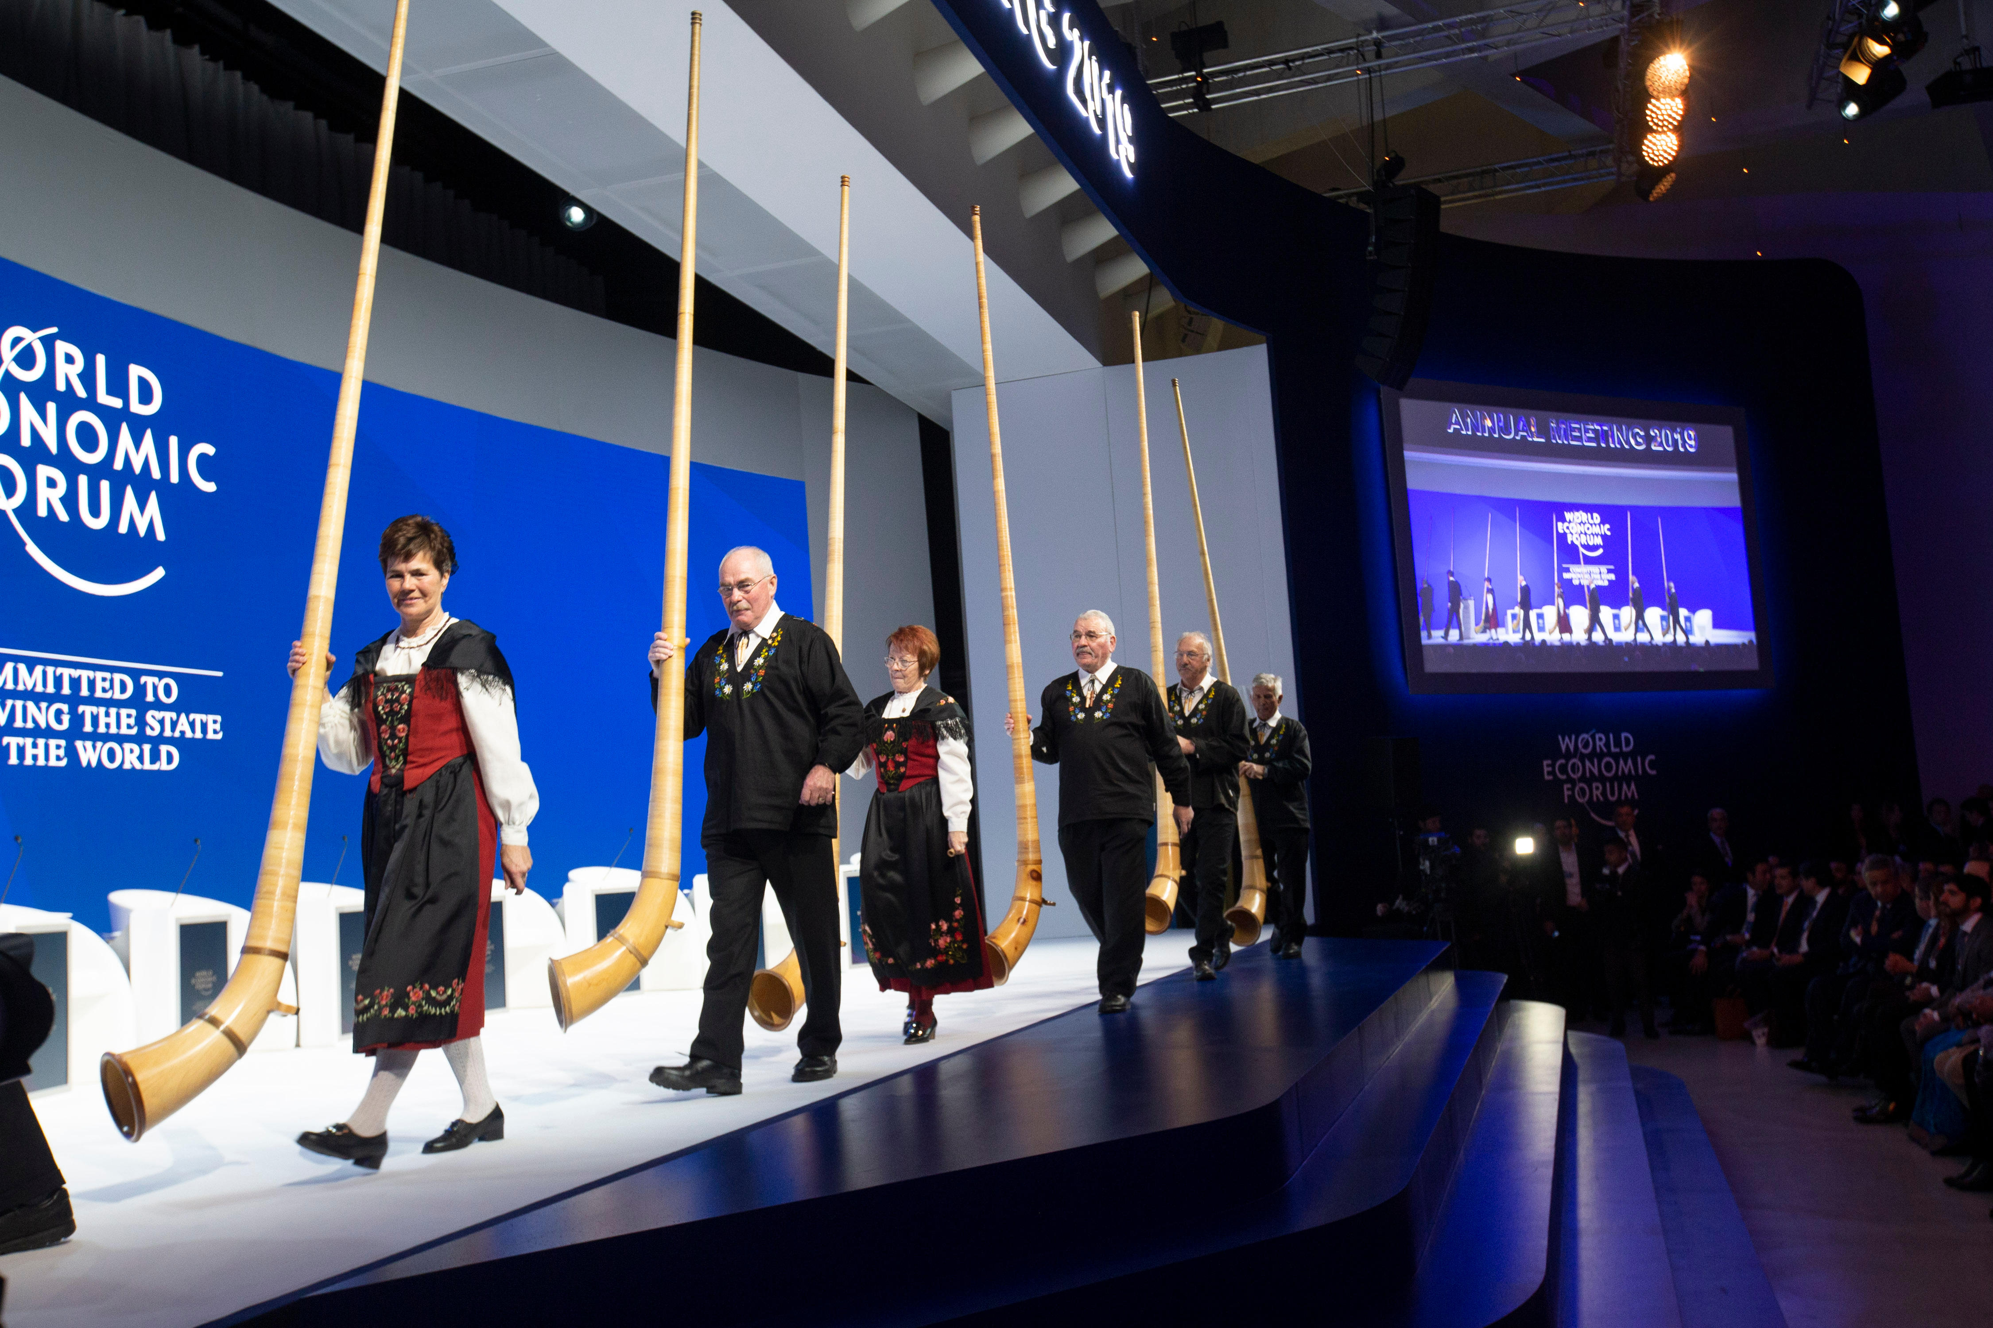
Chapter 10
Global Political Economy – Protecting Wealth in the Global North
Notes:
1

Slide 2
Chapter 10
Global Political Economy – Protecting Wealth in the Global North
Theories of Global Political Economy
The World Economy: Globalization and Interdependence
The Dominant Global Economic Institutions
Regional and Bilateral Economic Cooperation

Slide 3
Chapter 10 Learning Objectives 1 of 2
10.1 Discuss the three theories relevant to understanding global political economy: economic nationalism, internationalism, and World Systems
10.2 Explain the philosophical roots of law, the historical evolution, and how international laws are made, obeyed, and decided.

Slide 4
Chapter 10 Learning Objectives 2 of 2
10.3 Explain the concepts of globalization and interdependence
10.4 Identify the dominant global economic institutions.
10.5 Describe efforts to promote regional and bilateral economic cooperation.

Slide 5
Theories of Global Political Economy 1 of 4
Economic Nationalism
Economic forces and conditions key determinants of the course of global politics
Internationalism equates largely with Liberalism
Economic nationalism
Colonialism, or imperialism
Neocolonialism
Notes:
Economic nationalism: state should use its economic strength to further national interests

Slide 6
Theories of Global Political Economy 2 of 4
Internationalism
International economic relations can and should be conducted cooperatively
That states should engage in trade according to their comparative advantage
Economic liberalism is rooted in capitalism

Slide 7
Theories of Global Political Economy 3 of 4
World Systems
Economic structure is a primary factor shaping political relationships and the power they engender
The haves -- the Global North -- work to keep
The have-nots -- the Global South -- weak and poor in order to exploit them
3. Dependency theory

Slide 8
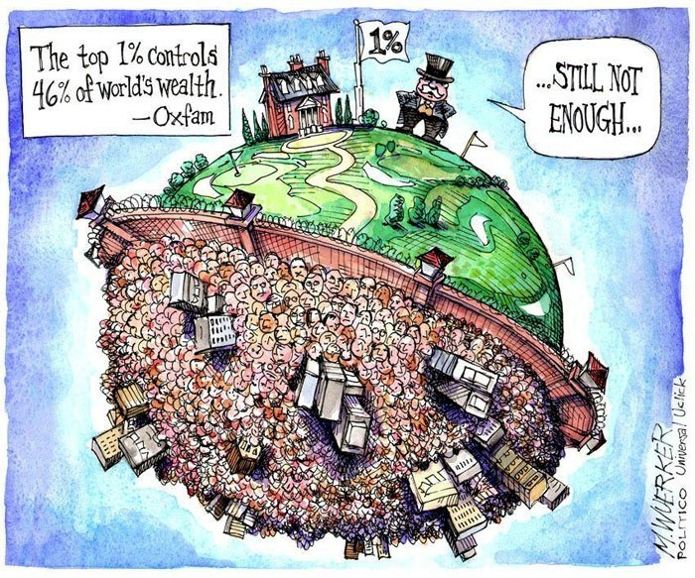
Theories of Global Political Economy 4 of 4
World Systems

Slide 9
The World Economy: Globalization and Interdependence 1 of 6
Trade
Merchandise trade is most frequently associated with imports and exports.
Service Trade: Services include things that you do for others.

Slide 10
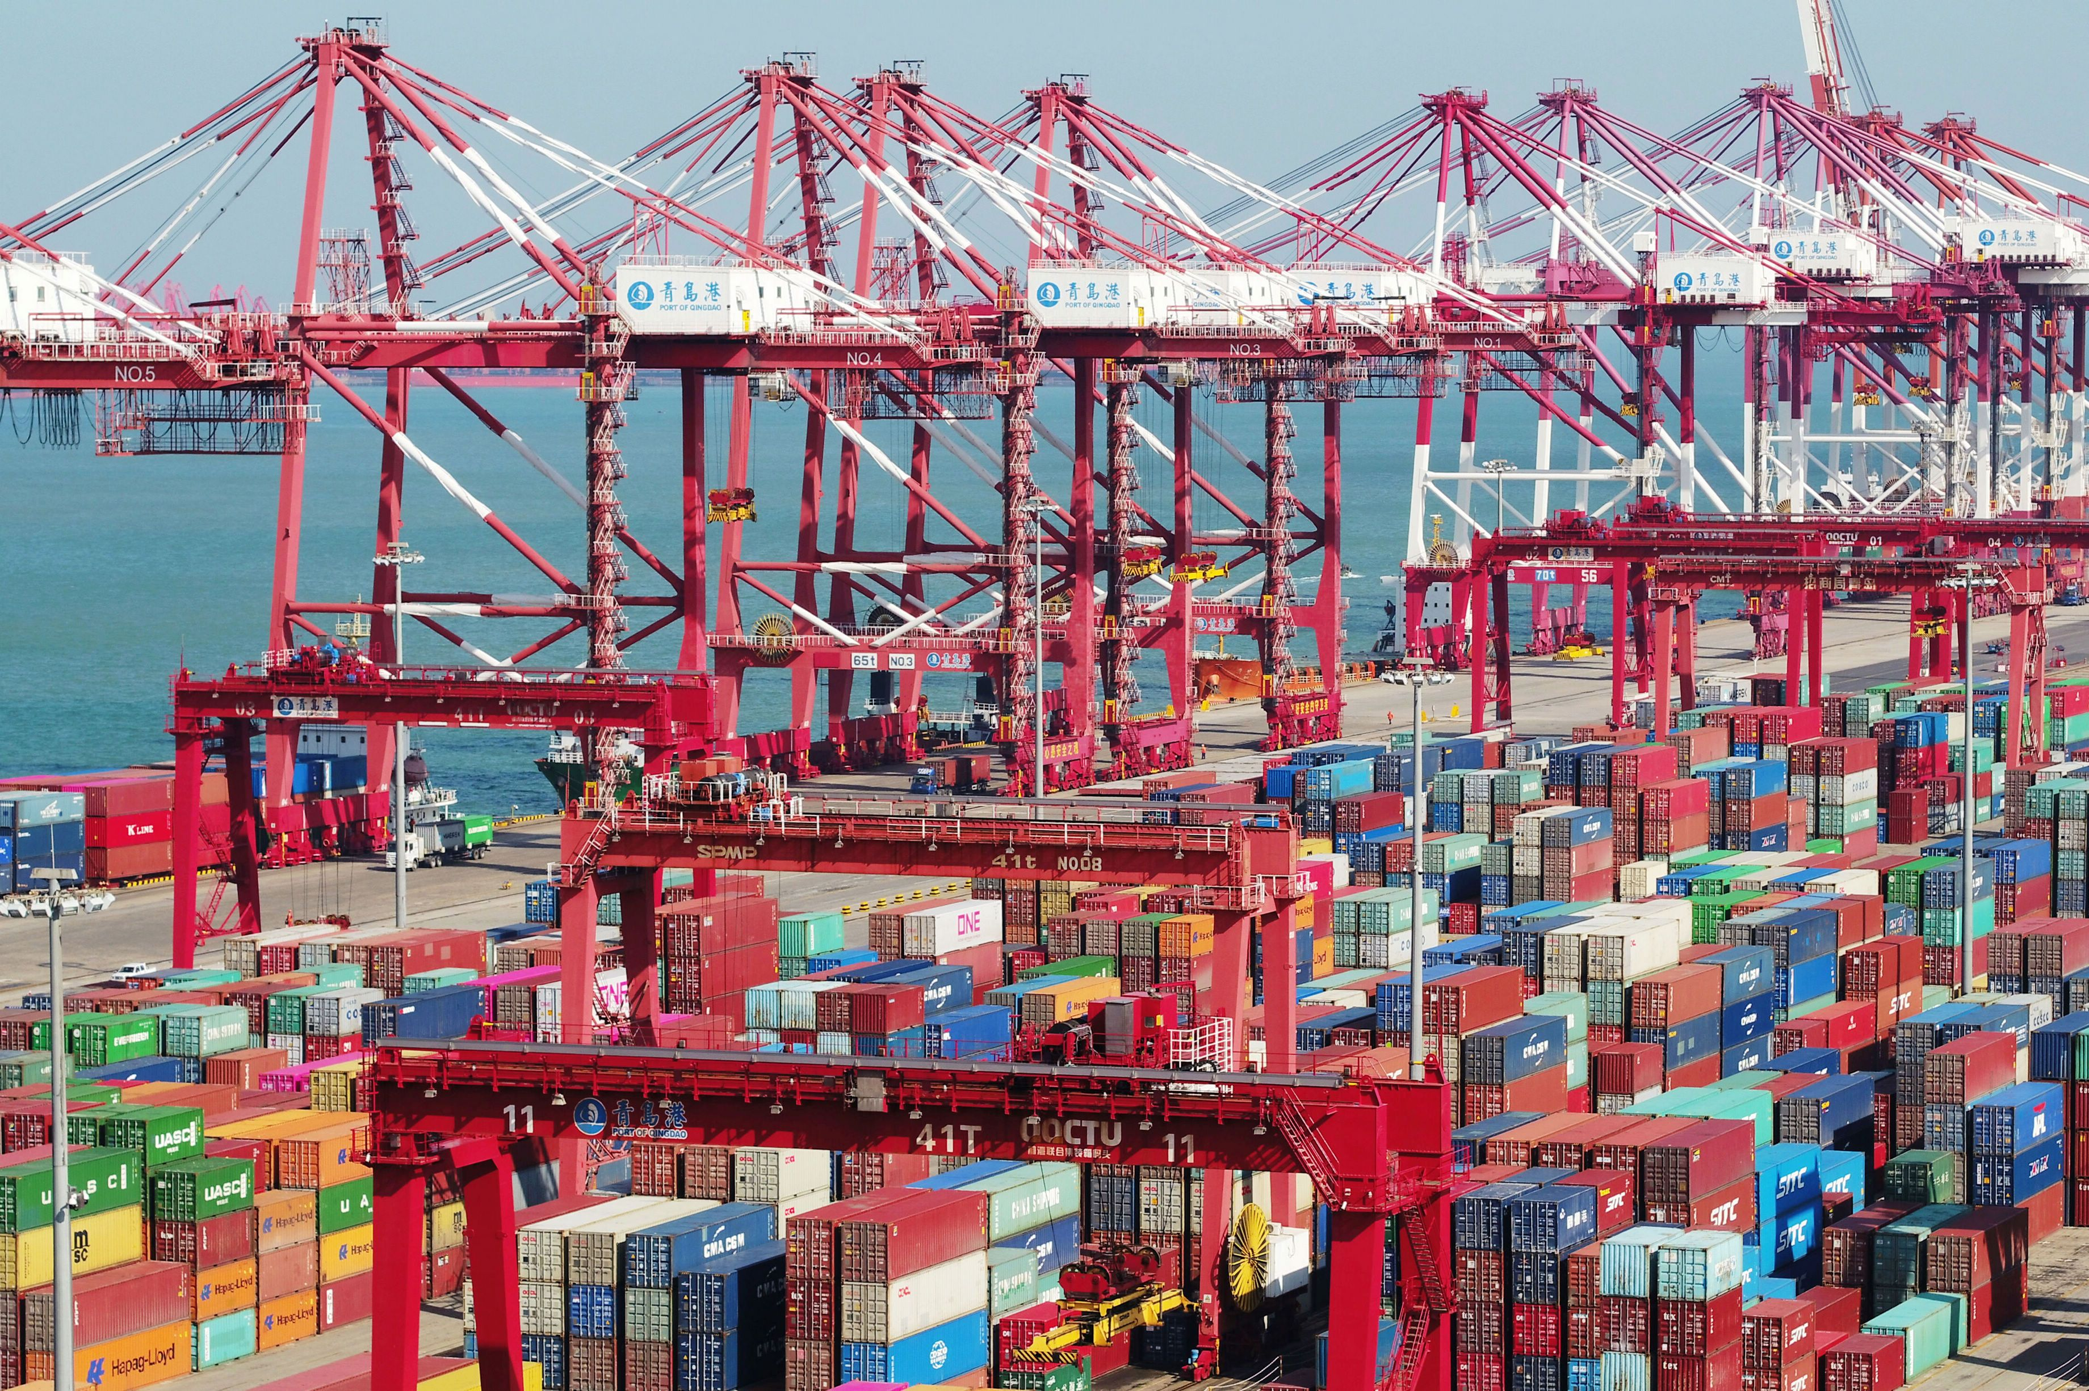
The World Economy: Globalization and Interdependence 2 of 6
Trade

Slide 11
The World Economy: Globalization and Interdependence 3 of 6
Trade
Factors Promoting Expanded Trade
a) Improved production technology
b) Materialism
c) Wide acceptance of a free trade philosophy
d) Decreased world tariff barriers

Slide 12
The World Economy: Globalization and Interdependence 4 of 6
International Investment
The world’s MNCs or TNCs,
Account for the lion’s share of global foreign investment
The immense wealth of the largest MNCs
Considerable influence and impact on many aspects of daily life.

Slide 13
The World Economy: Globalization and Interdependence 5 of 6
Monetary Relations
The globalization of trade and investments
Fixed exchange rate system: Saudi Arabia, rates are held constant
Freely floating exchange rate systems
The Chinese yuan used to be a fixed currency

Slide 14
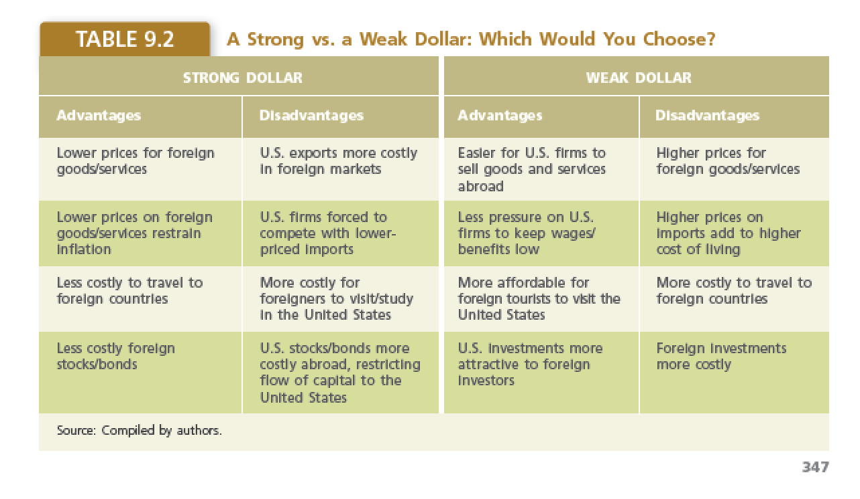
The World Economy: Globalization and Interdependence 6 of 6

Slide 15
The Dominant Global Economic Institutions 1 of 10
Economic Relations Among the Dominant
Competitive tensions of the economic system
Economic and political changes are creating strong competitive pressures on the North.
Changes in the North’s Economic Climate
Service sector jobs are increasingly subject to foreign competition through outsourcing

Slide 16
The Dominant Global Economic Institutions 2 of 10
Trade Cooperation Under the WTO
WTO grew out of its underlying series of international agreements
The General Agreement on Tariffs and Trade (GATT).
The organization’s initial membership of 23 countries has expanded to 164.
Reduction of trade barriers

Slide 17
The Dominant Global Economic Institutions 3 of 10
Trade Cooperation Under the WTO
The Structure and Role of the WTO.
a) headquarters in Geneva, Switzerland
b) Dispute Settlement Body
c) levy sanctions on the offending country
d) 50 cases filed annually in recent years
e) dispute settlement body increased
Notes:
significantly in 2018 with seven complaints filed, by Mexico, Canada, the EU, and others, disputing U.S tariffs on steel and aluminum and complaints again China filed by the United States

Slide 18
The Dominant Global Economic Institutions 4 of 10
Monetary Cooperation in Support of Development: The IMF
Western powers created the IMF Bretton
Woods outcome liberalization of economic interchange.
The IMF utilizes hard currency reserves placed at its disposal by the Global North.
3. Can also borrow up to about $25 billion to meet emergency needs

Slide 19
The Dominant Global Economic Institutions 5 of 10
Monetary Cooperation in Support of Development: The IMF
Notes:
Grotius and Joyner

Slide 20
The Dominant Global Economic Institutions 6 of 10
Monetary Cooperation in Support of Development: The IMF
Special drawing rights (SDRs)
Help maintain exchange-rate stability by making short-term loans.
IMF tries to prevent financial difficulties
The Global South, are critical of the IMF
Notes:
Special drawing rights (SDRs), a virtual currency whose value is based on an average, or market basket, value of the EU euro, Japanese yen, British pound, and U.S. dollar

Slide 21
The Dominant Global Economic Institutions 7 of 10
Monetary Cooperation in Support of Development: The IMF
Decision-making controlled by the Global North
Critics; IMF unfair and unwise conditions on countries that borrow from it.
Critics; IMF conditions often harm economies in the Global South

Slide 22
The Dominant Global Economic Institutions 8 of 10
Development Cooperation: The World Bank Group
World Bank established in the World War II era
Priorities have shifted to assisting the development of the South.
The International Development Association
Notes:
The International Development Association (IDA), created in 1960), focuses on making loans at no interest to the very poorest countries.

Slide 23
The Dominant Global Economic Institutions 9 of 10
Development Cooperation: The World Bank Group
The IMF, the World Bank is dominated by the North
Economic structuralism
Global North use the World Bank and other IGOs to maintain control of the South
Should the bank grant loan China?
Notes:
Economic structuralism: Global North use the World Bank and other IGOs to maintain

Slide 24
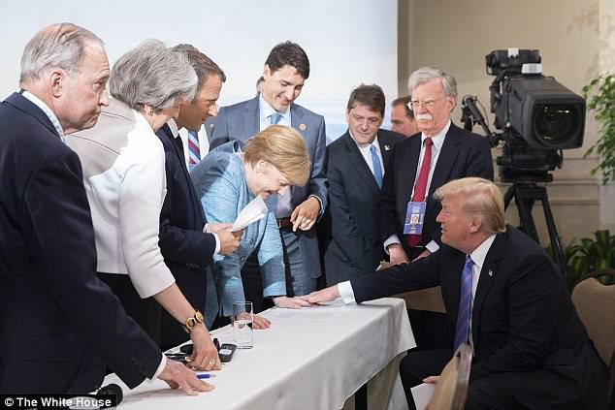
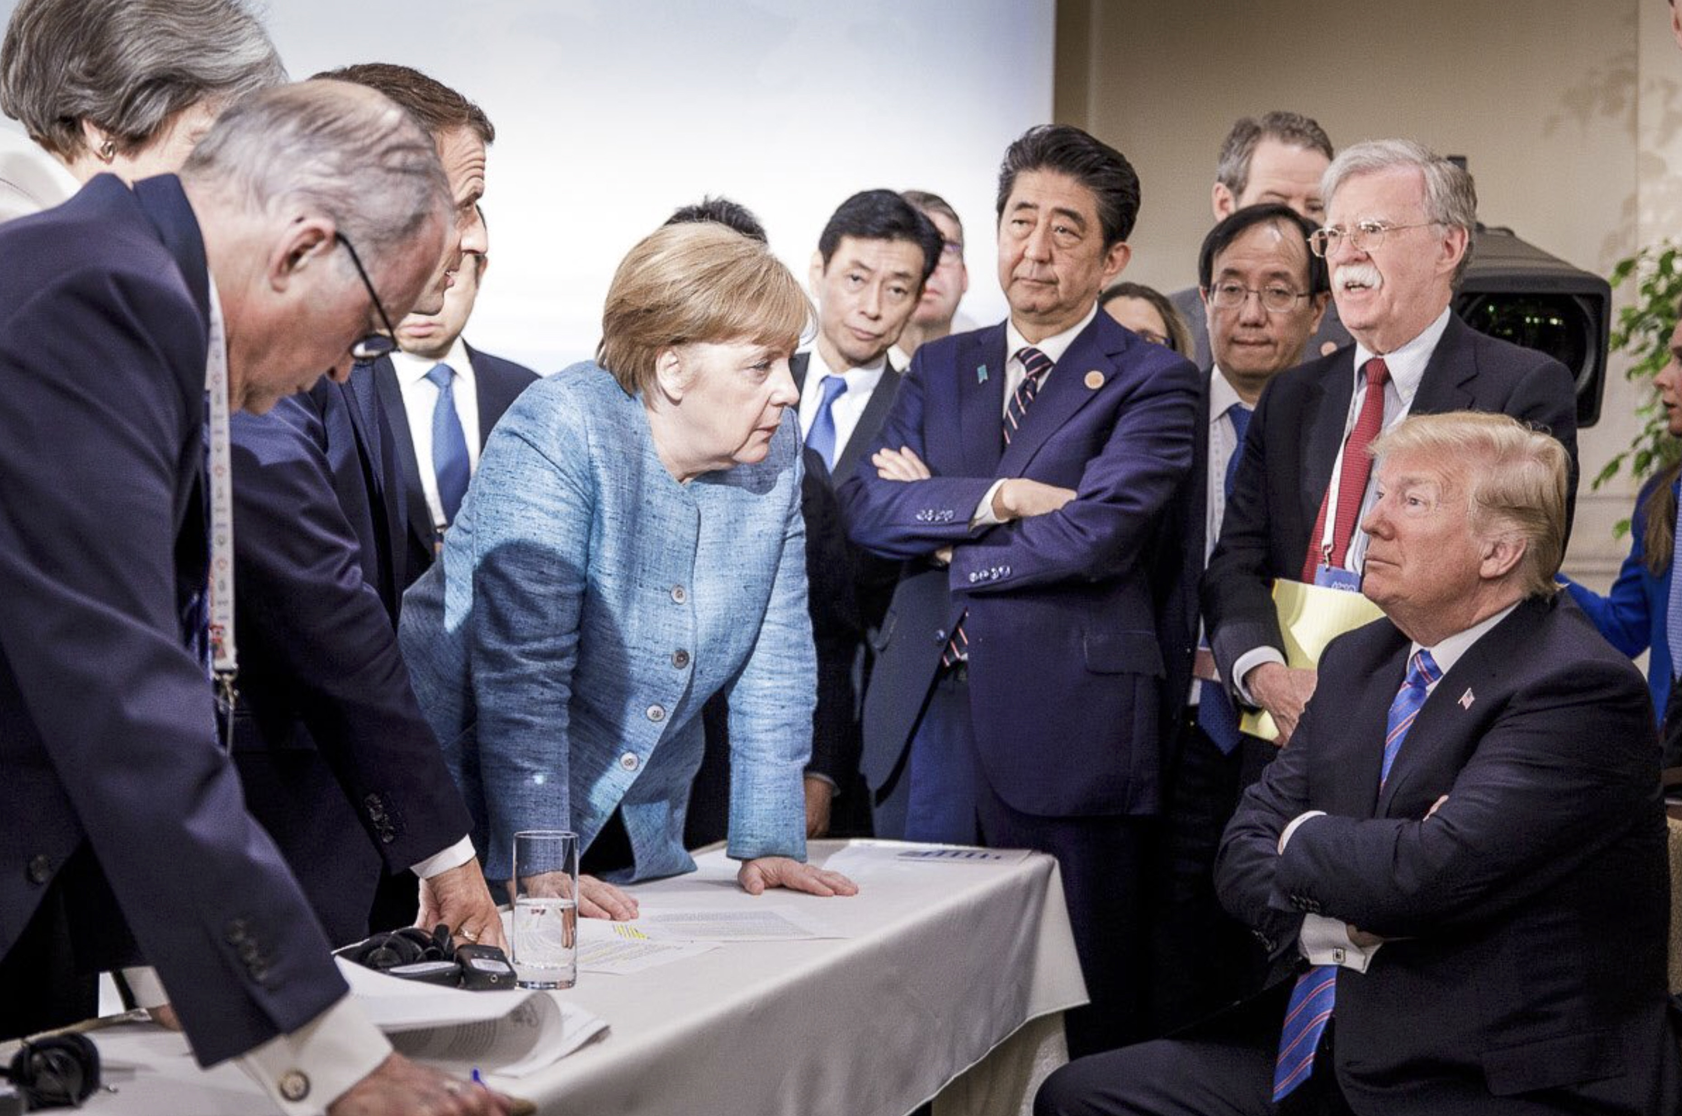
The Dominant Global Economic Institutions 10 of 10
Cooperation Among the Dominant
The Group of Eight (G-8) and the Group of 20 (G-20)

Slide 25
Regional and Bilateral Economic Cooperation 1 of
A Close Look at the European Union
The EU’s genesis occurred in 1952
European Economic Community (EEC) to facilitate trade.
In 1992 the Maastricht Treaty
The EU’s organizational structure is complex
Notes:
The EU’s genesis occurred in 1952 when Belgium, France, (West) Germany, Italy, Luxembourg, and the Netherlands created a common market for coal, iron, and steel products, called the European Coal and Steel Community (ECSC).
In 1992 the Maastricht Treaty was signed, and the European Community became the European Union (EU).

Slide 26
Regional and Bilateral Economic Cooperation 2 of
A Close Look at the European Union
Brexit shook the EU politically and economically
The EU’s organizational structure is complex.
Political decision-making with European Council
The EU’s bureaucracy; European Commission.
The European Parliament; legislature.
The European Court of Justice

Slide 27
Regional and Bilateral Economic Cooperation 3 of
NAFTA -- Past and Future?
The largest RTA in the Western Hemisphere
2,000-page agreement; effect in 1994.
Intra-NAFTA trade is import exports
NAFTA has had the greatest effect on Mexico

Slide 28
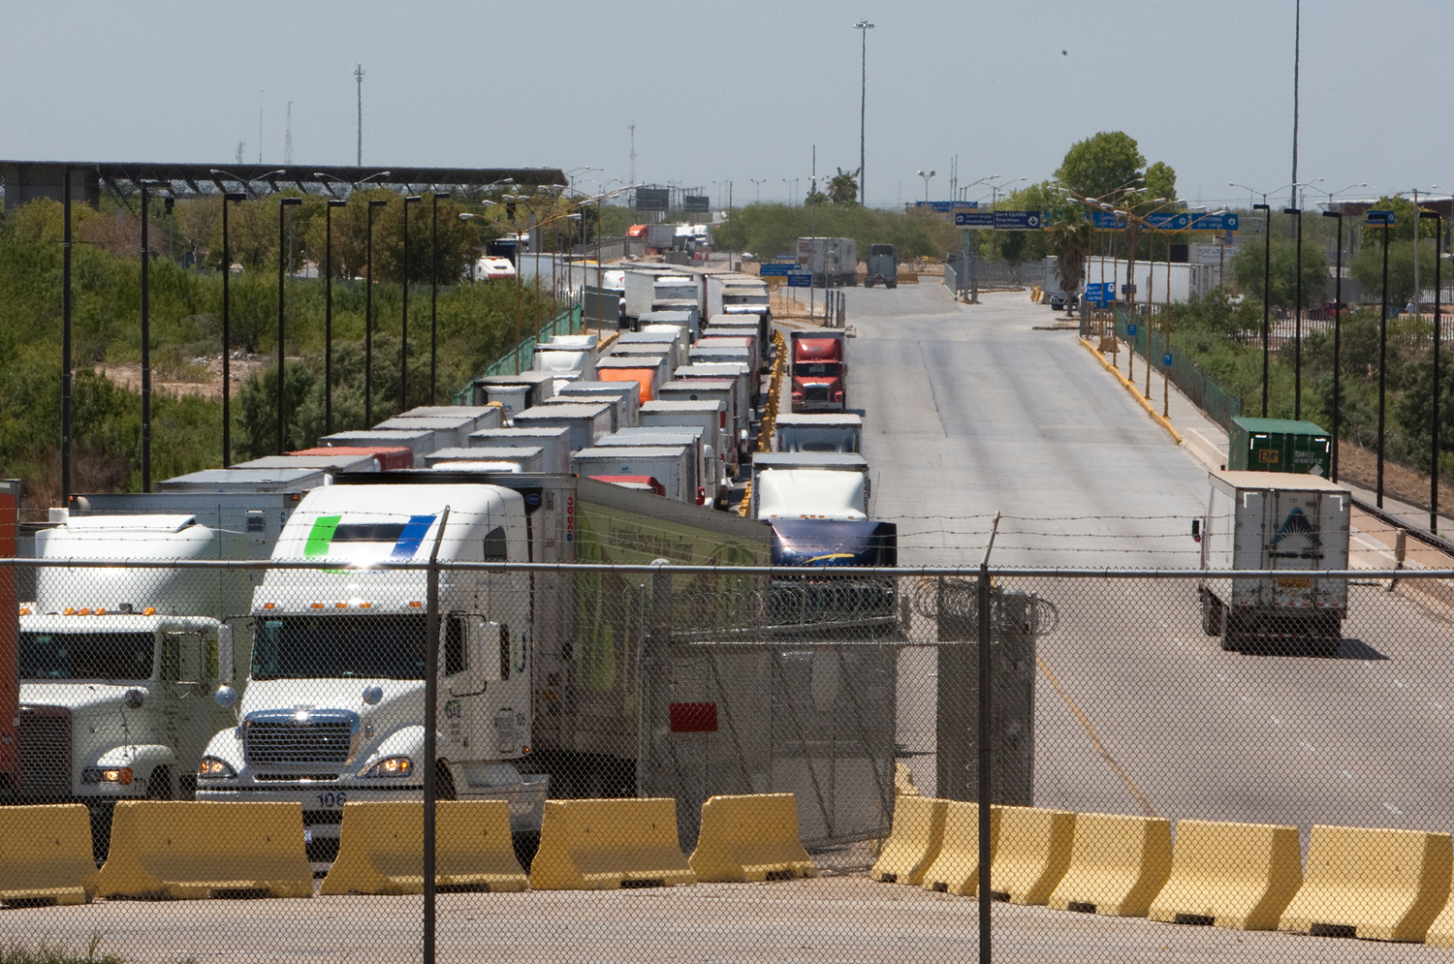
Regional and Bilateral Economic Cooperation 4 of
NAFTA -- Past and Future?

Slide 29
Regional and Bilateral Economic Cooperation 5 of
NAFTA -- Past and Future?
United States–Mexico–Canada Agreement
(USMCA) but it has yet to be ratified and put into force.
High level uncertainty
Difficult for American businesses to plan

Slide 30
Regional and Bilateral Economic Cooperation 6 of
Cultivating Free Trade in Latin America and Asia
The Southern Common Market (Mercosur)
Association of Southeast Asian Nations (ASEAN)
The Asia-Pacific Economic Cooperation (APEC)
APEC; 40% population, about 50% of the global GDP, and over 40% of world trade.
Notes:
The Southern Common Market (Mercosur) established in 1995 by Argentina, Brazil, Paraguay, and Uruguay. Venezuela has joined since then as a full member, and Bolivia, Chile, Colombia, Ecuador, and Peru have become associate members

Slide 31
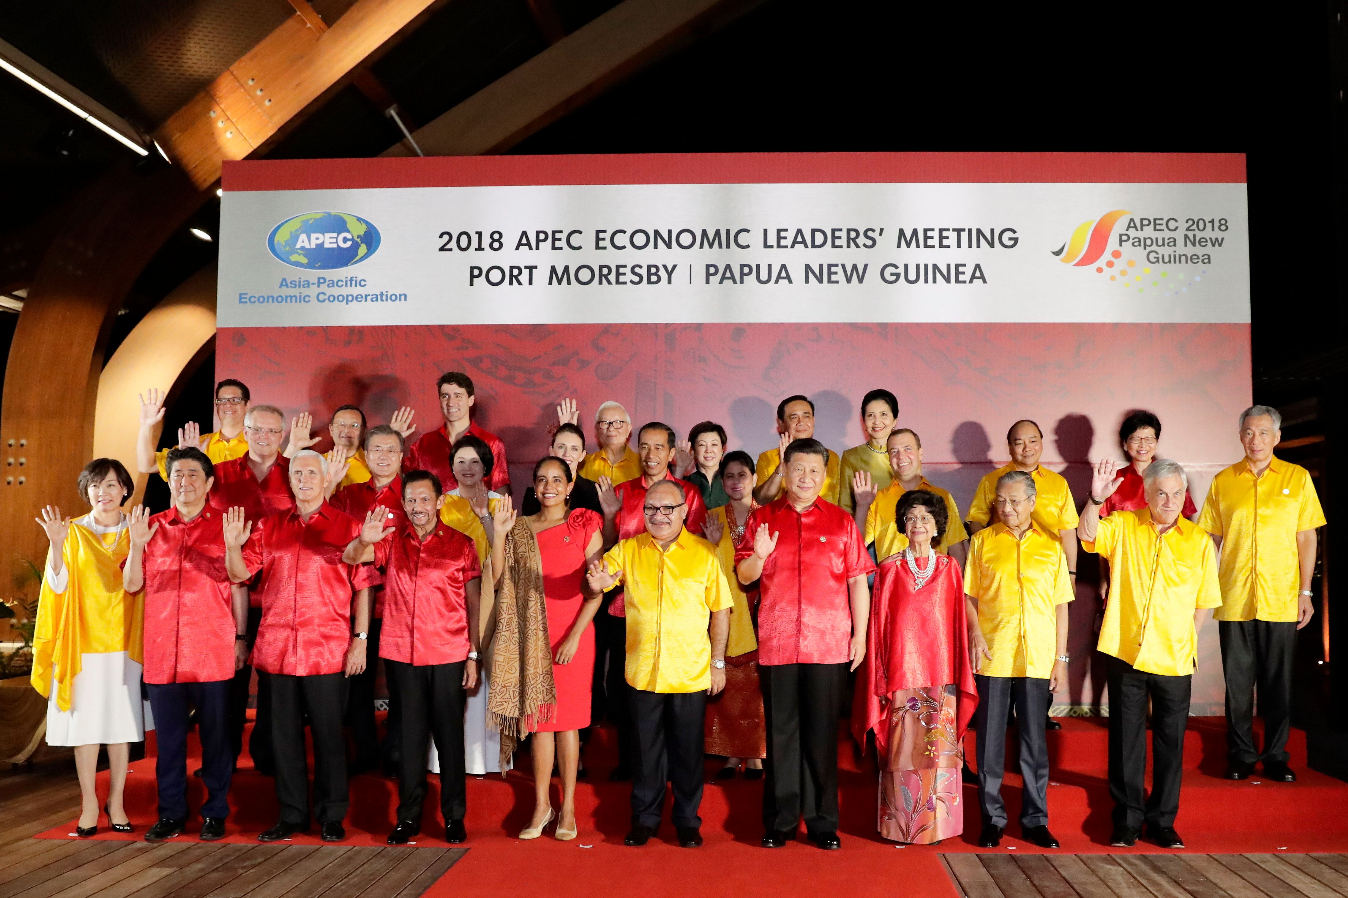
Regional and Bilateral Economic Cooperation 6 of
Cultivating Free Trade in Latin America and Asia

Slide 32
Chapter 10 Review of Learning Objectives 1 of 2
10.1 Discuss the three theories relevant to understanding global political economy: economic nationalism, internationalism, and World Systems
10.2 Explain the philosophical roots of law, the historical evolution, and how international laws are made, obeyed, and decided.

Slide 33
Chapter 10 Review of Learning Objectives 2 of 2
10.3 Explain the concepts of globalization and interdependence
10.4 Identify the dominant global economic institutions.
10.5 Describe efforts to promote regional and bilateral economic cooperation.

