Slide 1
Chapter 4 Nations and States Past, Present and Evolving
Notes:
1

Slide 2
Chapter 4 Nations and States Past, Present and Evolving
Nations, Nationalism, and the Nation-State Defined
The Historical Evolution of Nations and Nationalism
Nationalism Reconsidered
The Sovereign State

Slide 3
Chapter 4 Learning Objectives
4.1 Define the concepts of nations, nationalism, and the nation-state.
4.2 Discuss the historical evolution of nations and nationalism.
4.3 Evaluate the positive and negative dimensions of nationalism.
3.4 Discuss the major developments in the emergence of the sovereign state.

Slide 4
Nations, Nationalism, and the Nation-State 1 of 12
Nations
Share one or more demographic and cultural traits
Possess a feeling of community
Seek to control their political affairs
A nation exists because its members think it does
Demographic and Cultural Similarities
Self-determination

Slide 5
Nations, Nationalism, and the Nation-State 2 of 12
Nations

Slide 6
Nations, Nationalism, and the Nation-State 3 of 12
Nationalism
Nationalism is a set of ideas.
Establish values about what is good and bad.
Direct adherents on how to act.
Link together those who adhere to the ideology.
I am an American, a Texan, and a Democrat—in that order; U.S. President Lyndon B. Johnson

Slide 7
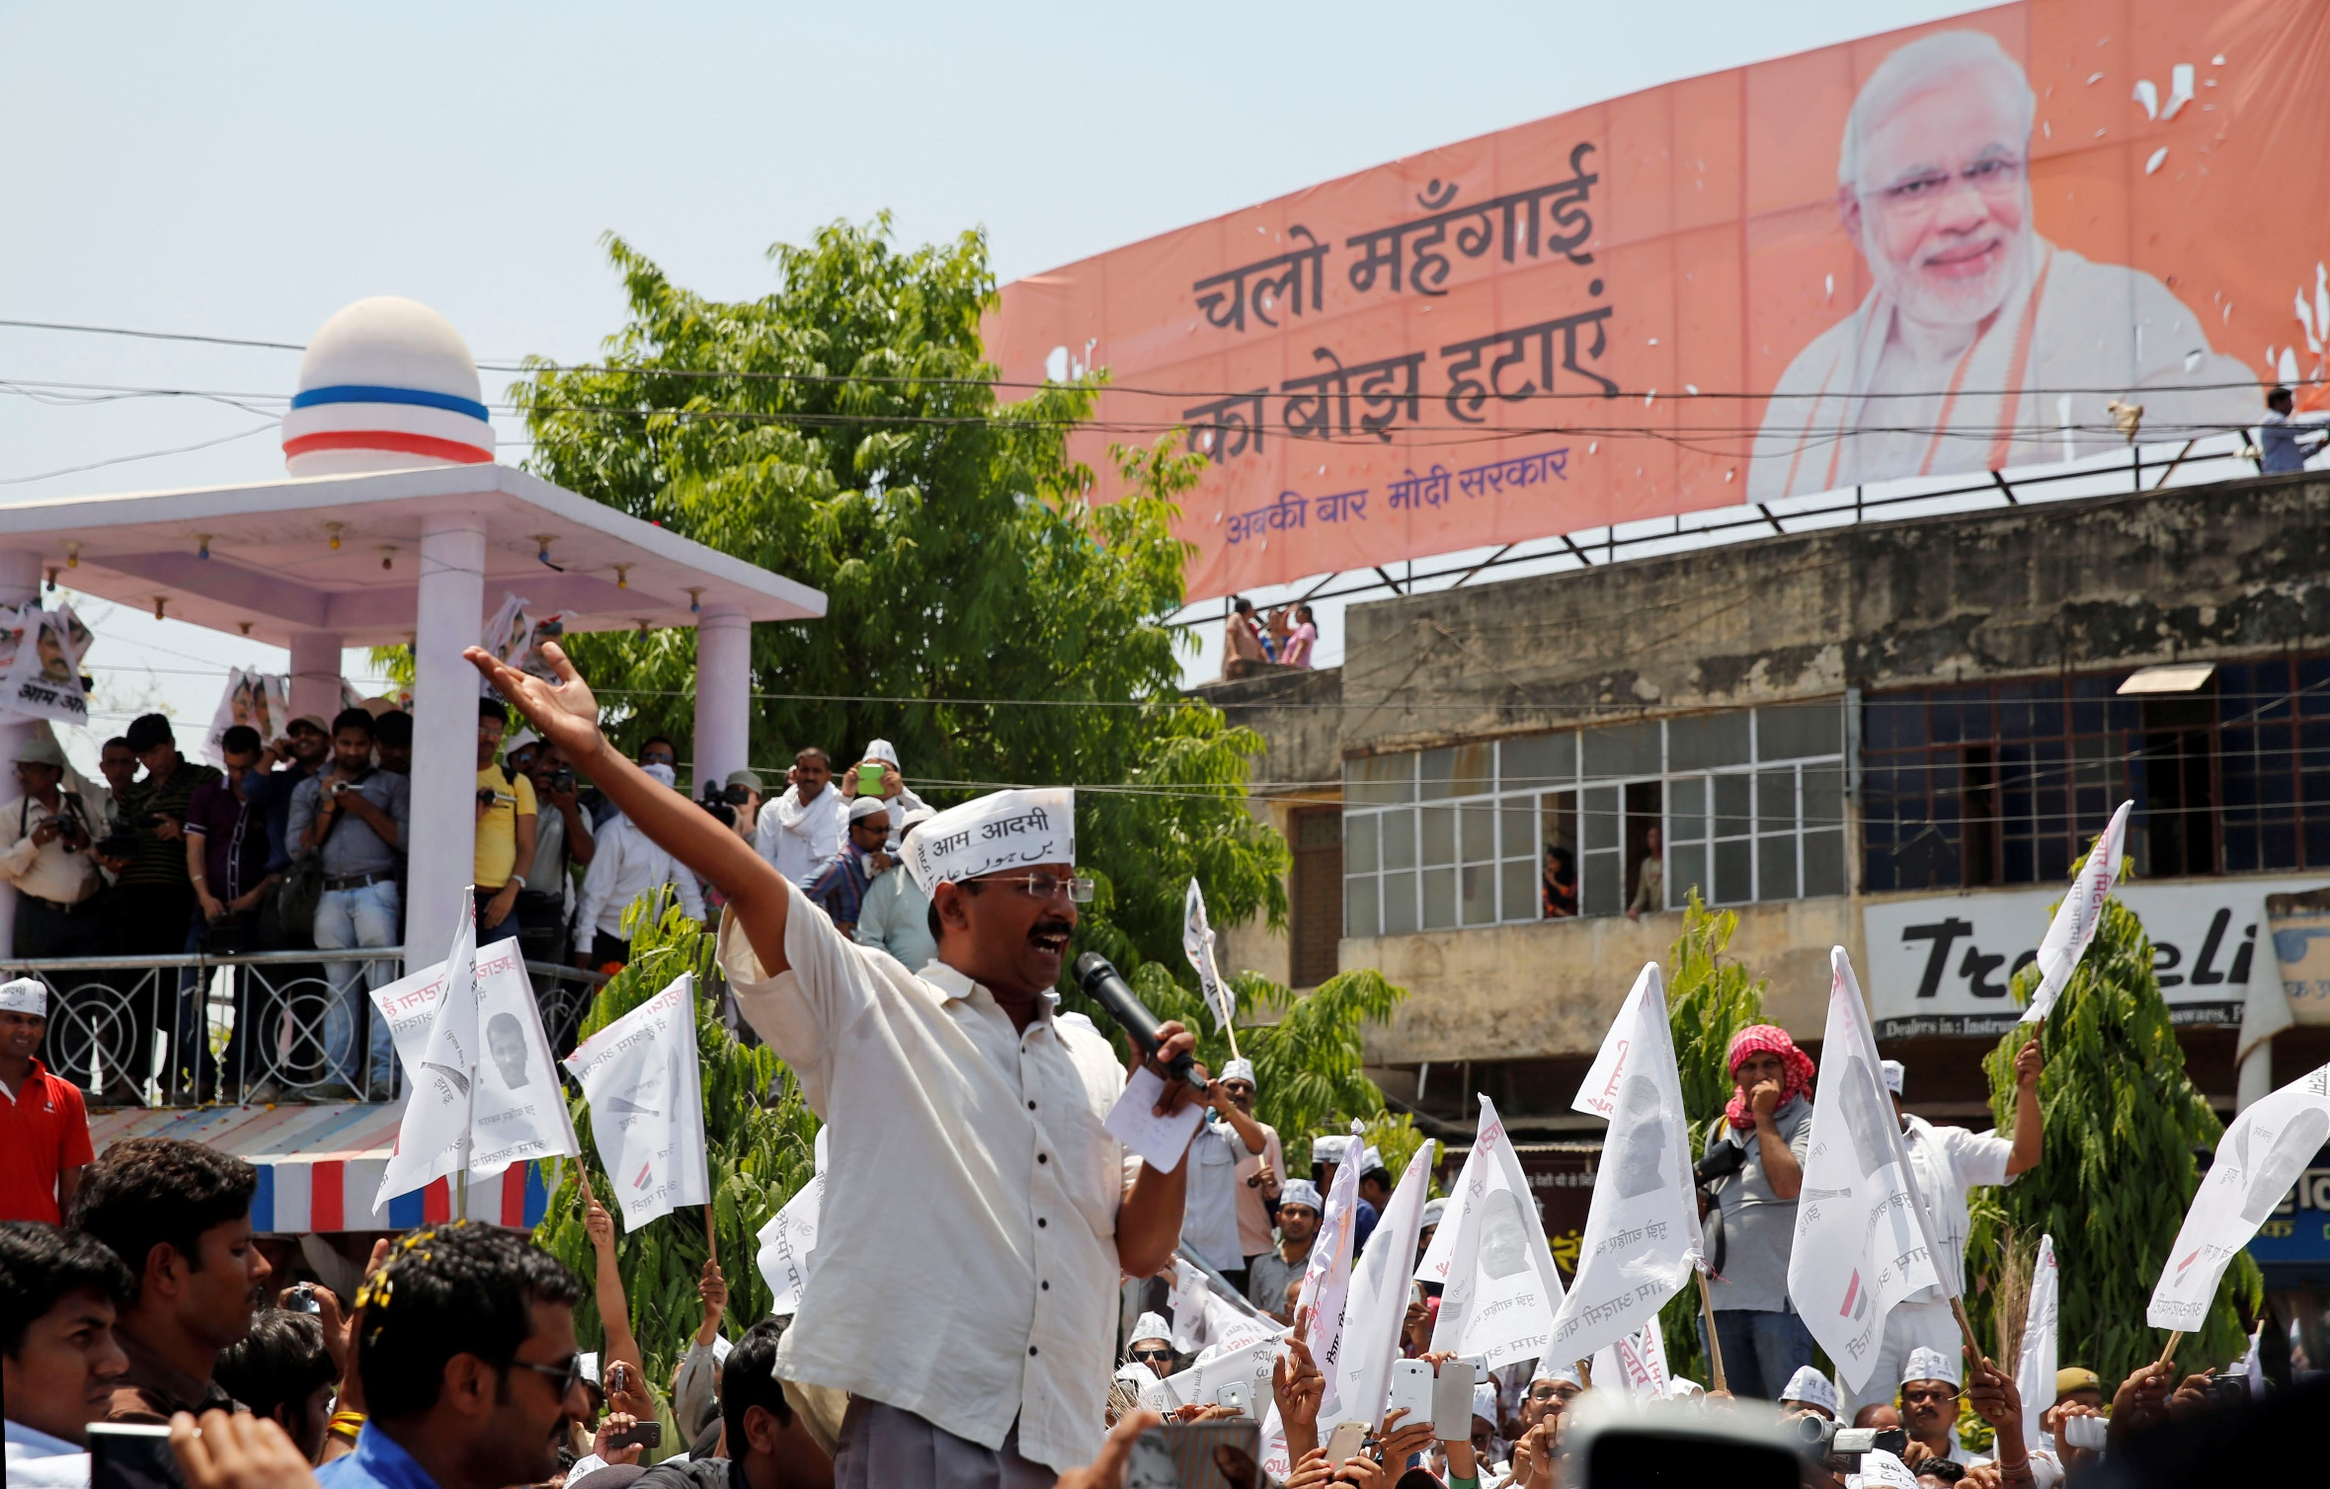
Nations, Nationalism, and the Nation-State 4 of 12
Nationalism

Slide 8
Nations, Nationalism, and the Nation-State 5 of 12
The Nation-State
Realization of self-determination in the overlap of the nation and state
Sovereign (independent)
Political organizations with certain characteristics
Some countries fail to attain such status: South Sudan, Moldova, and Afghanistan

Slide 9
The Historical Evolution of the Nations and Nationalism 6 of 12
Nations Emerge
Difficult to pinpoint the start of nationalism
Its origins are rooted in modern Western experiences
The fall of the universalistic Roman Empire in 476 CE set the stage for the emergence of the nation

Slide 10
The Historical Evolution of the Nations and Nationalism 7 of 12
Nations Emerge
Holy Roman Empire (HRE): lasted until 1806
The Protestant Reformation
6. Thirty (1618-1648) War
Eighty Years’ (1568-1648) War
Catholic vs. Protestant

Slide 11
The Historical Evolution of the Nations and Nationalism 8 of 12
Nations Emerge
Holy Roman Empire (HRE): lasted until 1806
The Protestant Reformation
Thirty (1618-1648) War
Eighty Years’ (1568-1648) War
Catholic vs. Protestant

Slide 12
The Historical Evolution of the Nations and Nationalism 9 of 12
Nations Ascend: The Age of Enlightenment
Fully realized by Enlightenment.
Modern nationalism first emerged early 1700s
Pre-Enlightenment link between state and its inhabitants were different
Popular sovereignty: Rooted in the idea of the social contract

Slide 13
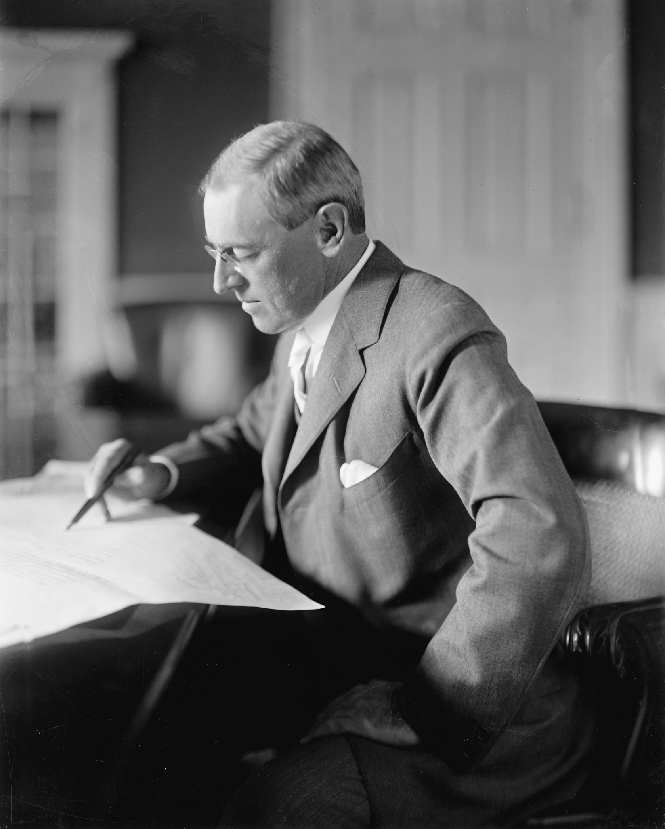

Slide 14
The Historical Evolution of the Nations and Nationalism 10 of 12
Nations Consolidate: The Era of Self-determination
Widespread of sovereignty and nationalism
State building through unification nationalism
The decline and death of vast multiethnic empires helped spread nationalism

Slide 15
The Historical Evolution of the Nations and Nationalism 11 of 12
Nations Expand: Colonization and Decolonization
By the late 18th and 19th
Western European power colonized the non-Western world.
Europe went to Asia, Africa, the Middle East, and Latin America
The exploitation of human and natural resources

Slide 16
The Historical Evolution of the Nations and Nationalism 12 of 12
Nations Collide The Uneasy (and often Brutal) Legacy of Colonialism
Decolonization process start mid-20th century
Nations, nationalism, and nation-states intersect
Nation-States Precede Nations
Nations and Nation-States Co-Evolve

Slide 17
Nationalism Reconsidered 1 of 7
Positive Dimensions of Nationalism
A positive force in the development of global politics
Nationalism Promotes Democracy
Nationalism Discourages Imperialism
Nationalism Promotes Economic Growth

Slide 18
Nationalism Reconsidered 2 of 7
Negative Dimensions of Nationalism
Parochialism: limit our sense of responsibility or concern for the other
Exceptionalism: the belief that your nation is better than others
Xenophobia leads to feeling superior to others or even fearing and hating them
Nativism
Imperialism

Slide 19
Nationalism Reconsidered 3 of 7
Positive Aspects of Self-Determination
Imperative principle of action
Reduce or even to eliminate the abuses that stem from ethnic, racial, linguistic, or gender (liberal theorist)
Could have prevented ethnonationalist conflicts
Bosnia, Chechnya, East Timor, Kosovo, Rwanda, and Sudan

Slide 20
Nationalism Reconsidered 4 of 7
Negative Aspects of Self-Determination
More problematic in practice
There are many ethic groups with the goal of seeking independence
Problem in resource and territory sharing
Realist: quest for self-determination

Slide 21
Nationalism Reconsidered 5 of 7
The Persistence of Nationalism
World War II changed many people’s view
The United Nations 1945
liberal internationalists and critical theorists
Continued strength of nationalism

Slide 22
Nationalism Reconsidered 6 of 7
The Persistence of Nationalism
Germany reunification 1990
Czechoslovakia became two states in 1993
Yugoslavia dissolved; six countries formed 1990s
The USSR, dissolved; 15 states formed (1991)

Slide 23
Nationalism Reconsidered 7 of 7
The Persistence of Nationalism
Germany reunification 1990
Czechoslovakia became two states in 1993
Yugoslavia dissolved; six countries formed 1990s
The USSR, dissolved; 15 states formed (1991)

Slide 24
The Sovereign State 1 of 6
Emergence of the State
Like nations, states have not always existed
European nations break away from the Holy Roman Empire
Eighty- and Thirty-Years Wars
Modern state system through the Treaty of Westphalia (1648)

Slide 25
The Sovereign State 2 of 6
Requisites of Statehood
Modern state has legal authority over its citizens
Does not recognizes external higher authority.
Sovereignty: The most important requisite
Internal Organization
Diplomatic Recognition
Domestic Support

Slide 26
The Sovereign State 3 of 6
Requisites of Statehood

Slide 27
The Sovereign State 4 of 6
Regime Types and Governance
How a state governs has a lot of implications on global politics.
What types of governments are more warlike?
Which are the democratic governments

Slide 28
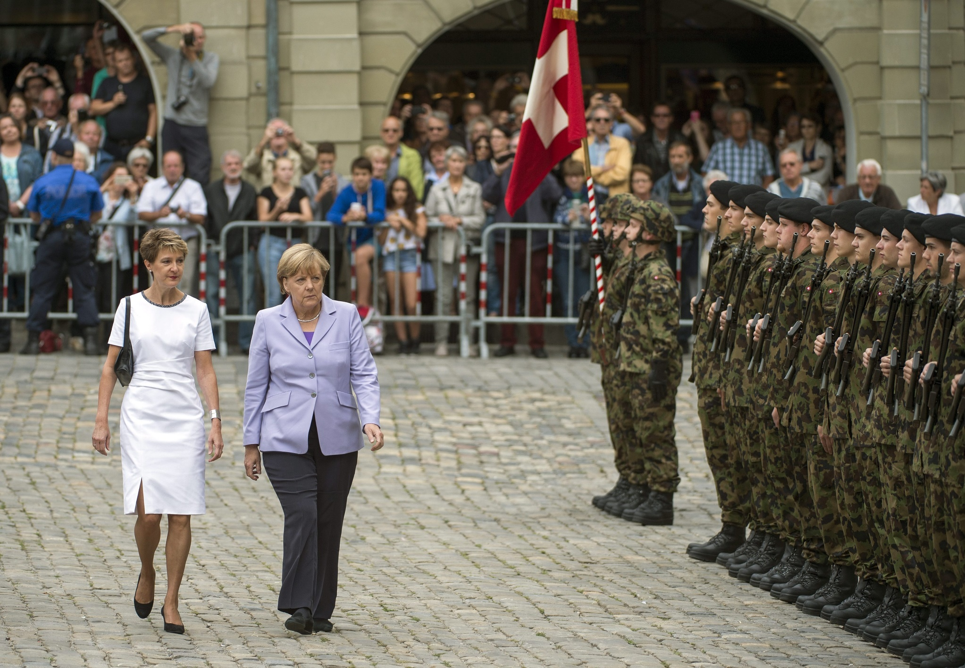
The Sovereign State 5 of 6
Regime Types and Governance

Slide 29
The Sovereign State 6 of 6
Weak and Failed States
State’s existence is more a political than a legal matter
A bit difficult to pinpoint if a state is weak or fail
The Fragile States Index

Slide 30
Chapter 4 Review of Learning Objectives
4.1 Define the concepts of nations, nationalism, and the nation-state.
4.2 Discuss the historical evolution of nations and nationalism.
4.3 Evaluate the positive and negative dimensions of nationalism.
3.4 Discuss the major developments in the emergence of the sovereign state.

