Slide 1
CHAPTER 13. RACE, RACISM AND RESISTANCE ACROSS THE LIFE SPAN
Human Behavior for Social Work Practice
Power Point format & design by: Bailey Jader, University of Minnesota

Slide 2
Objectives
Consider how beliefs & concepts of race, ethnicity, racism, white privilege & immigration influence development
Consider how sociocultural processes affect individuals & how individuals affect environment through discussions of racial identity development & resistance to racism
Highlight how indigenous & minority communities developed strategies for resisting racism, protecting family members & nurturing development across life span
Photo Credit: Unsplash
Notes:
The major learning objectives for this chapter are:
Consider how beliefs and concepts of race, ethnicity, racism, white privilege, and immigration influence development.
Consider how sociocultural processes affect individuals and how individuals affect the environment through discussions of racial identity development and resistance to racism.
Highlight how indigenous and minority communities developed strategies for resisting racism, protecting family members, and nurturing development across the life span.

Slide 3
Race
Race = complex concept from history of oppression & resistance
History encompasses the:
Genocide of Indigenous people
Enslavement of Africans & African-Americans
Military conquest of Mexico
Internment of Japanese Americans
Social work = profession that deals w/ people from diverse backgrounds
Essential we develop capacity to discuss race/racism & learn about different communities
Photo Credit: Pixabay
Notes:
Race is a complex concept wrought from a history of oppression and resistance.
The history encompasses the:
genocide of Indigenous people;
enslavement of Africans and African-Americans;
military conquest of Mexico;
internment of Japanese Americans.
Social work is a profession that deals increasingly with people from diverse backgrounds
It is essential that we develop our capacity to discuss race and racism; and to learn about communities unfamiliar to us.

Slide 4
“Race” as a Social Construct
“Race” historically defined as people who share physical characteristics & thought to share common bloodline
Science documents racial groups don’t reflect discrete biological categories; social constructions
Reflect social & political divisions used for social, economic & political subordination
Terms “minority” or “person of color” minimizes diversity, individuality & makes comparisons to structurally dominant positions
Photo Credit: Unsplash
Notes:
“Race” historically has been defined as a group of people who share physical characteristics and are thought to share a common bloodline.
However, science now documents that racial groups do not reflect discrete biological categories, but are primarily social constructions.
They reflect social and political divisions used primarily for the purpose of social, economic, and political subordination.

Slide 5
“Race” as a Social Construct
Terms “minority” or “person of color” minimizes diversity, individuality & makes comparisons to structurally dominant positions
Intersectionality = multifaceted nature of personal & social identities
Individuals differ by categories of oppression & privilege
Intersectionality at different points in life span, create disadvantages/advantages
Must consider intersectionality changes to understand individual experiences
Photo Credit: Unsplash
Notes:
The terms “minority” or “person of color”:
Minimizes diversity and individuality; and
Makes comparisons to structurally dominant positions.
Intersectionality refers to the multifaceted nature of our personal and social identities.
Individuals additionally differ by categories of oppression and privilege.
e.g. race, age, gender, social class, sexual orientation, religion, and ability status.
Intersectionality at different points in the life span can create disadvantages or advantages for an individual.
One must consider intersectionality changes in order to adequately understand varying individual experiences.

Slide 6
“Race” as a Social Construct
Culture = shared values, beliefs, behaviors, traditions, technology & resources of human group
Transmitted & developed from one generation to next
Ethnicity = individual’s membership in group that shares ancestral heritage based on nationality & culture
May include shared biological factors &/or psychological attachments
Largely voluntary, self-defined &culturally oriented
Photo Credit: Unsplash
Notes:
Culture refers to the shared values, beliefs, behaviors, traditions, technology, and other resources such as language, literacy, music and mathematics of a human group.
Culture is transmitted and developed from one generation to the next.
Ethnicity refers to an individual’s membership in a group that shares a common ancestral heritage based on nationality and culture.
It may include shared biological factors and/or psychological attachments.
Ethnicity is largely voluntary, self-defined, and culturally oriented.

Slide 7
“Race” as a Social Construct
Acculturation = process of learning language, values & social competencies for functioning in majority society
Assimilation = ancestral culture largely replaced w/ dominant culture’s
Can acculturate in varying degrees; physical appearance & group markers communicate race/ethnicity to others.
Code switching = individuals alter features of language in relation to social/cultural context
Photo Credit: Unsplash
Notes:
Acculturation is a process of learning the language, values, and social competencies beneficial for functioning in the majority society.
Assimilation is an outcome of acculturation, in which the ancestral culture is largely replaced with that of the dominant culture.
People acculturate in varying degrees.
Physical appearance and other group markers (e.g. religion and social class) communicate race/ethnicity to others. This is particularly true for people of color living among a white majority.
Code switching may occur, where individuals alter features of their language (e.g. phonology, grammar, and pragmatics) in relation to social and cultural context.

Slide 8
Racism, White Privilege & Institutional Racism
Racism = hierarchical system of advantages based on race
Racism reflected in social institutions, individual attitudes & behaviors
People of color penalized in housing, bank loans, social service systems, child protective services & criminal/police/legal system
Prejudice = preconceived judgment/opinion based on limited info & exposure to cultural stereotypes
Prejudice attitudes deny person’s individuality & marks power differential between members of dominant & subordinate groups
Photo Credit: Pixabay
Notes:
Racism can be defined as a hierarchical system of advantages based on race.
Racism is reflected in our social institutions and individual attitudes and behaviors.
People of color continue to be penalized in areas like housing, bank loans, social service systems, child protective services, and the criminal/police/legal system.
Prejudice is a preconceived judgment or opinion based on limited information and exposure to cultural stereotypes.
Prejudice attitudes deny a person’s individuality and identifies the power differential between members of dominant and subordinate groups.

Slide 9
Racism, White Privilege & Institutional Racism
Internalized racism = inculcation of racist stereotypes, values, images & ideologies perpetrated by dominant society among racially subordinated group members
Result of interlocking social processes
Cn lead to feelings of self-doubt, disgust & disrespect for one’s race
Defensive othering occurs, when individuals attempt to be like dominant group to distance from stereotypes associated w/ subordinated group
Photo Credit: Unsplash
Notes:
Internalized racism is the inculcation of racist stereotypes, values, images, and ideologies perpetrated by the dominant society among members of racially subordinated groups.
It is the result of interlocking social processes, not of any shortcomings of the oppressed.
Internalized racism can lead to feelings of self-doubt, disgust, and disrespect for one’s race or oneself.
Defensive othering may occur, when individuals attempt to be like the dominant group or to distance themselves from stereotypes associated with their subordinated group

Slide 10
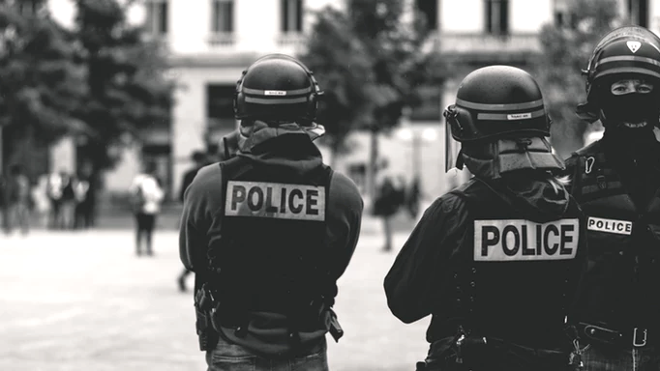
Racism, White Privilege & Institutional Racism
Racism = part of social & economic institutions
Institutional racism = social policies & institutional practices that disadvantage nonwhite racial & ethnic groups
Examples:
Restrictive housing contracts & bank lending policies
Racial profiling by police
Under/misrepresentation of ethnic groups in mass media
Race-based barriers to employment & professional advancement
Photo Credit: Unsplash
Notes:
Racism is part of our social and economic institutions.
Institutional racism refers to social policies and institutional practices that place nonwhite racial and ethnic groups at a disadvantage.
Examples of institutional racism include:
restrictive housing contracts and bank lending policies;
racial profiling by the police;
under- and misrepresentation of ethnic groups in mass media; and
race-based barriers to gainful employment and professional advancement.

Slide 11
Racism, White Privilege & Institutional Racism
White privilege = unearned advantages, entitlements, immunities, & dominance “white” identities at expense of people of color
Behaviors & values of dominant group seen as the norm
Meritocracy = myth that rewards given based on hard work, achievement & motivation
Photo Credit: Unsplash
Notes:
White privilege refers to the unearned advantages, entitlements, immunities, and dominance of individuals considered to be “white” at the expense of those who are not.
May emerge through the inadequate or suppressed history of oppression in classroom instruction.
The behaviors and values of the dominant group are seen as the norm.
Meritocracy is the myth that rewards are given based on hard work, achievement, and motivation, when in reality many rewards are also based on unearned privileges.
As an example, attending college in the United States is more determined by family socioeconomic status than by individual educational ability.

Slide 12
Racism, White Privilege & Institutional Racism
Critical consciousness = perception of social, political & economic contradictions & oppression
Reflexive self-awareness = process of becoming aware of personal biases & how we construct identities
Concepts necessary to move beyond guilt, shame, anger & understand how oppression manifests
Photo Credit: Unsplash
Notes:
Critical consciousness is the perception of social, political, and economic contradictions and oppression.
Reflexive self-awareness is an ongoing process of becoming aware of personal biases and how we construct our own identities.
These concepts are necessary to move beyond guilt, shame, or anger, and to understand how oppression manifests itself.

Slide 13
Racial Identity Development
Racial socialization practices based on:
Parents’ perceptions of how children can be safe/successful in particular sociocultural & physical ecologies
Children’s responses to racist incidents & socialization messages
Experiencing prejudice, stigmatization & observing others penalized because of race alter child’s emotional/cognitive development & trigger long-term mental trauma.
Photo Credit: Unsplash
Notes:
Racial socialization practices are based, in part, on:
parents’ perceptions of how children can be safe and successful within particular sociocultural and physical ecologies; and
the individual responses of children to racist incidents and to socialization messages.
Both experiencing racial prejudice, stigmatization, and bigotry as well as
observing others penalized because of race
can alter a child’s emotional/cognitive development, and in some cases
trigger long-term mental trauma.

Slide 14
Racial Identity Development
Racial-identity development begins early in life, continues through development
Racial-identity trajectories differ for members of dominant vs. subordinate groups
People of color explore racial/ethnic identities & seek attachments to in-group during adolescence
Photo Credit: Unsplash
Notes:
Racial-identity development begins early in life and continues throughout development.
e.g. preschool aged children distinguish physical characteristics and learn to verbalize certain attitudes.
The trajectories for developing racial-identity may differ for members of dominant and subordinate groups.
People of color tend to explore their racial/ethnic identities and seek attachments to their in-group during adolescence.
This normative process is associated with the development of racial and ethnic group consciousness, and identity in general.

Slide 15
Racial Identity Development
Racial identity development = dynamic & nonlinear
No universal trajectory/sequence of racial identity development
Racial identity formation may be central for members from minority groups, and may be largely voluntary for members of the majority group
Everyone part of privilege &oppression; all play a role
Models of racial identity & development vary for all ethnic groups
Photo Credit: Unsplash
Notes:
Racial identity development is dynamic and nonlinear.
There is no one universal trajectory or sequence of racial identity development that all individuals follow.
Racial identity formation may be central for members from minority groups, and may be largely voluntary for members of the majority group.
We are all part of the system of privilege and oppression, and all play a role.
There are many models of racial identity and development may vary for:
African Americans;
European Americans;
Multiracial Individuals; and
Immigrants of Color.

Slide 16
Racial Identity Development in African Americans
Nigrescence Model: Negro-to-black conversion experience = early formulation of racial identity development for African Americans
Consists of four stages; pre-encounter, encounter, Immersion/emersion & internalization
Pre-encounter stage
Absorb beliefs & values of dominant white culture
Seek to assimilate & be accepted; distance from other African Americans
Photo Credit: Unsplash
Notes:
The Nigrescence Model. The Negro-to-black conversion experience is an early formulation of racial identity development for African Americans.
This model consists of four stages:
Pre-encounter
Encounter
Immersion/emersion
Internalization
Pre-encounter stage of the Nigrescence Model.
Individuals absorb beliefs and values of the dominant white culture.
Individuals may seek to assimilate and be accepted, and distance themselves from other African Americans.

Slide 17
Racial Identity Development in African Americans
Encounter stage
Forced to acknowledge identity as member of group targeted by racism
Face reality they don’t experience same privileges as European Americans
Immersion/Emersion stage
Explore aspects of own history & culture w/peers
Find security in newly defined & affirmed sense of self
Photo Credit: Unsplash
Notes:
Encounter stage of the Nigrescence Model.
Individuals are forced to acknowledge their identity as a member of a group targeted by racism when they face the reality that they do not experience the same privileges as European Americans.
Immersion/emersion stage of the Nigrescence Model.
Individuals actively explore aspects of their own history and culture with peers from their own racial background.
Toward the end of this phase security in a newly defined and affirmed sense of self emerges.

Slide 18
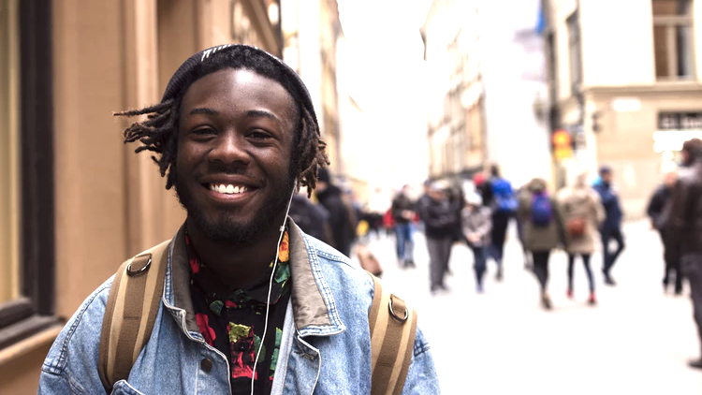
Racial Identity Development in African Americans
Internalization stage
Maintain connections to African-American peers; begin to establish meaningful relationships w/whites & members of other oppressed groups
Model also applicable to experiences of other people of color
Photo Credit: Unsplash
Notes:
Internalization stage of the Nigrescence Model.
Individuals maintain connections to African-American peers, but also begin to establish meaningful relationships with whites and members of other oppressed groups.
This model is also applicable to the experience of other people of color.

Slide 19
Racial Identity Development in European Americans
Have diverse cultural heritages
Some report feeling envious of people of color; perceive them to have stronger bond w/ cultural heritages
Many report feelings of having no culture
Social workers; important to help clients realize & connect w/ historical/current cultures
Photo Credit: Unsplash
Notes:
European Americans have diverse cultural heritages, which include values and beliefs emerging from the European enlightenment, Anglican Protestantism, and Western colonialism.
Examples include, rationalism, individualism, personal responsibility, a strong work ethic, self-effacement, and mastery over nature.
Some European Americans report feeling envious of people of color because they perceived them to have a stronger bond with their cultural heritages.
Many report feelings of not having a culture.
From a social work perspective, it is important to help all clients realize and connect with their historical and current cultures.

Slide 20
Racial Identity Development in European Americans
White racial identity development model developed by Helms (1990): focuses on rejection of racism & development of nonracist white identity
Six stages of model:
Contact
Disintegration
Reintegration
Pseudo-independence
Immersion/emersion
Autonomy
Photo Credit: Unsplash
Notes:
White racial identity development is a model developed by Helms (1990) which focuses on the rejection of racism and the development of a nonracist white identity.
This model consists of six stages:
Contact
Disintegration
Reintegration
Pseudo-independence
Immersion/emersion
Autonomy

Slide 21
Racial Identity Development in European Americans
Contact stage:
Show naïve curiosity/fear of people of color based on stereotypes
May resist new race-related info they find dissonant w/ existing beliefs
Disintegration stage:
May feel guilt, shame & anger recognizing own advantages & role of whites in maintaining racism
Photo Credit: Unsplash
Notes:
Contact stage of White racial identity development.
Individuals may show a naïve curiosity about or fear of people of color, based on stereotypes.
Some may resist new race-related information that they find dissonant with existing beliefs.
Disintegration stage of White racial identity development.
Individuals may feel guilt, shame, and sometimes anger at the recognition of their own advantages and the role of whites in maintaining racism.

Slide 22
Racial Identity Development in European Americans
Reintegration stage
Desire to be accepted by racial group; leads to reshaping own belief systems to be more congruent w/ acceptance of racism & belief in white superiority
Pseudo-independent stage
Abandon beliefs of white superiority; still unintentionally perpetuate system
Experience alienation from whites, haven’t examined own racism
Rejection from people of color suspicious of motives
Photo Credit: Unsplash
Notes:
Reintegration stage of White racial identity development.
Individuals desire to be accepted by their racial group, which leads to the reshaping their own belief systems to be more congruent with an acceptance of racism and belief in white superiority.
Pseudo-independent stage of White racial identity development.
Individuals abandon beliefs of white superiority, but may still unintentionally perpetuate the system with their actions.

Slide 23
Racial Identity Development in European Americans
Immersion/emersion stage
Seek to positively redefine what it means to be white
Replace racially related stereotypes w/ accurate information
Autonomy stage
Internalize newly defined sense of self as white & let go of racial privilege
Positive feelings energize efforts to confront racism & oppression
Photo Credit: Unsplash
Notes:
Immersion/emersion stage of White racial identity development.
Individuals seek to positively redefine what it means to be white through replacing racially related stereotypes with accurate information about what it means to be white in U.S. society.
Individuals seek to positively redefine what it means to be white through replacing racially related stereotypes with accurate information.
Learning about whites who have been antiracist allies and activists can be central to this process.
Autonomy stage of White racial identity development.
Individuals internalize a newly defined sense of self as white, and let go of their racial privilege.
Positive feelings that result can energize efforts to confront racism and oppression in daily lives.

Slide 24
Biracial & Multiracial Identity Development
Bi/multiracial individuals experience discrimination based on antimiscegenation attitudes
Straddle 2+ social worlds, no full acceptance in either
Receive pressure to identify w/one group over another, denying part of cultural heritage.
Identities include singular, border, protean & transcendent
Photo Credit: Unsplash
Notes:
Bi- and multiracial individuals may experience discrimination based on antimiscegenation attitudes – against the “mixing” of races.
They may straddle two or more social worlds without experiencing full acceptance in either.
They can receive pressure to identify with one group over another, denying part of their sense of self and cultural heritage.
Identities bi- or multiracial individuals may assume include:
Singular identity: identify with only one race.
Border identity: identity lies between social categories.
Protean identity: fluidly change behavior depending on the particular ethnic group or situation they encounter.
Transcendent identity: person does not see self as racialized, or
does not use race as a construct to understand the social world.

Slide 25
Racial Identity Development in Immigrants of Color
2014, approx 13% U.S. population = foreign born
Since 1970s non-European immigration accelerated
Middle Easterners first entered U.S. late 19th century; recently numbers increased dramatically
Majority Middle Eastern Americans = Muslim; Christian & Jewish #’s smaller
Immigrants face challenges, compounded by misunderstanding Middle Easterners
Photo Credit: Unsplash
Notes:
As of 2014 approximately 13% of the U.S. population was foreign born.
Since 1970s non-European immigration has accelerated.
Middle Easterners first entered the United States in the late nineteenth century, but recently their numbers have increased dramatically.
Although the majority of Middle Eastern Americans are Muslim, many however, are Christian and a smaller number are Jewish.
These immigrants face many challenges, compounded by widespread misunderstanding of Middle Easterners, including stereotypes of them as terrorists.

Slide 26
Racial Identity Development in Immigrants of Color
People of color = native & foreign born
Immigrant’s life experiences play role in how person develops & perceives self
Ethnic identity development related to common experiences in U.S.
1st & 2nd generation immigrant adolescents struggle to fit in w/ peers & mainstream White America
Photo Credit: Pixabay
Notes:
People of color include those who are native born, and individuals who were born and lived for various periods of time in other countries.
The immigrant’s total life experiences play a role in how the person develops, and the “self” is perceived.
Ethnic identity development for immigrants is related to common experiences they had in the United States.
For example, immigrants who had been discriminated against and attended public schools were more likely to identify with their native ethnicity.
First or second generation immigrant adolescents may struggle to fit in with peer groups and mainstream white America.
This can cause friction with their parents and other extended family members, who often prefer their children to maintain traditional ethnic and cultural ties.

Slide 27
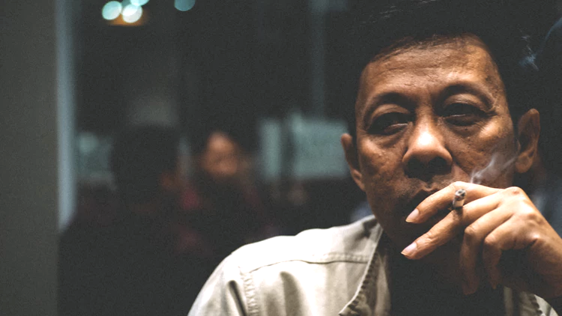
Responses to Oppression
Conley (2015) outlines group responses to oppression
Oppressed groups or individuals may “withdraw”
Some immigrants attempt to overcome oppression by “passing or blending” in w/ dominant group
Process includes altering physical characteristics or changing name
Others avoid oppression through process of “acceptance”
Person feigns compliance & hides feelings of resentment
Photo Credit: Unsplash
Notes:
Conley (2015) outlines several group responses to oppression: Withdraw, Pass or blend in with dominant group & Acceptance
Oppressed groups or individuals may “withdraw.”
Jewish populations largely left Poland after World War II.
During the great migration of the mid-twentieth century, large numbers of African Americans moved from the rural South searching for jobs, opportunities and equality.
Some immigrants attempt to overcome oppression by “passing or blending” in with the dominant group.
The “pass or blend” process includes steps such as altering physical characteristics or changing one’s name
Yet, others try to avoid oppression through the process known as “acceptance.”
To gain “acceptance” the person feigns compliance and hides feelings of resentment.

Slide 28
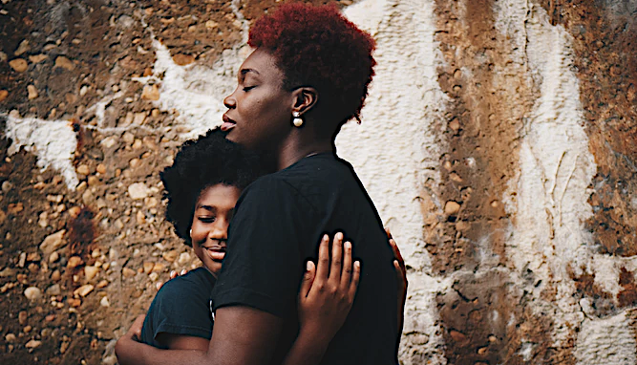
Protective Socialization Practices in Families & Communities
Socialization strategies help people survive & maintain humanity when faced w/ adversity
Strategies include fictive kin, spiritual teachings & education
Fictive kin = people unrelated by birth/marriage with has emotionally significant relationships & treated as family
Spiritual teachings = concrete psychological/social support to individuals & families
Photo Credit: Unsplash
Notes:
Socialization strategies can allow individuals to survive and maintain their humanity when faced with adversity resulting from racism.
These strategies include:
Fictive kin
Spiritual teachings
Education
Fictive kin are individuals unrelated by birth or marriage with whom one has emotionally significant relationships and treats as family.
Spiritual teachings provide concrete psychological and social support to individuals and families.
As an example, one may adopt a belief of equality and the inherent worth of each individual as a child of God.

Slide 29
Protective Socialization Practices in Families & Communities
Direct education about cultural heritage/values increase positive self-concepts
Knowledge of achievements by significant cultural icons provide insight to positive self-worth & discovery of motivation & hope
Important developmentally for individuals to recognize their culture/people produced significant contributions to past/current societies
Photo Credit: Pixabay
Notes:
Direct education about one’s cultural heritage and values increase positive self-concepts.
Learning about African heritage and the central contributions of African Americans to the larger U.S. society can be protective for individuals across the life span.
Knowledge of achievements by significant cultural icons can provide individuals insight to their positive self-worth and the discovery of motivation and hope.
It is important developmentally for individuals to recognize that their culture and people have produced significant contributions to past and current societies.

Slide 30
Formal Education
Formal education system can play critical role in decreasing racism & privilege
Understanding U.S. history & contemporary society requires attention to contributions/struggles of diverse groups
Schools integrate social diversity into curricula by:
Teaching about leaders of color
Detailing how policies historically favored European-American males over marginalized populations
Photo Credit: Unsplash
Notes:
The formal education system can play a critical role in decreasing racism and privilege.
Understanding U.S. history and contemporary society requires attention to the contributions and struggles of diverse groups.
Many schools integrate social diversity into their curricula by,
teaching about African-American leaders in the sciences or
detailing how policies have historically favored European-American males over women and minorities.

Slide 31
Formal Education
Schools must respect/support development & culture of children when English not native language
Progress made for supporting written/verbal communication in more than one language
Progress made in social work education to address racism
Ex: The Center for Regional and Tribal Child Welfare Studies focuses on:
Indigenous practices
Spirituality, language, culture & history
Legacy of genocide & historical trauma
Contemporary laws & policies
Photo Credit: Unsplash
Notes:
Schools also must respect and support the development and culture of children for whom English is not their native language.
Progress has been made for supporting written and verbal communication in more than one language.
Progress has been made in social work education to address racism.
An example is the Center for Regional and Tribal Child Welfare Studies at the University of Minnesota, Duluth, School of Social Work.
This program has graduated Indigenous and non-Indigenous child welfare workers with MSWs that are now practicing within tribal communities in North America.
The Center for Regional and Tribal Child Welfare Studies guides social workers in learning about
Indigenous practices;
spirituality, language, culture and history;
legacy of genocide and historical trauma; and
contemporary laws and policies.

Slide 32
Activism
Resistance to oppression occurs at political & legal systems level
Gandhi, Martin Luther King Jr., Malcolm X, Robert Williams, Nelson Mandela & others led resistance movements against racial oppression
Affirmative action = positive steps taken to increase representation of women & people of color in employment, education & business
Intended to give historically disenfranchised people fair chance to engage in public institutions
Photo Credit: Unsplash
Notes:
Resistance to oppression also occurs at the level of political and legal systems.
Gandhi, Martin Luther King Jr., Malcolm X, Robert Williams, Nelson Mandela, and many others have led resistance movements against racial oppression, using a variety of approaches.
For example, affirmative action refers to positive steps taken to increase representation of women and people of color in the areas of employment, education, and business.
It is intended to give people who have been historically excluded a fair chance to engage in public institutions.

Slide 33
Summary
Cultural awareness requires openness to new learning & ongoing self-reflection to effectively serve diverse communities
Socially constructed concept of race remains complex, problematic part of personal identity development
Minorities endured long history of oppression in U.S.
Developed important strategies for resistance:
Protective factors within families & communities
Formal education
Political activism
Social workers must be aware of ramifications of racism, white privilege & institutional racism
Photo Credit: Unsplash
Notes:
Cultural awareness requires an openness to new learning and ongoing self-reflection to effectively serve the diverse communities that make up society.
The socially constructed concept of race remains a complex, problematic, and important part of personal identity development for many people.
Minorities have endured a long history of oppression in the United States.
They have also developed important strategies for resistance that includes:
protective factors within families and communities,
formal education, and
political activism.
Social workers need to be aware of the social psychological, and developmental ramifications of racism, white privilege, and institutional racism.

