Slide 1
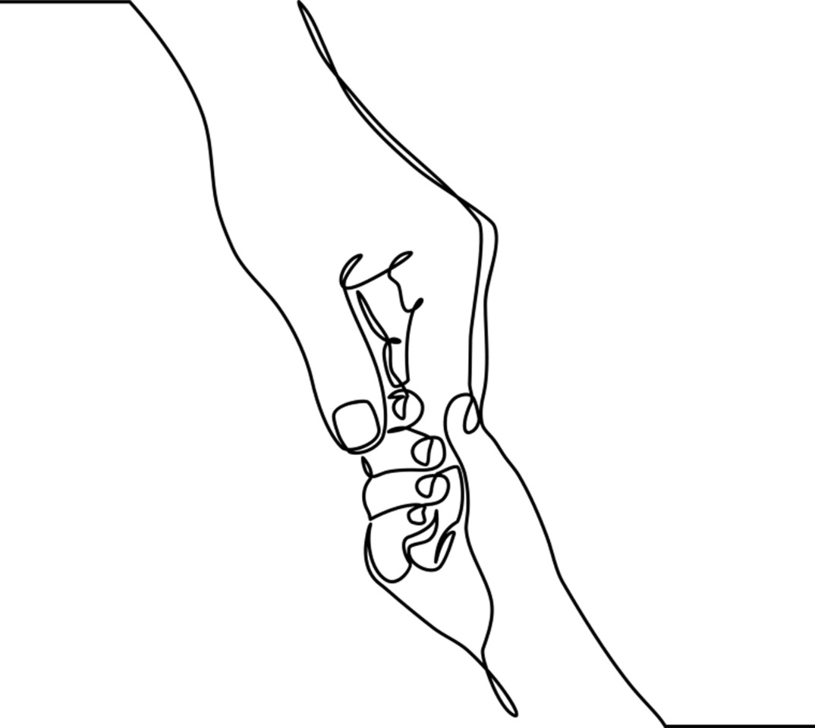
Chapter 6: Working with Parents

Slide 2
The term parent is broadly defined and inclusive of a range of adults and adolescents in parenting roles.
PARENTS
Notes:
The term parent refers to biological, adoptive and foster parents; stepparents, extended family members and grandparents; same sex and gender non-conforming partners, non-related and fictive kin all of whom function in primary care giving roles. Parents may be legally married or never-married, living together or separately, and single-parenting.
Some parents effectively co-parent and divide up care giving functions. Others adhere to culturally gendered roles, while there are those that apportion care giving with extended family, hired caregivers and/or tribal/community members.
Photos: Left Circle: Photo by Blake Barlow on Unsplash; Upper Circle: Photo by Caroline Hernandez on Unsplash; Right Circle: www.flickr.com; Bottom Circle: Photo by TREGG MATHIS on Unsplash

Slide 3
Building worker-parent relationships is a dynamic and individualized process.
Respect
Acceptance
Working Alliance
Patience
Shame
Fear
Prior Negative Experiences
Notes:
As with child-clients, it’s the worker’s responsibility to create and nurture the working alliance.
Building trust takes time and includes taking into account the strengths, vulnerabilities, circumstances, experiences, and expertise of clients and their families.
Establishing a safe atmosphere where parents can speak openly about their concerns is one of many steps in this trust-building process.
A second step is meeting people where they are in their parenting process; to begin where the clients are in their relationships with their children.
Trust is often difficult to initially establish because all too many parents have had unsatisfying or negative experiences with child-centered professionals.
Effective workers anticipate that parents will learn from them, lean on them, and at times, they will take the lead in their children’s treatment and services.

Slide 4
Workers may feel caught in the middle priorities of children and those of their parents.
Notes:
Ethical, moral, and personal strains surface most commonly when working with child protection cases, domestic violence, and/or contentious family situations.
Strains are well documented when workers must make decisions about the contradictory needs of dependent children living with parents facing addiction and/or mental illness.
Workers may also find themselves siding with parents when children’s behaviors or emotions are particularly difficult or hard to address.
Contentious cases of parental divorce and separation also place workers in a stressful position, especially when asked to make recommendations to the court.
Photo: defineterms.com

Slide 5
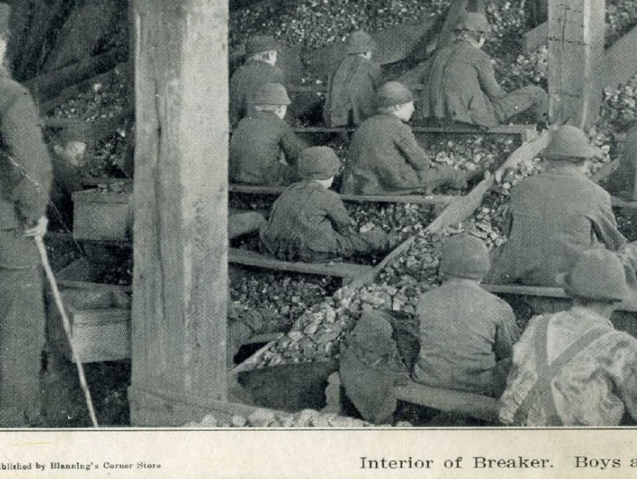
Today’s parents are expected to keep children protected and safe from harm. Yet this conceptualization of parents’ roles and children’s needs has not always been the case.
Postmarked 1907. Boys as young as nine worked in the breakers picking slate out of the coal.
Notes:
In the 18th century good parenting was meant to be stern rather than nurturing. Parents believed that discipline encouraged healthy, moral development.
Up until the early 20th century, unless living in prosperous families, children over the age of 7 in America were expected to help support the family; some working in highly hazardous and often abusive conditions.
Industrialization and urbanization brought tremendous hardships to children and families. Child advocates and lay reformers were concerned about the impact a rapidly changing society had on an increasing population of children.
Photo: www.flickr.com by Janet Lindenmuth.

Slide 6
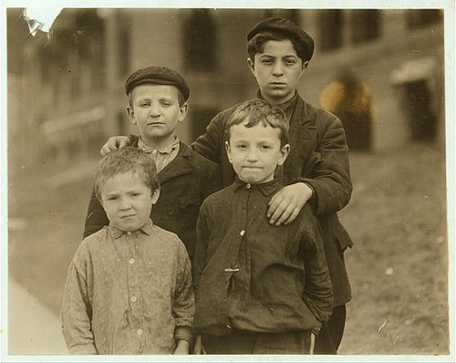
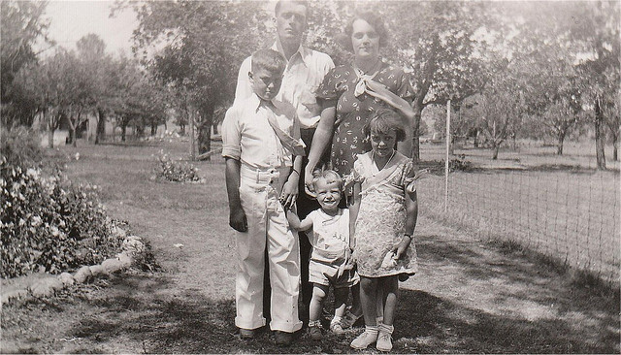
Early in the 20th century, two institutions took the lead for children’s needs: The juvenile justice system aided children convicted of crimes; and child guidance centers responded to children identified as mentally and emotionally troubled.
Juvenile Court Boys
Parents of the 1930’s
Notes:
1. The juvenile justice system advocated to change circumstances for children who broke the law and were committed to adult penal institutions. To a great extent these youngsters were poor, undereducated, and frequently broke the law to sustain themselves and their families.
Child guidance workers initially were based in the community. They reached out to economically disadvantaged children to improve their living and working conditions. These youngsters were more often than not, from immigrant families or living with foster families and in orphanages and were sometimes exploited as child laborers.
By the 1930’s the growing popularity and influence of psychoanalytic theory shifted child guidance outreach. Child psychiatry focused on children’s emotional and behavioral struggles, which were often blamed on parenting deficiencies. Blame for children’s problems was particularly cast towards mothers.
Photo: www.flickr.com
LC-DIG-nclc-03523
Title: The Slein boys. Meyer Slein (12 yrs. old) his brother Abe (10 years old) who has just returned from Industrial School (Reform School). Another brother is in the School. Show effects of street life and are Juvenile Court boys. Location: St. Louis, Missouri. Creator(s): Hine, Lewis Wickes, 1874-1940, photographer Date Created/Published: 1910 May.
Photo of family: www.flickr.com Medium: 1 photographic print. Reproduction Number: LC-DIG-nclc-03523 (color digital file from b&w original print) Rights Advisory: No known restrictions on publication.
Call Number: LOT 7480, v. 2, no. 1426-A [P&P] Repository: Library of Congress Prints and Photographs Division Washington, D.C. 20540 USA
Photo Credit: Library of Congress, LC-DIG-nclc-03523

Slide 7
Children’s rights to safety and freedom from maltreatment were asserted by the Child Abuse Prevention and Treatment Act (CAPTA) of 1974.
Notes:
CAPTA made a bold statement that no adult, regardless of relationship, had the authority to misuse or harm a child.
Similar to the CAPTA, the Convention on the Rights of the Child (1989) mandated that authorities intervene when adults placed children in jeopardy of harm.
Canada ratified the CRC in 1991 and to this day it supports the duty to report law (mandated reporting) in matters of child protection.
Image by: Photo by Larm Rmah on Unsplash

Slide 8
People enter into parenthood with hopes and dreams for their children. They do not anticipate or prepare for the fact that their children may need therapeutic interventions in the future.
Notes:
By the time most parents reach social work, counseling, mental health or social services they believe that they have in some way failed their children.
The range of parents who seek out services is wide, deep and varied: Some are veterans of social service/care institutions , others have little or no experience with helping systems outside of the family. Some are self-referred, eager to get help for their children; others are mandated by the courts or other authoritative bodies.
Photo by Jordan Whitt on Unsplash

Slide 9
Engaging effectively with parents takes time, humility, and patience.
Notes:
Engaging with parents takes time, knowledge, compassion, and skill whether parents have sought out treatment and with those whose children’s circumstances have caused them to become “unintentional clients” (Boyd Webb, 2003).
Understanding and compassion are needed when working with parents whose own lives contained few if any models of connection or trustworthiness.
Respectfully invite parents to engage in their children’s therapy and reinforce the value of their participation throughout the treatment relationship.
Photo by Paul Talbot on Unsplash

Slide 10
Parents do the best they can.
Notes:
The goal of any relational partnership is to ascertain what works best for parents; to optimize and support their functioning, and to foster skills that can be sustained once the formal relationship has ended.
Children benefit from positive and productive parent-worker relationships. Parents who feel engaged in their children’s treatment and services are more likely to implement, maintain, and follow through on suggestions.
Workers must balance doing things for parents with the aim of working with them and creating options for shared decision-making.
Each partnership is shaped by the circumstances and dynamics of its participants. Workers must be prepared to work with a myriad of family circumstances and a wide range of parental expectations.
Photo by Sebastián León Prado on Unsplash

Slide 11
Qualities for Building Parent/Worker Partnerships
Parent/Worker Partnerships
Open Communication
Commitment
Trustworthiness
Respect
Notes:
RESPECT: Respect is conveyed by taking time to get to know parents; acknowledging they know their children best; accept diverse family structures, cultures and backgrounds; and see children as individuals, not as diagnoses or labels. Respectfulness in action requires being courteous; treating parents as one would want to be treated.
OPEN COMMUNICATION: Parent-worker communication should be candid, honest and transparent, and bi-directional. It should be free of jargon and utilize culturally appropriate language.
COMMITMENT: Workers express commitment through dedication to their work, following through on promises made, and going the extra mile when necessary.
TRUSTWORTHINESS: Trust is established by way of actions that are responsible, reliable, and dependable. When cemented, trustworthiness means children are safe within practitioners’ care.

Slide 12
Diverse Parent Populations
Notes:
Child workers must be open to a range of families and systems including those that may require selected knowledge to enhance the quality and effectiveness of worker-parent engagement.
Workers must reflect upon their conscious and hidden cultural biases and assumptions including ableism and heterosexism.
Child-centered workers are often the first to introduce parents to the unfamiliar world of childhood illness and disability. Parents who care for children with chronic health conditions appreciate the unavoidable gap between professionals’ knowledge and parents’ wisdom; they know that people who have not been in their circumstances cannot truly know their plight.
Culture influences how parents care for, discipline, and guide their children’s growth and development. Parents from diverse backgrounds and circumstances encounter discrimination, prejudice and/or racism within medical and mental health systems, social service agencies and in educational institutions.
According to the American Academy of Pediatrics children raised by lesbian and gay parents develop in ways similar to those raised by heterosexual parents.
Despite growing tolerance for sexual orientation and gender diversity in America, acceptance of same sex or gender nonconforming parents’ remains questioned and stigmatized. Gay and lesbian parents still experience rejection and disenfranchisement in their roles as parents and families.
Heterosexism causes challenges for children of gays and lesbians; at its most destructive, it feeds into bullying, violence and hate directed at children and their parents.
Photo: Left Top: www.flickr.com; Bottom Left: Left Top: www.flickr.com; Right Top: Photo by M.T ElGassier on Unsplash; Right Bottom: Photo by Gift Habeshaw on Unsplash

Slide 13
Meet the Barrons
“If you judge us we can’t trust you.”
Notes:
Case Study (Abridged from Chapter 6, pp. 137-140): As the cottage social worker I was accustomed to working with challenging children and families. To prepare for meeting Ben and his parents, I combed through his thick case file to get a preliminary sense of the family’s history. The Barrons had married young. Both had experiences living in the foster care system. Saul, Ben’s father, age 34, had severe cognitive disabilities due to early brain injuries. He dropped out of school in 11th grade and worked as a handyman.
Paula, age 33, Ben’s mother, earned a GED while pregnant with Wyatt, the Barron’s oldest child. She worked part-time as a cashier for a big box store.
Ben was the second of the five Barron children ages 3 to 15. The youngest child, Maura, 3, had Down syndrome. According to the records, Ben and Wyatt, 15, were both diagnosed with untreated attention deficit hyperactivity disorder, a diagnosis not accepted by their parents.
A year before Ben’s residential placement, the Barron family was evicted from their apartment and lived in their car. No one knew of their circumstances until a police officer saw the family asleep parked behind Wal-Mart and reported them to child protective services. The Barrons applied for and received subsidized housing, Medicaid, and food assistance. The children returned home from temporary foster care placements to live with their parents. Saul enrolled in a job retraining program.
Overall I was impressed by the parents’ ability to keep their family together despite the odds and looked forward to meeting them. The Barrons however did not show up for their first two appointments and their phone was disconnected. Given that Ben’s placement required the family’s involvement in his treatment I had no recourse but to do an unscheduled home visit.
On the way to the Barron’s home I spontaneously picked up donuts thinking that perhaps they would soften the impact of an unanticipated visit. If all else failed I thought I’d have the donuts to soothe myself on the long ride back home.
Paula answered the door. She seemed perturbed to see me. Saul was watching a small TV in the living room. After several moments, I asked if I could come in. Saul yelled from the living room, “Let her in. She won’t leave anyway.” Paula turned away and I followed.
It was early afternoon and all the children except Maura were at school. I handed Paula the box of donuts. “Congratulations on your new home” I said. “How’s it working out?” Paula put the donuts on the small kitchen table. “Want coffee?” she asked. “Sure, thanks” I responded. Paula heated a kettle on the stove and spooned instant coffee into two mugs. Saul joined us at the table.
After some awkward small talk I reminded them about the conditions of Ben’s residency. Missing family therapy could jeopardize Ben’s placement, I explained. “That’s why I came to visit. It wasn’t because I was checking up on you,” I said.
Saul seemed suspicious of my explanation. He said that no one understood how hard it was for them. “People don’t get it. They expect us to be at a million appointments a week.” Saul went on to explain that he and Paula were working alternate hours so that the kids were never left alone. Paula interjected “People don’t care about how many responsibilities we have. They think we’re screw ups.”
I sipped my coffee trying to think of what to say next. “How can we make this work?” I asked with emphasis on the ‘we’. Paula spoke up: “If you judge us we can’t trust you,” she said.
Her remark momentarily caught me by surprise – it was clear, simple, and deeply honest. I took a breath and responded “I understand. It’ll take time for you to trust me. No doubt we’ll have our differences and it’s simply true that our relationship is not equal. But what we do have in common is we want Ben to succeed. So where do we start?”
By the end of that visit we determined that for the short-term I’d continue coming to their home. We agreed to honor appointment times and let each other know when these needed to be rescheduled. When I left, the donuts were gone.
I visited weekly with the Barrons for a nine-month period. Each time I brought donuts, played with Maura, and Paula made the coffee. We spoke plainly and directly. Our time together had its moments, both good and challenging. When conflicts occurred it took time to restore the fragile trust we built.
But the Barrons were always available when I came to call. They gave honest consideration to my ideas as I did to theirs. For my part, I showed up on time, called if I had to change anything, and followed up on all their requests for information.
Once Saul completed his training and got a welding job the parents decided they could afford trips to the Children Home.
When it came time for discharge planning, Paula and Saul informed me that they weren’t yet prepared to handle Ben at home. Instead, they wanted to have him placed in a long-term therapeutic group home where he could get the supervision he needed. They didn’t want him to backslide. This was not the outcome that I had initially hoped for however, having come to know this family, I agreed that they knew best.
Photo: www.flickr.com.

Slide 14
Conversation Starters
What qualities constitute ‘good enough’ parenting? How do factors such as culture, race, socioeconomics, and faith influence parenting practices?
In small groups, discuss situations in which the needs of children and those of parents conflict. In each instance, identify relational practice principles that affect decision-making.
What did Paula Barron mean when she said, “If you judge us we can’t trust you?” Analyze the worker’s application of relational practice principles in her work with the family?
Would you consider the outcome of the Barron case successful? Why? Why not?

