Slide 1
How to do Your Social Research Project Or Dissertation
by Tom Clark, Liam Foster and Alan Bryman

Slide 2
Chapter 2
The Social Research Process
© Tom Clark, Liam Foster, and Alan Bryman, 2019

Slide 3
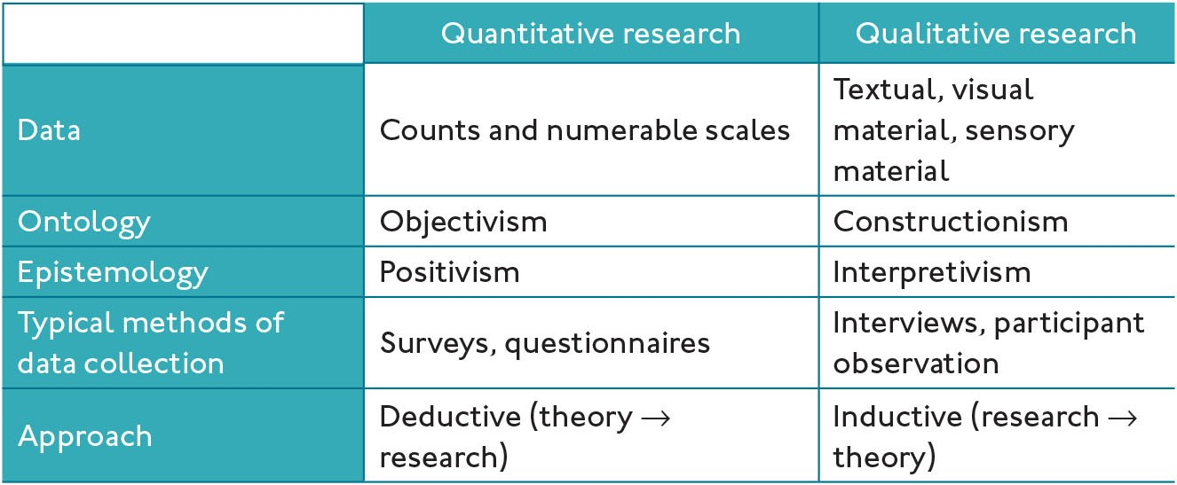
Table 2.1 Types of social research

