Slide 1
Chapter 13 Real Econometrics Second Edition Michael A. Bailey

Slide 2
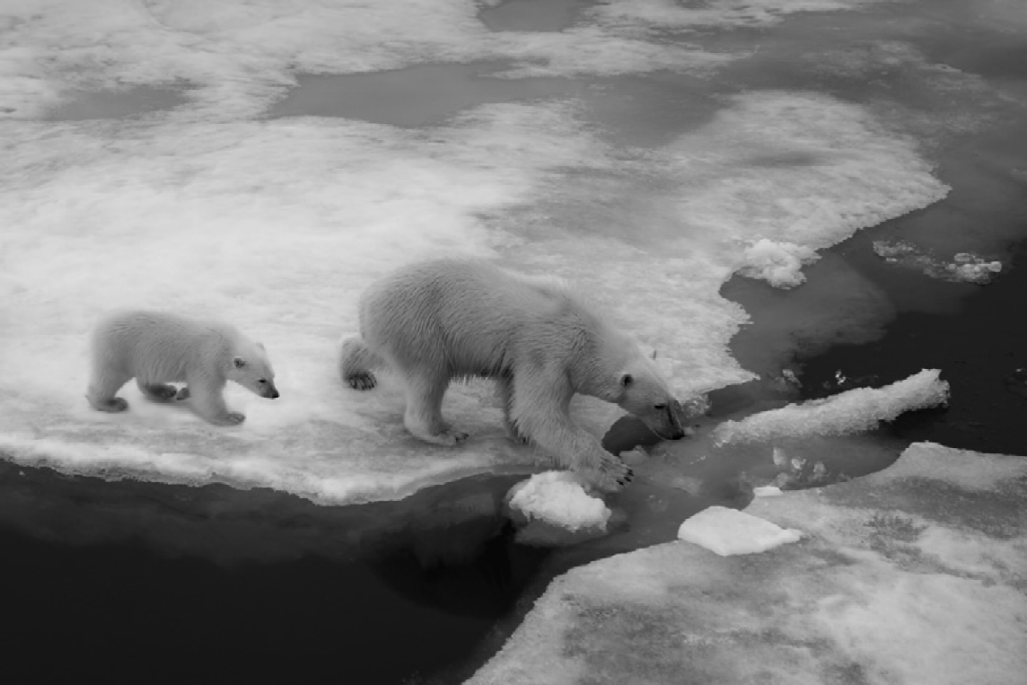

Slide 3
Case Study Photos
Chapter 13

Slide 4
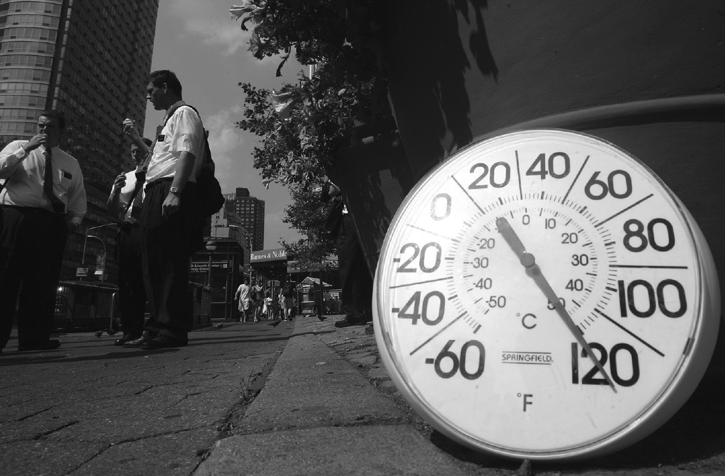
Case Study 1

Slide 5
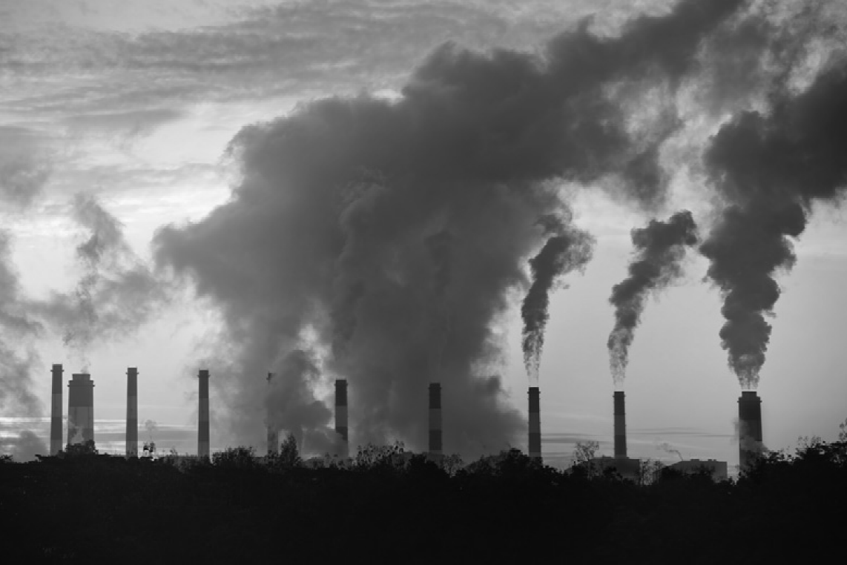
Case Study 2

Slide 6
Figures
Chapter 13

Slide 7
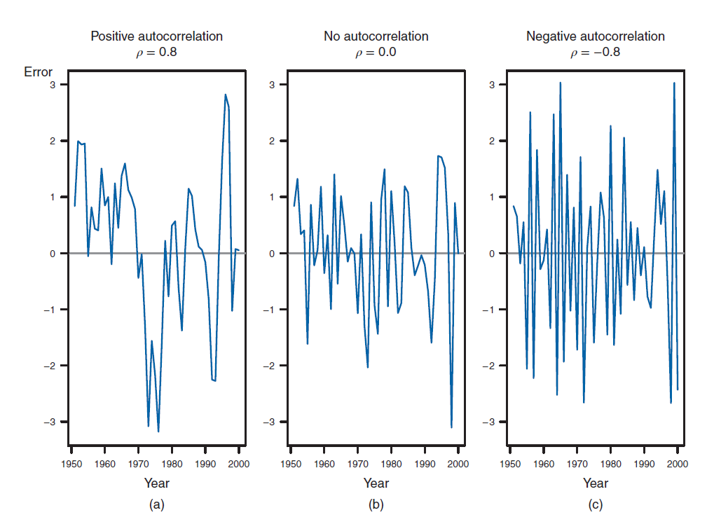
Figure 13.1

Slide 8
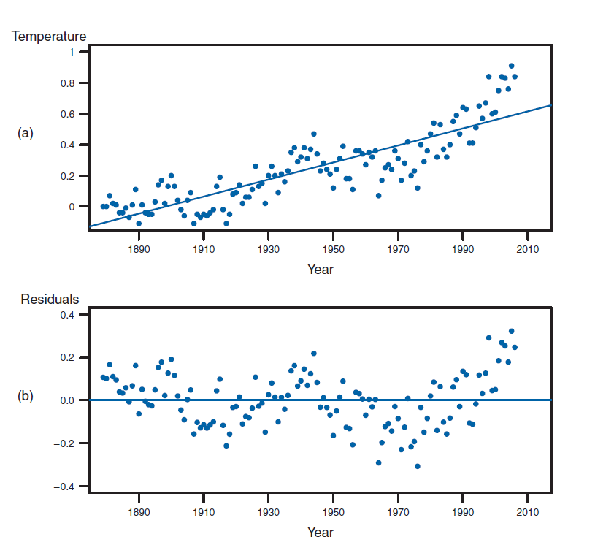
Figure 13.2

Slide 9
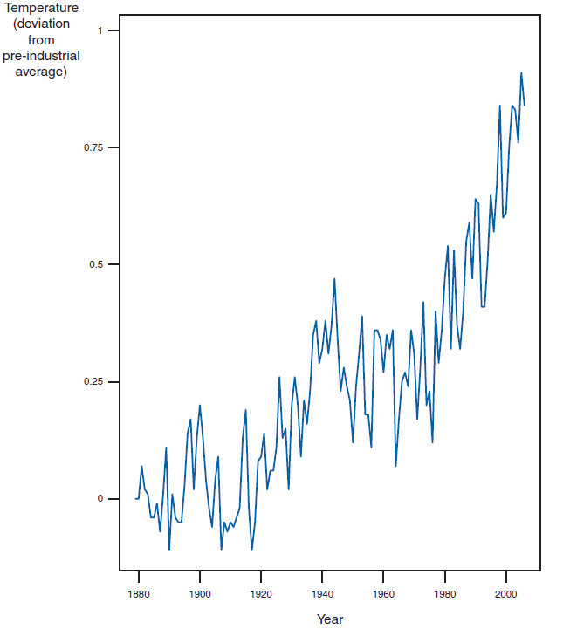
Figure 13.3

Slide 10
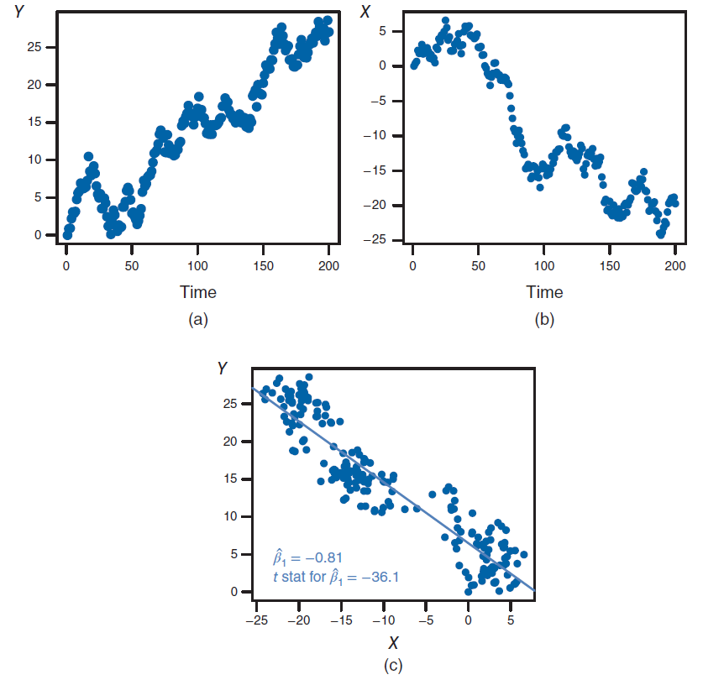
Figure 13.4

Slide 11
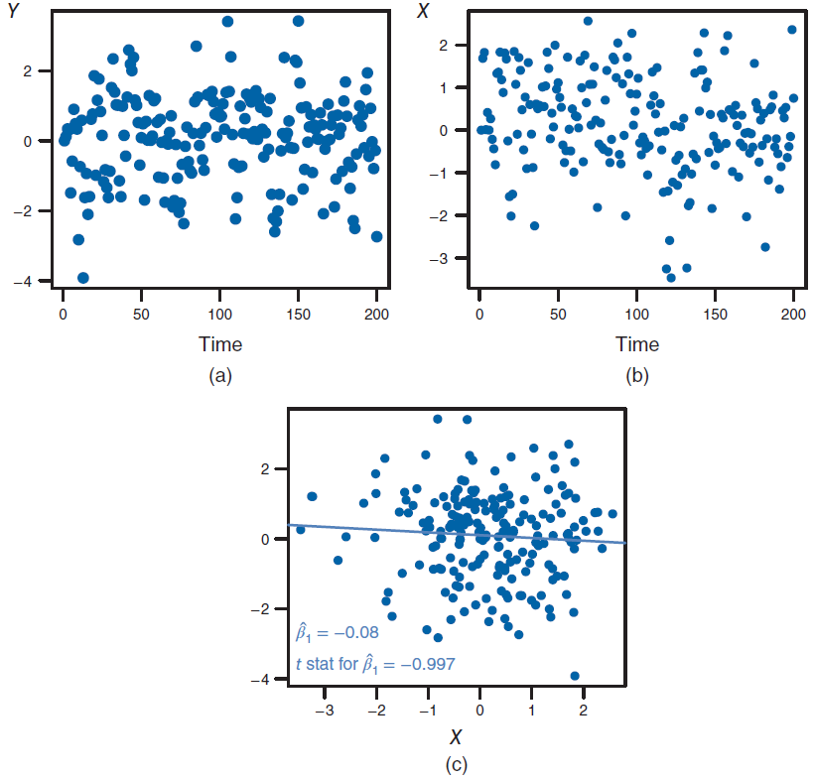
Figure 13.5

Slide 12
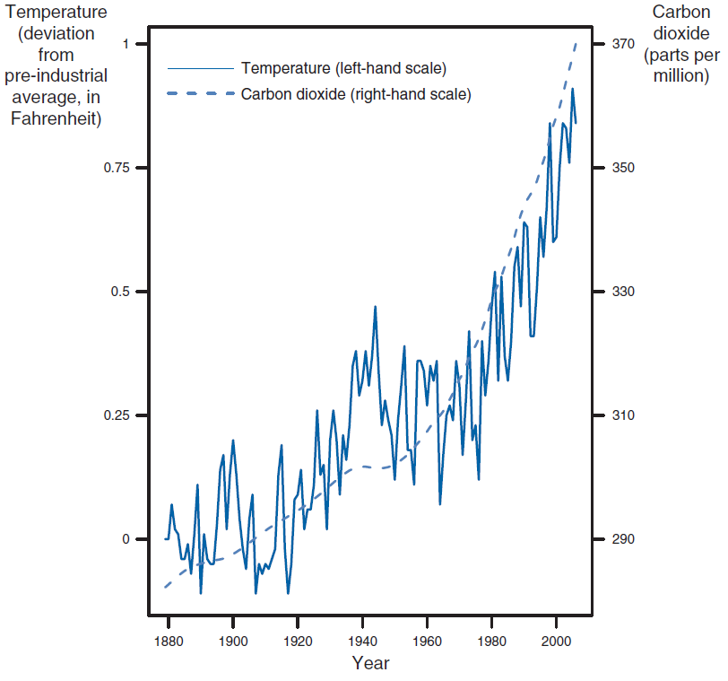
Figure 13.6

Slide 13
Tables
Chapter 13

Slide 14
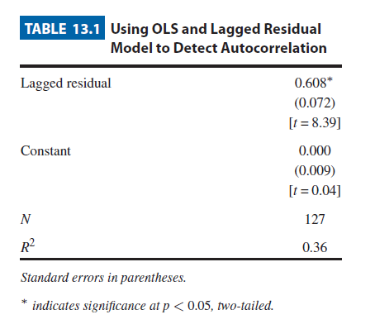
Table 13.1

Slide 15
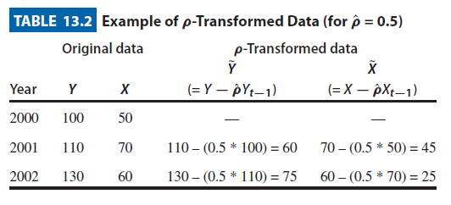
Table 13.2

Slide 16
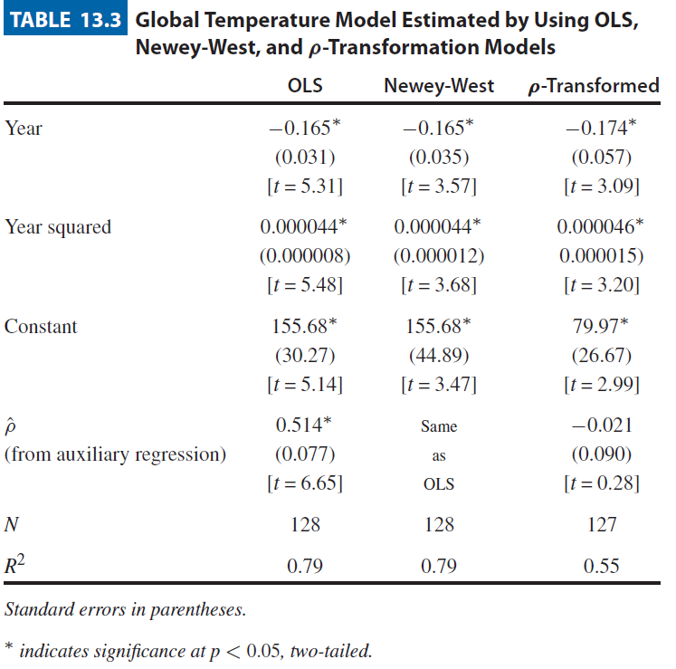
Table 13.3

Slide 17
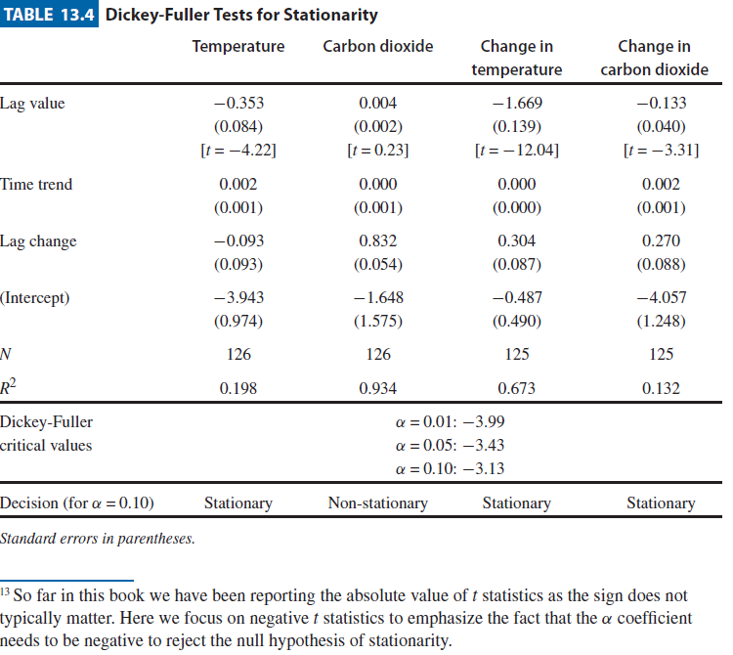
Table 13.4

Slide 18
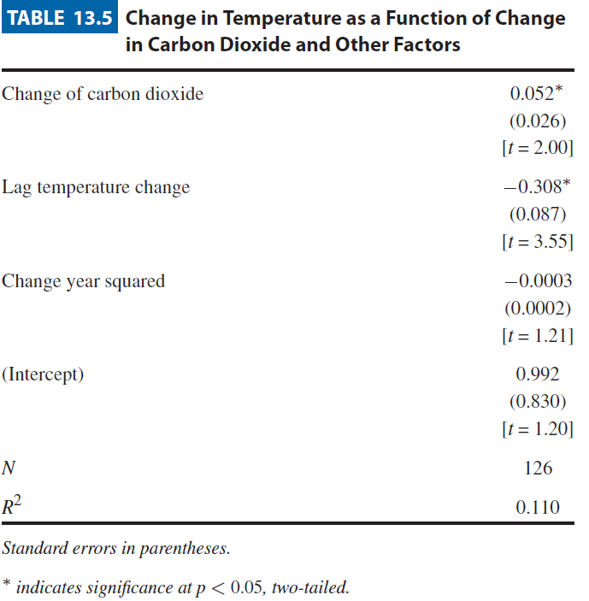
Table 13.5

