Slide 1
Vital Statistics Probability and Statistics for Economics and Business
William H. Sandholm
University of Wisconsin-Madison
Brett A. Saraniti
Northwestern University
Chapter 19
Simple Regression: Descriptive Statistics

Slide 2
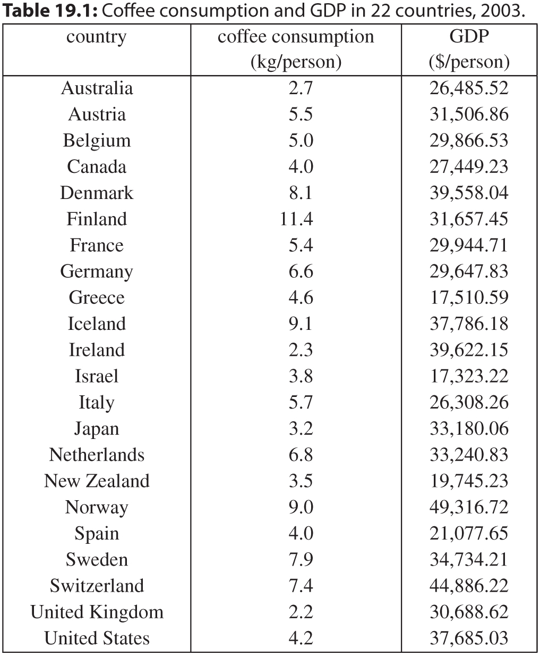
Table 19.1: Coffee consumption and GDP in 22 countries, 2003.

Slide 3
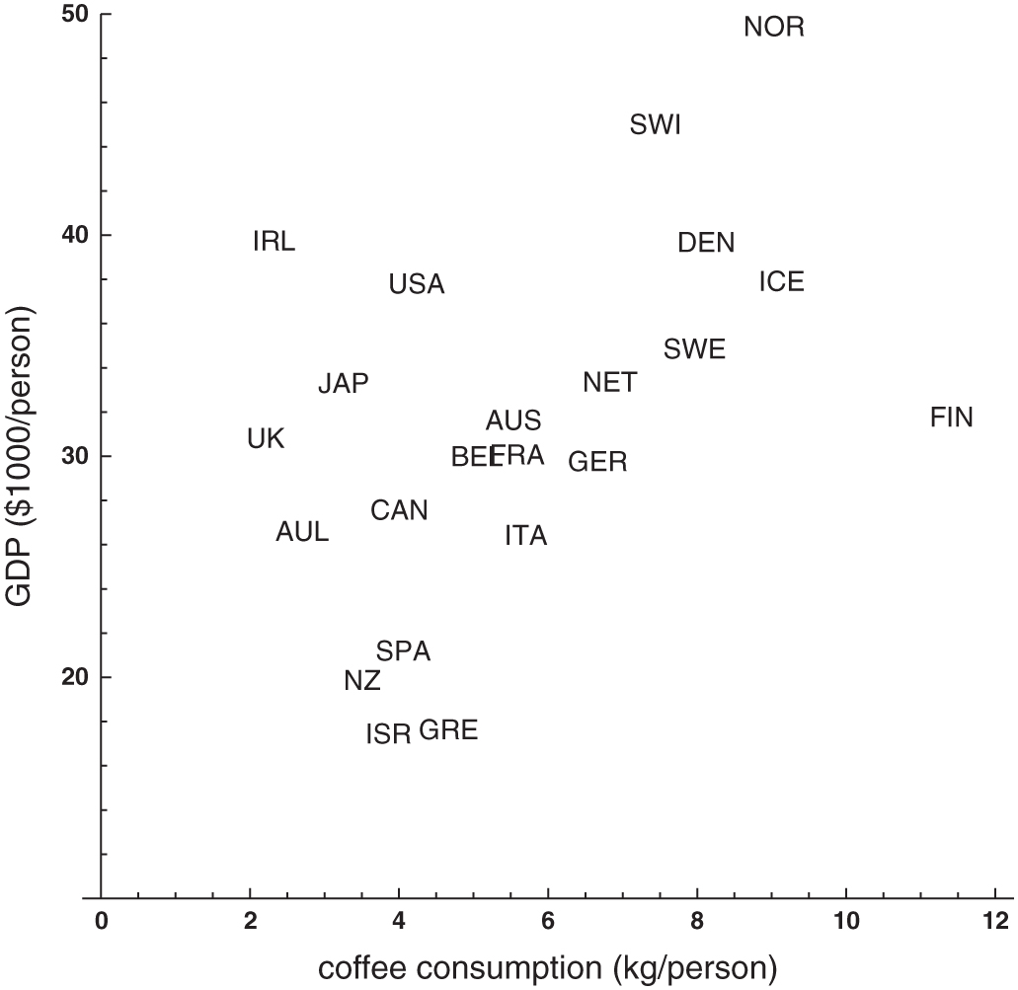
Figure 19.1: Coffee consumption and GDP in 22 countries, 2003.

Slide 4
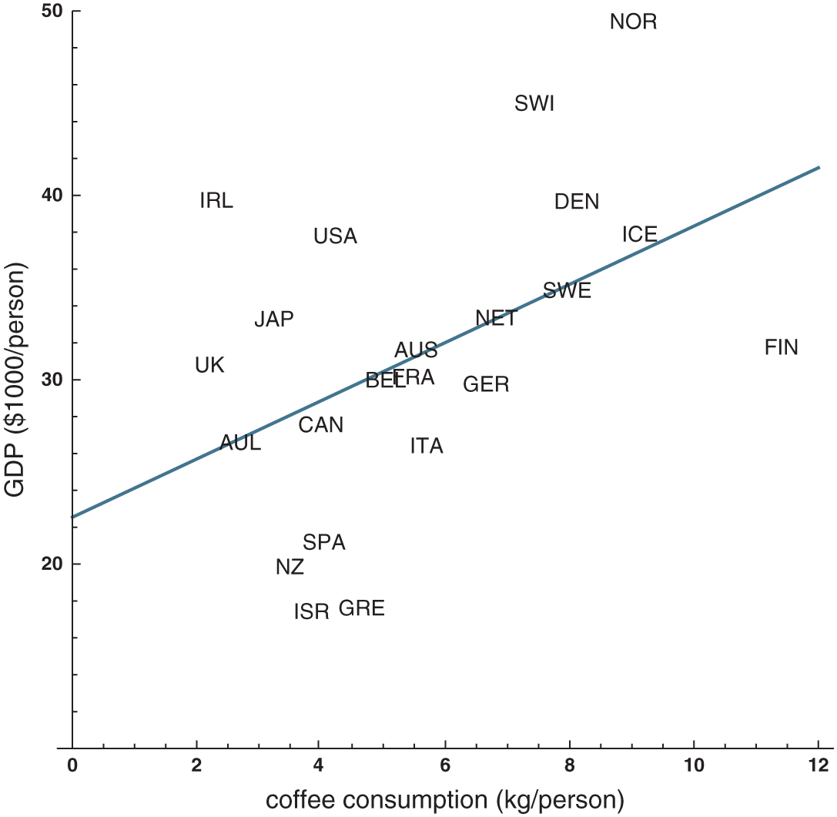
Figure 19.2: The regression line for the coffee/GDP data.

Slide 5
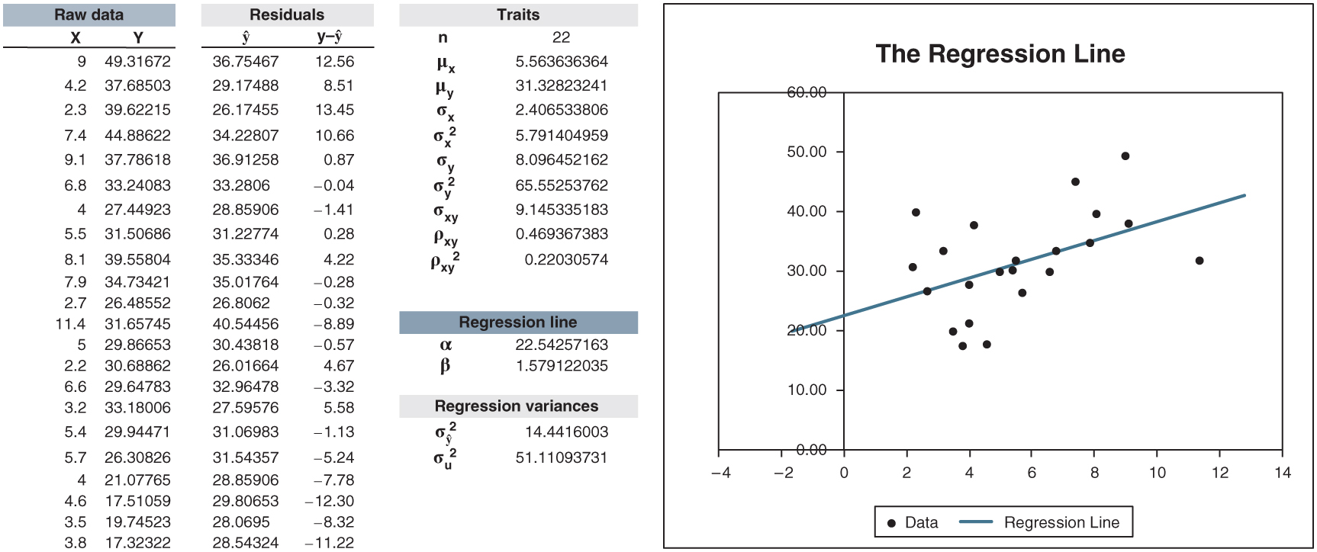
Figure 19.3: regression_descriptive.xlsx/regression_line

Slide 6
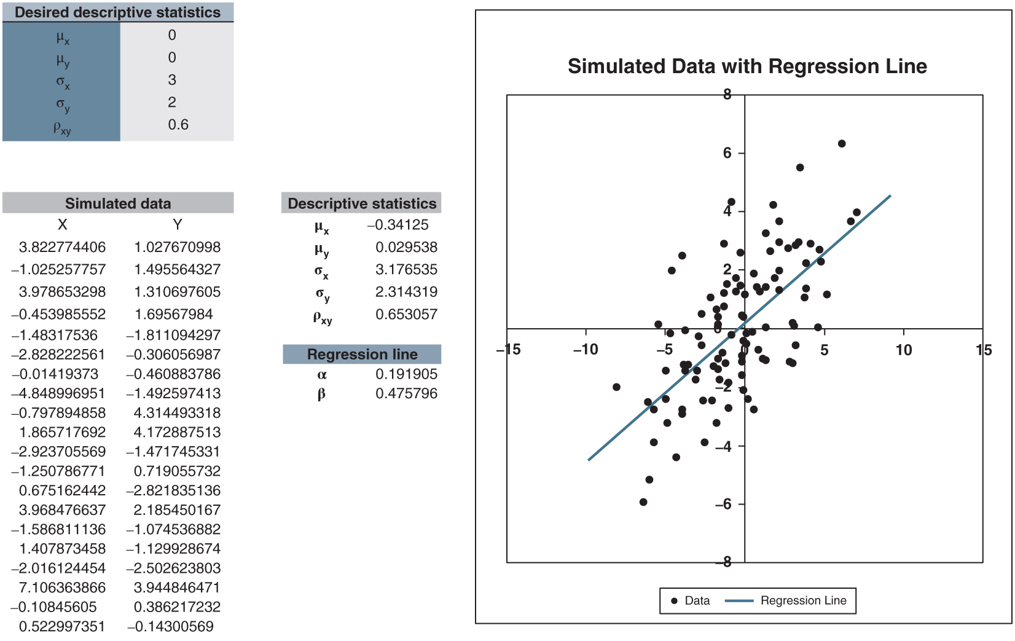
Figure 19.4: regression_generator.xlsx/regression_line

Slide 7
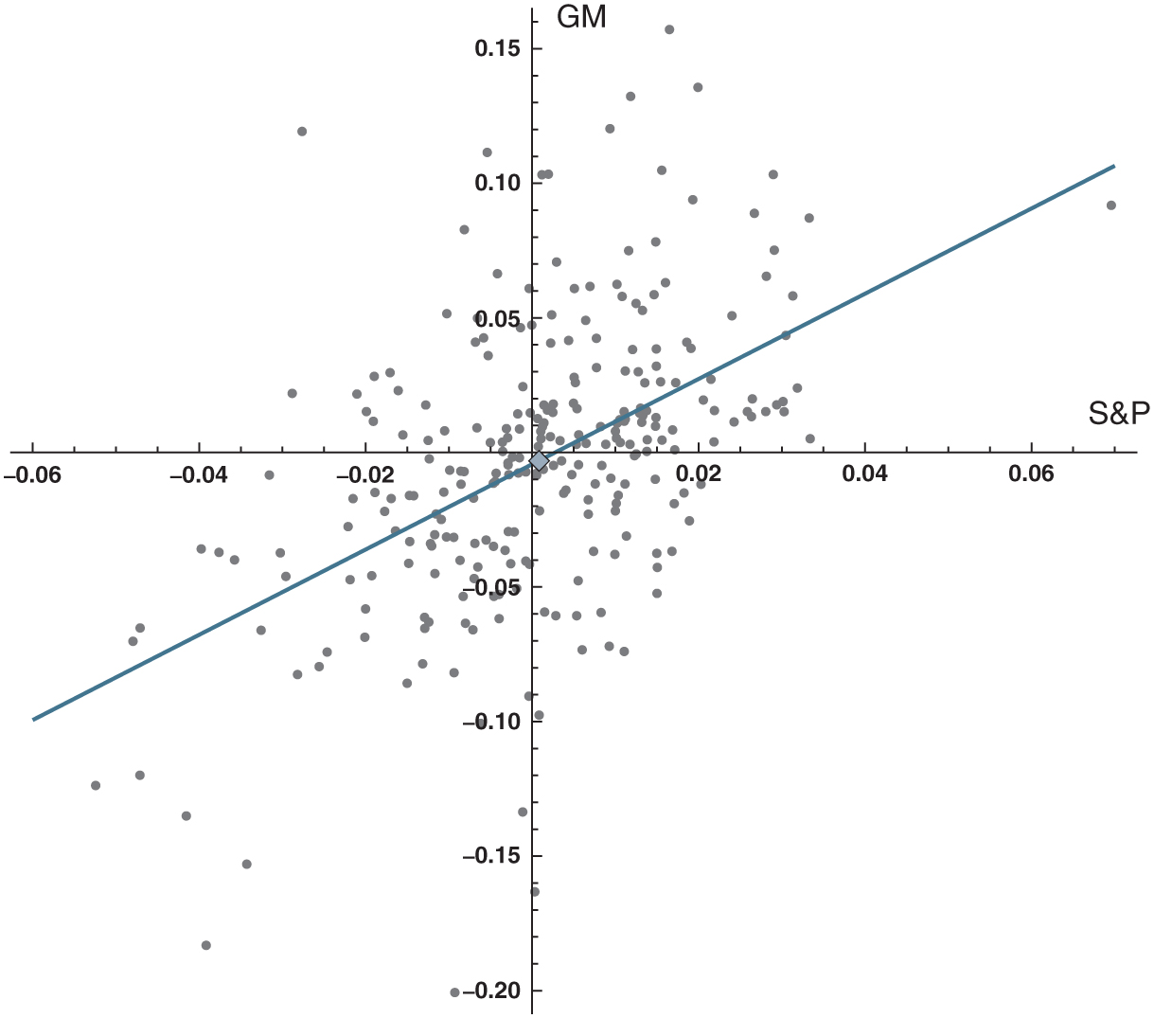
Figure 19.5: Weekly returns on the S&P 500 and General Motors, 2003–2007.

Slide 8
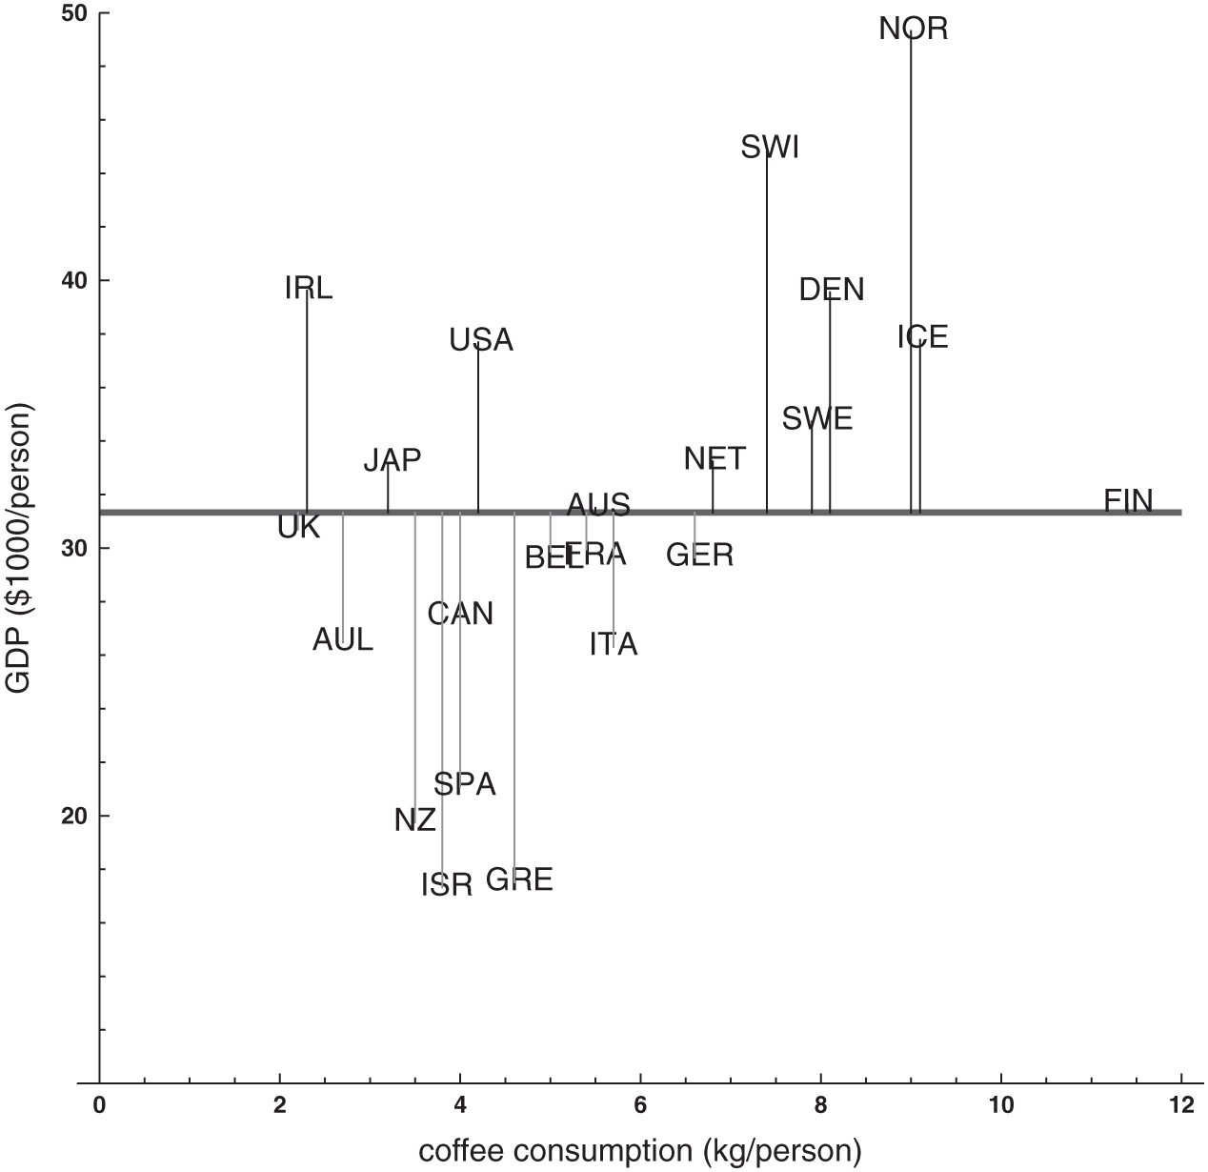
Figure 19.6: The mean line and mean-line residuals for the coffee/GDP data.

Slide 9
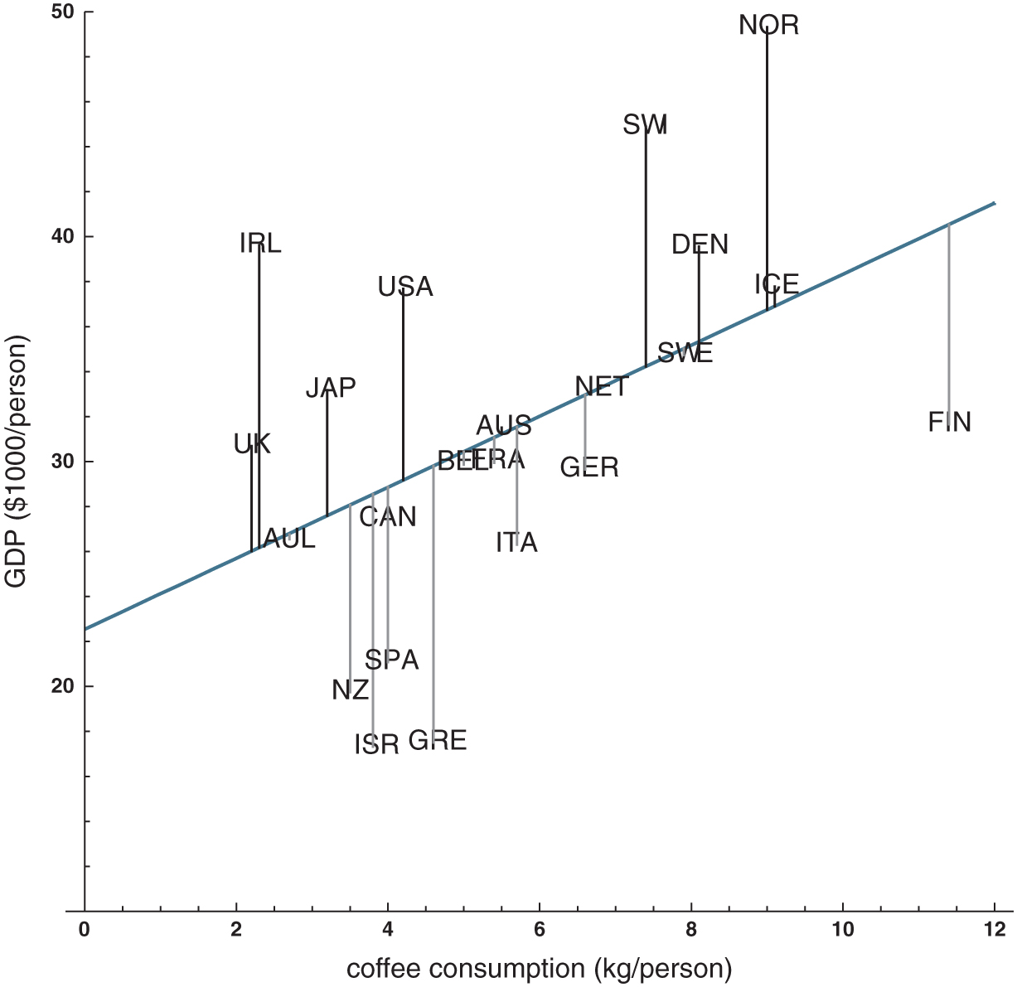
Figure 19.7: The regression line and regression residuals for the coffee/GDP data.

Slide 10
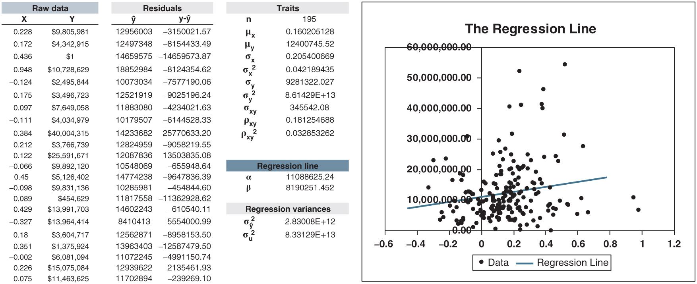
Figure 19.8: Pay for performance? Regressing CEO pay on stock performance.

Slide 11
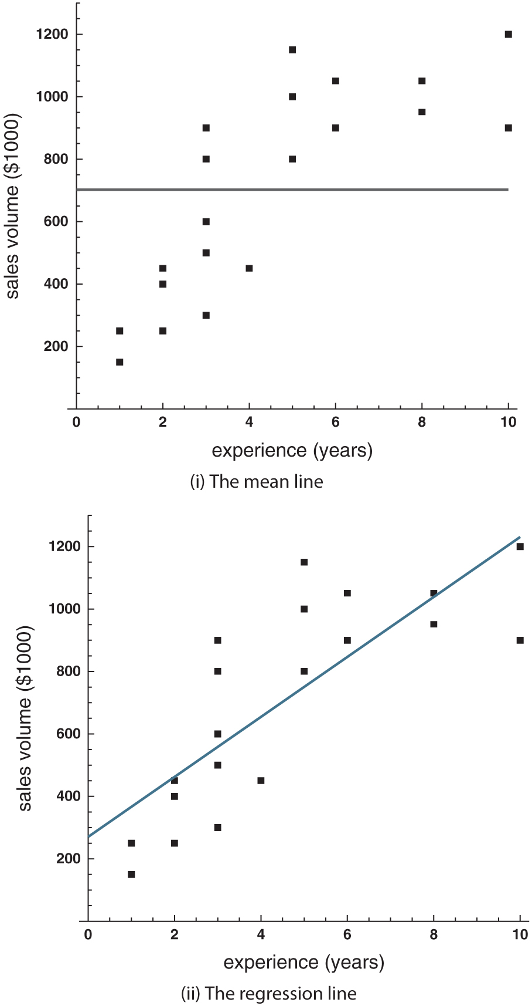
Figure 19.9: Best constant prediction and best linear prediction for the sales force data.

Slide 12
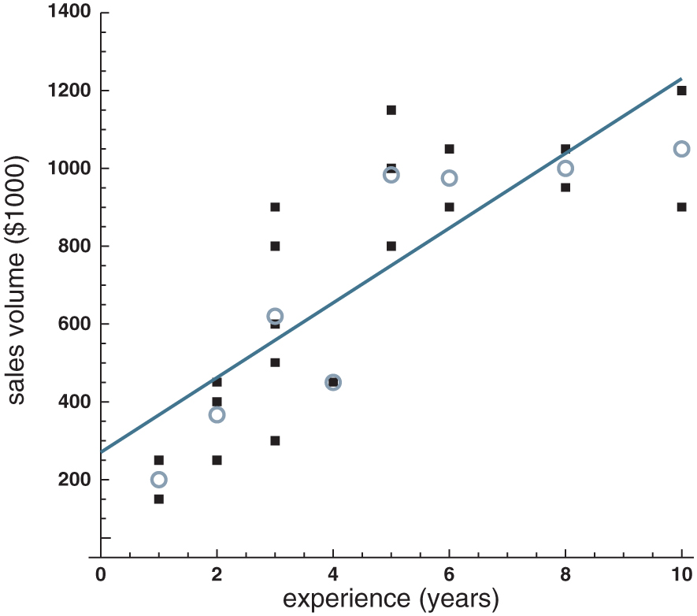
Figure 19.10: The regression line and the conditional means for the sales force data.

Slide 13
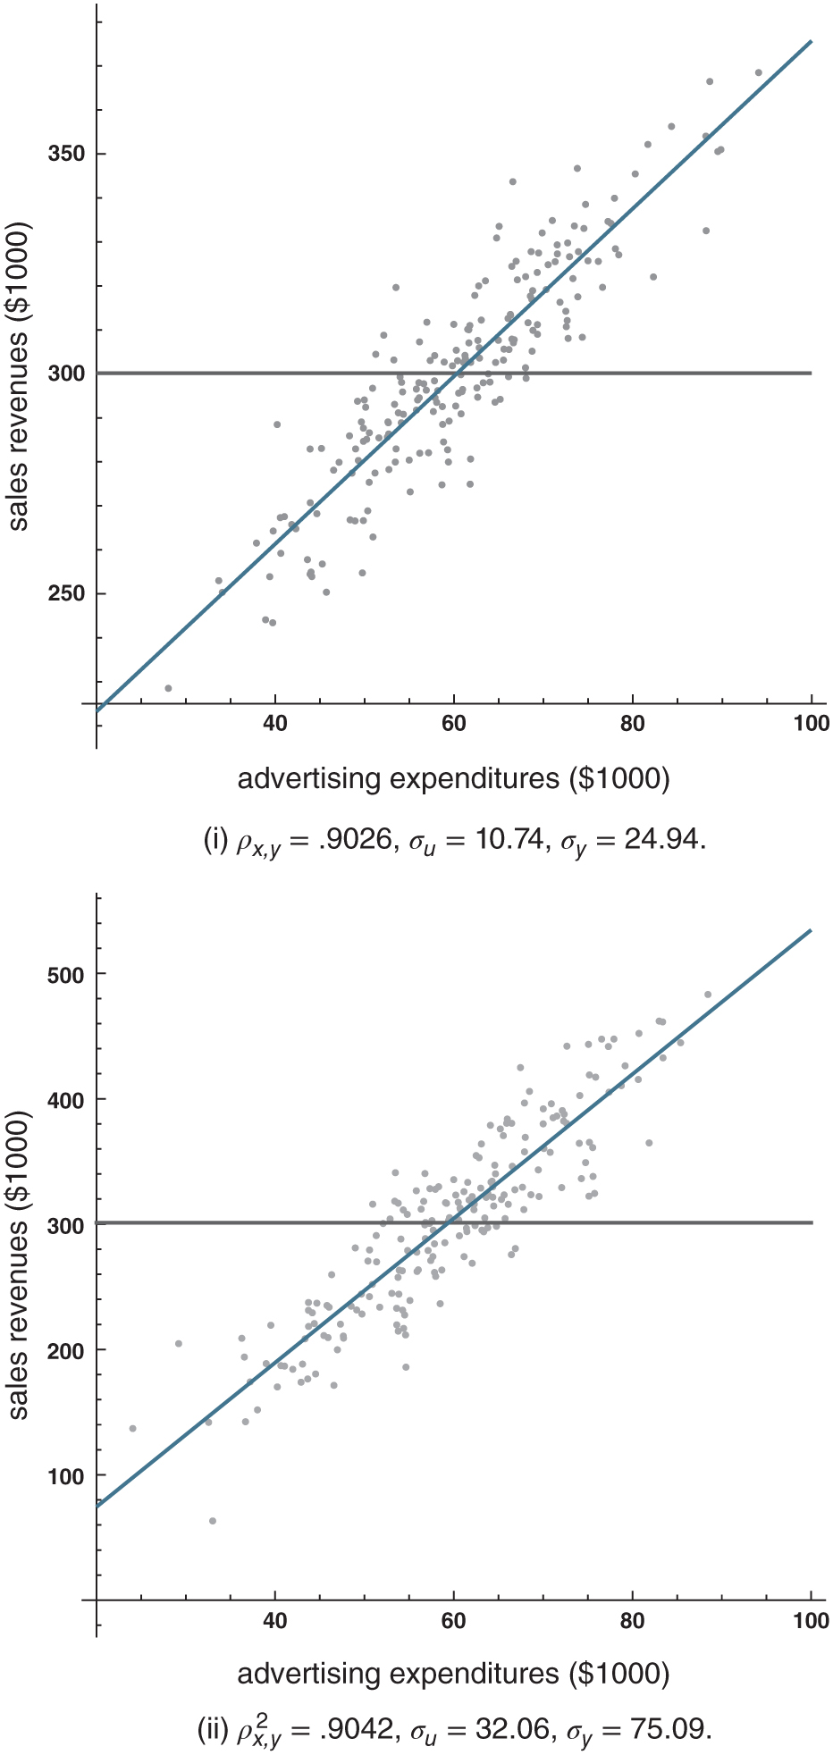
Figure 19.11: Relative and absolute quality of regression predictions.

Slide 14
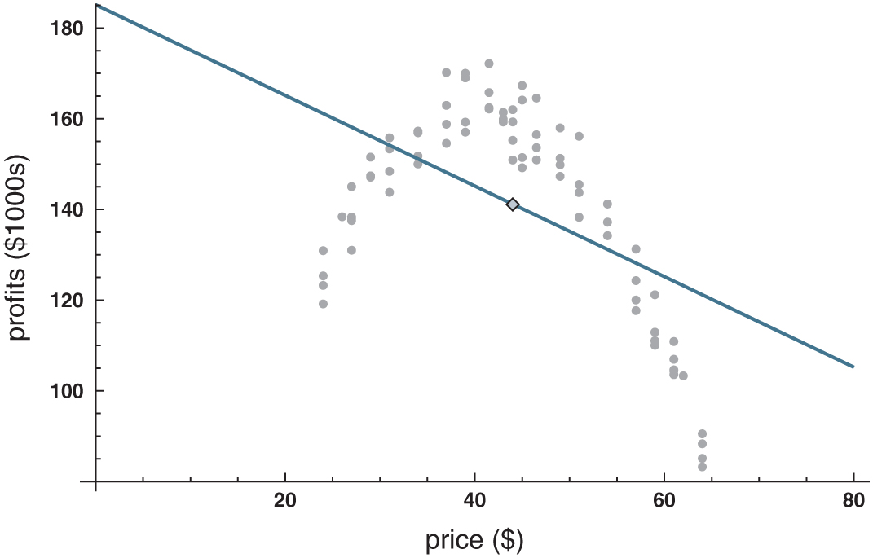
Figure 19.12: Regressing profits on prices.

Slide 15
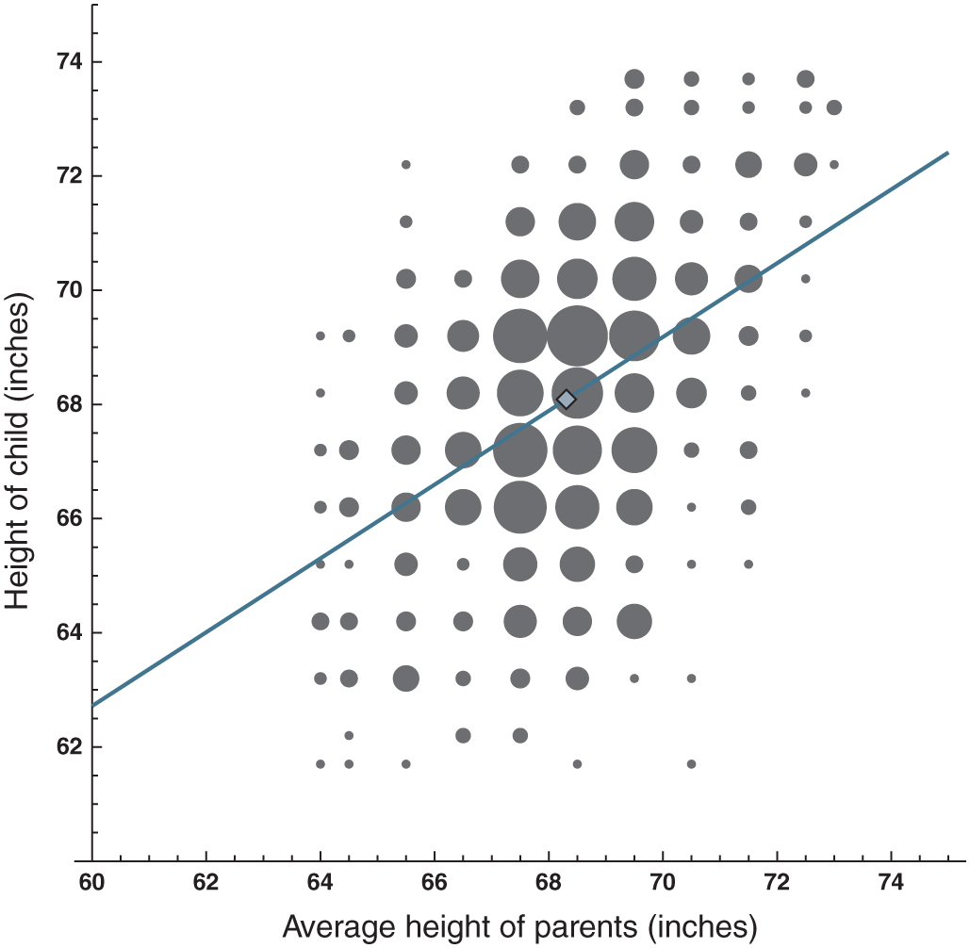
Figure 19.13: Galton’s height data, with regression line and mean point shown.
The area of each plot point corresponds to the number of observations.

Slide 16
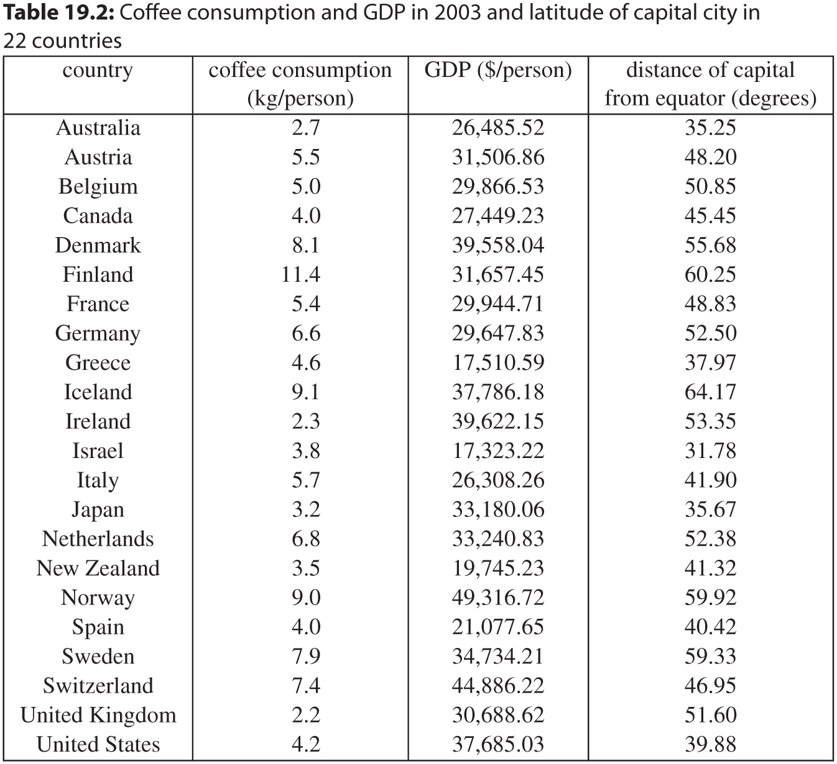
Table 19.2: Coffee consumption and GDP in 2003 and latitude of capital city in 22 countries

Slide 17
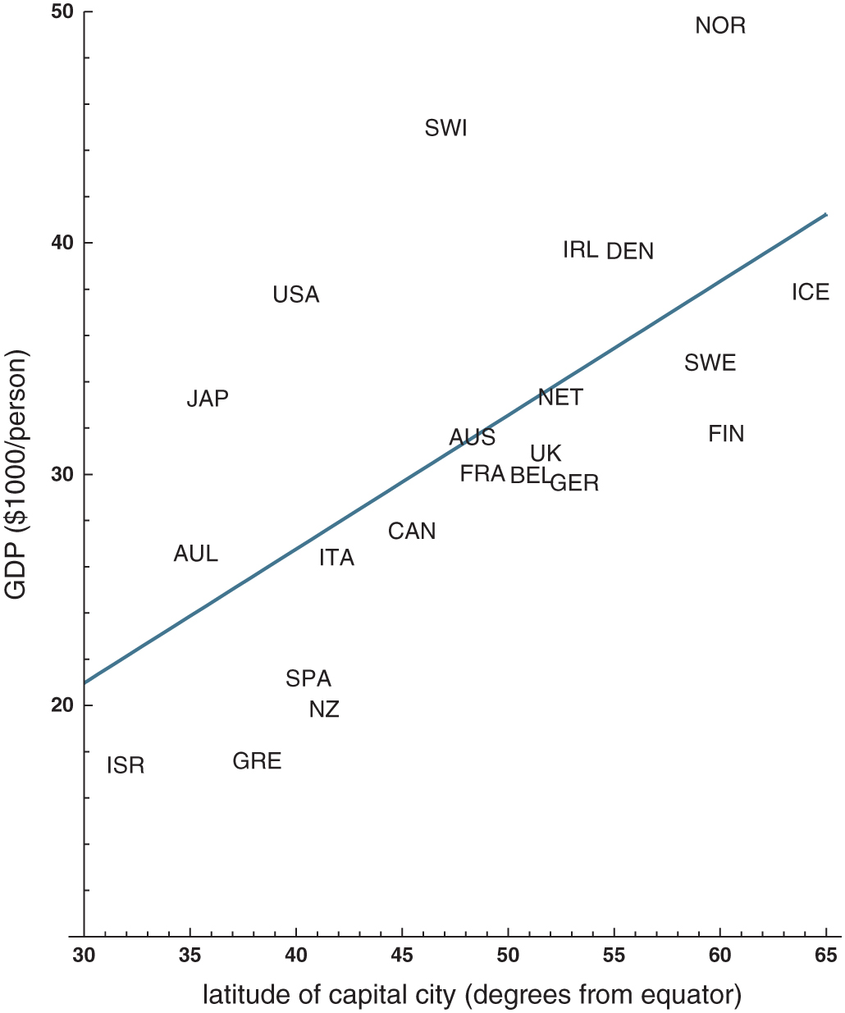
Figure 19.14: Regressing GDP on latitudes of capital cities.

Slide 18
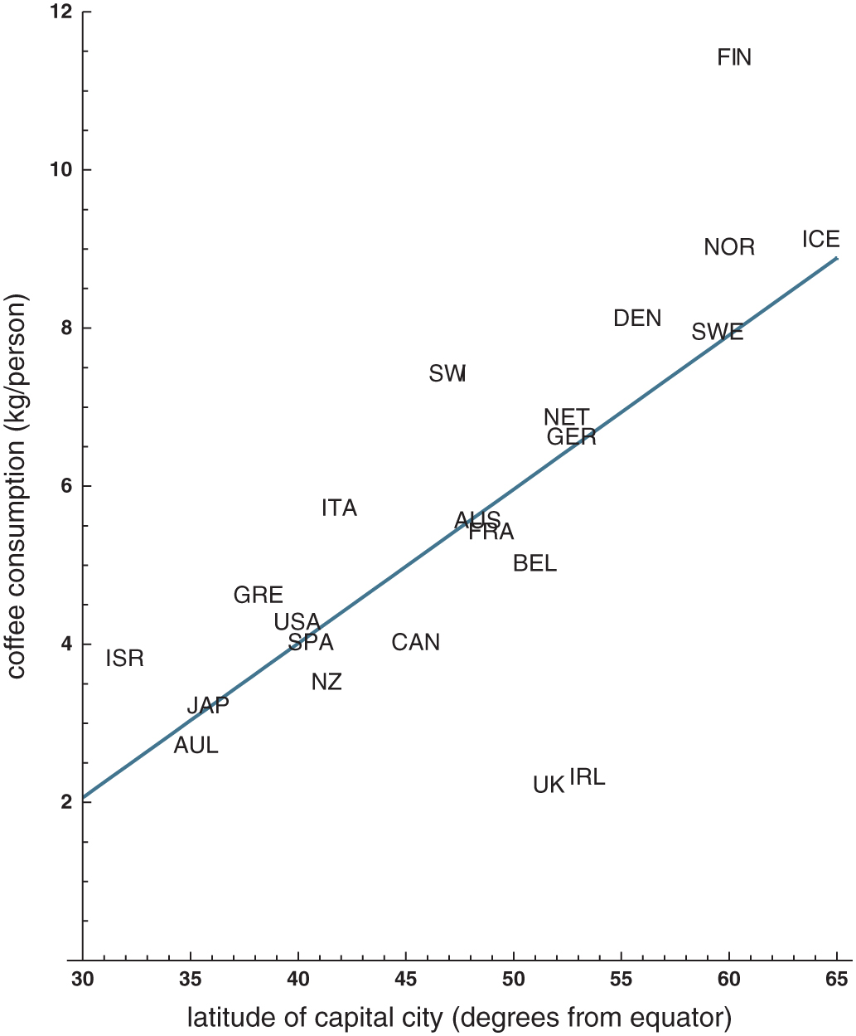
Figure 19.15: Regressing coffee consumption on latitudes of capital cities.

Slide 19
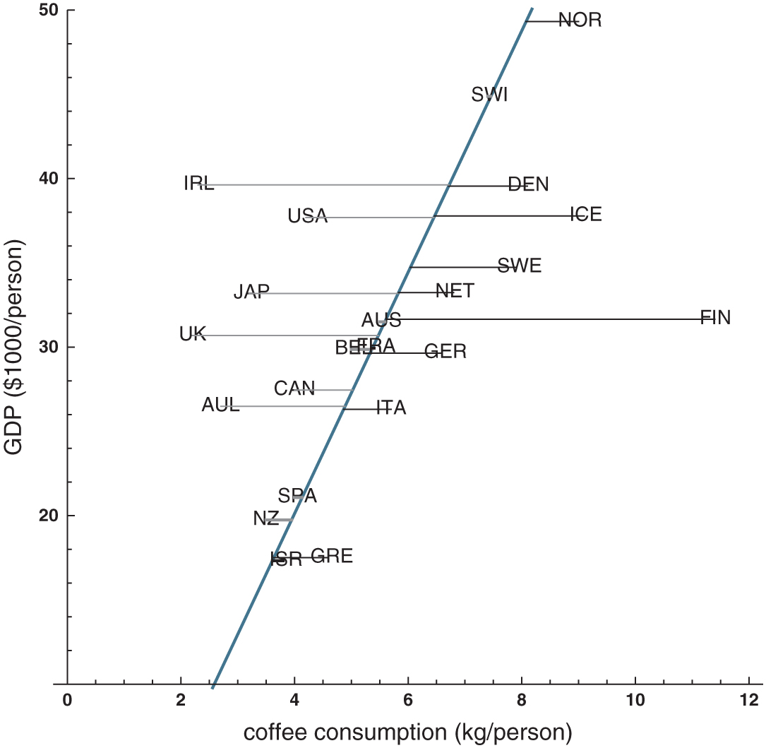
Figure 19.16: The reverse regression line and its horizontal residuals for the coffee/GDP data. Positive residuals are drawn in black, negative residuals in gray.

Slide 20
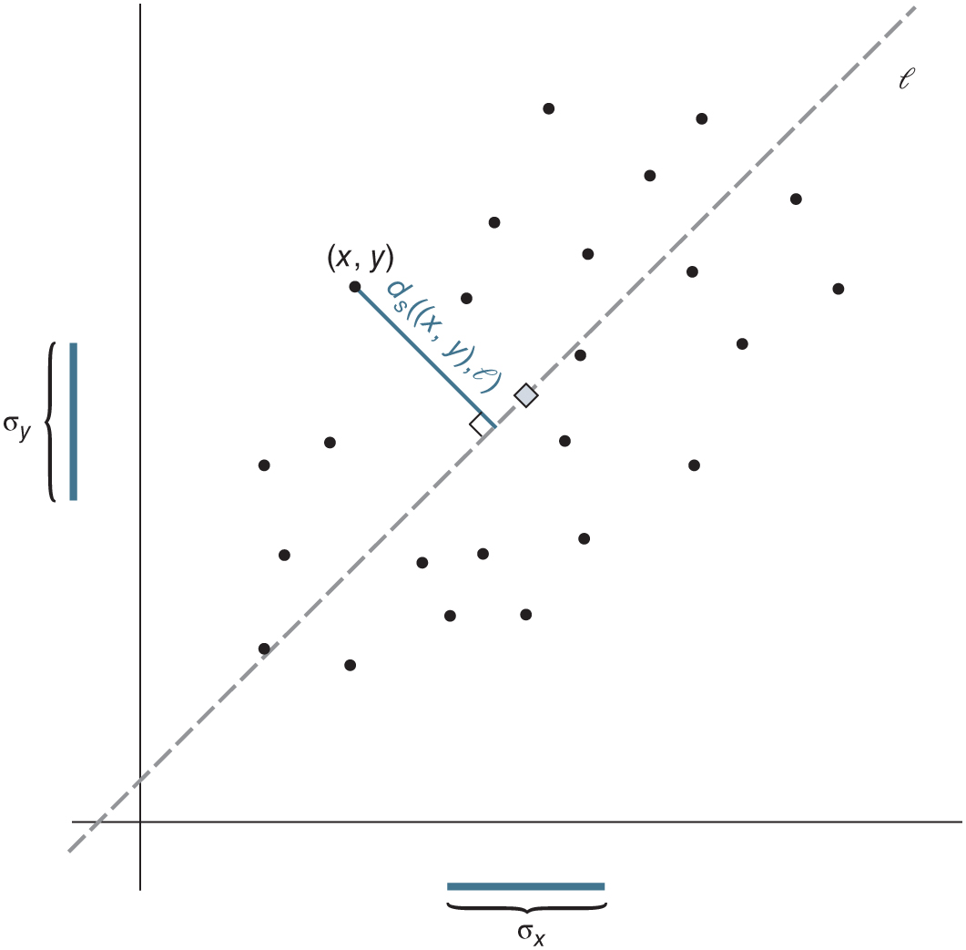
Figure 19.17: A standardized scatterplot (length of 𝜎_{x} on horizontal axis = length of 𝜎_{y} on vertical axis), and the standardized distance d_{s}((x, y), 𝓁). The diamond
marks the mean point.

Slide 21
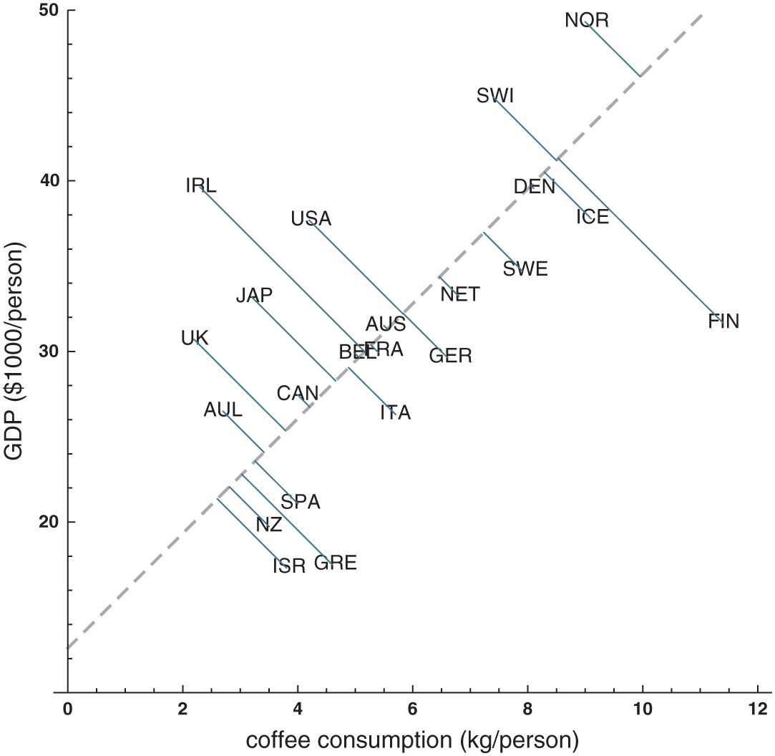
Figure 19.18: The neutral line for the coffee/GDP data, presented on a standardized
scatterplot. The thin lines represent the standardized distances from the data points to the neutral line.

Slide 22
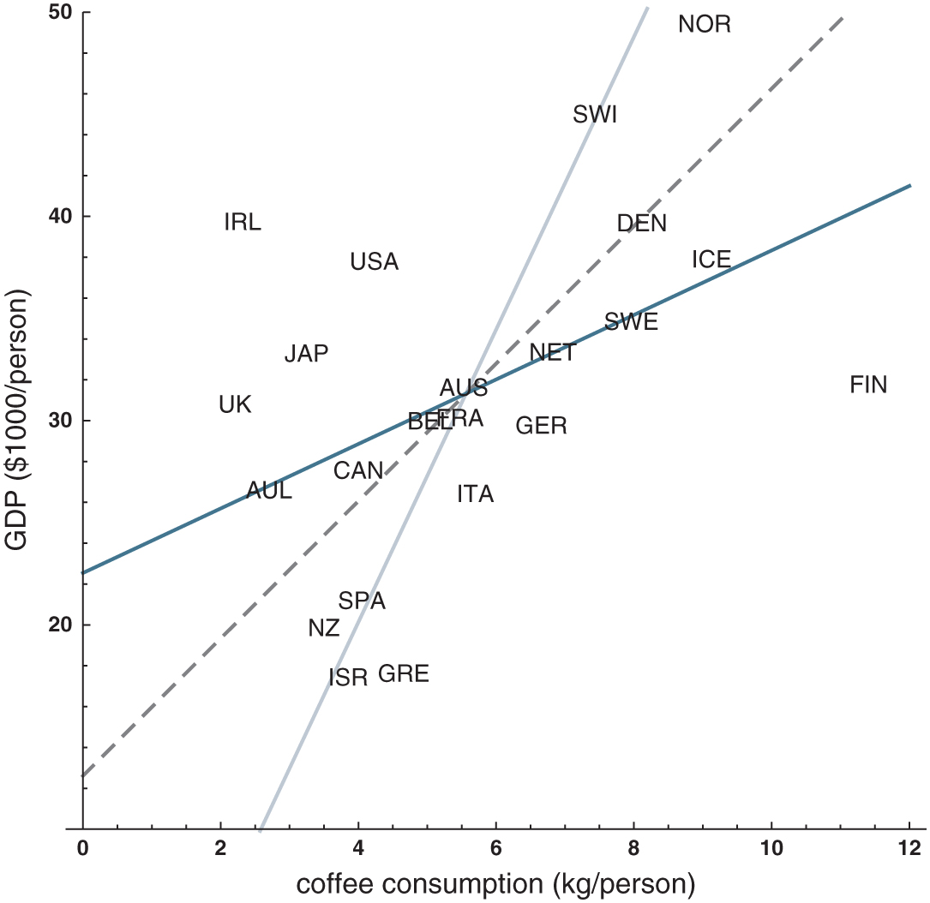
Figure 19.19: The regression line (dark blue), the reverse regression line (light blue), and the neutral line (dashed gray) on a standardized scatterplot of the coffee/GDP data.

Slide 23
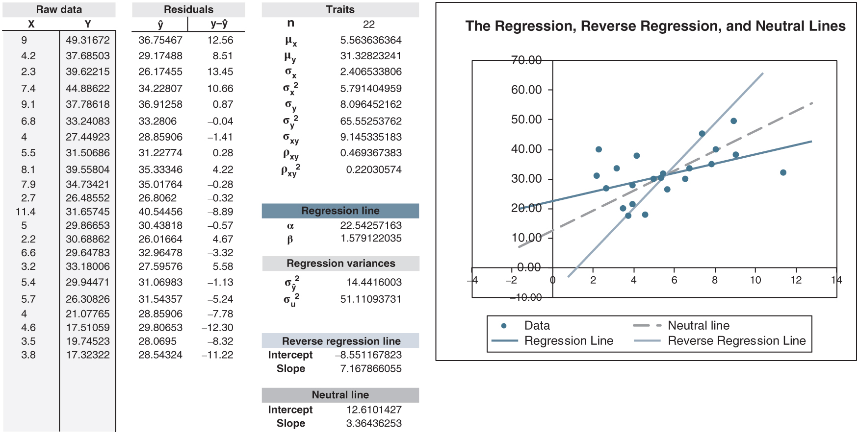
Figure 19.20: regression_descriptive.xlsx/three_lines.

Slide 24
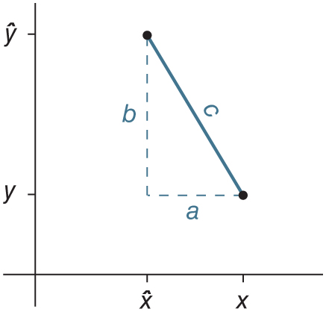
Figure 19.21: Computing the distance between two points.

