Slide 1
Vital Statistics Probability and Statistics for Economics and Business
William H. Sandholm
University of Wisconsin-Madison
Brett A. Saraniti
Northwestern University
Chapter 16
Hypothesis Testing

Slide 2
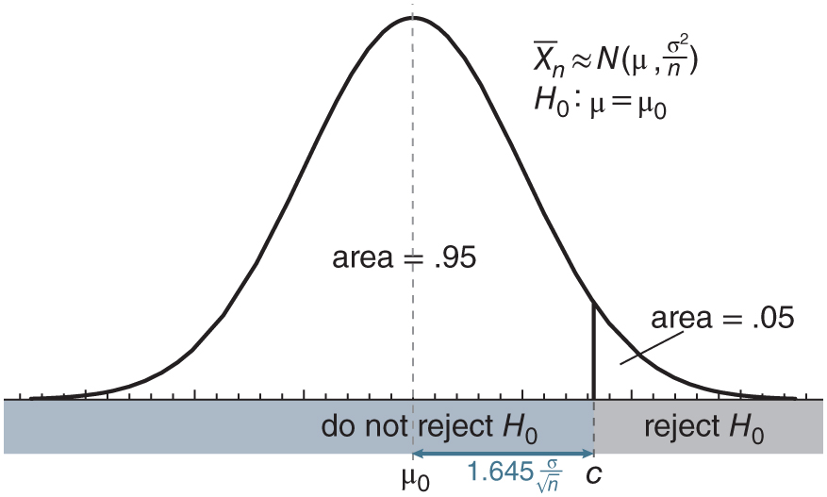
Figure 16.1: Testing H₀ ∶ 𝜇 = 𝜇₀ against H₁ ∶ 𝜇 > 𝜇₀ at significance level .05. The critical value is c = 𝜇₀ + 1.645 𝜎 .
√n

Slide 3
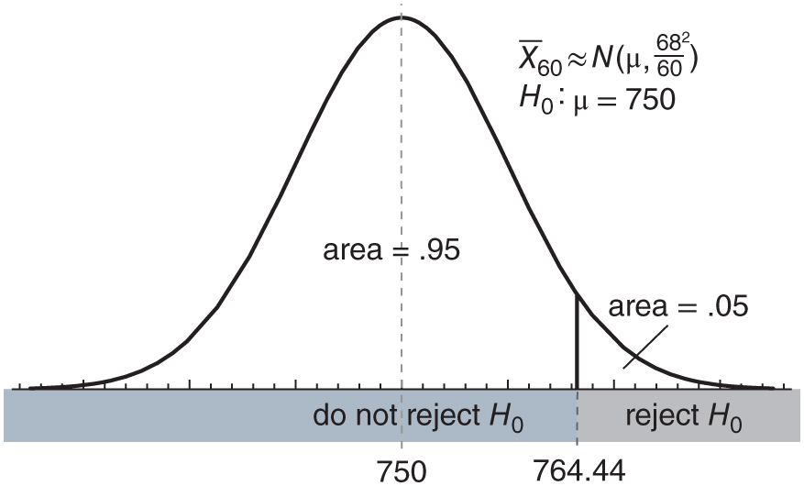
Figure 16.2: A hypothesis test to evaluate the effectiveness of new banner ads.

Slide 4
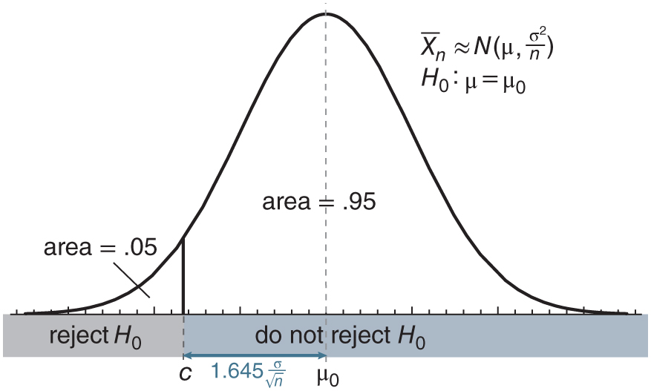
Figure 16.3: Testing H₀ ∶ 𝜇 = 𝜇₀ against H₁ ∶ 𝜇 < 𝜇₀ at significance level .05. The critical value is c = 𝜇₀ − 1.645 𝜎.
√n

Slide 5
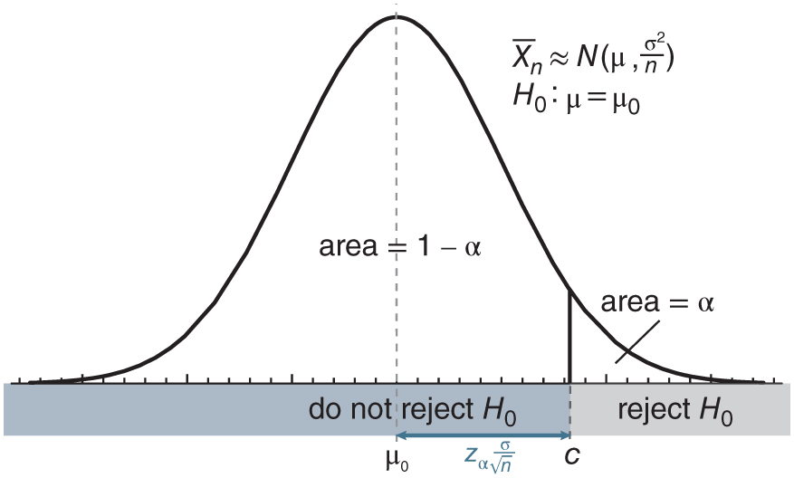
Figure 16.4: Testing H₀ ∶ 𝜇 = 𝜇₀ against H₁ ∶ 𝜇 > 𝜇₀ at significance level 𝛼. The critical value is c = 𝜇₀ + Z_{𝛼} 𝜎 .
√n

Slide 6
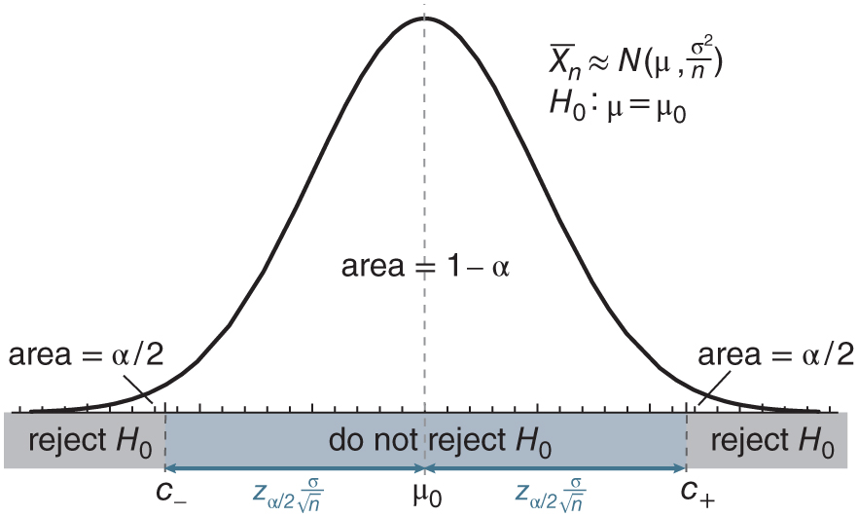
Figure 16.5: Testing H₀ ∶ 𝜇 = 𝜇₀ against H₁ ∶ 𝜇 ≠ 𝜇₀ at significance level 𝛼. The critical values are c- = 𝜇₀ − Z_{𝛼∕2} 𝜎 and c+ = 𝜇₀ + Z_{𝛼∕2} 𝜎 .
√n
√n

Slide 7
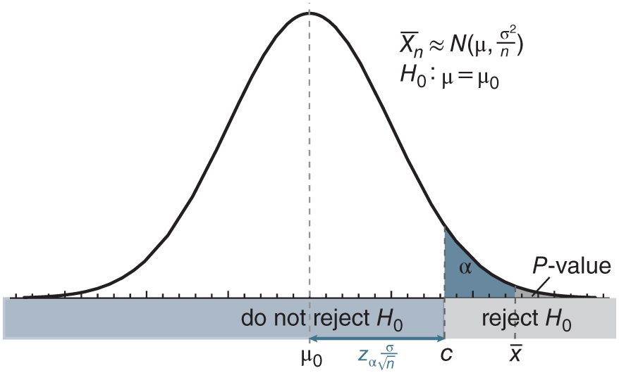
Figure 16.6: The P-value (the dark gray area) is less than 𝛼 (the dark blue and dark gray areas combined) when the sample mean x is more extreme than the critical value c. In this case, we reject the null hypothesis.

Slide 8
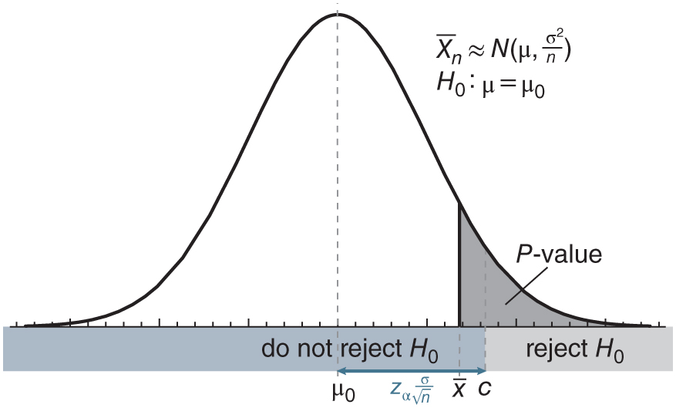
Figure 16.7: The P-value (the dark gray area) is greater than 𝛼 when the sample mean x is less extreme than the critical value c. In this case, we do not reject the null hypothesis.

Slide 9
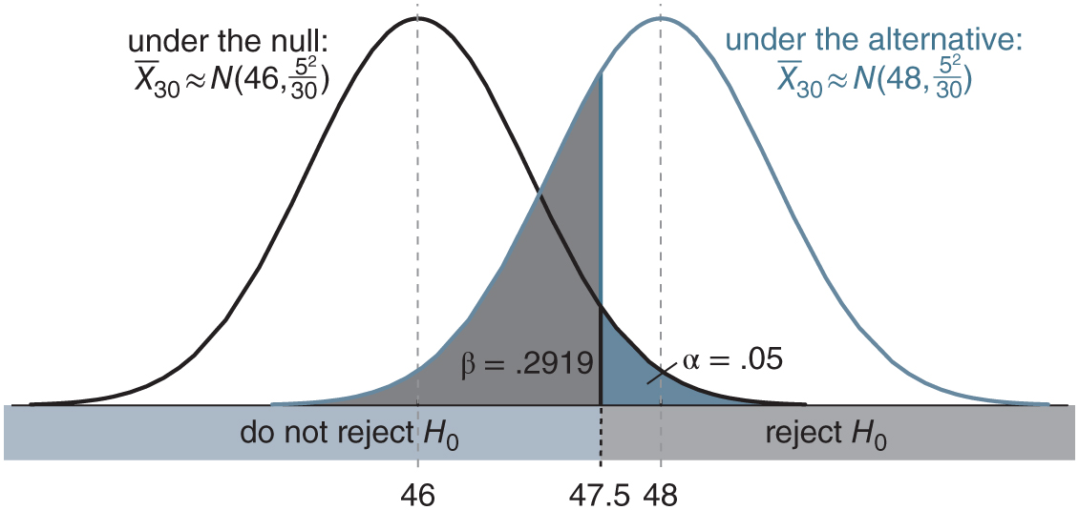
Figure 16.8: Probabilities of Type I and Type II errors in the hybrid example: n = 30, c = 47.5.

Slide 10
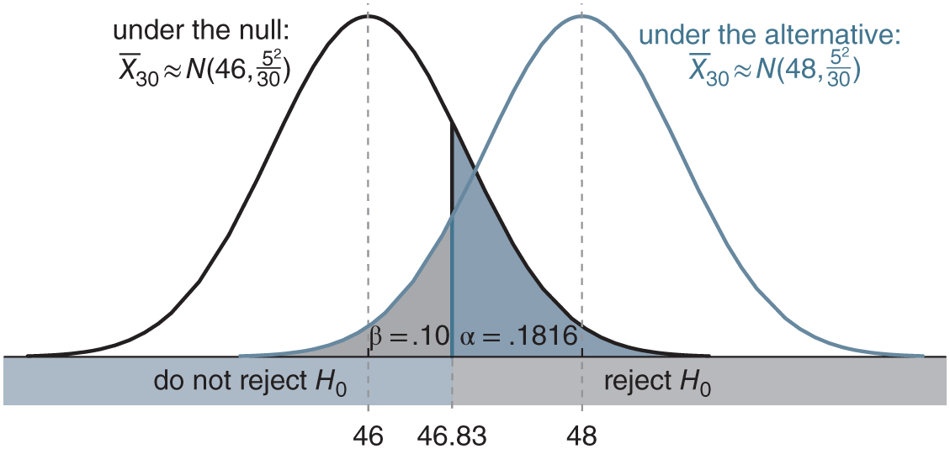
Figure 16.9: Probabilities of Type I and Type II errors in the hybrid example: n = 30, c = 46.83.

Slide 11
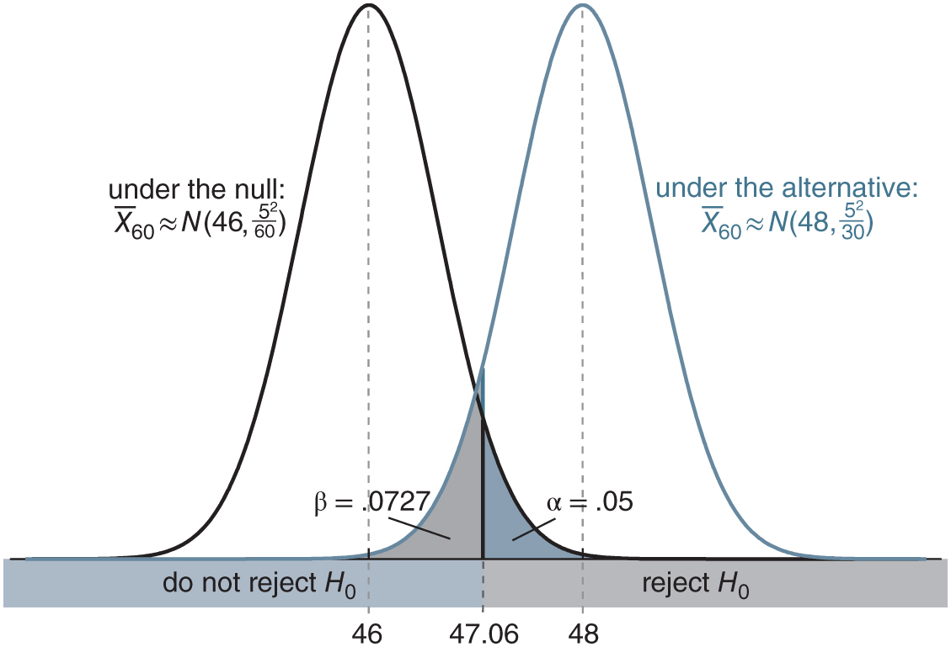
Figure 16.10: Probabilities of Type I and Type II errors in the hybrid example: n = 60, c = 47.06.

Slide 12
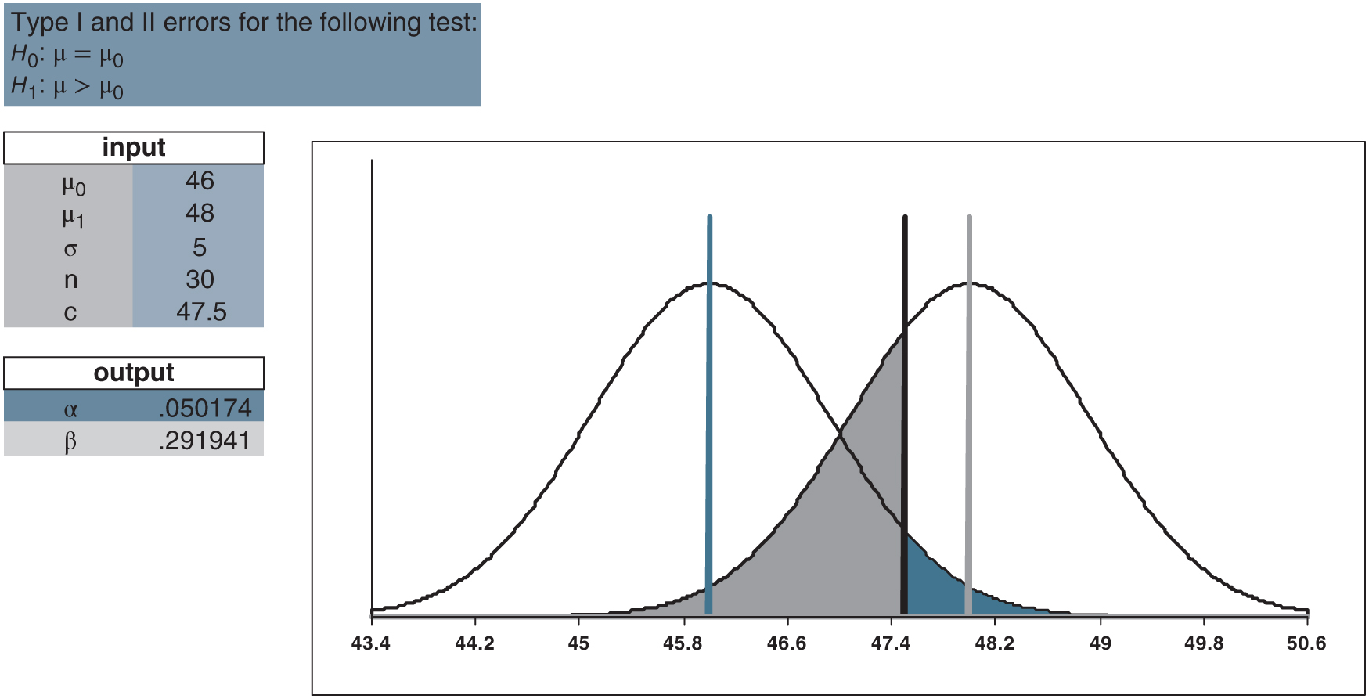
Figure 16.11: Reproduction of Figure 16.8 using HT_errors.xlsx/alternative_greater.

Slide 13
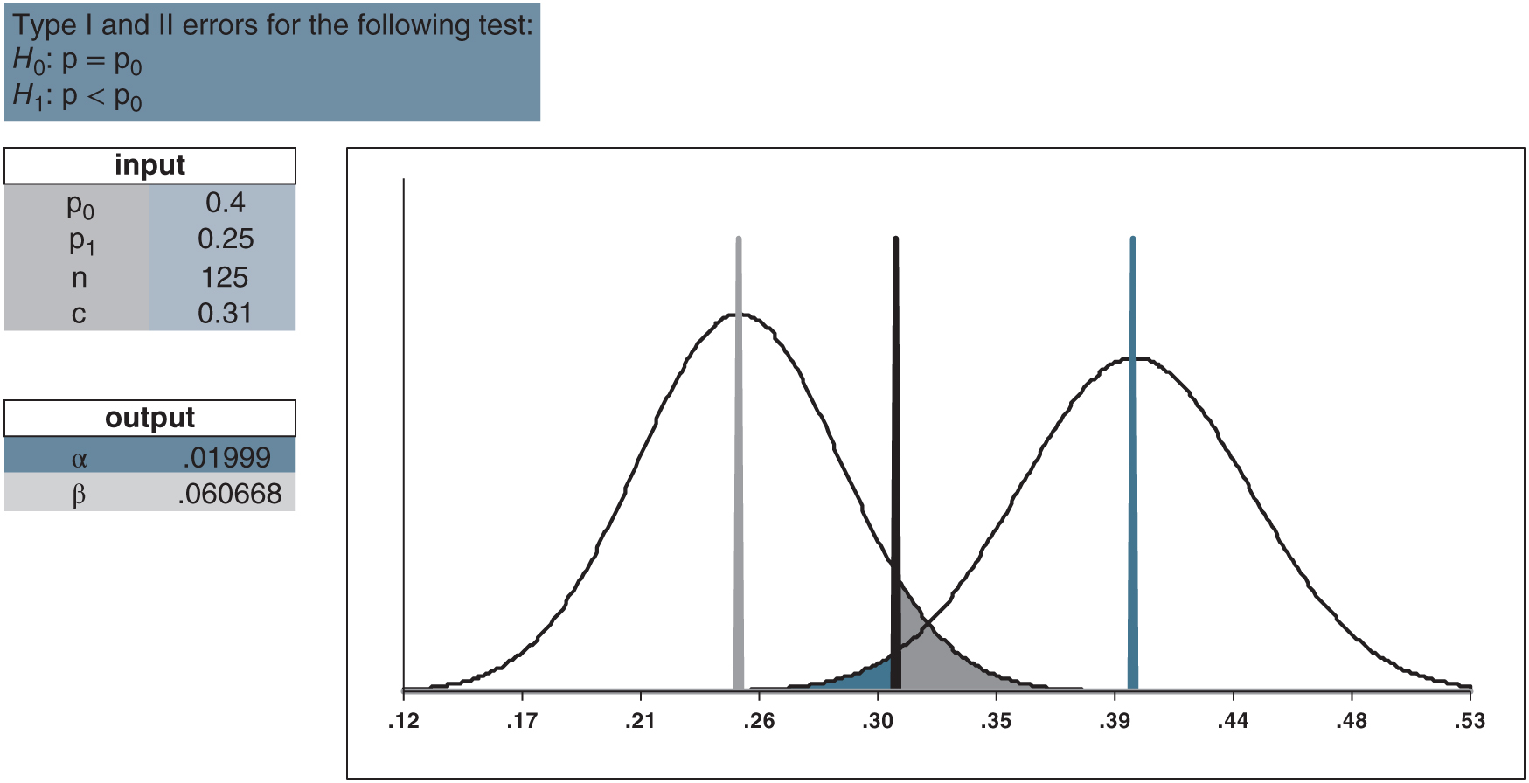
Figure 16.12: Error probabilities in the product placement example using HT_errors_BTP.xlsx/alternative_less.

Slide 14
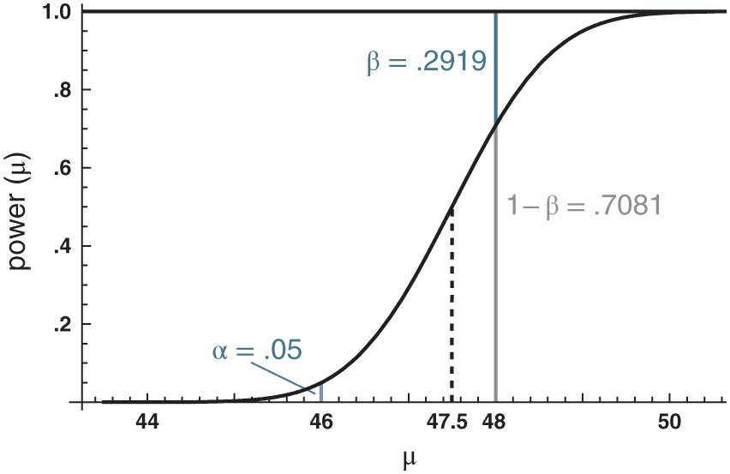
Figure 16.13: The power curve for the hypothesis test defined by n = 30 and c = 47.5.

Slide 15
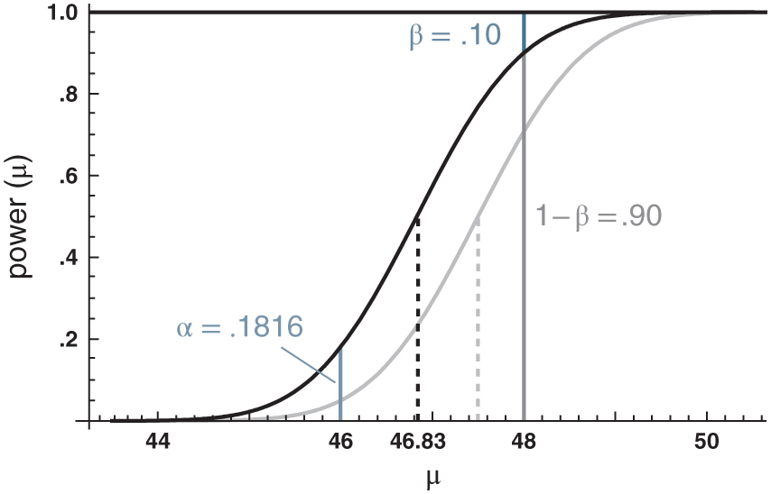
Figure 16.14: Power curves for two hypothesis tests: n = 30, c = 47.5 (light gray) and n = 30, c = 46.83 (black).

Slide 16
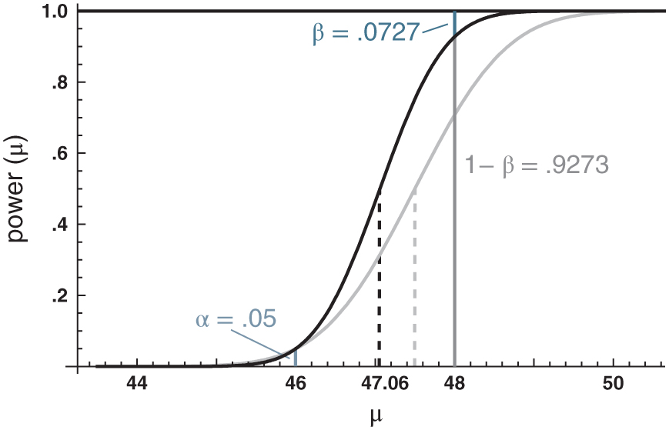
Figure 16.15: Power curves for two hypothesis tests: n = 30, c = 47.5 (light gray) and n = 60, c = 47.06 (black).

Slide 17
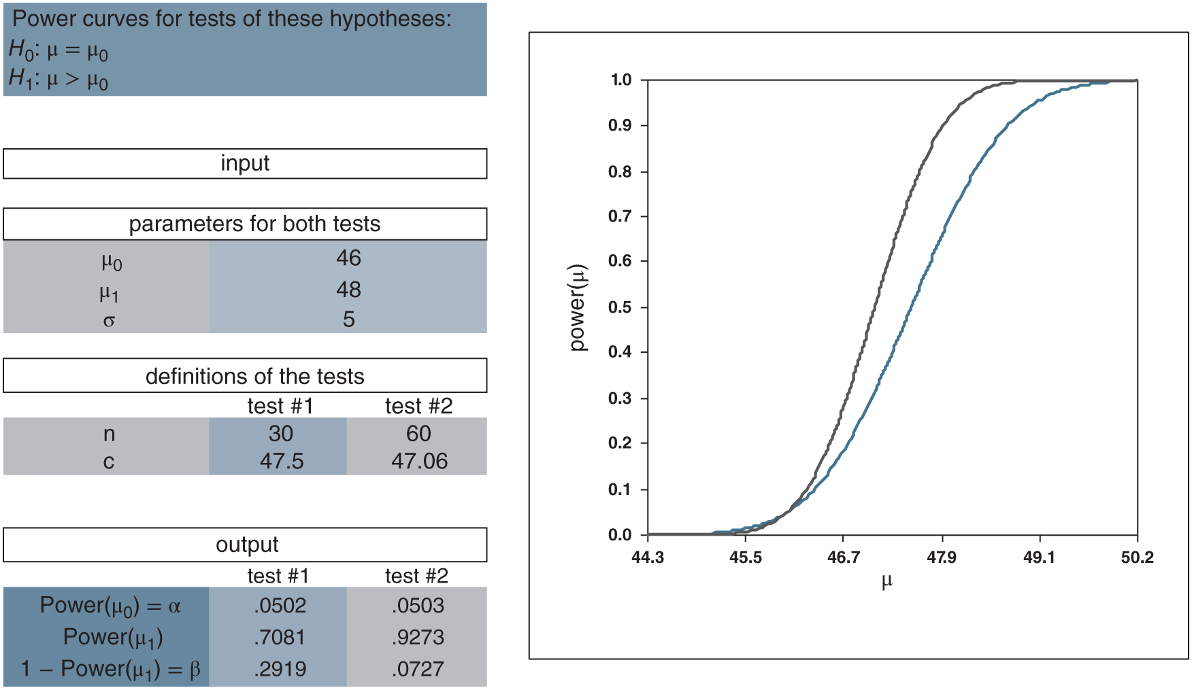
Figure 16.16: power_curves.xlsx/alternative_greater

