Slide 1
Vital Statistics Probability and Statistics for Economics and Business
William H. Sandholm
University of Wisconsin-Madison
Brett A. Saraniti
Northwestern University
Chapter 15
Interval Estimation and Confidence Intervals

Slide 2
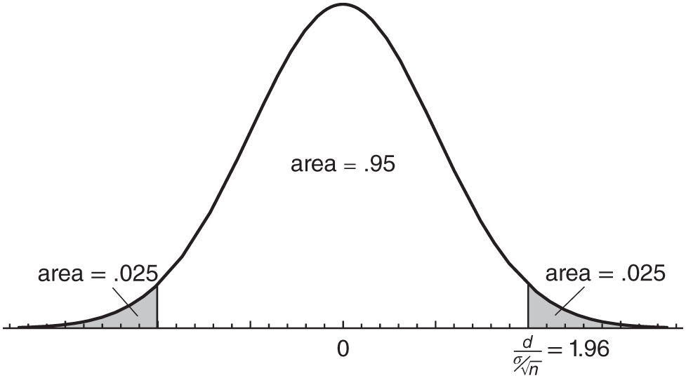
Figure 15.1: Determining the margin of error d.

Slide 3
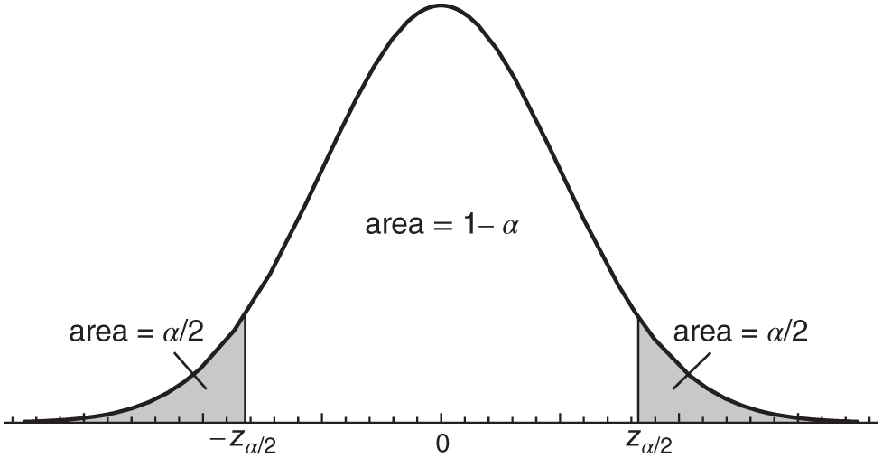
Figure 15.2: z-values.

Slide 4
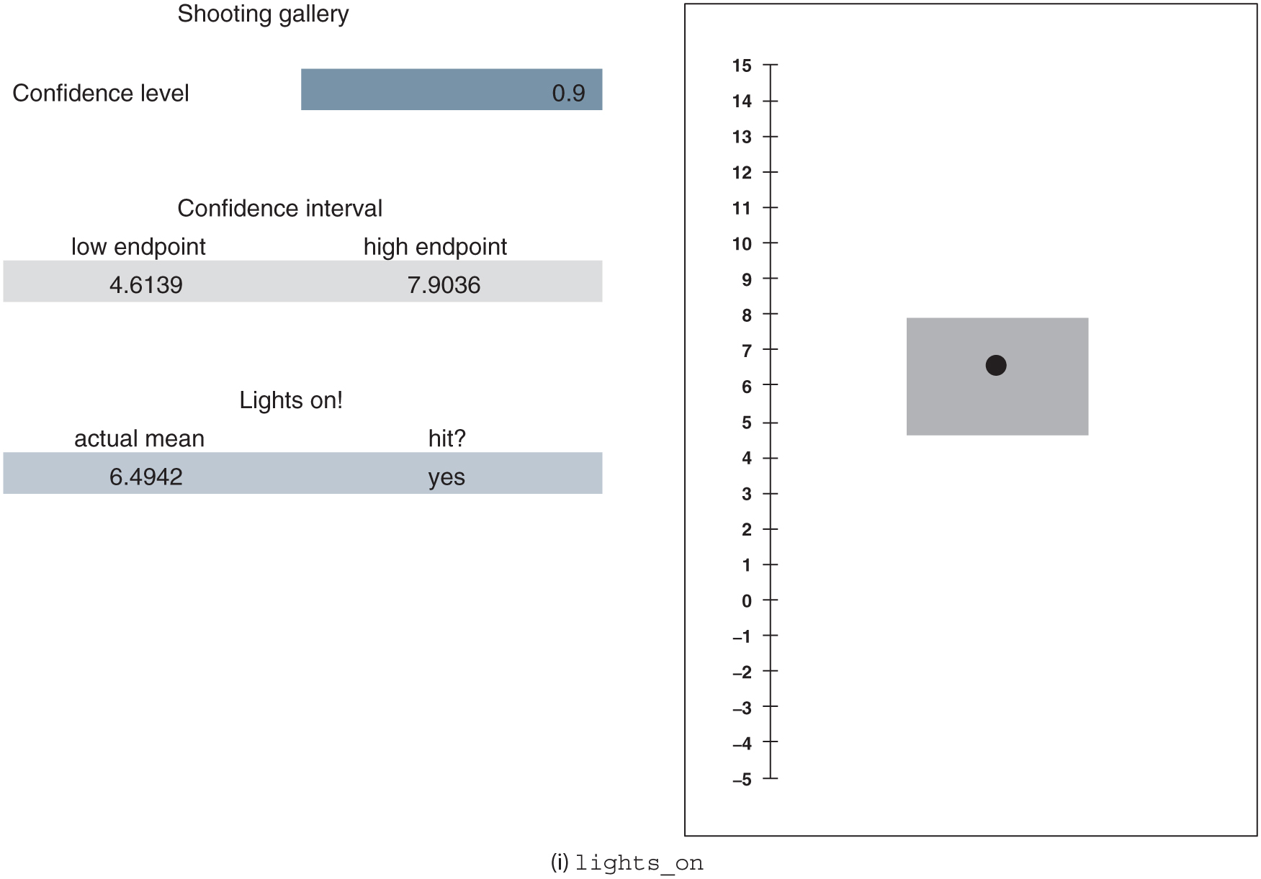
Figure 15.3: paintball.xlsx

Slide 5
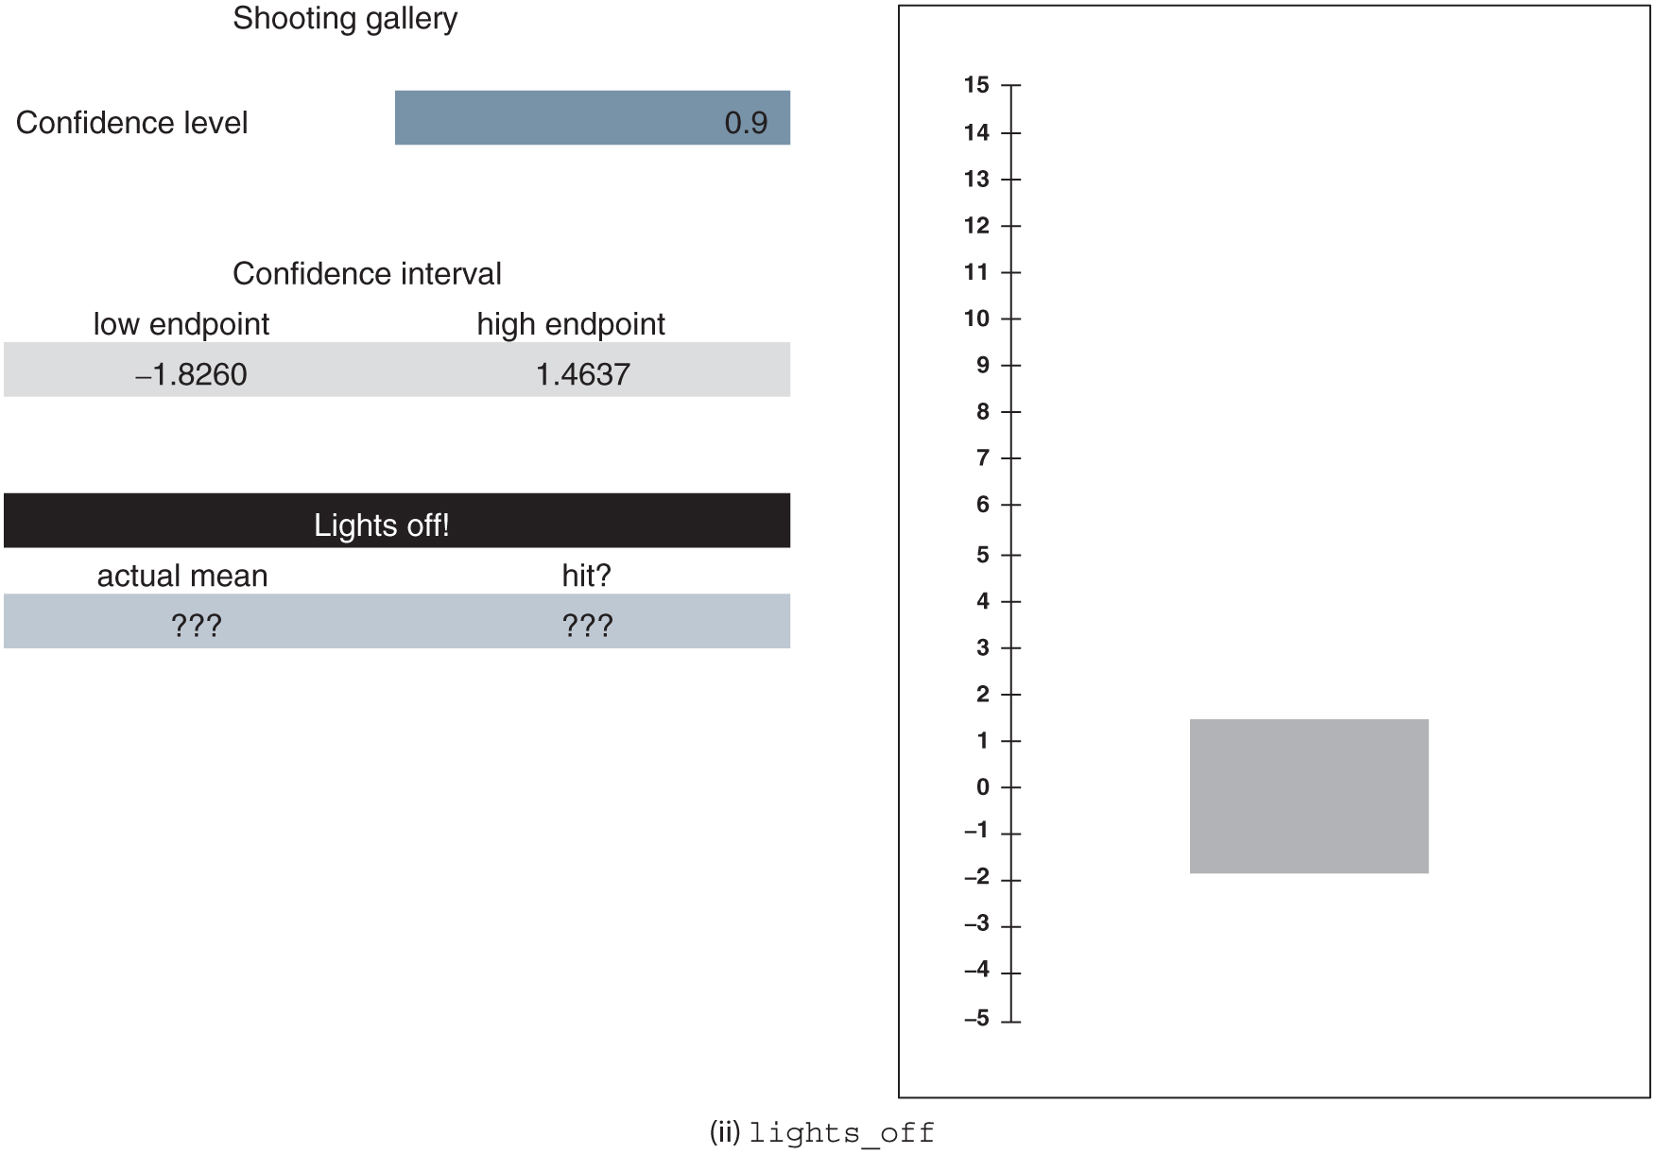
Figure 15.3: continued

Slide 6
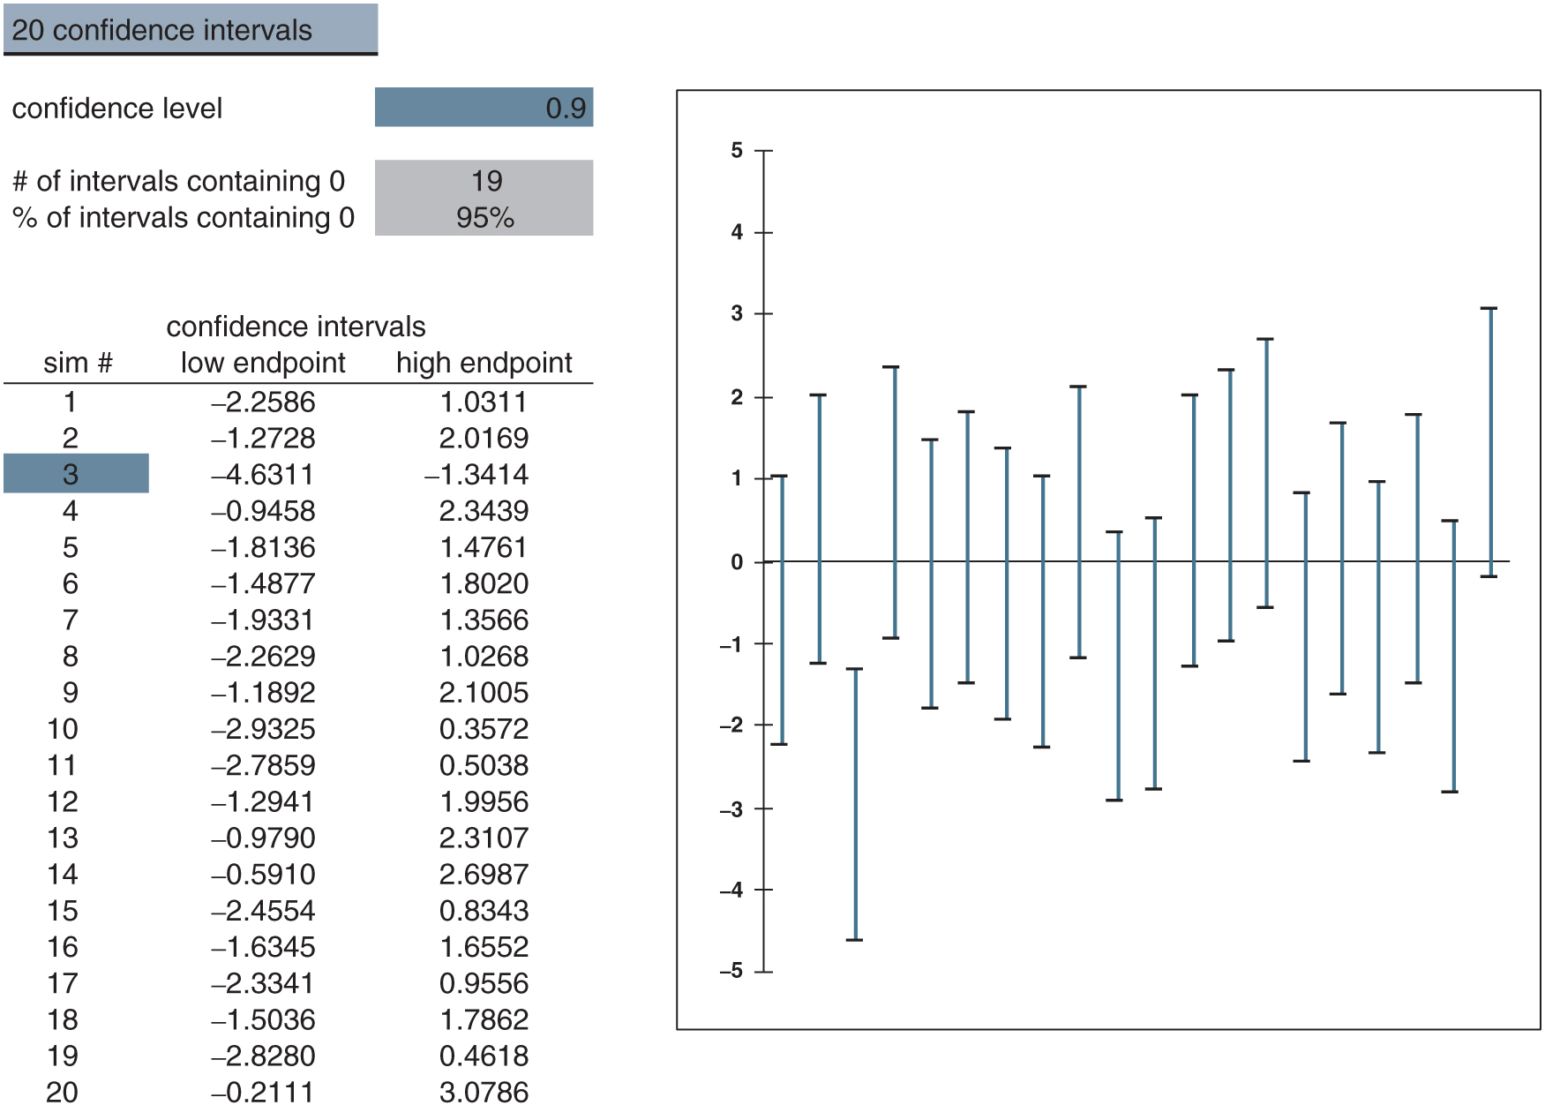
Figure 15.4: 20_CIs.xlsx

Slide 7
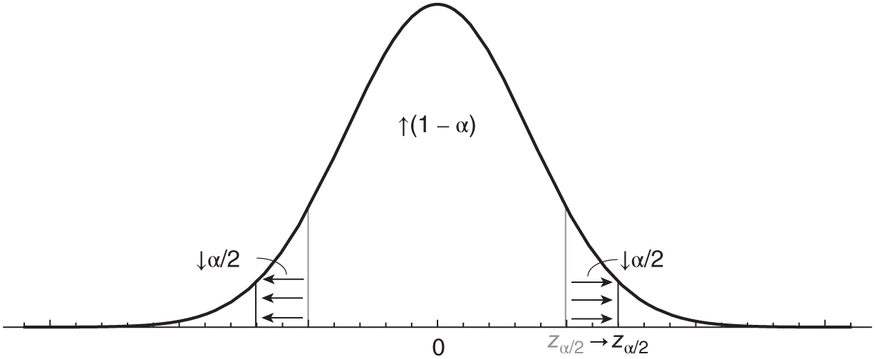
Figure 15.5: Increasing 1 − 𝛼 also increases z_{𝛼∕2}.

Slide 8
Figure 15.6: The function f (p) = p(1 − p).

Slide 9
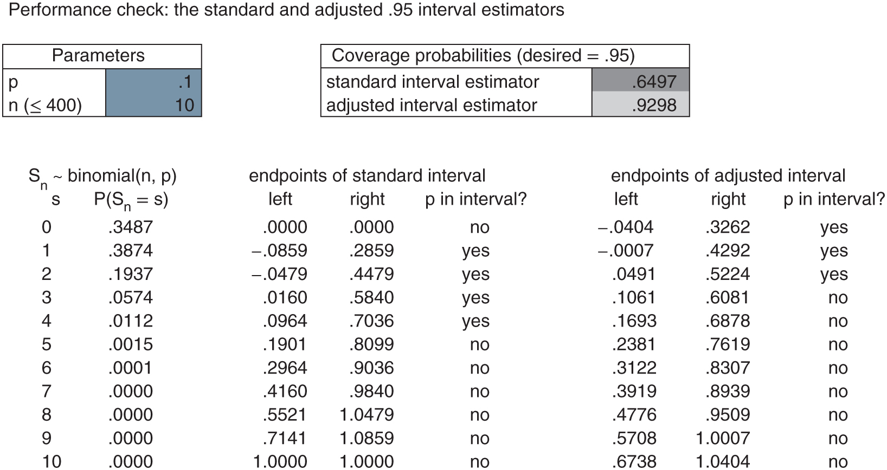
Figure 15.7: Calculating coverage probabilities using BTP_interval_estimators.xlsx.

