Slide 1
Vital Statistics Probability and Statistics for Economics and Business
William H. Sandholm
University of Wisconsin-Madison
Brett A. Saraniti
Northwestern University
Chapter 10
How to Lie with Statistics

Slide 2
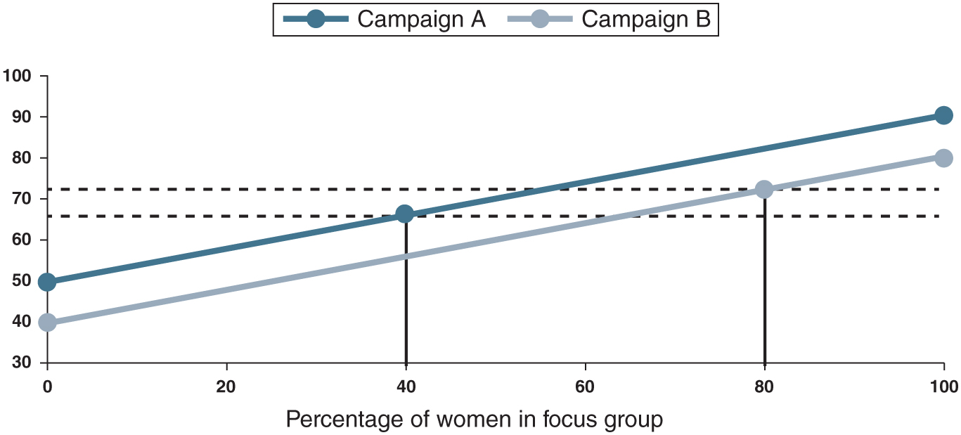
Figure 10.1: Resolving Simpson’s paradox.

Slide 3
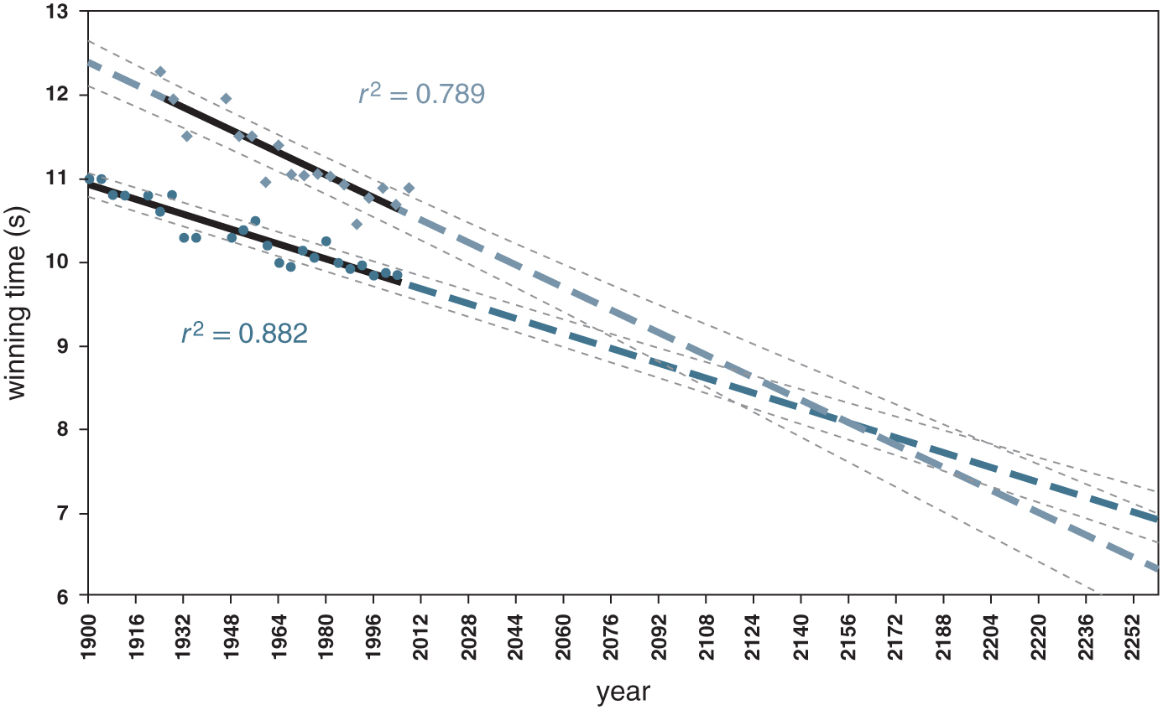
Figure 10.2: Men’s and women’s winning Olympic sprint times, 1900–2004, with linear extrapolations. Reproduced from Tatem et al. (2004); see footnote 22.

