Slide 1
Vital Statistics Probability and Statistics for Economics and Business
William H. Sandholm
University of Wisconsin-Madison
Brett A. Saraniti
Northwestern University
Chapter 3
Random Variables

Slide 2
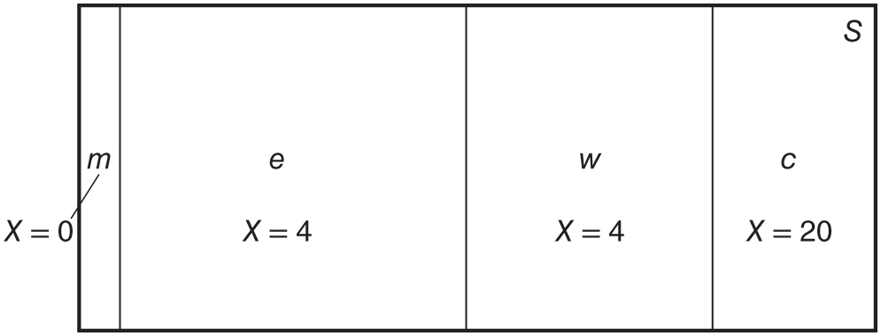
Figure 3.1: Probability diagram of the random variable X.

Slide 3
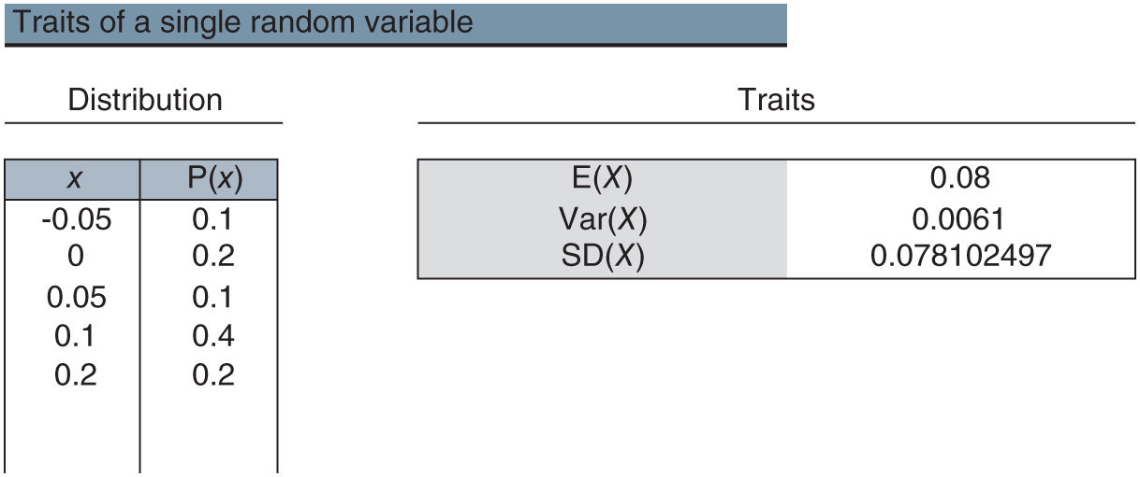
Figure 3.2: traits.xlsx/1_RV

Slide 4
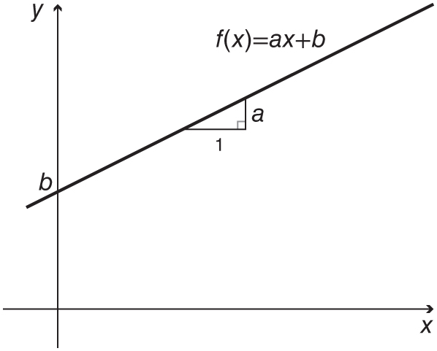
Figure 3.3: A linear function.

