Slide 1
Vital Statistics Probability and Statistics for Economics and Business
William H. Sandholm
University of Wisconsin-Madison
Brett A. Saraniti
Northwestern University
Chapter 1
Random Reasoning

Slide 2
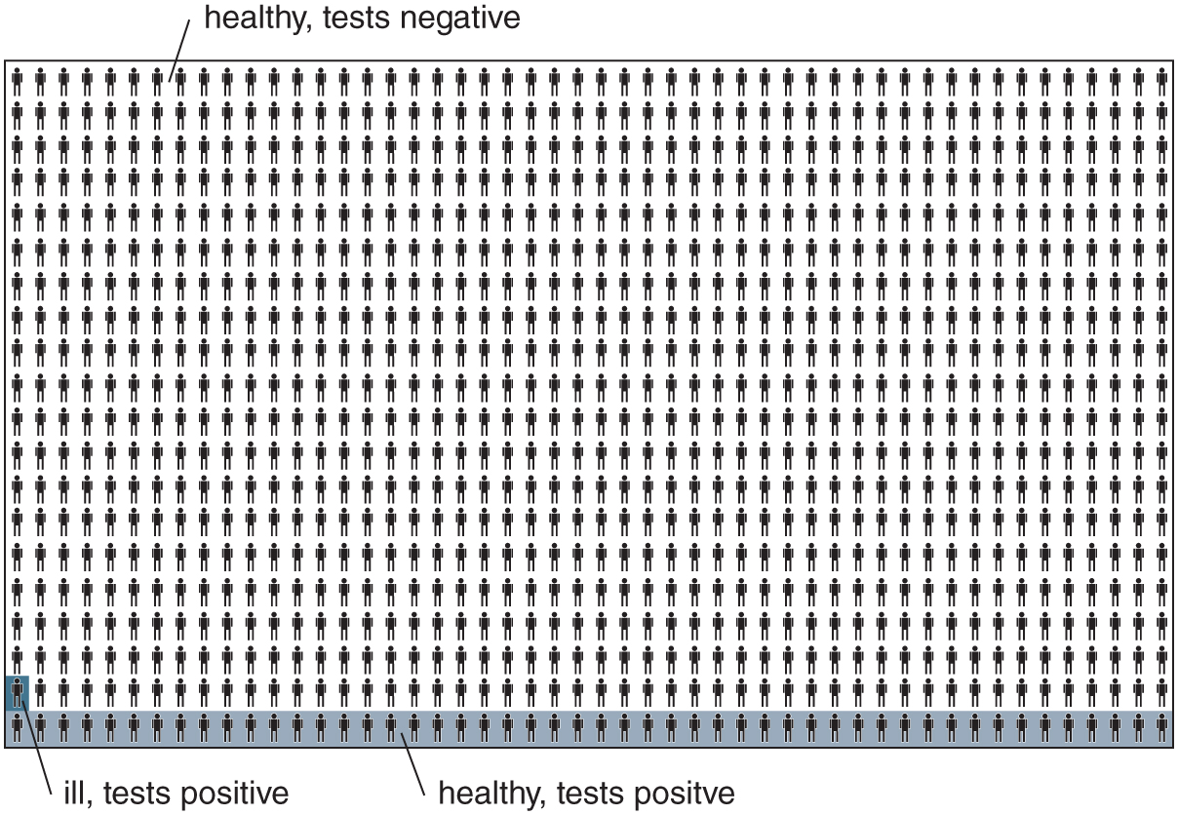
Figure 1.1: A representative group of 1000 people.

Slide 3
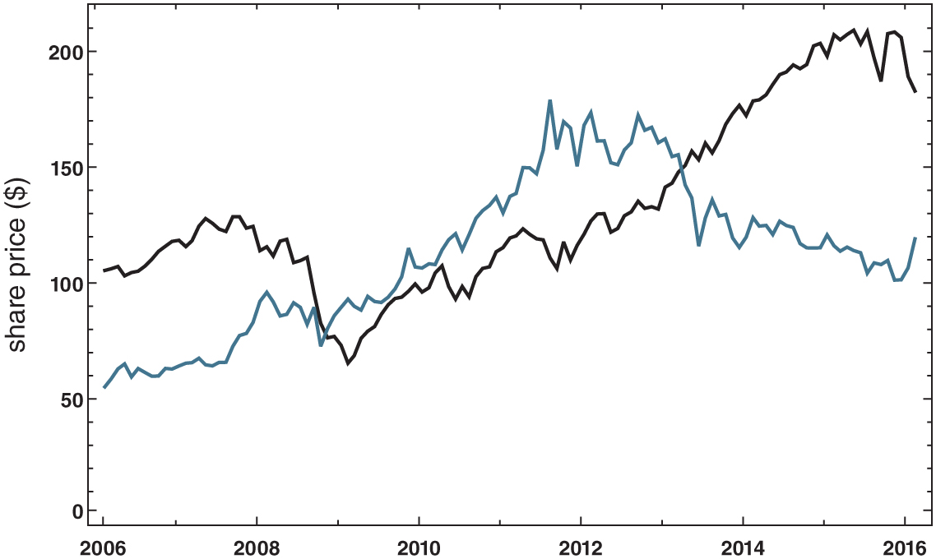
Figure 1.2: Share prices of the SPDR S&P 500 index fund (black) and the SPDR gold fund (blue), 2006–2016.

Slide 4
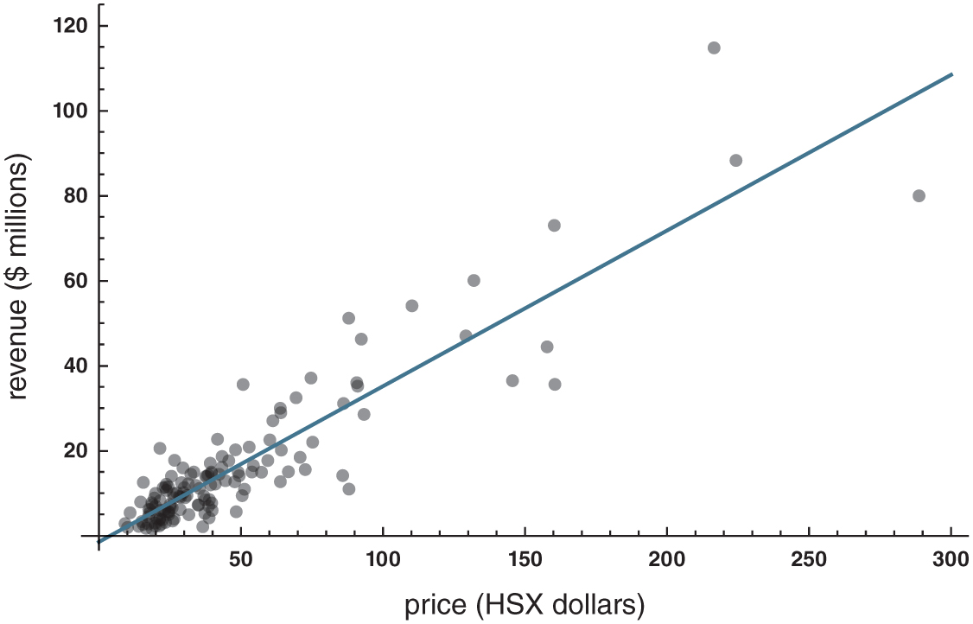
Figure 1.3: Closing HSX prices and opening weekend gross revenues, with regression line.

